Slide 1

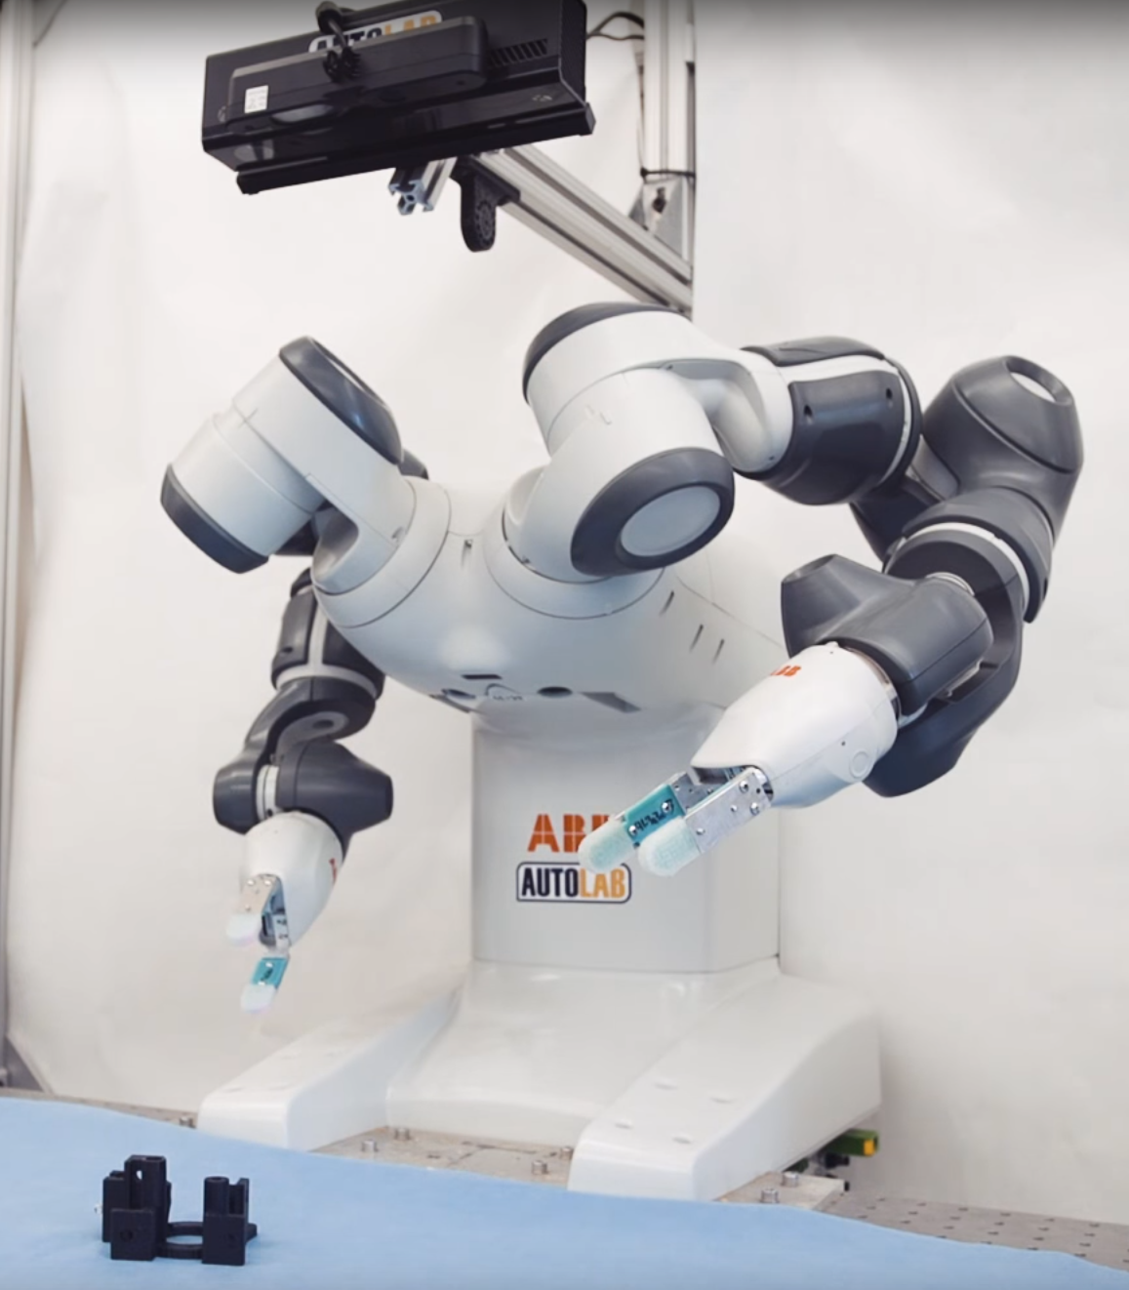
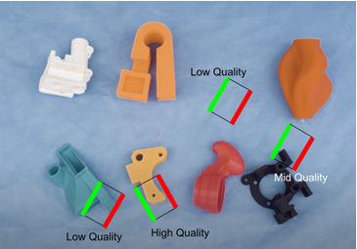
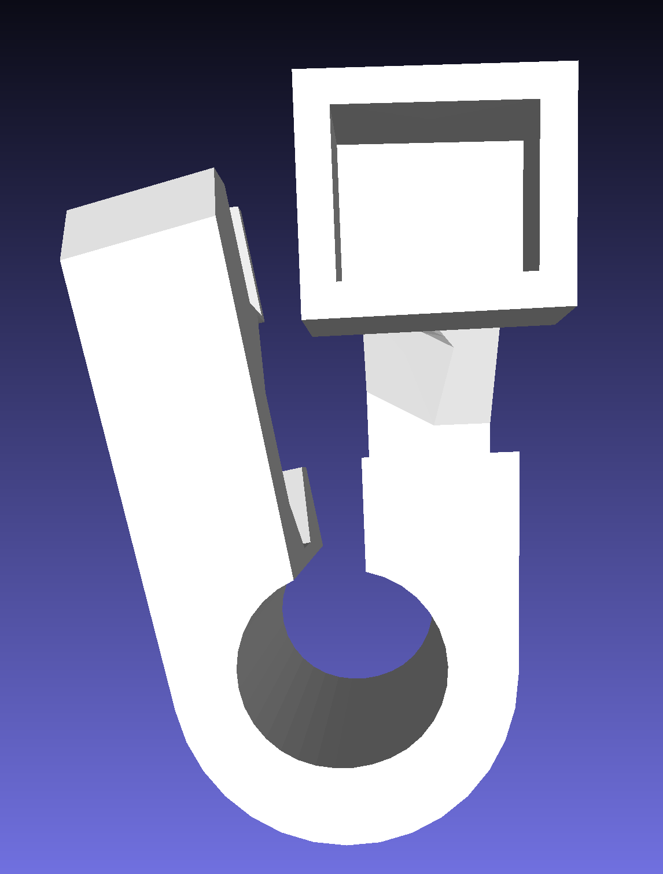
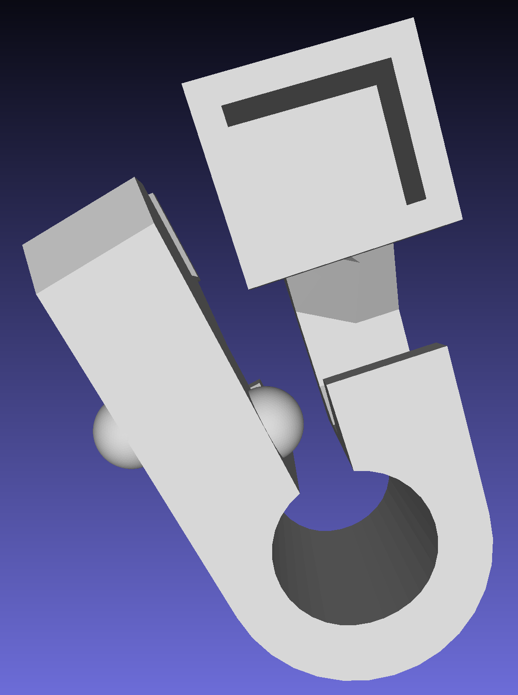
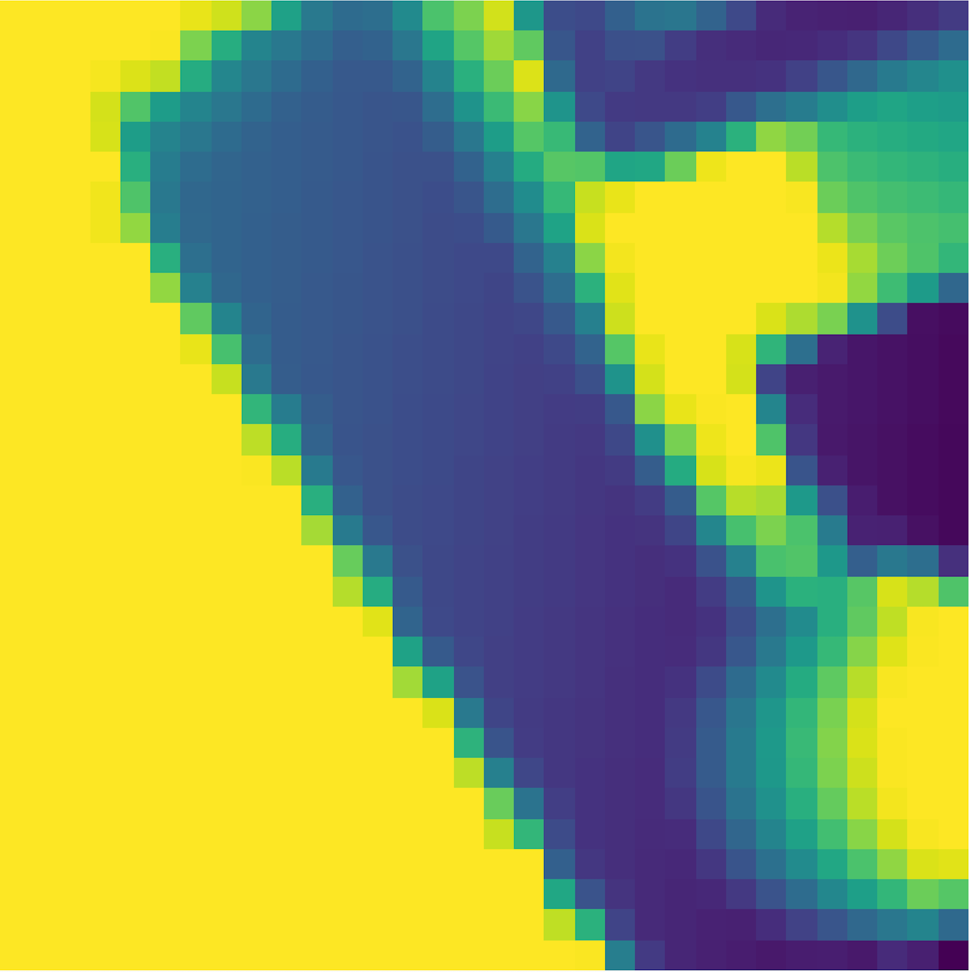
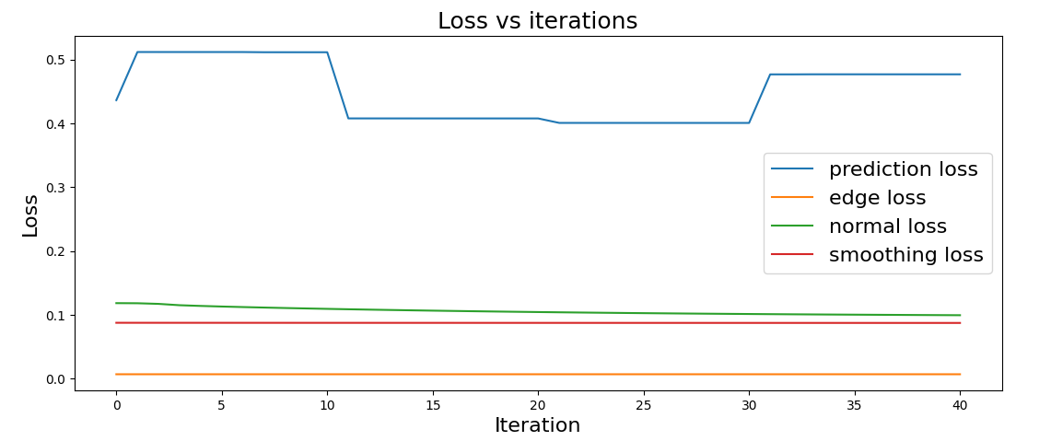

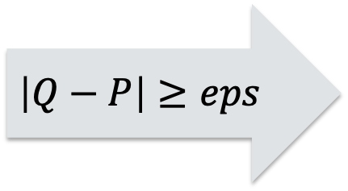

Efficient Bug Finding in Robotic Deep Learning:
Adversarial Rendering for GQCNNs
Hailie Mitchell, Dickinson College
BACKGROUND: Adversarial attacks expose vulnerabilities in DL models, and we extend this to 3D objects.
Adversarial attacks subtly manipulate input data to cause an ML model to output an incorrect prediction with high confidence.
Differentiable rendering allows optimization of 3D objects via operations on 2D projections. Thus, we can attack a 3D object based on model gradients from a 2D image of the object.
Grasp Quality Convolutional Networks (GQCNNs) predict the quality of a robotic grasp on an object, and this is the type of model we attack.
We combine these ideas with differentiable rendering to perturb a 3D object to attack a GQCNN and expose vulnerabilities in the model. This new technique can help expose vulnerabilities in CNNs that process 3D shapes before they are deployed in physical systems like robots or autonomous vehicles.
Examples of robotic grasps¹
Example robot from UC Berkeley AUTOLAB that uses a GQCNN to plan grasps¹
RESULTS: We found 3D preliminary adversarial examples.
Input: 3D mesh object and a specific grasp
Output: Adversarial 3D mesh object that tricks the model on that grasp
After 41 iterations in an attack, the model predicted a 99.6% quality, and the oracle output a 0.0% quality:
CONCLUSIONS: Adversarial rendering has potential to expose vulnerabilities in CNN models that process 3D objects.
We are currently continuing experiments to find trends in attacks and to improve and validate our current preliminary results.
Perturbed object
Input processing
Oracle
50.8%
Q: Oracle quality
$$\left|Q−P\right|<eps: \\ \text{Mesh} \text{perturbation}$$
Grasp selection
Input processing
STOP
Acknowledgements:
Special thanks to collaborators Trenton Tabor and Meriel von Stein, as well as thanks to Professor John MacCormick and Professor Claire Le Goues for advising.
GQCNN
99.9%
P: Model prediction
$$\left|Q−P\right|≥eps$$
Grasp object²
Selected grasp
Processed depth image
References:
[1] CITRIS and the Banatao Institute. 2017. DexNet2.0: 99% Precision Grasping. Video. (25 May 2017). Retrieved April 3, 2024 from https://www.youtube.com/watch?v=i6K3GI2_EgU
[2] Jeffrey Mahler, et al. 2017. Dex-net 2.0: Deep learning to plan robust grasps with synthetic point clouds and analytic grasp metrics. arXiv:1703.09312. Retrieved from https://arxiv.org/abs/1703.09312
Final adversarial object
Notes:
Background → Span two columns; cite robot picture
Results → Replace approach section, drop approach section completely; add color to show selected grasp

