Slide 1
Five useful ethical theories
Kantianism
Do things that make sense as universal rules
Don’t treat people as a means to an end
Act utilitarianism
Perform individual acts that maximize total utility
Rule utilitarianism
Act according to rules that maximize total utility
Social contract theory
Use rules that everyone would agree to ( if everyone followed them)
Rawls’ difference principle: aim for “greatest benefit of the least-advantaged”
Virtue ethics
Act in accordance with virtues such as kindness, courage, and loyalty
Source: M. Quinn, Ethics for the Information Age, 2.6-2.9 & 8.4.2

Slide 2
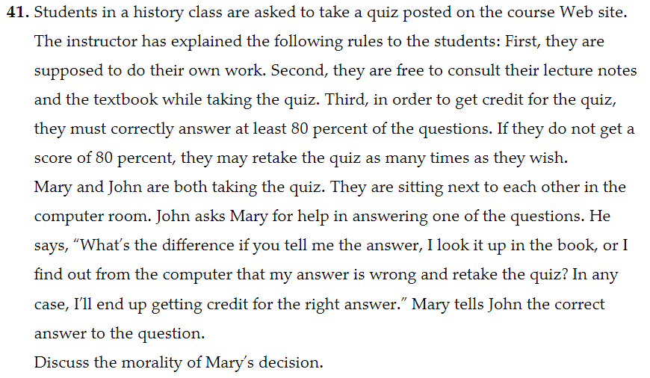
Source: Quinn Chapter 2

