Slide 1


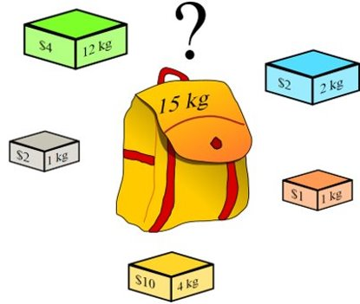
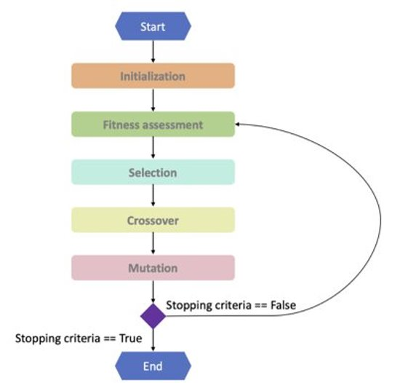
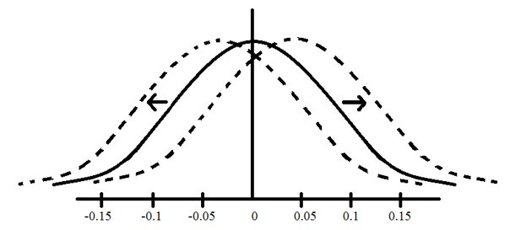
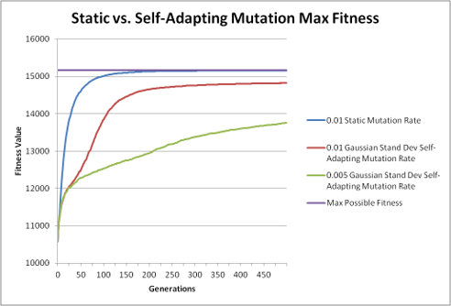
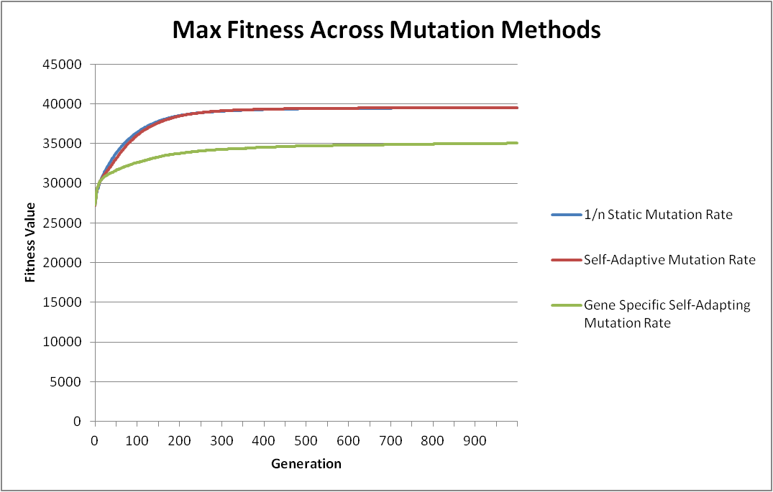
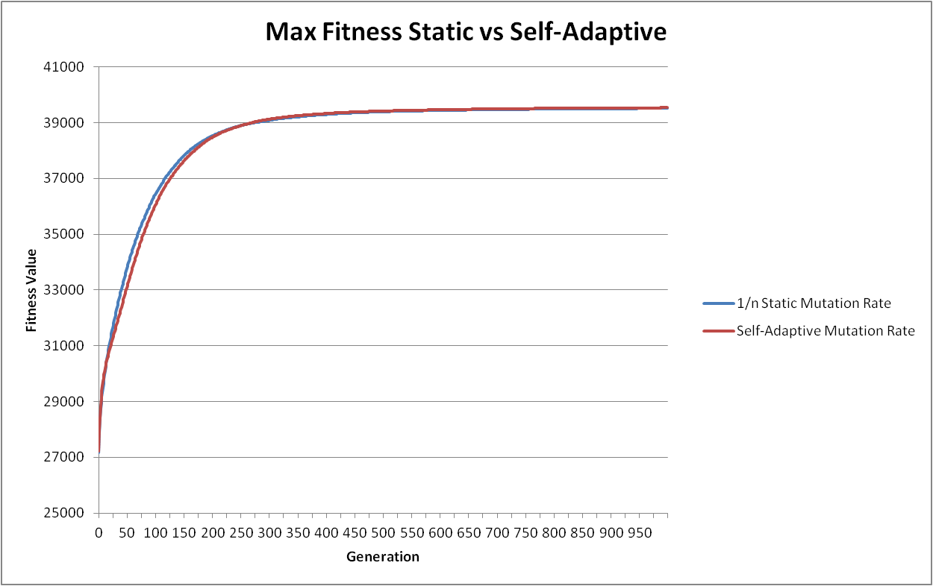
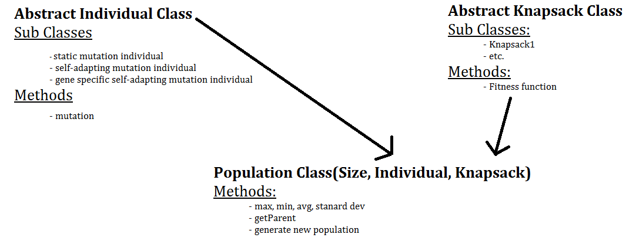
Mutation Rates in Genetic Algorithms
By Iris Shaker-Check'23 Advisor: Professor Grant Braught
Introduction
Knapsack Problem:​
An optimization and NP-Hard problem​
There are n items with a weight and value. The knapsack has a cap weight which the weight of all the items exceeds​
Goal is to maximize the value in the Knapsack​
Genetic Algorithm:​
Type of Evolutionary Algorithm which are machine learning algorithms based on the Theory of Evolution​
Used to solve optimization Problems
Important Terminology:
Gene: a section of the solution that encodes a specific element of that solution
Individual: A solution to the problem
Population: a collection of all current solutions
Fitness: how well adapted the individual is to the solution space
Solution-Space: Represents all possible solutions. It is determined by the fitness function
Experiments:
Each experiment was run 100 times, with the values averaged across the runs
Each run had the same number of generations and 100 individuals
However, the ideal mutation rate for the static mutation rate is 1/n which raises some questions about how the self-adaptive mutation rate works if it needs to have a floor at 1/n
Gene Specific Mutation Rates
A Mutation Rate for Each Gene
Stepping out of Evolution: The mutation rate is more likely to be increased if mutating that individual had a positive effect and decreased if it has a negative effect. This is done by shifting the normal distribution mutation rates are pulled from
Performs below the static and self-adaptive individuals
The average mutation rate ends around 0.07, while static and self-adaptive end around 0.003 and 0.004 respectively. More research is needed to understand why
Results
Self-Adaptive vs Static Mutation Rate
Past Reasearch has shown that self-adaptive outperforms static (Back & Schutz)
Initial results indicate that my static outperformed my self-adaptive mutation rate. This was because the self-adaptive mutation rate went below the ideal
Looking back at the research, past research put the floor of the mutation rate 1/n. Added this floor meant that the self-adaptive was outperforming the static mutation rate
Methods
Pieces that Make Up the Algorithm:
References:
Bäck, T & Schutz, M (1996). Intelligent mutation rate control in canonical genetic algorithms. Foundations of Intelligent Systems, 158-167. Retrieved September 11, 2022 from https://link.springer.com/chapter/10.1007/3-540-61286-6_141.
Buchanan, A., Triant, M., & Bedau, M (2004). Flexible balance of Evolutionary Novelty and Memory in the Face of Environmental Catastrophes. Reed College. Retrieved March 27, 2023 from https://people.reed.edu/~mab/publications/papers/alife9.pdf

