Slide 1


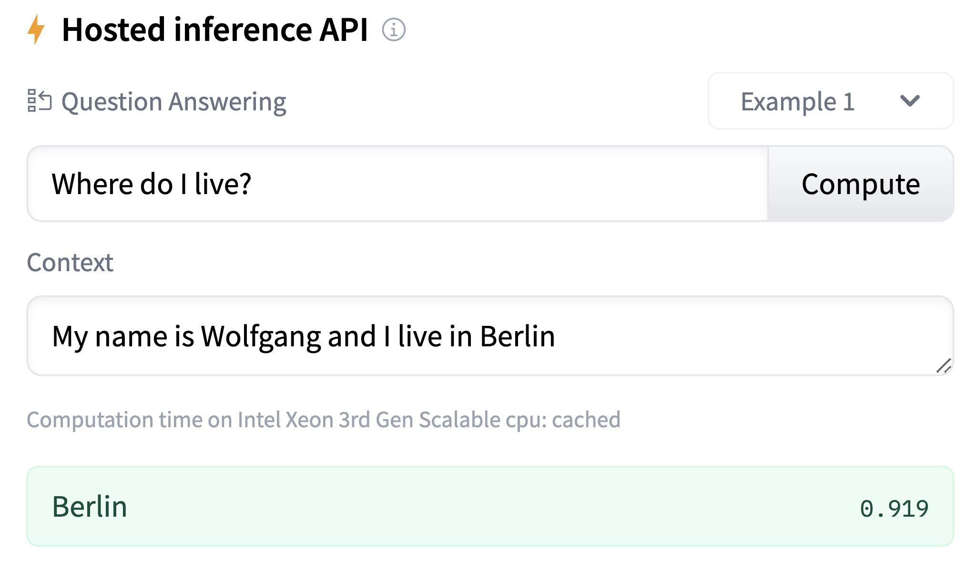
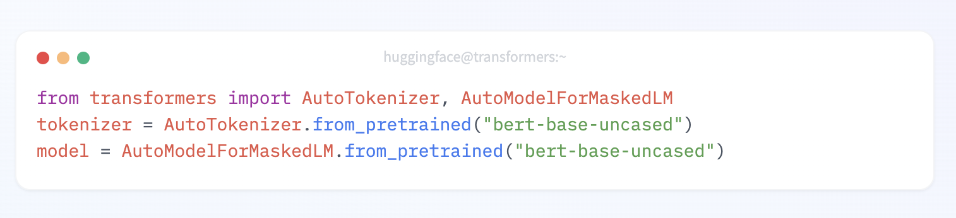
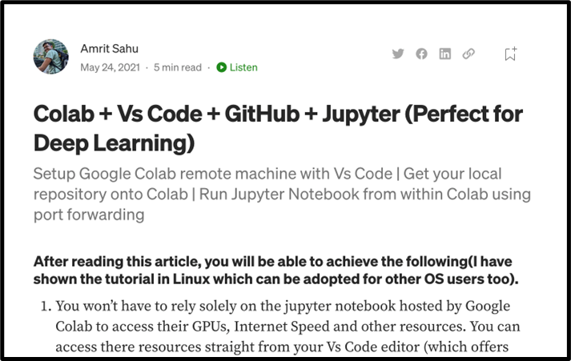
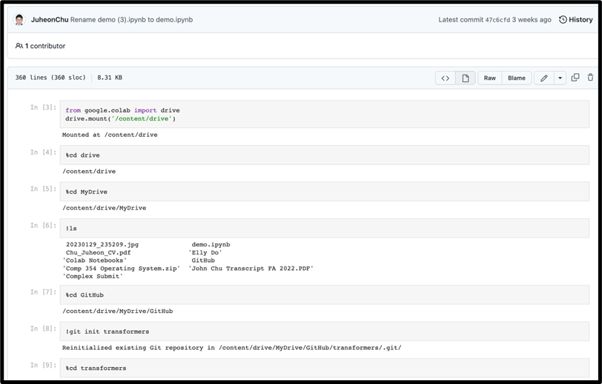
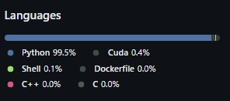
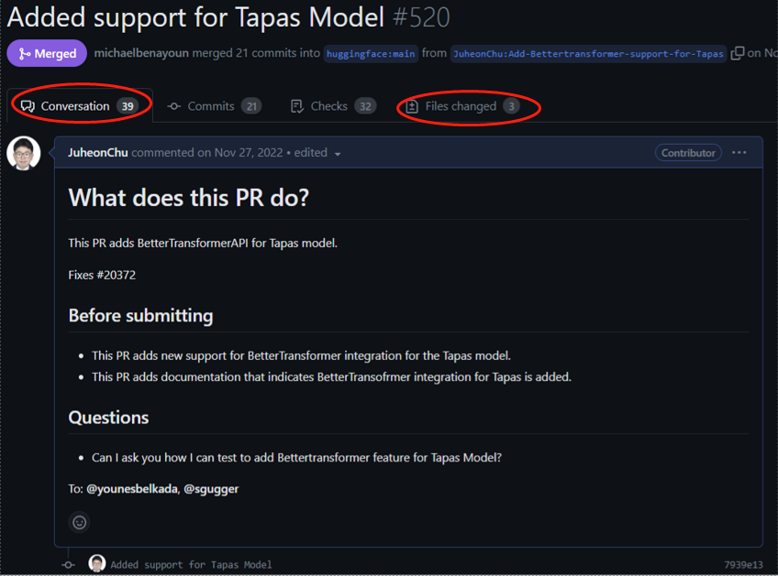
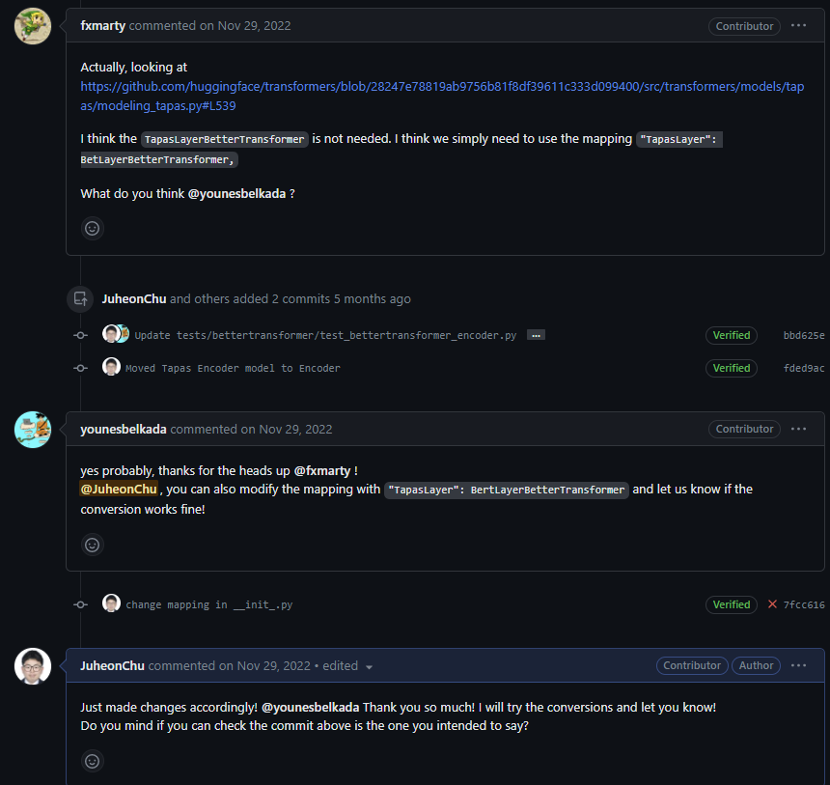
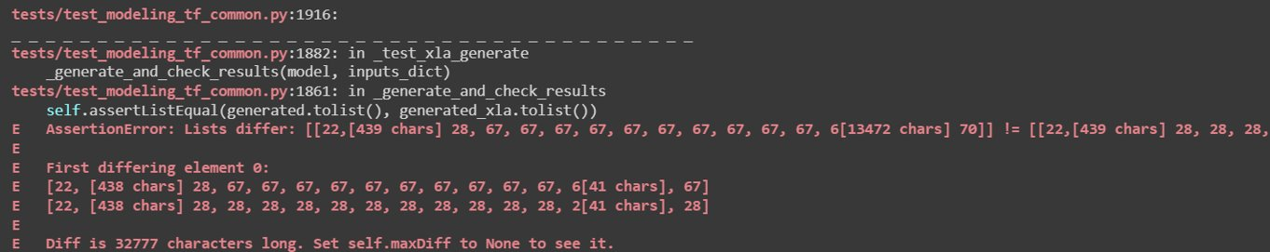
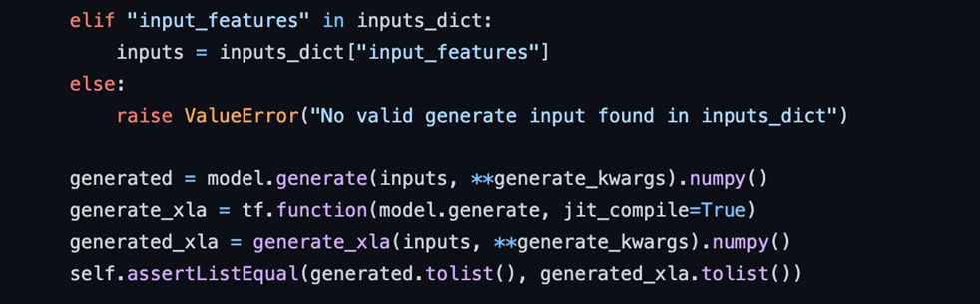
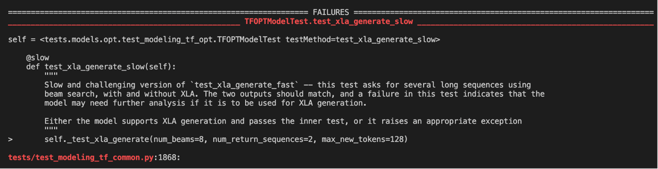
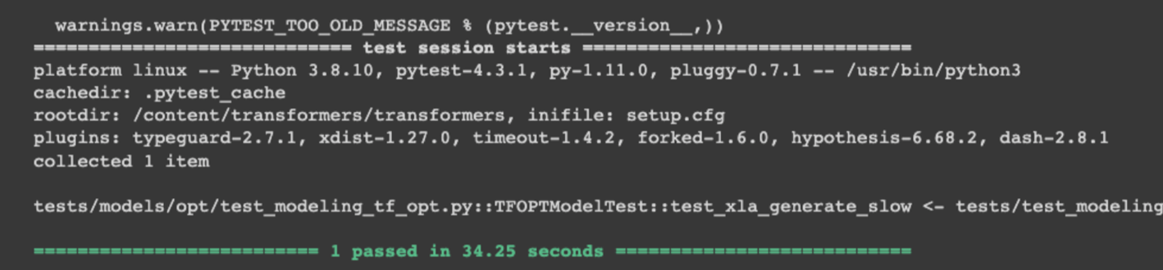
| Transformers
Evan Bates, John Chu, Katie Le,
Philip Mollerus, Billy Lee, Adia Wu
Introduction
Contributions
Reflection
Background
Huggingface Transformers is an open-source library that provides pre-trained machine learning models for various applications across text, vision, and audio. It includes APIs for rapid model access, customization, and fine-tuning on individual datasets.
Objective
Troubleshoots existing software defects in the open source and acquire deep learning skills.
Issues ​ | Claimed Model(s) | Pull Request Status​
#12789​​ - Raise exceptions instead of using assertions for control flow | DistilBERT | 3/3 PRs Merged
#14642 - Encapsulate all forward passes with "with torch.no_grad()"​ | Rembert, XLM-Roberta, Camembert | 3/3 PRs Merged
#16059 - Add missing type hints to PyTorch and TensorFlow models​ | Marian, TFPegasus, VisionEncoderDecoder, EncoderDecoder, DeiT | 6/6 PRs Merged
#17935 - XLA tests failed for some TensorFlow models​ | OPT | Postponed due to communication issues ​
#18926 - Integrating multi-page document support into the QA pipeline​ | QA | Ongoing ​
#19587 - Doc Tests Sprint - Configuration files | Timesformer | 1/1 PRs Merged
#20055 - Aggregate existing resources on a model's documentation​ | ALBERT | 0/1 PRs Merged (Communication issue)
#20372 - BetterTransformers API integration for existing models​ | Tapas, Flava | 1/2 PRs Merged
#21737 - Fix gradient_checkpointing and use_cache bug for generate-compatible models​ | Blenderbot TimeSeriesTransformer | 2/2 PRs Merged ​
Challenges
Non-interactive communication with open-source contributors.
Insufficient resources to troubleshoot Good Second Issues or Good Difficult Issues.
We had to familiarize ourselves with the large codebase and abstract neural network concepts in deep learning
What we have learned
Acquired deep learning skills that can be practically used.
Reinforce open-source experiences.
Improved problem-solving skills by debugging the codebase.
Simulate professional work setting through Slack team channel.
Major Issues
#20372: BetterTransformer – Tapas
#17935: XLA Generation Test
Issue: BetterTransformer API provides faster inference on CPU & GPU through a simple interface on Transformer models that have a transformer encoder layer. One of the models that we contributed is the Tapas model.
Why Chose this Issue?
Good First Issue
Easily approachable but also requires series of communications with maintainers
Sufficient technical practice
Solution:
Step 1: We identified the source layer to change and built the BetterTransformer module on the Tapas module.
Step 2: We built the forward pass to check if the parent class (Bert Layer) runs all safety checkers.
Step 3: Lastly, we updated the BetterTrasnformer model mapping dictionary to convert the Tapas model into the BetterTransformeras model.
Issue: XLA generation is essential to improve the runtime and memory efficiency of running Transformer models. We are troubleshooting the root of the XLA generation issue in the OPT model.
Why Chose this Issue?
Good Second Issue
Challenging technical practice
Recent issue
Critical feature of the Transformer open source
Solution:
Issue 1: Difficulty reproducing the failed test
Solution: Switch to zero-setup platforms
Issue 2: No clear differences between non-XLA and XLA code
Solution: Print statements in debug mode. However, this produces no results.
Issue 3: Inconsistent XLA test results
Solution: Execute tests repeatedly.
Future Work
Models
Create pull requests for Good Difficult Issues.
Use Transformers models and libraries for practical application and research.
The issues involve multiple models, allowing us to choose specific ones, assign tasks to subteams, and gain insights into various areas, including text and vision.
Out of +190 supported Transformers models, we contributed to the following models.​
Tools & Skills Used
Flava
Libraries
PyTorch
TensorFlow
Jax/Flax
Transformers
ALBERT
OPT
TFDeiT
TFMarian
TFEncoderDecoder
DistilBERT
TFVisionEncoderDecoder
References
Tapas
TFPegasus
Adding BetterTransformer support for new architectures (huggingface.co)
XLA: Optimizing Compiler for Machine Learning | TensorFlow
TF: XLA generation not working properly in some models · Issue #17935 · huggingface/transformers (github.com)
Community contribution - `BetterTransformer` integration for more models! · Issue #20372 · huggingface/transformers (github.com)
Added support for Tapas Model by JuheonChu · Pull Request #520 · huggingface/optimum (github.com)
Vision-based
Text-based
Fun fact: We have debugged +2000 lines of code

Slide 2
Issues ​ | Responsible Teammate​ | Pull Request Status​
#12789​​ - Raise exceptions instead of using assertions for control flow | Everyone (2 per PR) | 3/3 PRs Merged
#14642 - Encapsulate all forward passes with "with torch.no_grad()"​ | Katie​ | 3/3 PRs Merged
#16059 - Add missing type hints to PyTorch and TensorFlow models​ | Everyone​ | 6/6 PRs Merged
#17935 - XLA tests failed for some TensorFlow models​ | John, Katie, Adia​ | Postponed due to communication issues ​
#18926 - Integrating multi-page document support into the QA pipeline​ | John, Adia​ | Ongoing ​
#19587 - Doc Tests Sprint - Configuration files | John, Adia | 1/1 PRs Merged
#20055 - Aggregate existing resources on a model's documentation​ | John, Adia, Phil​ | 0/1 PRs Merged (Communication issue)
#20372 - BetterTransformers API integration for existing models​ | Katie​, John, Billy | 1/2 PRs Merged Billy's Ongoing
#21737 - Fix gradient_checkpointing and use_cache bug for generate-compatible models​ | Evan​, Phil​ | 2/2 PRs Merged ​
Issues ​ | Claimed Model | Pull Request Status​
#12789​​ - Raise exceptions instead of using assertions for control flow | DistilBERT | 3/3 PRs Merged
#14642 - Encapsulate all forward passes with "with torch.no_grad()"​ | Rembert, XLM-Roberta, Camembert | 3/3 PRs Merged
#16059 - Add missing type hints to PyTorch and TensorFlow models​ | Marian, TFPegasus, VisionEncoderDecoder, EncoderDecoder, DeiT | 6/6 PRs Merged
#17935 - XLA tests failed for some TensorFlow models​ | OPT | Postponed due to communication issues ​
#18926 - Integrating multi-page document support into the QA pipeline​ | QA | Ongoing ​
#19587 - Doc Tests Sprint - Configuration files | Timesformer | 1/1 PRs Merged
#20055 - Aggregate existing resources on a model's documentation​ | ALBERT | 0/1 PRs Merged (Communication issue)
#20372 - BetterTransformers API integration for existing models​ | Tapas, Flava | 1/2 PRs Merged
#21737 - Fix gradient_checkpointing and use_cache bug for generate-compatible models​ | Blenderbot TimeSeriesTransformer | 2/2 PRs Merged ​
ALBERT (A Lite-BERT self-supervised Learning model of Language Representations)
Tapas (A BERT-based model specifically designed (and pre-trained) for answering questions about tabular data)
Flava (A pre-trained multilingual language model that Excels in various NLP tasks across diverse languages and domains)
OPT (A series of open-sourced large causal language models which perform similar in performance to GPT3)
TFEncoderDecoder (initialize a sequence-to-sequence model with any pretrained autoencoding model as the encoder and any pretrained autoregressive model as the decoder)

Slide 3
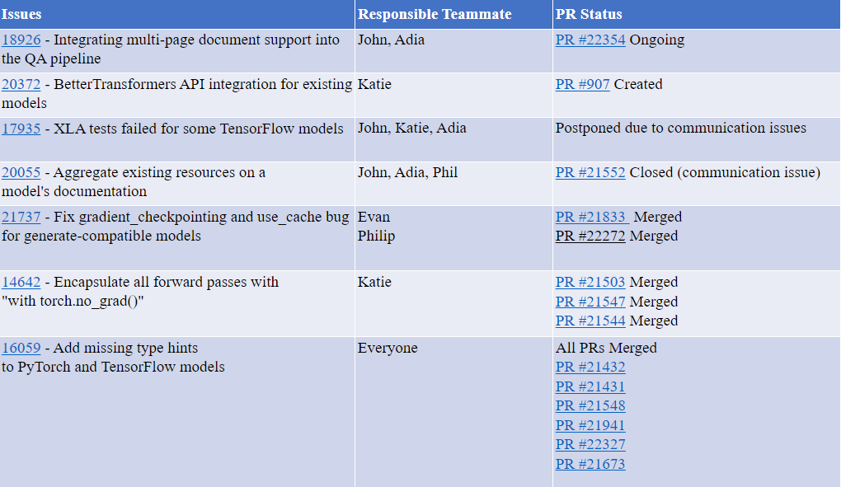
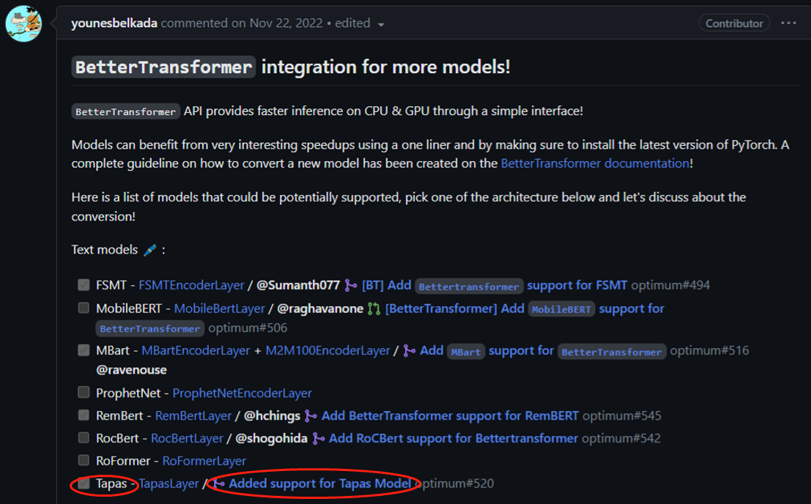
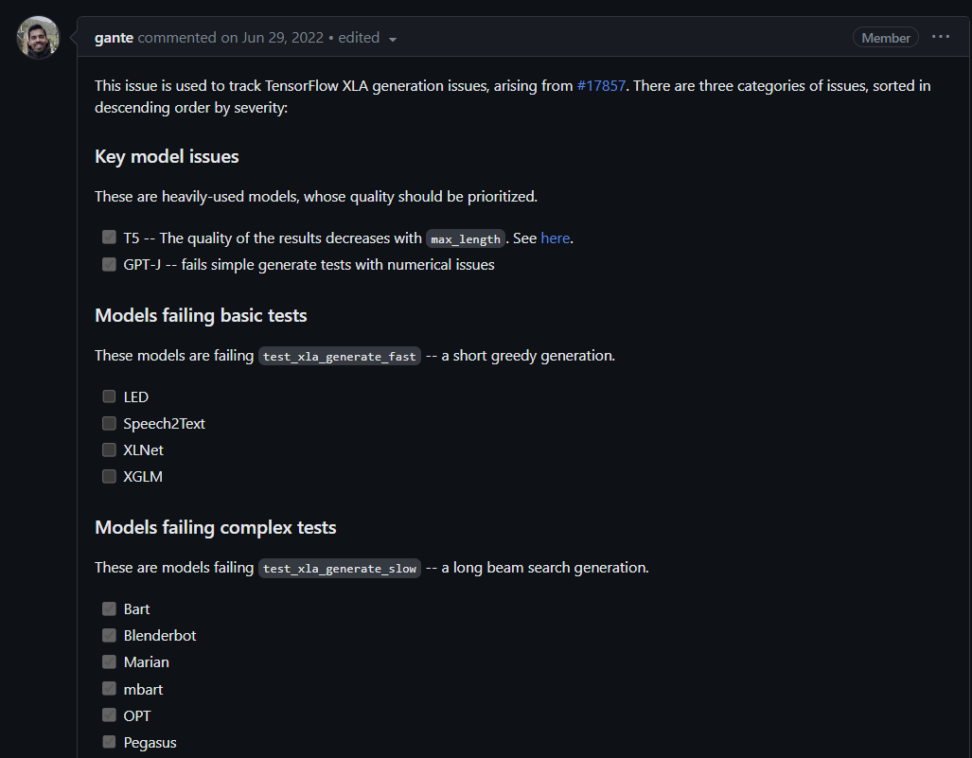
| Transformers
Evan Bates, John Chu, Katie Le,
Philip Mollerus, Billy Lee, Adia Wu
Introduction
Contributions
Reflection
Dense + hot
Background: Huggingface Transformers is an open-source library that provides pre-trained machine learning models for various applications across text, vision, and audio. It includes APIs for rapid model access, customization, and fine-tuning on individual datasets.
Objective: troubleshoots existing software defects in the open source and acquire deep learning skills.
Challenges
Non-interactive communication with open-source contributors.
Insufficient resources to troubleshoot Good Second Issues or Good Difficult Issues.
List of issues + PRs here + Responsible team member
What we have learned
Acquired deep learning skills that can be practically used.
Reinforce open-source experiences.
Improved problem-solving skills by debugging the codebase.
Simulate professional work setting through Slack team channel.
Major Issues
BetterTransformer
XLA Generation Test
Models
Out of numerous Transformers models, we contributed to the following models.​
ALBERT (A Lite-BERT self-supervised Learning model of Language Representations)
Tapas (AN BERT-based model specifically designed (and pre-trained) for answering questions about tabular data)
Flava (A pre-trained multilingual language model that Excels in various NLP tasks across diverse languages and domains)
OPT(A series of open-sourced large causal language models which perform similar in performance to GPT3)
TFEncoderDecoder (initialize a sequence-to-sequence model with any pretrained autoencoding model as the encoder and any pretrained autoregressive model as the decoder)
Tools & Skills Used
Library
PyTorch
TensorFlow
Jax/Flax
Transformers
Overview
Good First Issue
Easily approachable but also requires series of communications with maintainers
Decent technical practice
Overview
Good Second Issue
Technically challenging
Recently
Critical feature of Transformers
Require debugging +2000 lines
Maybe another issue OR XLA challenge OR anything

Slide 4
| Transformers
Evan Bates, John Chu, Katie Le,
Philip Mollerus, Billy Lee, Adia Wu
Introduction
Contributions
Reflection
Light + cold
Background: Huggingface Transformers is an open-source library that provides pre-trained machine learning models for various applications across text, vision, and audio. It includes APIs for rapid model access, customization, and fine-tuning on individual datasets.
Objective: troubleshoots existing software defects in the open source and acquire deep learning skills.
Challenges
Non-interactive communication with open-source contributors.
Insufficient resources to troubleshoot Good Second Issues or Good Difficult Issues.
List of issues + PRs here + Responsible team member
What we have learned
Acquired deep learning skills that can be practically used.
Reinforce open-source experiences.
Improved problem-solving skills by debugging the codebase.
Simulate professional work setting through Slack team channel.
Major Issues
BetterTransformer
XLA Generation Test
Models
Out of numerous Transformers models, we contributed to the following models.​
ALBERT (A Lite-BERT self-supervised Learning model of Language Representations)
Tapas (AN BERT-based model specifically designed (and pre-trained) for answering questions about tabular data)
Flava (A pre-trained multilingual language model that Excels in various NLP tasks across diverse languages and domains)
OPT(A series of open-sourced large causal language models which perform similar in performance to GPT3)
TFEncoderDecoder (initialize a sequence-to-sequence model with any pretrained autoencoding model as the encoder and any pretrained autoregressive model as the decoder)
Tools & Skills Used
Library
PyTorch
TensorFlow
Jax/Flax
Transformers
Overview
Good First Issue
Easily approachable but also requires series of communications with maintainers
Decent technical practice
Overview
Good Second Issue
Technically challenging
Recently
Critical feature of Transformers
Require debugging +2000 lines
Maybe another issue OR XLA challenge OR anything

Slide 5
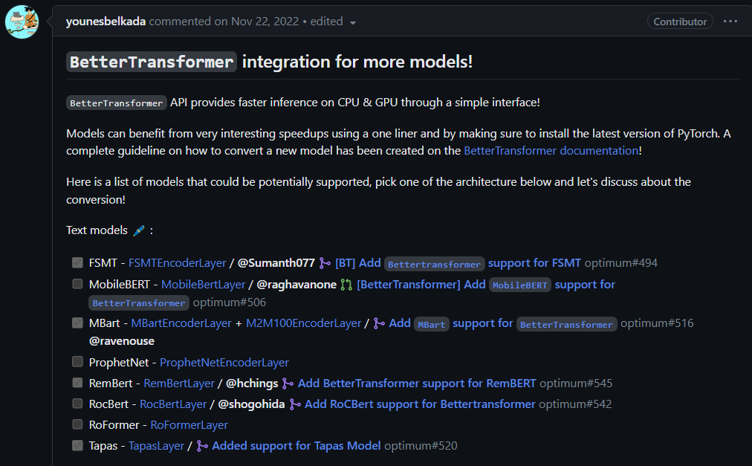
fff4e7

