Slide 1
MATH121 Elementary Statistics: mid-semester feedback, Fall 2026

Slide 2
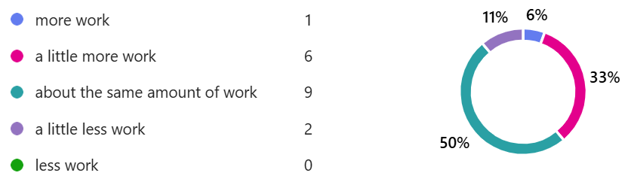
Compared to other courses at Dickinson, this course requires

Slide 3
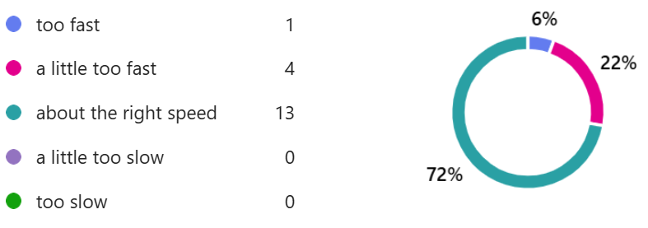
When the instructor explains a new concept during class, I feel that the pace of the explanation is usually

Slide 4





If you could change one thing about the course, what would it be?
OK, I will provide more practice problems/exams
Practice exams: 6x
Less weight on exams: 3x
More time to practice in class: 2x
Minitab issues:
  Homework is time-consuming: 1x
  Doesn't work well on my computer: 1x
  “Make homework Minitab free” 1x
Office hours don't fit: 1x
OK, optional change to homework weight 20% from 10% -- see updated syllabus
Try Tuesday 8am office hour and QR center Tuesdays 7:30 PM-9:00 PM &
Thursdays 9:00 PM-10:30 PM

Slide 5
What do you like most about the course so far?
Content: interesting; real-world applications: 4x
Homework: 2x
Clear schedule: 2x
Good explanations: 2x
In-class practice: 2x
Text book & its direct connection to class 2x
Great semester so far: 2x

