Slide 1
Introduction to R in Africa
Day 1 DIMA Units of Regional Bureaux: East and Horn of Africa and the Great Lakes, Southern Africa, West and Central Africa

Slide 2
Introductory remarks

Slide 3
Pre-workshop survey: reminder!
We invite all participants to take part in this 3-minute survey.
If you haven’t taken part, there’s still time.
https://enketo.unhcr.org/x/R4L2j3eM
You can also find the link in the chat.

Slide 4
The facilitators
Ahmadou Dicko | Hyunju Park | Vinicius Feitosa
West and Central Africa | Southern Africa | East and Horn of Africa and the Great Lakes

Slide 5
The participants
Focused on staff working with IM, Statistics and Data Analysis, ODM, Registration, Economics, Monitoring & Evaluation etc.
Where are you based? Please write in the chat

Slide 6
Poll
Have you already installed R and R Studio?
Please answer in the pop-up window

Slide 7
Pre-workshop requirements
R (Base R)
RStudio
Extra tools (setting up accounts)
R Cloud
GitHub

Slide 8
Training objectives
English
From 14 to 18 February 2022 (Monday through Friday)
Dakar: 12:00 - 14:00
Pretoria: 14:00 - 16:00
Nairobi: 15:00 - 17:00

Slide 9
Training objectives (cont.)
Assessment of current capacity within the regions in Africa
Raise awareness on how R has been used within UNHCR
Use examples and datasets that are relevant to the regions
Community building
UNHCR Learn and Connect
R Teams Group

Slide 10
Introduction to R

Slide 11
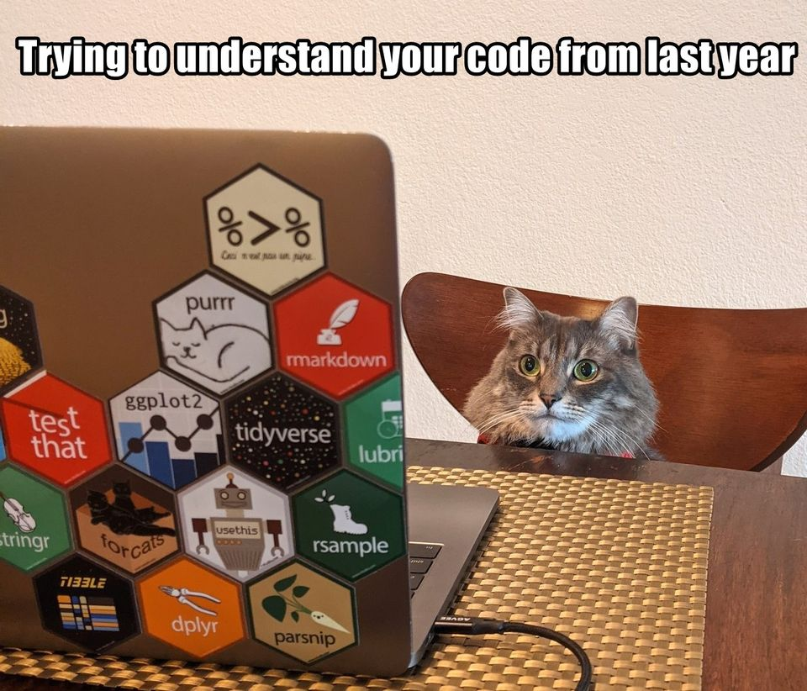
What is R?
Statistical programming language
Text interface (no graphical user interface)

Slide 12
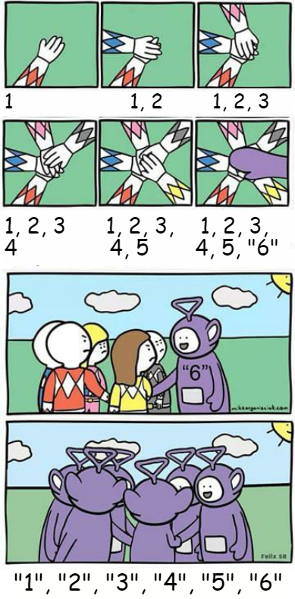
Why use R?
100% free
Support community
Transparent, easily shareable and reproducible

Slide 13
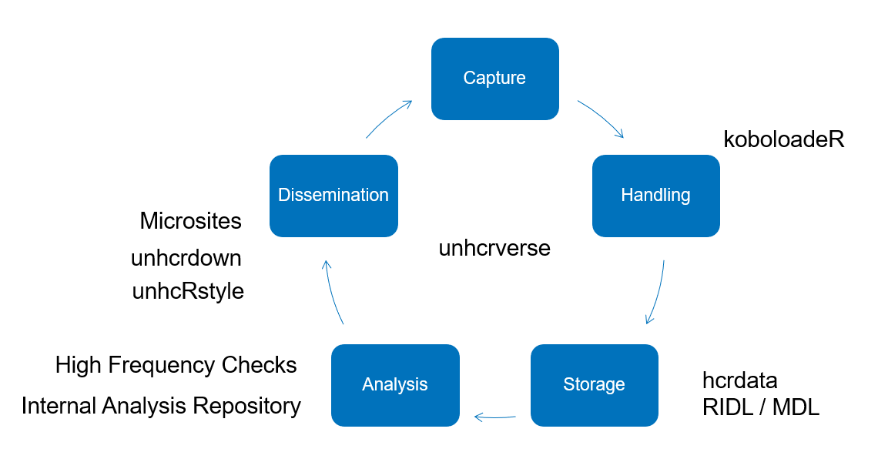
R and the data cycle
Capture
Handling
Storage
Analysis
Dissemination
Examples

Slide 14
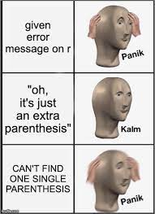
No experience in coding?
Let RStudio guide you
Start with basic commands
Be curious to see the end results
Developing a new relationship
There is nothing more frustrating than when your code does not work…
There is nothing more satisfying than when your code does work!

Slide 15
Installation
R from https://cran.r-project.org/
RStudio from https://www.rstudio.com/products/rstudio/download/
Link to installation guide

Slide 16

What is the difference between R and R Studio?
To use R, we will need to download two first download R (Base R) and RStudio.
Base R is the basic software which contains the R programming language and packages that were created by original R authors. It does not come with a graphical interface by default.
RStudio is a full “Integrated Development Environment” (IDE), i.e., the software the makes R programming easier. We will use it as a place where we can keep scripts, plots and R outputs together in one single place.
Open source and free

Slide 17
RStudio panes
Source
Where you write your code, which will be “Run” to the console.
Console
Where your code is evaluated by R
Environment / History
Files / Plots / Packages / Help
Appearances

Slide 18
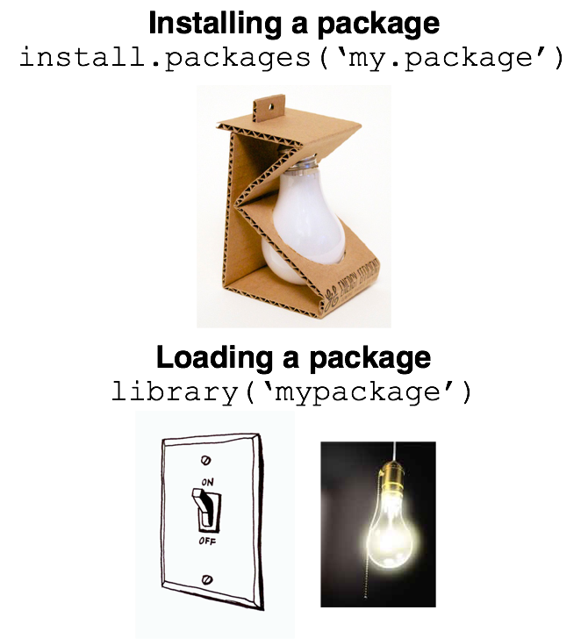
Packages
Fundamental unit of shareable code
Comprehensive R Archive Network
Installing packages
Loading packages

Slide 19
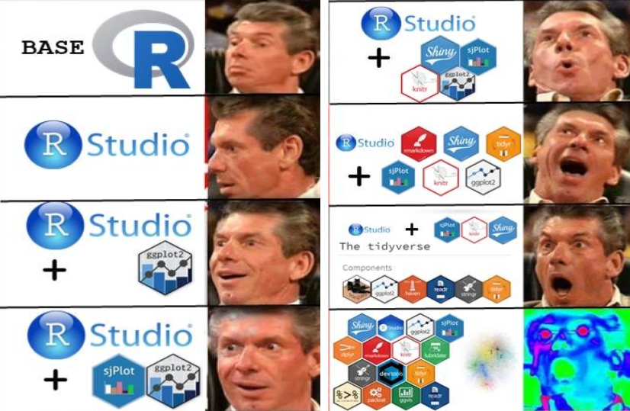
UNHCRverse

Slide 20
Institutional tools
unhcrdown
unhcrdatapackage
hcrdata
HighFrequencyChecks
koboloadeR
GitHub

Slide 21
Questions?

Slide 22
Day 1 Recap

Slide 23
Recap
Installation of R and R Studio
Difference between R and R Studio
Basics of interface and basic commands with R Studio
Introduction of unhcRverse

Slide 24
Additional resources
UNHCR Learn and Connect (LinkedIn)
RStudio Cheatsheets https://www.rstudio.com/resources/cheatsheets/

Slide 25
Tomorrow
Organizing your data project
Export / Import data
Using R for population statistics
Using R with Kobo

Slide 26
Thank you and see you tomorrow!

