Slide 1
Welcome to CS61A Disc 5 Sect. 29/47 :D
Previous: Data Abstraction >>>
Today: Lists and Trees >>>
Next stop: Object oriented programming
Dickson Tsai
dickson.tsai+cs61a@berkeley.edu
OH: Tu, Th 4-5pm 411 Soda

Slide 2
Section Quiz Logistics
Please take out a piece of paper
Put your name, login (e.g. cs61a-ty), SID, and section number (#47 for 11-12:30 pm, #29 for 6:30-8pm)
Graded on effort: effort = revise your quiz with diff color

Slide 3
Section Quiz
How can I make your lab/discussion experience more worthwhile?
Review: What is data abstraction?
From lab: What would Python print?
  >>> a = [1, 2, 3, 4] >>> a + [3]
  >>> a[2:] _____
  ____ >>> a
  >>> a[-2:] _____
  _____
  >>> a[-2::-1]
  _____
  >>> a + 3
  _____

Slide 4
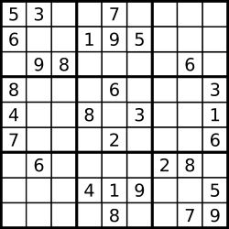
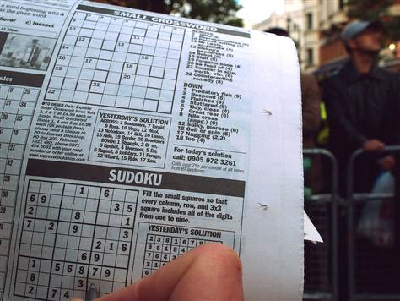
Section Quiz [Solutions]
What is data abstraction? Think of a real life example.
  A methodology by which functions enforce an abstraction barrier between representation and use
The grid is represented by pixels on a screen
In both grids:
lookup(board,position)
fill_in(board,position)
take_note(board, position, possibility)
is_valid(solution)
(Sudoku has the same rules no matter the form!)
The grid is represented by a newspaper

Slide 5
Section Quiz [Solutions]
From lab: What would Python print?
  >>> a = [1, 2, 3, 4] >>> a + [3]
  >>> a[2:] [1, 2, 3, 4, 3]
  [3, 4] >>> a
  >>> a[-2:] [1, 2, 3, 4]
  [3, 4] (Bonus): >>> a[5:]
  >>> a[-2::-1] []
  [3, 2, 1]
  >>> a + 3
  TypeError: can only concatenate list (not “int”) to list
  (Bonus): >>> 3 + a
  TypeError: unsupported operand type(s) for ‘+’: ‘int’ and ‘list’
Explanations:
Slicing and concatenation are non-mutating operations. The original list remains unchanged. You get a new object every time!
If slicing is invalid, you will get an empty list

Slide 6
Anuncios
HW4 due next Tuesday 10/7.
Project 2 Trends due next Wed 10/8 for one extra point, or 10/9
Reminder: My OH are Tuesdays, Thursdays 4-5 PM in Soda 411
Do not post any of your code on a public-viewable platform online. (e.g. Github, Pastebin)
Go to dicksontsai.com/meet to schedule an appointment if you would like to talk to me about anything related to the course.

Slide 7
5-min Review Recap
Pingpong (should require) translating an iterative solution to a recursive solution.
1. Variables to track
def fib_iter(n):
curr, prev = 0, 1
while n > 0:
curr, prev = curr + prev, curr
n -= 1
return curr
def fib_trans(n):
def helper(n, curr, prev):
if n == 0:
return curr
return helper(n-1, curr+prev, curr)
return helper(n, 0, 1)
2. Initial values
3. When to stop (note – they are opposite)
4. Update values. In recursion, assignment happens by argument passing
5. Loop
6. Return

Slide 8
Tip of the Day
Appreciate the power of the tools you have!(Think of more reasons!)
  Why are while loops powerful?
    You just have to state how a general iteration should go
    You can control when the loop ends generally (with variables)
  Why are functions powerful?
    State a piece of computation generally. Manipulate the computation via the parameters of the function.
    Store the code until the code needs to be called up.
  Why is recursion powerful?
    Instead of coming up with whole solution at once, build up from a smaller solution. Lets you think more about concepts than code
  Why is data abstraction powerful?
    Custom types = more flexibility, precision in manipulating data
    Specialized tweet functions can take in tweet objects, know what the objects store

Slide 9
New Way of Running Disc
Form groups of 2-3 as usual
Write up your solution (function boxes + answers) on the board!
  If you are concerned about putting about an incorrect answer, you shouldn’t be. It’s better to make mistakes here than on the test.
    Plus, everyone can see common mistakes and learn together.
  More practice with writing code
  Chalkboards should make you feel smart.
  Rotate people every problem so everyone gets a chance.

Slide 10
List Comprehension
[<map_expr> for <name> in <iter_exp> if <cond_expr>]
A list comprehension is an expression that evaluates to a list.
To create the list:
Evaluate the iter exp. <name> will take on each value in the resulting sequence
Evaluate the cond exp. If false, move on to the next value.
Evaluate the map exp under the context of the name. The value of the map exp will be an element of the new list.

Slide 11
List Comprehension Examples
1. Iter exp 2. cond exp 3. map exp
A list of 50 1’s:
[1 for i in range(50)]
A list of odd squares from a to b:
[x * x for x in range(a, b) if x % 2 == 1]
The list of fibonacci numbers for odd squares from a to b if odd square ends with a 7
[fib(x) for x in [x*x for x in range(a, b) \
if x % 2 == 1] if x % 10 == 7]

Slide 12
List Comprehension Examples
Iter exp 2. cond exp 3. map exp
A list of odd squares from 1 to 6:
[x * x for x in range(1, 9) if x % 2 == 1]
Iter exp seq: 1 2 3 4 5 6
Cond exp eval: 1 2 3 4 5 6
Map exp:
x * x
x * x
x * x
[1, 9, 25]

Slide 13
Why use list comprehensions?
“Concise way to create lists” – Python documentation
Writing out a whole list is tedious and high-maintenance
  [tweet_text(tweets[0]), tweet_text(tweets[1])]
Q: How can one piece of code generate all elements
  Q: What does each element share? -> map expression
  Q: What varies from element to element? -> iter expression
    Have another list that will determine the differences. You can filter that list -> cond expression

Slide 14
Why use list comprehensions?
Q: How can one piece of code generate all elements
  Q: What does each element share? -> map expression
  Q: What varies from element to element? -> iter expression
    Have another list that will determine the differences. You can filter that list -> cond expression
Example: collecting text of tweets
  Part that’s the same: tweet_text(…)
  Part that’s different: tweets[0], tweets[1]
    The differences are [tweets[0], tweets[1], …,] -> tweets!
  Now, as long as we can plug in difference under the same name “tweet”, we can write all elements using same code:
    [tweet_text(tweet) for tweet in tweets]

Slide 15
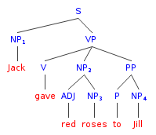
Tree Terminology
Tree – a graph without cycles (there is only one path from one node to another) -> Hierarchy

Slide 16
Tree Terminology – Parent/Child
S is the parent of NP₁ and VP
NP₁ and VP are children of S
Parent – a node that has children.
Child – a node that has a parent

Slide 17
Tree Terminology - Root
S is the root of this tree
Root – a node with no parent
  To refer to a tree, usually have a reference to the root

Slide 18
Tree Terminology - Leaf
The words are leaves here
Leaf – a node without any child
  Most involved with base cases???

Slide 19
Tree Terminology - Subtree
The tree corresponding to a child is a subtree.
Subtree – the tree corresponding to a child. The child is the root of this tree

Slide 20
Tree Terminology – Depth/height
Depth of PP: 2
Height: 4
Depth(node) – the distance from root to given node
Height – the depth of the lowest leaf: min{depth(node)}

Slide 21
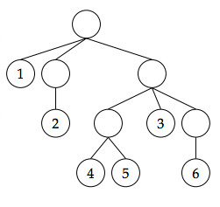
Non-rooted Tree
tree = [1, [2], [[4, 5], 3, [6]]]
Q: What do you notice about this tree?
A: There are only values at the leaves!

Slide 22
Non-rooted Tree ADT
tree = [1, [2], [[4, 5], 3, [6]]]
Representation
Leaves are ints
every other node is a list
Use
is_leaf(tree)
apply_to_leaves(fn, tree)
To get values, just return tree

Slide 23
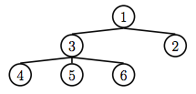
Rooted Tree
tree = rooted(1, [rooted(3, [leaf(4), leaf(5), leaf(6)]), leaf(2)])
Q: What do you notice about this tree?
A: There are values at every node!

Slide 24
Rooted Tree ADT
tree = rooted(1, [rooted(3, [leaf(4), leaf(5), leaf(6)]), leaf(2)])
Representation
Each tree = value + list of children (list of rooted trees)
Use - Constructors
rooted(value, branches)
leaf(value) # makes branches an empty list
Use – Selectors: root(tree) branches(tree)
Use – Functions: is_rooted_leaf(tree)
Note:
Selecting is more complicated now!

Slide 25
Closure Property
The result of combination can itself be combined using same method
  For trees: To create a tree, combine value of list of trees. Now we can put this new tree into another list of trees and value to produce yet another tree!
  i.e. Every subtree of a tree is a tree
    -> You can do recursion so easily now!
height
0
height
2
height
1

Slide 26
Optional Conceptual Questions (Wednesday 10/1 lecture)
What are the restrictions on dictionary keys?
  Note that strings can be keys. What does this say about string objects?
What are the restrictions on dictionary values?
  Can I have a dictionary whose value is another dictionary?
What are the behavior conditions of a linked list?
Draw the box-and-pointer diagram (if possible) for:
  link(1, 2, 3, 4, None) 3. link(1, link(‘hi’, link(3, None)))
  link(1, link(link(2, link(3, None)), link(4, None)))
What functions do we have to add to our linked list to satisfy the sequence abstraction?
How are rooted trees different from non-rooted trees? Why might the difference be useful?
What’re the constructors and selectors of the linked list? The rooted tree?

