Slide 1
Welcome to CS61A Disc 4 Sect. 29/47 :D
Previous: Recursion, Tree Recursion >>>
Today: Data Abstraction >>>
Next stop: Trees
Dickson Tsai
dickson.tsai+cs61a@berkeley.edu
OH: Tu, Th 4-5pm 411 Soda

Slide 2
Section Quiz Logistics
Please take out a piece of paper
Put your name, login (e.g. cs61a-ty), SID, and section number (#47 for 11-12:30 pm, #29 for 6:30-8pm)
Graded on effort: effort = revise your quiz with diff color

Slide 3
Section Quiz
How can I make your lab/discussion experience more worthwhile?
What is an object? Think of a real life example.
    Hint: They consist of _______ and ______, bundled together to create _______
An abstract data type (ADT) allows us to treat ________ as units. Think of a real life example.
What is data abstraction? Think of a real life example.
  Hint: A methodology by which functions enforce an __________ between r________ and u___

Slide 4
Section Quiz [Solutions]
What is an object? Think of a real life example.
    Hint: They consist of data and behavior, bundled together to create abstractions
An abstract data type (ADT) allows us to treat compound objects (object that combines objects) as units. Think of a real life example.
What is data abstraction? Think of a real life example.
  Hint: A methodology by which functions enforce an abstraction barrier between representation and use

Slide 5
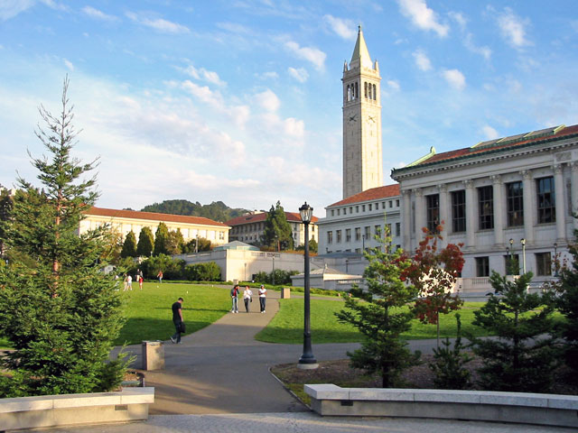
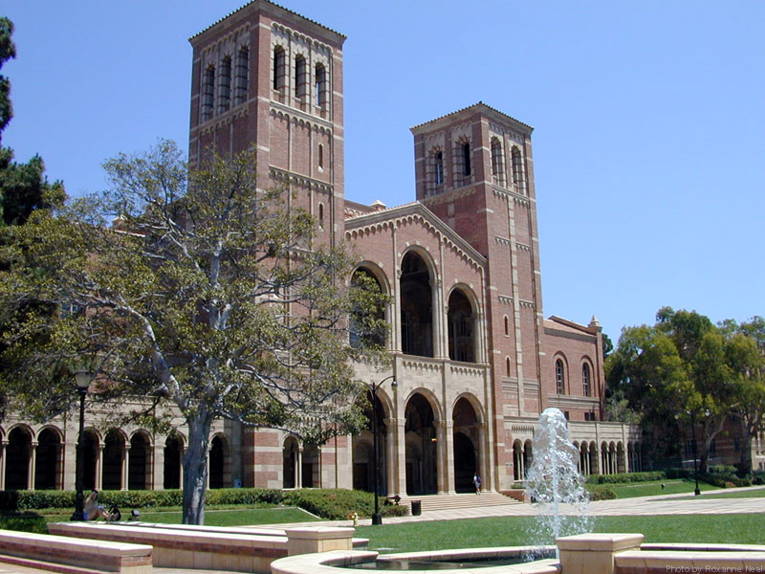
Section Quiz [Solutions]
What is an object? Think of a real life example.
  A car. Has properties (data) such as color, model, etc. Has behavior such as drive, brake, etc.
Abstract data type (ADT) Think of a real life example.
  UC Berkeley is collection of classrooms, labs, faculty, etc.
  ‘University’ – institution for teaching, research
  University rankings: manipulate univ. as single unit
Top Public Univ.
UC Berkeley
UCLA

Slide 6
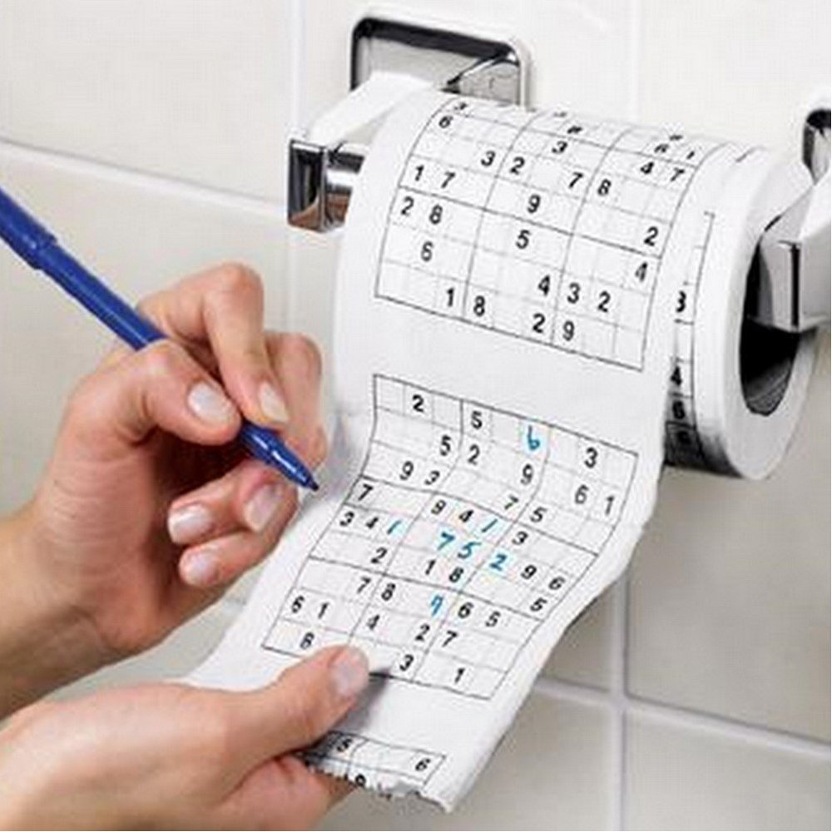
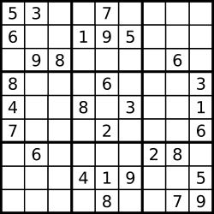
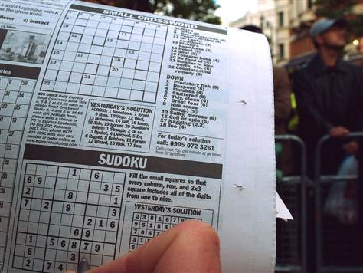
Section Quiz [Solutions]
What is data abstraction? Think of a real life example.
  Real life example:
  You can play Sudoku anywhere! How’s that possible???
  - The appearance may change, but the rules never change!

Slide 7
Anuncios
Midterm 1 is graded. Exams require practice!
HW3 due next Wednesday 10/1.
Reminder: My OH are Tuesdays, Thursdays 4-5 PM in Soda 411
Guerrilla section on recursion will be held this Saturday. Remember, it’s a place where you can collaborate with people and do practice problems
Do not post any of your code on a public-viewable platform online. (e.g. Github, Pastebin)
Email me to schedule an appointment if you want me to go over the midterm with you personally.

Slide 8
Your feedback
5-10 minutes to talk about HW/Project/Q&A
More time for quiz?
  I’ll make them easier/shorter b/c lots to cover
More examples and explain them
  I have found that helpful as well – will do more easy ones
Discussion questions of different difficulty
  You can work ahead! I usually skip questions.
Hit more difficult questions
  Will attempt 1 difficult question/disc using rules
More analysis of writing code
Funny videos, CS in the news, practice midterm Q, educational vids
Allow food -> You can eat during discussion! Just clean up after yourselves.
More fill-in-the-blank questions to start with
More walkthrough of my approach

Slide 9
5-min Review Recap
Monday Midterm: 4b Section avg. 1.311/4
def if_fn(cond):
if cond:
return lambda a, b: a
else:
return lambda a, b: b
def factorial(n):
def base():
return 1
def rec():
return n * factorial(n-1)
return ______________
Remember that boolean operators are also operators! (e.g. >=, ==, …)
Function boxes!!!!!!!!!!!

Slide 10
Tip of the Day
Focus on your thought process, not the solutions!
  When reviewing your midterm, don’t just memorize the solutions. We’re smart enough not to throw the same tricks at you.
  Write as much as you can in a test!
    Will help you remember more thoughts while you take the test.
    Will help you determine what thought processes worked
  If your answer is right… what worked?
  If your answer is wrong…
    What could you have done differently?
    E.g. use function boxes, call expression trees next time

Slide 11
New Way of Running Disc
Form groups of 2-3 as usual
Write up your solution (function boxes + answers) on the board!
  If you are concerned about putting about an incorrect answer, you shouldn’t be. It’s better to make mistakes here than on the test.
    Plus, everyone can see common mistakes and learn together.
  More practice with writing code
  Chalkboards should make you feel smart.
  Rotate people every problem so everyone gets a chance.

Slide 12
Data Abstraction
The general technique of isolating the parts of a program that deal with how data are represented from the parts that deal with how data are manipulated
Representation – stored as 2x2 matrix here
Class city
----------
Name
Latitude
Longitude
City instance
Madrid
40N
3W
City instance
151E
Sydney
33S

Slide 13
Data Abstraction
You can do cool stuff, like define functions that take in cities, or make lists of cities, etc.
A city is now a new type, alongside built-in types like booleans, ints, floats, strs, functions, lists, etc.
Use – don’t care about how data’s stored
Class city
----------
Name
Latitude
Longitude
City instance
Madrid
40N
3W
City instance
distance
Number
value
City instance

Slide 14
Data Abstraction
Another real life example (because examples help with learning).
Representation
Use
Facebook friend
------------
Id1=190324823234
Id2=435920809920
Shared photos computed by query
(Not the actual representation. Just trying to get message across)
Facebook friend
------------
Mutual friends with me
Date we first met
Shared tagged photos
Behavior: Add friend
Behavior: Delete friend
Abstraction barrier: Non-disclosure agreement

Slide 15
Data Abstraction – More Examples
Another real life example (because examples help with learning): file names
Representation
Use
Version 1
------------
color: #1340EE
beautiful_website.html
------------
<link src=“header.css” …>
header.css
Version 2
------------
color: #24B6C2
Version 3
------------
color: #AA3451
Behavior conds: Style should be for header HTML

Slide 16
Data Abstraction – Python
Did you know? Python files in your current directory can be imported as modules!
Representation
Use
constants.py
------------
SLIDES = 8
life.py
------------
from constants import *
print(“I made {0} slides for my section”.format(SLIDES))
print(“The {0} slides are made
with care”.format(SLIDES))
constants.py
Behavior conds: Style should be for header HTML

Slide 17
Data Abstraction – Python
Then, for next lab:
Representation
Use
constants.py
------------
SLIDES = 9
life.py
------------
from constants import *
print(“I made {0} slides for my section”.format(SLIDES))
print(“The {0} slides are made
with care”.format(SLIDES))
constants.py
Wow, I only had to change constants.py!
I just use SLIDES without worrying about the
actual count.
Behavior conds: Style should be for header HTML

Slide 18
Data Abstraction Qs
Representation: How will I store my data?
  Choose a data structure! They can range from a simple list to a complicated class.
  Not all values the user asks for has to be stored. They can sometimes be computed.
    def get_distance(self, city2):
Constructors: What’s the interface available for me to make objects of a certain ADT?
Selectors: How to get info from an object of a certain ADT?
Working with the type: What functions can I use to manipulate objects of an ADT? Or should I write my own?

Slide 19
Data Abstraction Qs Example
Rational: numerator / denominator
Representation: How will I store my data?
  A simple list suffices: [numer, denom]. Note: order is important here!
Constructors: What’s the interface available for me to make objects of a certain ADT?
  def make_rational(n, d): def make_rational(w):
  return [n, d] return [w, 1]
Selectors: How to get info from an object of a certain ADT?
  def numer(r): def denom(r):
  return r[0] return r[1]
Working with the type: What functions can I use to manipulate objects of an ADT? Or should I write my own?
add_rationals(r1, r2) mul_rationals(r1, r2) reciprocal(r1)

Slide 20
Application of Data Abstraction from my classes
E.g. states in AI search problem
  Each state is a combination of information (game board, where the agents are, etc.)
  They are treated as a unit when passed into functions expecting state-types.
  E.g. heuristic functions take in a state and returns a value for that state.
E.g. synchronization primitives (locks, semaphores) in operating systems
  Very low level: disabling interrupts
  However, having to implement that all the time is tedious! We want a type of object that has that desired behavior.

Slide 21
Sample Data Abstraction Problems
Given this selector function, implement the corresponding constructor of the object.
Use this type’s interface to create a function that manipulates this type.
How do we represent the unit ADT using the Pair ADT?
  Related question: how do we use the Pair ADT (holds 2 objects) to create a list of any length?
There are so many questions to explore! Try working on programs to practice data abstraction!
Reminder to finish discussion packets at home.

Slide 22
Optional Conceptual Questions (Wednesday 9/24 lecture)
What are advantages of object-oriented programming syntax?
What is the type of an object called?
  [Experienced programmers:] Can you consider the ____ an object as well?
What functions do we need to define an ADT and therefore create data abstraction? Con______ and sel______.
What 2 objects does the rational ADT combine?
  What does the con_______ look like? Give the domain and range.
  What do the sel______ look like? Give the domain and range.
How do you describe the domain/range of add_rationals(x, y)?
Why is it that divide_rational = lambda x, y: [x[0]*y[0], x[1]*y[1]] violates the abstraction barrier set up by the rational constructors/selectors?
What are behavior conditions for ADTs? Why can (and should we) recognize ADTs by their behavior, not by their class?

