Slide 1
Welcome to CS61A Disc 1 Sect. 29/47 :D
Previous: Working Effectively in CS >>>
Today: Statements/Expressions/Functions >>>
Next stop: Higher Order Functions
Dickson Tsai
dickson.tsai@berkeley.edu
OH: Tu, Th 4-5pm 411 Soda

Slide 2
Anuncios
Labs are generally due Wednesdays at 11:59PM
Section homework: for me to help track your progress/attendance. More info at the end.
To get to my website:
  dicksontsai.com/cs61a OR:
    Go to cs61a.org
    Click the “Staff” link and click my name
    Go to Discussion
  You will find my slides to discussion/lab. They may be different, because I add more content along the day.

Slide 3
Programming Language
Programming involves acquiring a language!!!
  How many programs are possible? How many sentences are possible?
  We don’t memorize all the sentences that exist. There are infinitely many! The house next to the house next to …
  We combine parts together. The way we combine them is also meaningful.
  Programming language: primitive expressions, means of combination, means of abstraction
  [ Discuss ] Can you think of examples of primitive expressions, means of combination, and means of abstraction in English?

Slide 4
Programming Language
Programming language: primitive expressions, means of combination, means of abstraction
  Previous question: Can you think of examples in English?
  Primitive expressions = words. E.g. walk, run, red, Bob
    Some words belong to certain categories, e.g. verb, adjective.
    Similarly, there are different data types: e.g. string, integer
  Means of combination = syntax. E.g. You are hardworking.
    Call exps allow nesting
  Means of abstraction = abbreviations, e.g. afaik, idk, laser, Harry Potter (name for 500 pages of text), “that lecture”
    So far we’ve encountered names and functions

Slide 5
Programming Language
What do both types of languages try to achieve?
  We want to express complex ideas (natural language) and complex computations (programming language), but do so easily.

Slide 6
Defining Functions + Warmup
Recall how function definition works
Try out the warmup.
[ Discuss ] Confirm with your neighbors that you have the right answer.
  If your answers do not match, don’t just copy your partner’s answer. See if you can modify your work to get your partner’s answer. Writing your thought process down helps.

Slide 7
Defining Functions + Warmup
Recall how function definition works:
def fn(x): def foo():
return 2 ** x return bar
fn(4) bar = 2
foo()

Slide 8
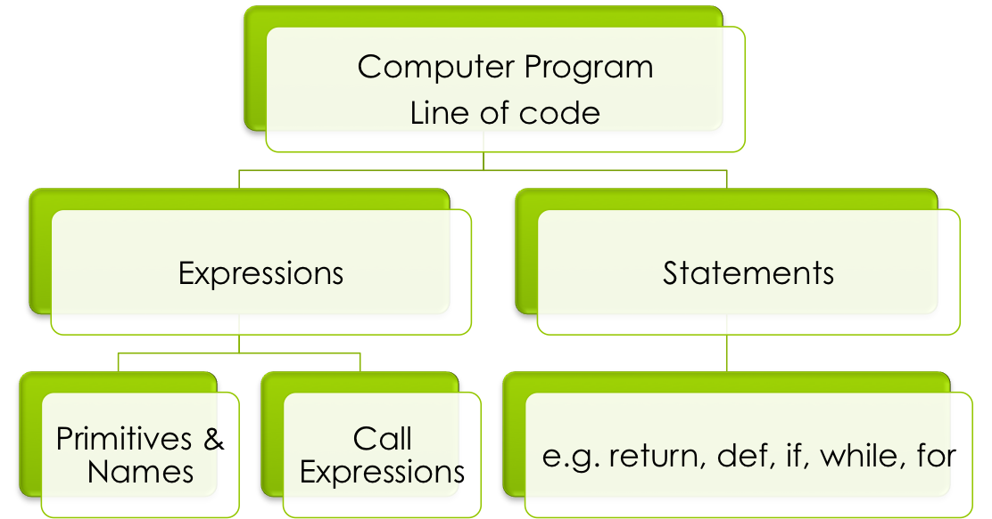
From the reading
Each type of code has its own procedure. E.g. names have a lookup procedure, assignment has rules

Slide 9
Expression
An expression describes a computation and evaluates to a value.
Computation – process that transforms input to output
  E.g. square(4) describes the process of squaring 4, whose eventual value should be 16.
  If everything works correctly, square(4) is a convenient abstraction for the code that actually does the squaring
Evaluate - convert expression to value (expression -> value)
  It’s like a function. There are rules you have to follow for each input.

Slide 10
Evaluation Rules
Primitive Expressions
  A number evaluates to a number
  A string evaluates to a string
  Primitive expressions evaluate to themselves!!
Names – Lookup Procedure
  Look in the current frame
  If not found, go look in the parent frames (the frame where the function is defined).
Call Expression
  Evaluate the operator and then the operands (from L to R)
  Apply the function (value of the operator) to the arguments (values of the operands)

Slide 11
Pop Quiz
Q: What does the value of the operator have to be?
A: A function
Q: What expression can the operator be?
A: An operator can be any expression whose value is a function. It can be a name, call expression, etc.

Slide 12
Statement
A statement is executed by the interpreter to achieve an effect.
Each statement has its own rules! You just have to memorize them
E.g. assignment, def, while, for, if
Suites are indented (e.g. this block of code belongs to this statement). All the lines belong to the function.
def print_lots():
print(1)
print(True)
print(“hello world”)

Slide 13
Pure vs Non-pure function
Whenever an expression is typed in directly to the interpreter, the interpreter prints it out. Why?
A: e.g. You can use Python like a calculator!
>>> 1 + 1 vs. >>> print(1 + 1)
2 2
The printing is different for some values!
>>> None vs. >>> print(None)
>>> None
The print function is non-pure because it has this side effect.

Slide 14
Recall:
Rule for Evaluating Call Exps
Evaluate the operator, then the operands (from L to R)
Apply the function (value of the operator) to the arguments (values of the operands)
  But what does apply mean?
  Create a new frame. This will be the function call’s own namespace (closure)
  Bind the formal parameters to the arguments
  Evaluate the body with the new frame as the current frame.

Slide 15
Recall:
Rule for Evaluating Call Exps
Evaluate
Apply the function (value of the operator) to the arguments (values of the operands)
  Create a new frame.
  Bind the formal parameters to the arguments
  Evaluate the body with the new frame as the current frame.
def square(x):
return x * x
square(4)
[Demo]

Slide 16
Recall:
Other Important Rules
Assignment
  Evaluate all of the expressions on the RHS of the assignment operator (the =), from left to right
  Bind all the names on the LHS to the resulting values in the current frame
  [ Tip ] Names can only bind to values, not other names
Lookup
  Look in the current frame
  If not found, go look in the parent frames (the frame where the function is defined).
You do not have to display built-in functions/func calls

Slide 17
Common Mistakes
Names have to be looked up, starting from the current frame. Do not make a guess based on intuition.
The return statement is important for a function:
  Immediately exits the body of the function and ‘returns’ control to the caller.
  The resulting value of a call expression will be the same as the resulting value next to the return statement
  If no return is present, Python will return None by default at end of function
Try >>> “hi” vs. >>> print(“hi”). What’s the difference?
Interpreter printing (vs. using print function) only happens in interactive mode. (i.e. when there’s >>>)
The value of a call to print() is always None.
Please trust the rules! Memorize them and be confident in them ☺

Slide 18
In Summary

Slide 19
Section Homework
This will be used to mark attendance for the next section for midterm recovery. Will help participation (but you can participate in other ways as well!).
Some other TAs give quizzes instead.
These should take at most 15 minutes, if you keep up with your reading.
Submit using any format (email/next week). If email, please use dickson.tsai+cs61ahw@berkeley.edu .
Graded on effort, but use your time wisely. 10 minutes of BS < 10 minutes of citing the textbook

Slide 20
Section Homework
We’re going to write a function that takes in two numbers and returns the sum of their square roots.
  You can break this problem down: how to define a function, how to add, how to take a square root. Google if you are stuck.
What will the function signature be?
Before you code, write a docstring for your function with doctests. Given 25 and 16, what do you expect the output of this function to be?
Write the code for this function.
Draw an environment diagram for the code to the right. Replace “your_fn” with the function above. Your name for the function must be better than “your_fn”
How can I improve your discussion experience?
  def your_fn…:
  …
  a, b, c = max, your_fn, \ your_fn(9, 9)
  b(a(c, your_fn(16, 25)),\ your_fn(c + 3, 6 * 6))

Slide 21
Additional Problems (not collected)
Credit: Andrew Huang
What would Python print?
>>> 3 + 4
>>> ‘3’ + 4
>>> 1 / 0
>>> def boom():
… return 1 / 0
…
>>> boom()

Slide 22
Additional Problems (not collected)
Credit: Andrew Huang
>>> def square(x):
… return x * x
…
>>> def so_slow(num):
… return num
… num / 0
…
>>> square(so_slow(5)) #What’s the output? Why?

Slide 23
Additional Problems (not collected)
Credit: Andrew Huang
>>> def foo(x):
… print(x)
… return x + 4
…
>>> def bar(x):
… x
… return x + 4
…
What is the difference between foo and bar?

Slide 24
Additional Problems (not collected)
Credit: Sumukh Sridhara
What gets printed?
>>> def hi(x)
… print(‘x’)
… return 42
… print(‘Oreos’)
…
>>> hi(0)

