Slide 1
Welcome to CS61A Disc. 29/47 :D
Previous stop: None >>>
Today: Working effectively in CS >>>
Next stop: Statements/Expressions/Functions
Dickson Tsai
dickson.tsai+cs61a@berkeley.edu
OH: Tu, Th 4-5pm 411 Soda

Slide 2
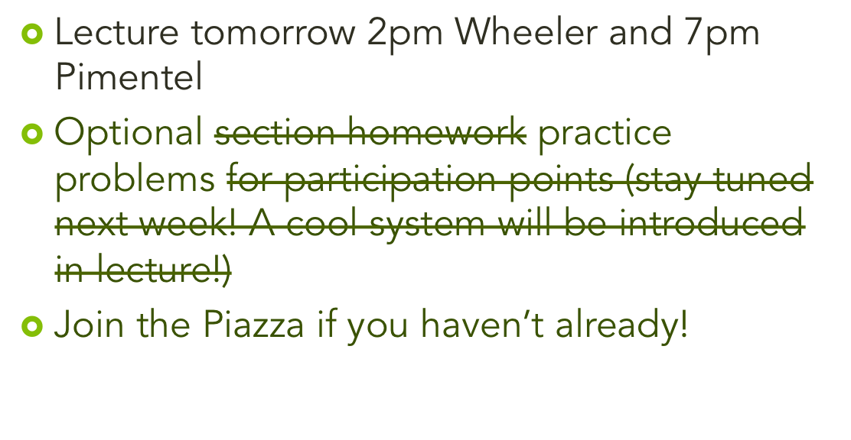
Anuncios

Slide 3
Meet and Greet
For how many weeks did you travel?
How many mass events did you attend? (e.g. sporting events/concerts/conferences)?
How many books/movies did you complete?
Sum that total up and write it down.
Feel free to share your experiences with your neighbors!

Slide 4
It’s a Race!
Right half:
  Drift to the side of the line you think you belong. Then fine tune.
Left half:
  Form groups of 2. Sort yourselves in those small groups. Then, keep combining 2 sorted groups into one big group.
Both halves:
  Tell me where the max begins.

Slide 5
My Summer
Did not travel ☹ Taught CS61A
Went to ForwardJS: a Javascript conference
Books I read over summer:
  What Every Body is Saying (body language)
  Everything is Obvious *Once you know the answer
  The First 20 Hours – How to learn anything fast
  The Art of Learning

Slide 6
What did I just do???
Sorting is a computation – a “deliberate process” (set of instructions) that “transforms” inputs to outputs (processes data). [Some parts from Wikipedia Computation]
In CS, we will study techniques to do computation more powerfully.
In CS61A, we will see how abstraction makes complex computation more manageable.
  E.g. Dining hall food’s just there. Don’t worry about where it comes from.
Notes:
Sorting is a computation: set of instructions to process data. In CS, you'll analyze how computation works, figure out what are the fastest ways to compute, most maintainable way to compute, and so forth. As you can see, I gave two different instructions to similar datasets. Which one works better? We could experiment and also estimate it mathematically. (Orders of growth)

Slide 7



Basic Computer Program
Instructions
Interpreter/
Memory
Output Data
Input Data

Slide 8
Basic Computer Program
“Sort yourselves in small groups, then in larger groups!”
Students lined
up
Student
Brains
Student
Numbers

Slide 9
Lost on the Moon
Put ALL electronic devices/distractions away. Humans are bad at multitasking.
Take 10 minutes to complete this activity alone.
Now take a 2 minute break.
Form groups of 3. Talk over your answers. The more debate the better.
Notes:
You may actually save time by dedicating yourself to doing one thing at a time instead of mashing all your tasks together.

Slide 10
Lost on the Moon (Solutions)
Evaluate your thought process. Don’t focus so much on the solutions.
  If your answer is right, see what allowed you to get it right.
  If you answer is wrong, what parts of your approach should you change for next time?

Slide 11
This worksheet seemed random???
Show of hands: how many people’s group score was better than the individual score?
Personal anecdote: chess over the summer.
Groups are powerful!
CS application: It’s better to have clusters of computers rather than one super-expensive computer.

Slide 12
Tools
Composing Programs – your online textbook
Ipython Notebook – Take notes w/ Python!
PythonTutor – Environment diagrams
Google + StackOverflow – google all your problems. Stackoverflow usually has good answers to your question
duckie.me
pydoc3 – on the command line

Slide 13
Mastering CS
There are millions of people learning CS right now! How do you make yourself stand out?
My observations:
  All start with the same resources: documentation/what’s online.
  What matters: how you combine them to make powerful stuff.
Actionables
  You must know the basics inside-out. Don’t try anything challenging until you have an intuition for the basics. Practice!
  Then, practice putting pieces together! Be creative! Solving hard problems is a nice side effect.
    E.g. functions that return functions???? List + trees, func + dicts
    Don’t feel bad about mistakes or bugs, especially in discussion. They will happen, and you’ll be stronger for them. ☺
    (Hint: Google your bugs.)

Slide 14
Example: printing
Classic CS Example: Print “hello world to the terminal
Python
  print(“Hello, world!”)
Questions?
  Can you print numbers?
    print(2)
  Can you print multiple things?
    print(“hello”, “world”)
  Can you print something with dickson after?
    def print_with_dickson(x): Look! Function + print!
    print(x, “dickson”)

Slide 15
Final Remarks
Come prepared to discussion! (i.e. reading done, have questions/insights to share). Don’t fall behind!
If you’re too tired, might as well take a nap in your dorm, right?
I’m not omnipotent. You have to put in the work to learn. I’m here to share my experience and my insights.
Everything has a purpose! Try to figure the purpose out with simple examples!
Let’s have a fun semester!

