Slide 1
Welcome to CS61A Lab 1 Sect. 29/47 :D
Previous: UNIX >>>
Today: Your Own Machine >>>
Next stop: Control and Higher Order Functions
Dickson Tsai
dickson.tsai@berkeley.edu
OH: Tu, Th 4-5pm 411 Soda

Slide 2
Anuncios
Divide yourselves based on:
  Windows user
  Mac/Linux user
  Already set up Python and did the lab
Post-lab activities – Work together to build something cool!!!
  Work with the Shakespeare data set
  Write a program that gives you the current headlines
  Write something that you see yourself using tonight

Slide 3
Optional Section Homework
This will be used to mark attendance for the next section for midterm recovery. Will help participation (but you can participate in other ways as well!)
These should take at most 15 minutes, if you keep up with your reading.
Submit with voice recording, email, paper, slideshow, however you want.
Graded on effort, but use your time wisely. 10 minutes of BS < 10 minutes of citing the textbook
Feel free to make your own questions!

Slide 4
Optional Section Homework
How do names/assignment provide abstraction?
How does Python evaluate a call expression?
How does Python evaluate primitive expressions?
Write a function square that takes in a number and returns the square of that number.
Now write call expressions that call the square function. Try nesting once you get the basics!
Note that the operator can be expressed using a call expression. How can this be useful?
  f(2)(3, 4)

Slide 5
Directions
Get an account form from me
Log into the school computer with your account
Open the terminal. There is a funny looking round thing on the top left. Click that, then search/open terminal
Run ssh update.cs.berkeley.edu to change your password
Access the labs for today at cs61a.org
Work on lab 0 on the school computers
Now, you can use your personal machines for lab 1
  Connect remotely: ssh cs61a-???@cory.eecs.berkeley.edu
Remember to submit lab01.py from your class account

Slide 6

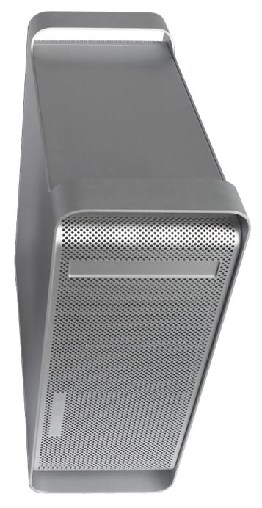
Directions
ssh cs61a-??@cory.eecs.berkeley.edu
connect to remote
terminal
submit lab01
Actually give your files to us!
Make sure you are in the right folder
Do not include .py ending here
Do not submit from ~ folder
scp ~/path/to/file.py
cs61a-??@cory.eecs.berkeley.edu:~/dest/folder
Copy file to remote server
cory[2] ~ #
Your prompt should now say that you are in Berkeley’s server! UNIX is used here!!!

Slide 7
To get to my website
dicksontsai.com/cs61a
OR
  Go to cs61a.org
  Click the “Staff” link
  Click my name
  Go to Discussion for discussion materials
You will find my slides to discussion/lab. They may be different, because I add more content along the day.

