Slide 1
Discussion 0 Working Effectively in CS
CS61A Sections 13/26
Dickson Tsai
dickson.tsai+cs61a@berkeley.edu
dicksontsai.com/cs61a
OH: M 4-5pm, Th 2-4pm Garbarini Lounge
Slide 1

Slide 2
Objectives
Understand the importance of groupwork
Icebreaker that doesn’t take too long yet effective and physically active
Understanding statements vs. expressions
Understand the power of names
Understand what issues names can raise
Final remarks
Slide 2

Slide 3
Anuncios
Please put all electronic devices away. You will not need your laptop for discussion ever.
Please ☺
Join the Piazza
Look out for HW1 this weekend
Midterm is in 3 weeks so…
… Let’s get rolling!
Slide 3

Slide 4
Lost on the mooooooo…..on
Take 10 minutes to complete this answer alone
Now, without changing your answers in the first column, get into a group of 3 and come up with a new list.
The more debate, the better
Get to know each other
Drumroll, please…
Slide 4

Slide 5
Lost on the moon [Solutions]
Evaluate your thought process. Apart from copying down the answers, don’t fixate too much on the results.
If your answer is right, what method led you to the right answer?
If your answer is wrong, how should you change your approach for next time?
Slide 5

Slide 6
This worksheet seemed random???
Show of hands: how many people’s group score was better than their individual score?
Personal anecdote: chess with TA’s over summer
Groups are powerful!
CS application: It’s better to have clusters of computers rather than one super-expensive computer.
Slide 6

Slide 7
Brief discussion
All Berkeley students are distinguished students. What made you successful?
[Discuss]: Share your tips for success. Personal anecdotes welcome!
Result: Self-confidence and motivation from peers are important
Lab is designed to foster this positive feeling
Take the time to encourage your friends as well!
Slide 7

Slide 8
A little tangent… Mastering CS
There are millions of people learning CS right now.
Q: How do you stand out?
A:
Everyone has access to same documentation
What matters is how well you can combine pieces together!
My high school Spanish anecdote
Slide 8

Slide 9
A little tangent… Mastering CS
Therefore:
Everything has a purpose. Try to figure the purpose out with simple examples! Master the basics!
Then, play with the pieces, then practice putting them together.
With proper reinforcement, you’ll build a strong intuition!
Slide 9

Slide 10
Breaktime!
Get in a circle! We’ll play “Have you ever?”
At the end of each turn:
If you have a new neighbor, introduce yourselves
If you have an old neighbor, learn something now about them
Slide 10

Slide 11
Elements of Programming Languages
Primitive expressions and statements
Means of combination
Means of abstraction
Examples
Numbers, booleans, strings, lists, …
Infix (+, *), call expression (a(b, c))
Assignment (a = 5), functions (def love(x)), objects
Slide 11

Slide 12
Expressions vs. Statements
An expression describes a computation and evaluates to a value.
Expression ----gets evaluated to---> a value
A statement makes a change, gets executed
Slide 12

Slide 13
Expressions are expressive
buy_groceries([‘eggs’, ‘milk’, ‘juice’, ‘strawberries’])
[Discuss]: What collection of procedures might this computation entail?
Write list on phone
Drive to Safeway -> (open car door, ignite engine, …)
For each item in the list, locate it and put it in cart
…
Slide 13

Slide 14
Abstraction
The property that expressions exploit is abstraction, our main tool for dealing with complexity.
Example: Dining hall food is just there. I don’t usually think about where it comes from. It’s a huge process.
The interface is the dining hall serving area
[Discuss]: Where has abstraction appeared in your field of study?
Slide 14

Slide 15
Abstraction
Q: What does abstraction do for us?
Allow us to manipulate massive amounts of data under simpler names
Categorize similar things together, more organized
Allow us to have one name stand for a collection of instructions, so we can code more quickly (instructions are data too!)
The list goes on…
Slide 15

Slide 16
Expressions vs. Statements
Computer Program
Line of code
Expressions
Primitives & Names
Call Expressions
Statements
e.g. return, def, if, while, for
Each type of code has its own procedure. E.g. names have a lookup procedure, assignment has rules
Slide 16

Slide 17
Example Evaluation Rule
To evaluate a call expression, Python will do the following:
Evaluate the operator and operand subexpressions
Apply the function that is the value of the operator subexpression to the arguments that are the values of the operand subexpressions
Slide 17

Slide 18
Practice evaluating call expressions
add(1, 2)
good_number = mul(add(1, 2), 3)
mul(2, good_number)
add(add(mul(5, 2), 5), mul(sub(1000, 900), 2, 10))
Practice walking through the rules step-by-step instead of making assumptions
Errata: It turns out that mul can only take two arguments
Slide 18

Slide 19
Practice evaluating call expressions
add(1, 2)
good_number = mul(add(1, 2), 3)
mul(2, good_number)
add(add(mul(5, 2), 5), mul(sub(1000, 900), 20))
Here is the corrected version
Slide 19

Slide 20
A note on infix operators
Disclaimer: You are not responsible for how infix operators work exactly in Python! Sorry for bringing this up in section…
Infix operators are governed by order of operations.
a + b * c False or True and 4
Just trust the order of operations, but remember to evaluate the expressions on both sides before applying them.
If you are curious, you can write a function like:
def num(x):
print(x)
return x
And then try it out like num(1) + num(2) * num(3)
Slide 20

Slide 21
Basic Computer Program
Instructions
Interpreter/
Memory
Output Data
Input Data
Slide 21

Slide 22
Basic Computer Program
Instructions
Interpreter/
Memory
Output Data
Input Data
Slide 22

Slide 23
Names
[Discuss]: What makes a calculator useful?
The interpreter keeps track of things by associating a name with a value
a = 5
a = a * (a + 1)
The difference comes when a does not represent a simple value:
a = some(very(expensive, fancy, computation))
Slide 23

Slide 24
Usefulness of names
One advantage: you shouldn’t have to recompute something if you’ve seen it before
But are there problems associated with using names?
Without names | With names
tau = 2 * 3.14159 | pi = 3.14159
circ = 2 * 3.14158 * 5 | radius = 5
 | circ = 2 * pi * radius
area = 3.14159 * 5 * 5 | area = pi * radius ** 2
Slide 24

Slide 25
Too many names!
What if two different functions want to use the same name!
Interpreter takes care of this by using frames. Each function has its own separate frame/scope to play with.
[Board demo]
You will learn more about environments and control flow next time.
Slide 25

Slide 26
Final Remarks
I’m not all-knowing, and my explanations certainly won’t write your exam answers for you.
You have to put in the effort to learn!
Everything has a purpose. Try to figure the purpose out with simple examples! Master the basics!
Then, play with the pieces, then practice putting them together.
With proper reinforcement, you’ll build a strong intuition!
Slide 26

Slide 27
Simple Examples
Master the basics
Slide 27

Slide 28
Simple Examples
Master the basics
Slide 28

Slide 29
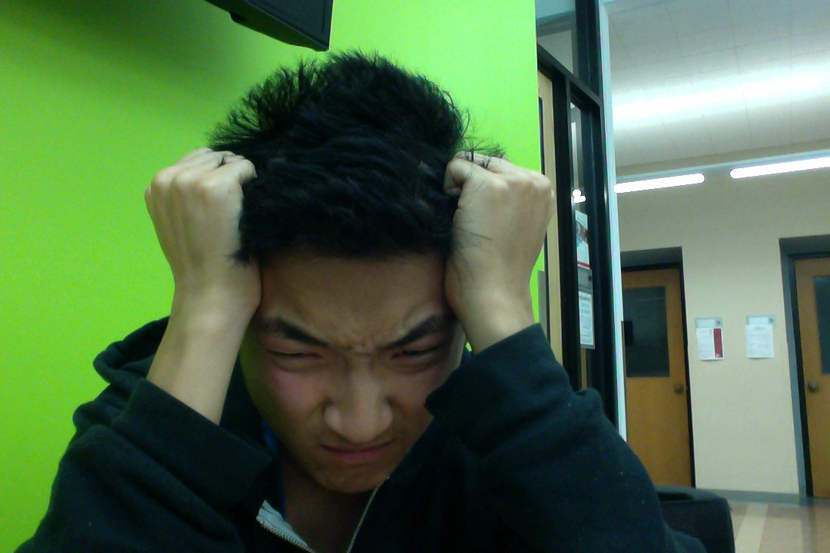
When you’re stuck…
Slide 29

Slide 30
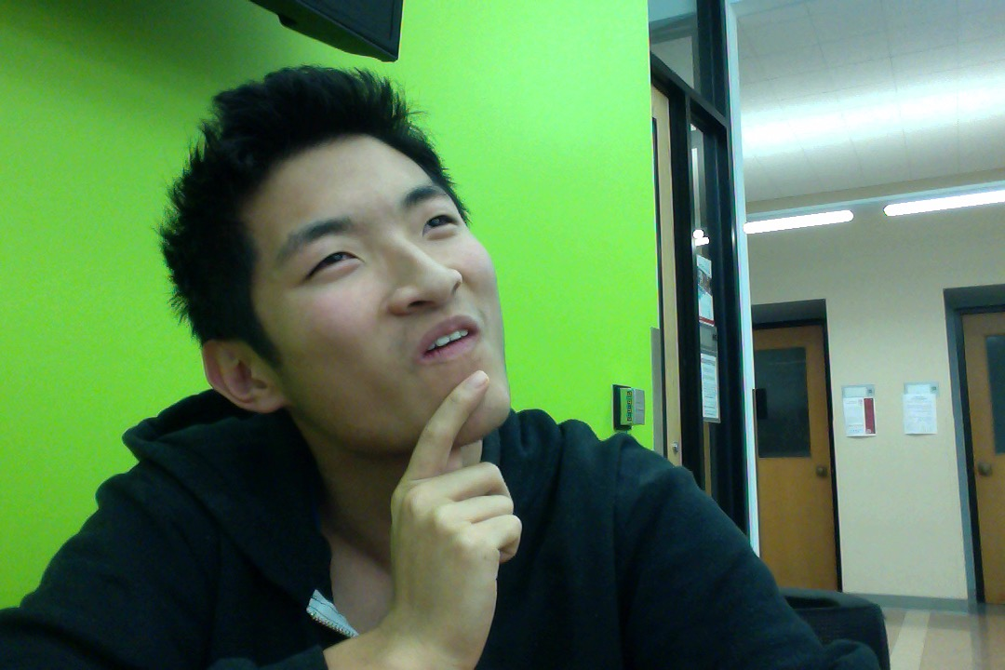
Keep these in mind!
Simple Examples
Master the basics
… and use Google + StackOverflow
Slide 30

Slide 31
FIN
Let’s have a fun semester!
Slide 31

