Slide 1
IBM Capstone Project
Exploring the possibility of start Online Food Delivery or Virtual Restaurant at Hong Kong
Prepared by – Leung Chi Duct
23-Dec-2019

Slide 2
1. Introduction and Background
Hong Kong is one of the most populous metropolitan area in the world, and a lot of top tier multinational companies are choice Hong Kong as APAC Headquarter. As result of average office rents continue to rise in core business areas (e.g. Central district), those companies no long to consider to start their business at core business areas and relocated their office to areas with lower rents.
We will concentrate on one most condensed business district; and we will use data science technology to generate the best location of each areas for stockholders.

Slide 3
2. Data Preparation
Based on the definition of business problem, the following factors will help to address problem:
The number of existing restaurants in the neighborhood
The distance of restaurant in the neightborhood
Distance of neighborhood from selected business district
We will use regularly spaced circular grids of selected business district at Hong Kong to define neighborhoods. Getting coordinates of selected business district by Geopy Client
List out the number of restaurants in ervery neighborhood by Foursquare API
Collect the Hong Kong district name, pupulation, area and density from Wikipedia Districts of Hong Kong

Slide 4
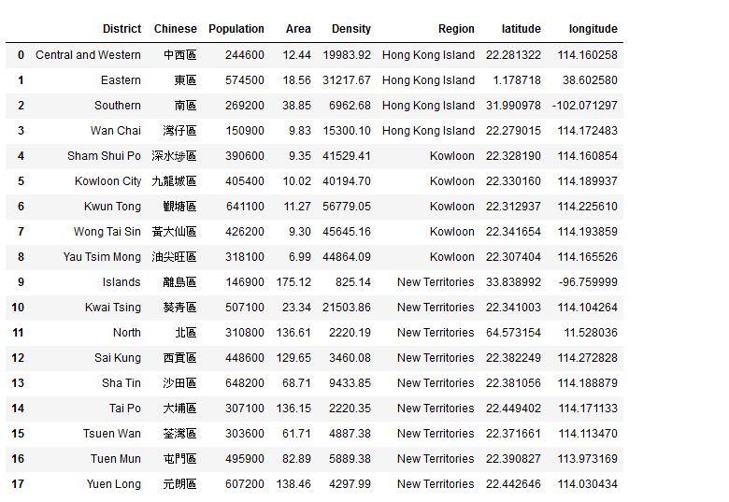
2.1. Get coordinates of HK Districts by Ceopy Client and Web Scraping

Slide 5
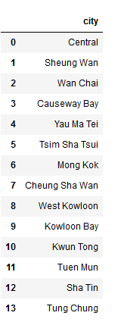
2.2. Start focus on Central Business Districts (CBD) at Hong Kong and it can help to shortlisted target areas. Here is favorites cities lists from stockholder

Slide 6
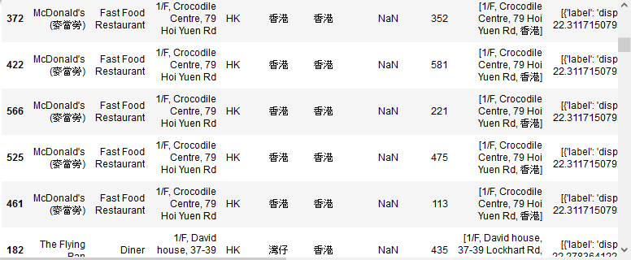
2.3. Start correct food & restaurant information by Foursquire API
After data cleaning process, finally we got 307 rows
Here is sample information:

Slide 7
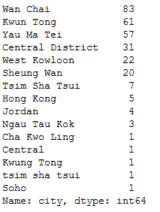
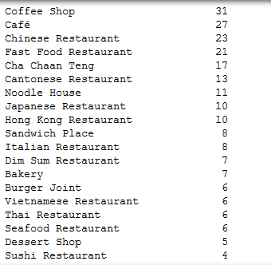
2.4. Sample data for restaurant/city and categories of restaurant in each city

Slide 8
3. Methodology
As the data collected as above, we can make use of contextualize data/cluster to help us to resolve the problem.
Combined the Foursquare venues data of different category of Hong Kong district, a matrix which captured restaurants information inside each district/cities. The weighted matrix able to help to shortlist 5 target locations with venues information to generate the result that help to select best location to start new virtual restaurant business.

Slide 9
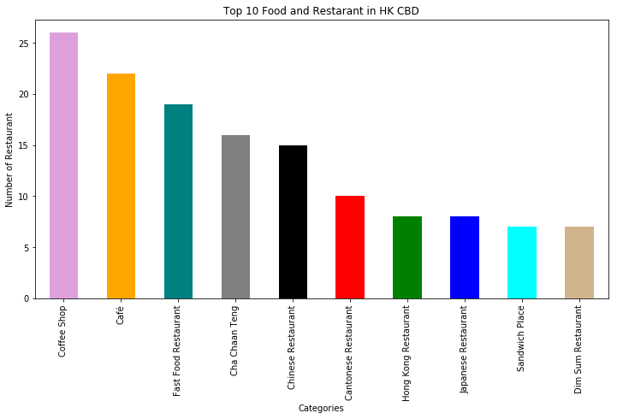
3.1. Top 10 Food and Restaurant in selected CBD

Slide 10
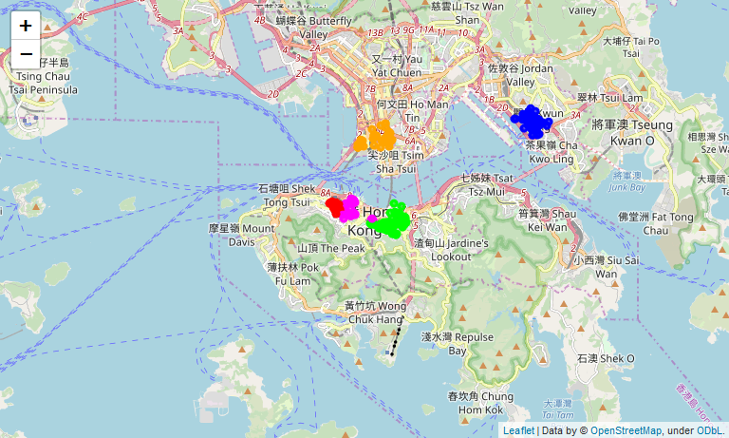
3.2. Visualize the Data as Leaflet Map

Slide 11
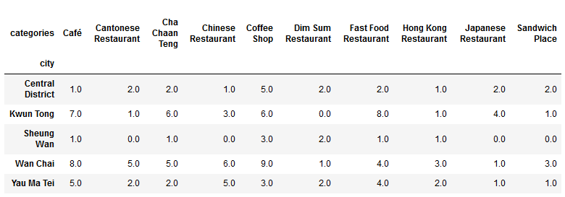
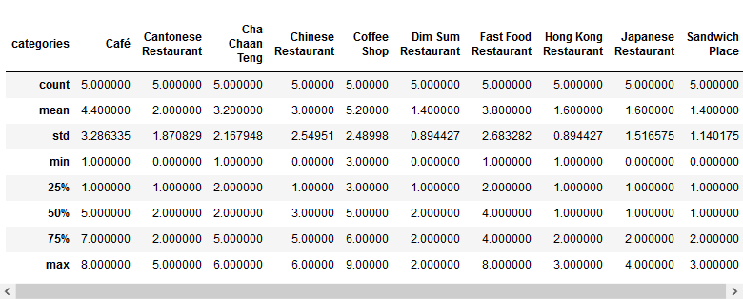
3.3. Data Analysis result

Slide 12
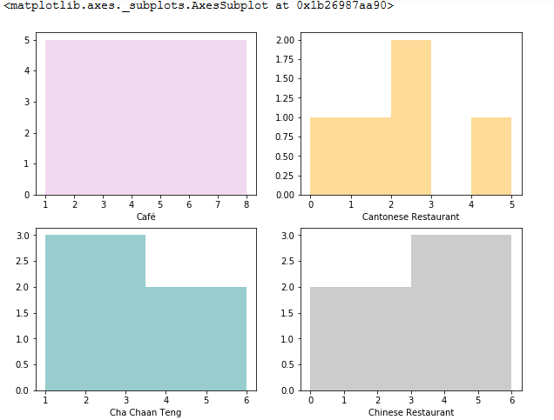
3.4. Virtualize the analysis result

Slide 13
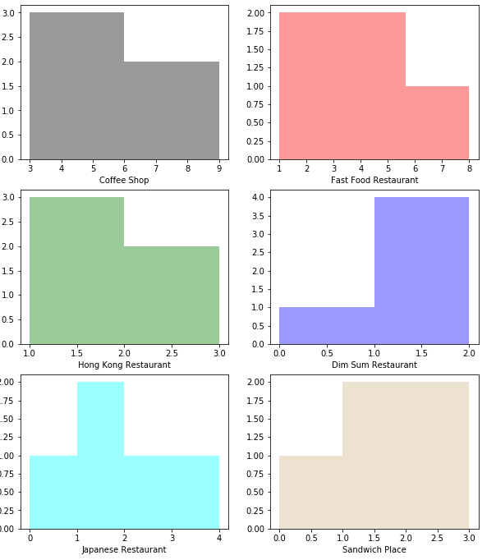
3.4. Virtualize the analysis result (con’t)

Slide 14
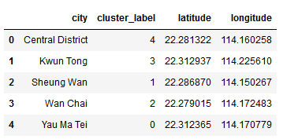
4. Clustering the Central Business District
Afterall, we are ready to cluster 5 selected Central Business District of Hong Kong. And we based on the venue categories and use K-Means clustering.

Slide 15
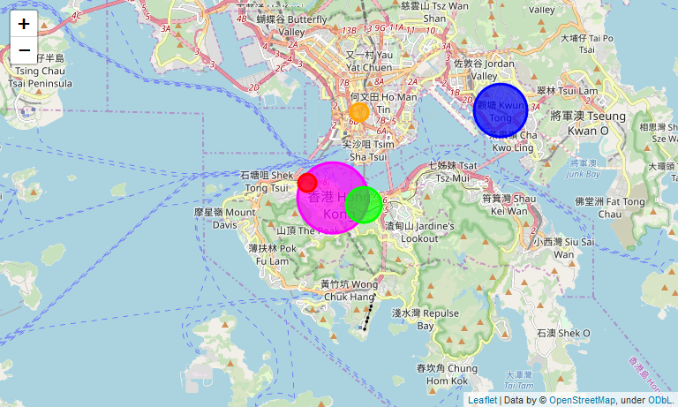
4.1. Visualize the Data as Leaflet Map

Slide 16
5. Results and Discussion
With stockholder interested 5 cities and Food & Restaurants list which nearby the Hong Kong central business district, we successfully clustered it into 4 clusters based on the most common venues. As the above leaflet map showing, we can finalize our recommendation to stakeholder that Central District and Kwun Tong are the areas they can start their Virtual Restaurants/Food Delivery business. The followings are the finding in this analysis:
The data corrected from Foursquare API are outdated and untrustworthy, and which spend too many time to perform clean data
It was very difficult to find suitable data source for this analysis

Slide 17
6. Conclusion
Finally in conclusion state, I am happy to said that the stockholder problem is resolved in this Data Science simulation project. And we experienced the real-live project of data science, which highly enhanced my python programming skill like web scraping and experienced on call Foursquare API, geopy.geocoder for geting location information and generate leaflet map to help on data analysis process.
And of course, in real life, final decision will be made by stakeholders which based on more precise data source, and consideration additional factors by professional agents.

Slide 18
--- End of Slide ---
Thank you

