Slide 1
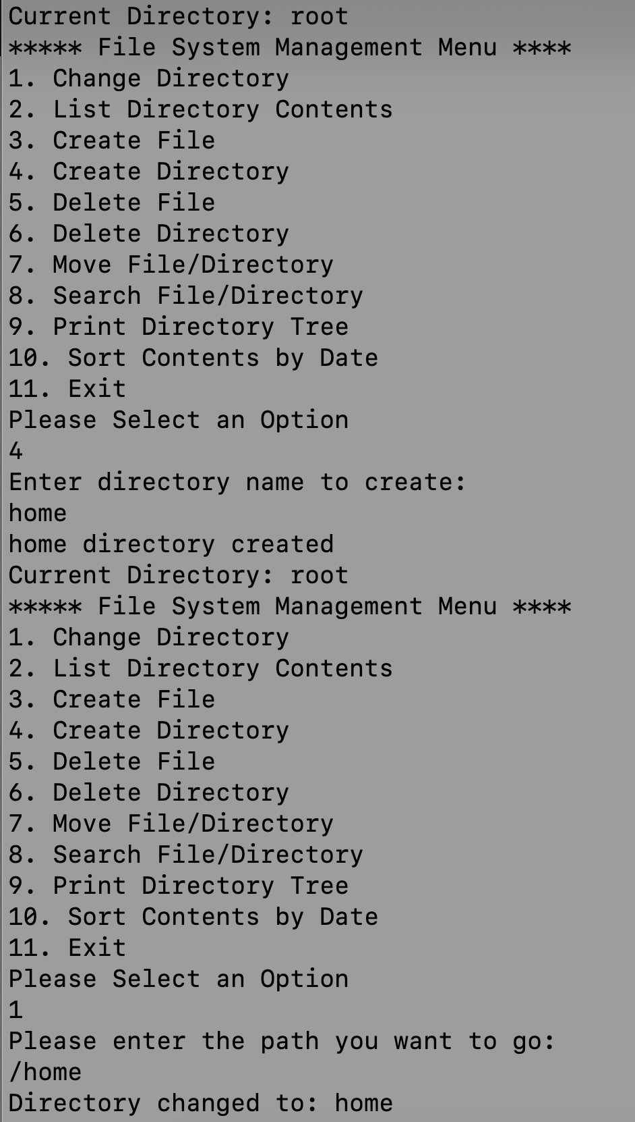
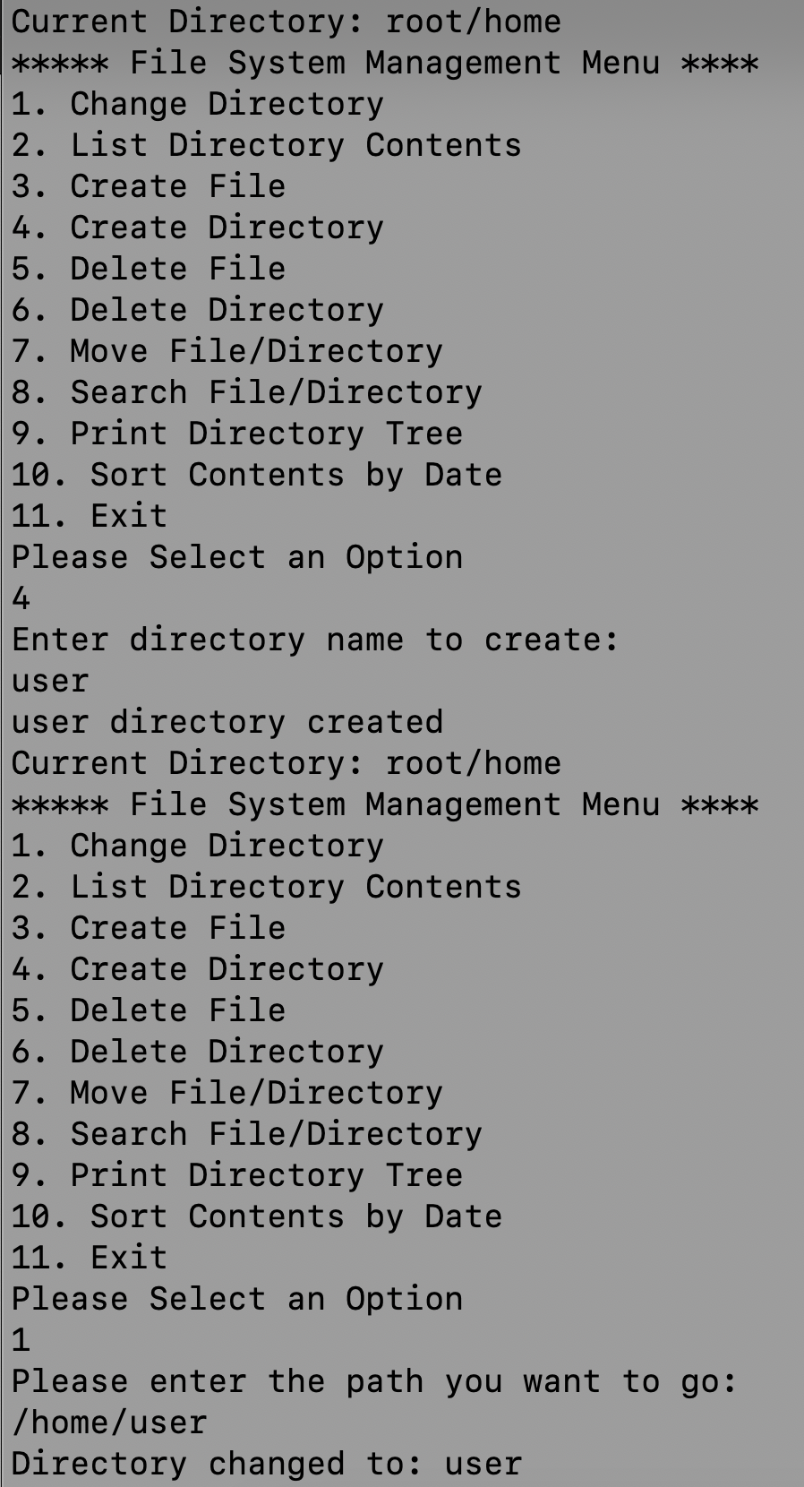
Creating home and user directories and going into that directories

Slide 2
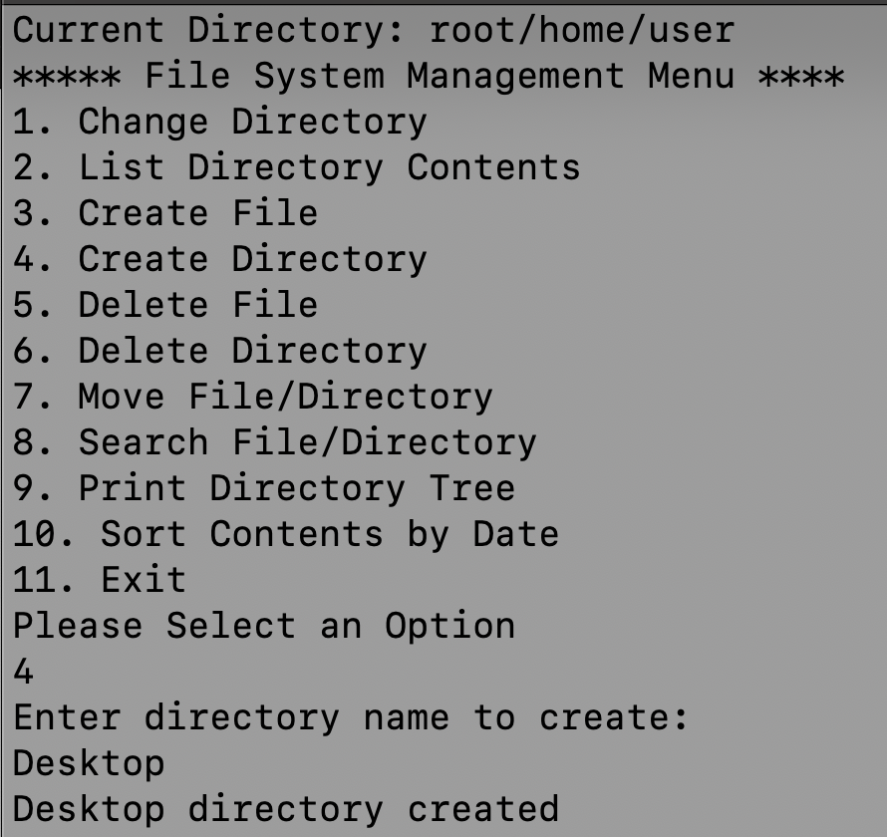
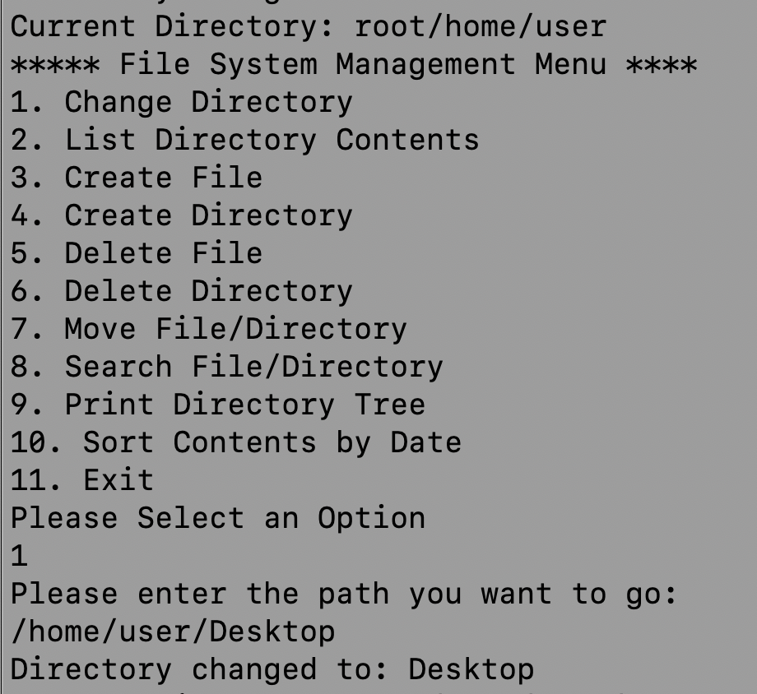
Creating Desktop directory then going into Desktop directory

Slide 3
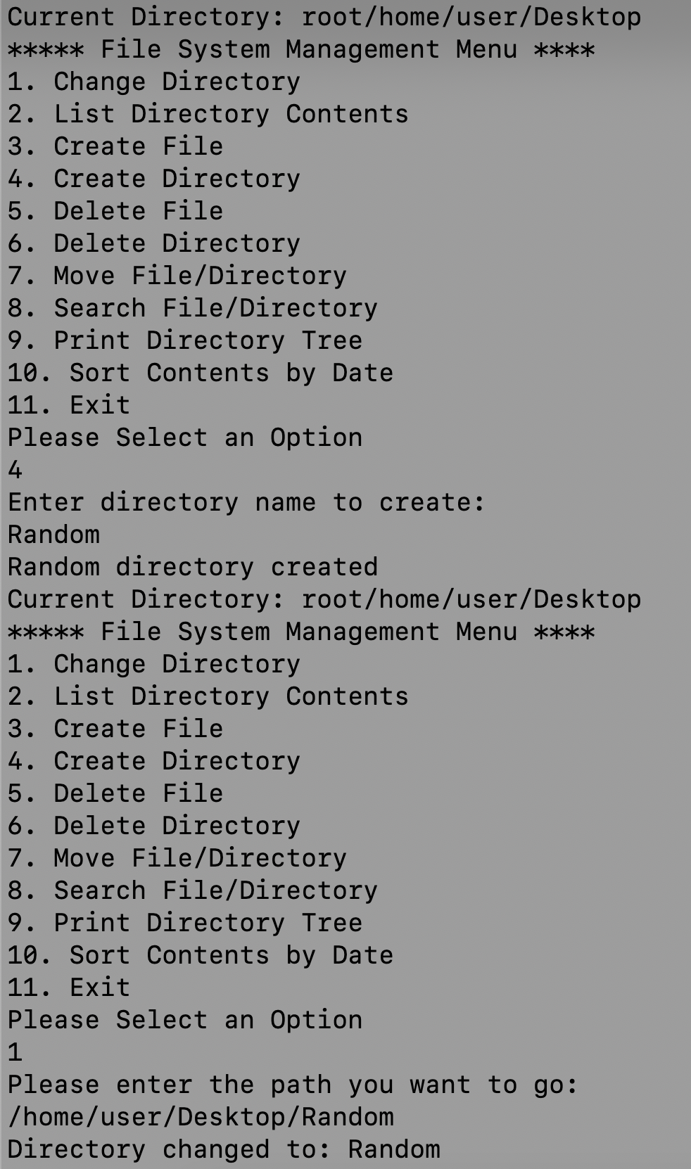
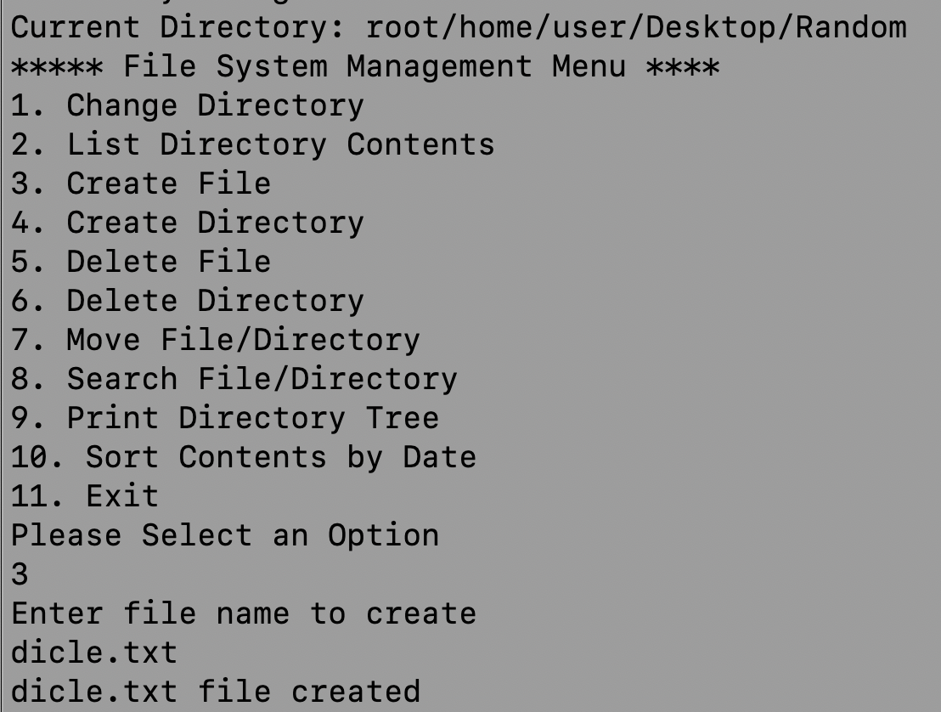
Creating a Random directory then going into that directory. Creating a dicle.txt file

Slide 4
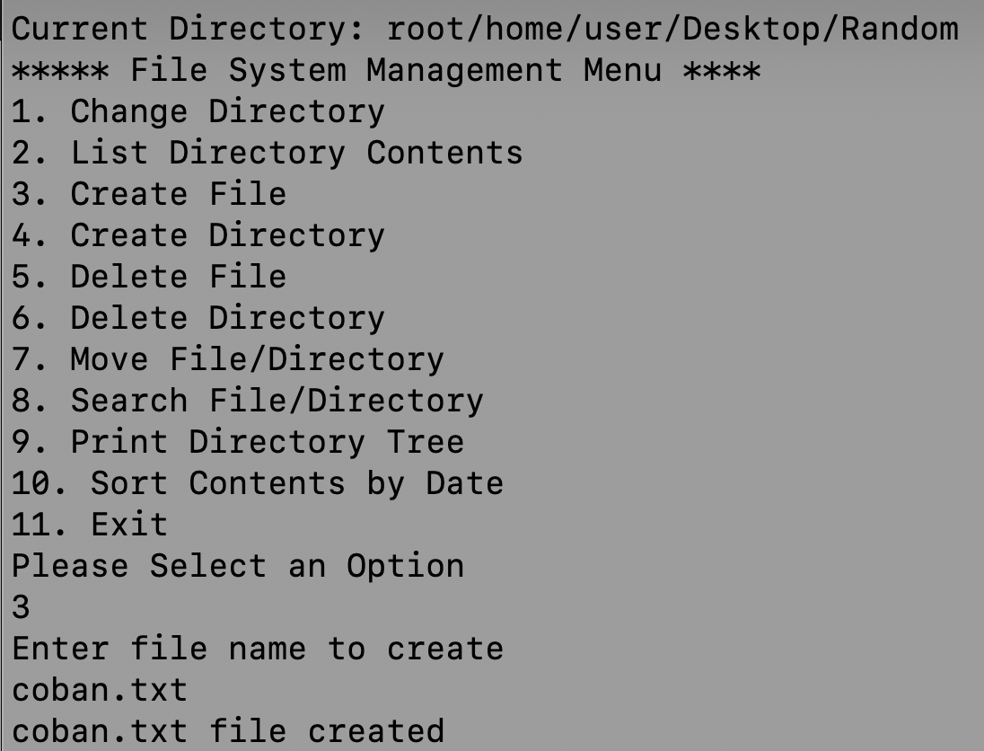
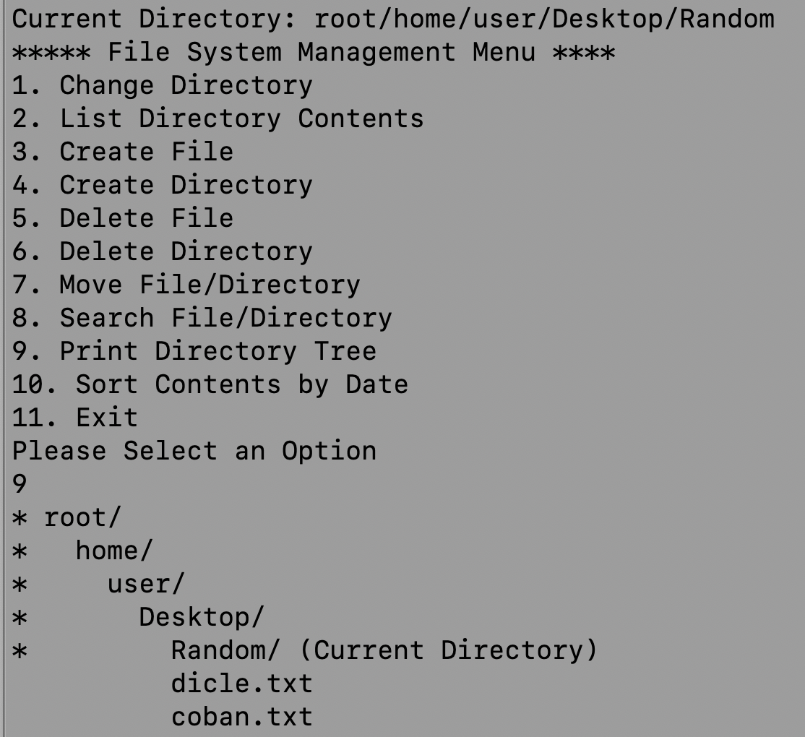
Creating a coban.txt file into the Random directory.
Printing the tree diagram

Slide 5
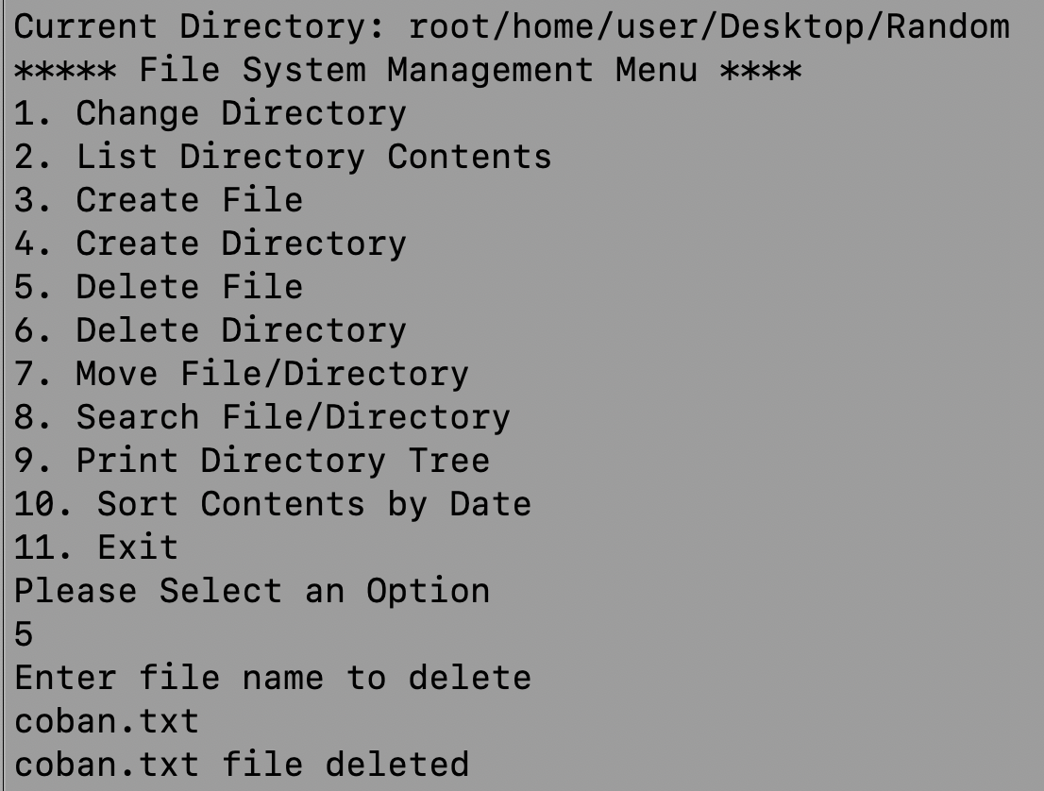
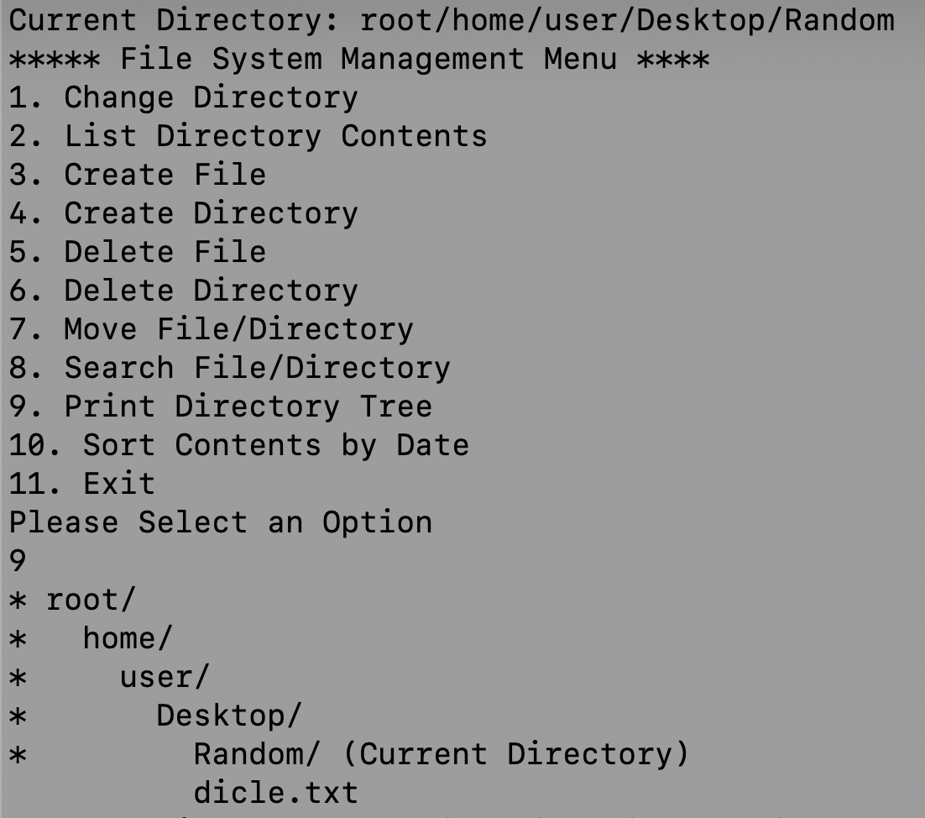
Deleting the coban.txt file. Showing the coban.txt file deleted from the Random directory

Slide 6
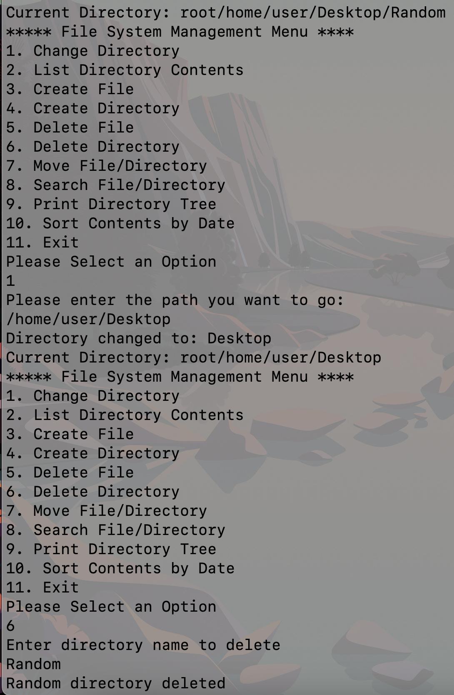
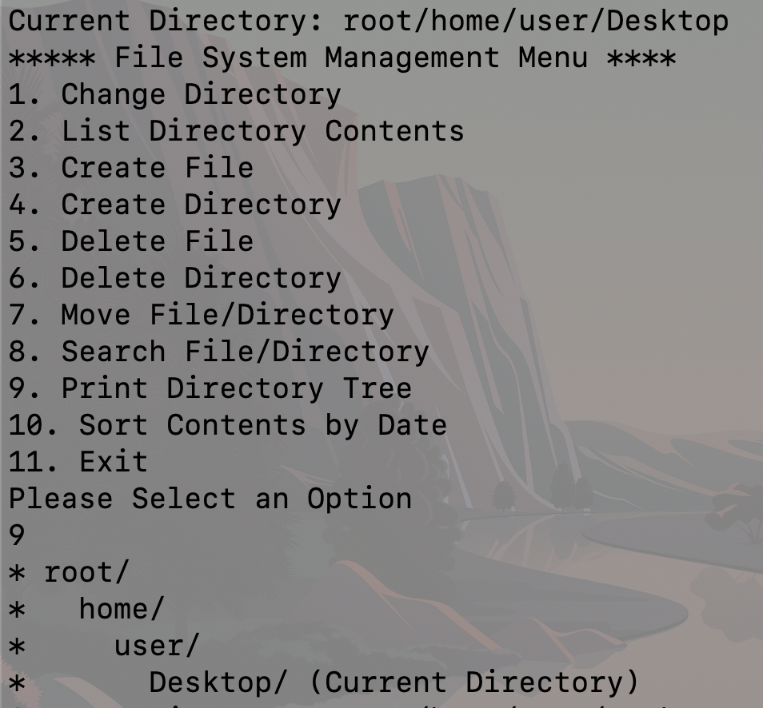
Deleting the Random directory (also dicle.txt file using recursive deleteDirectory function. Showing the Random directory deleted.

Slide 7
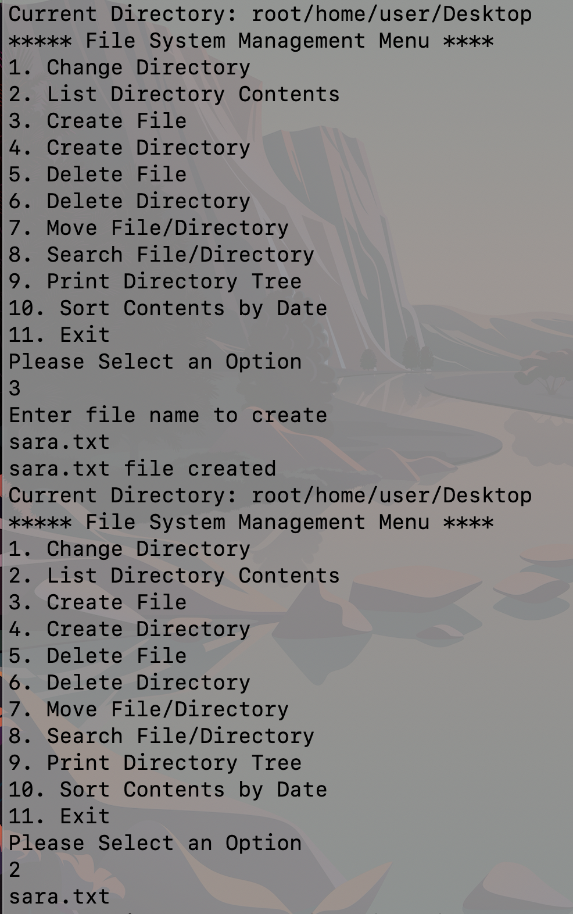
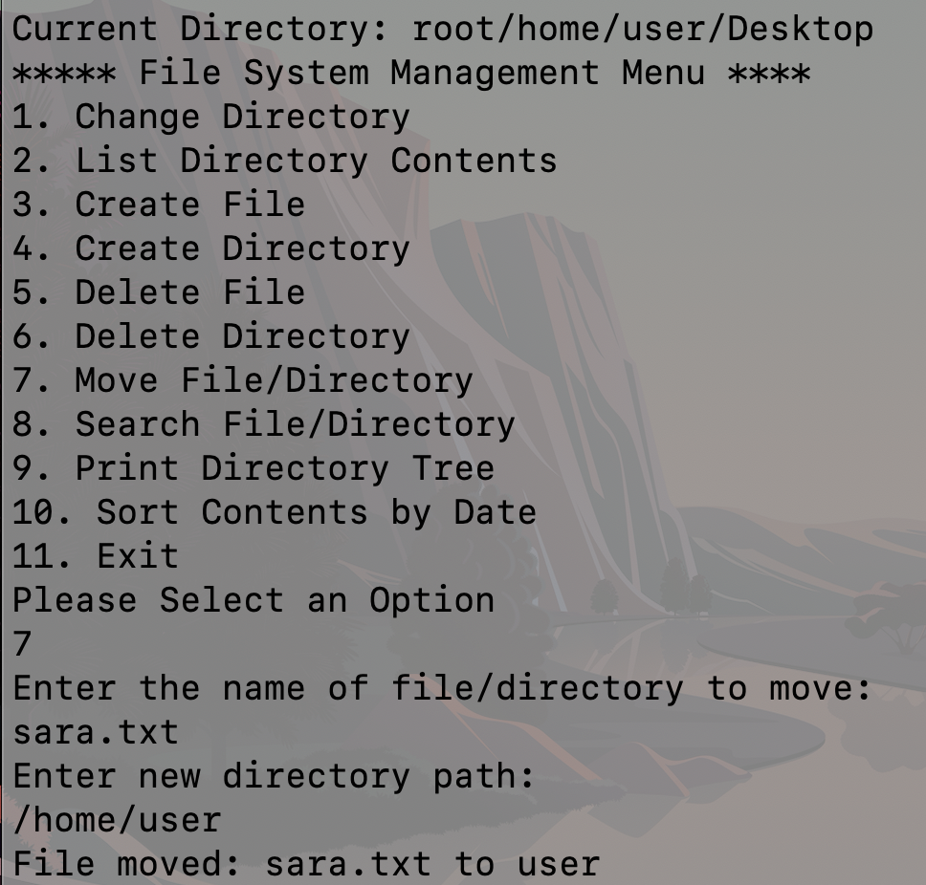
Creating sara.txt file then listing the files/directories inside of current directory.
Moving the sara.txt file from Desktop directory to user directory.

Slide 8
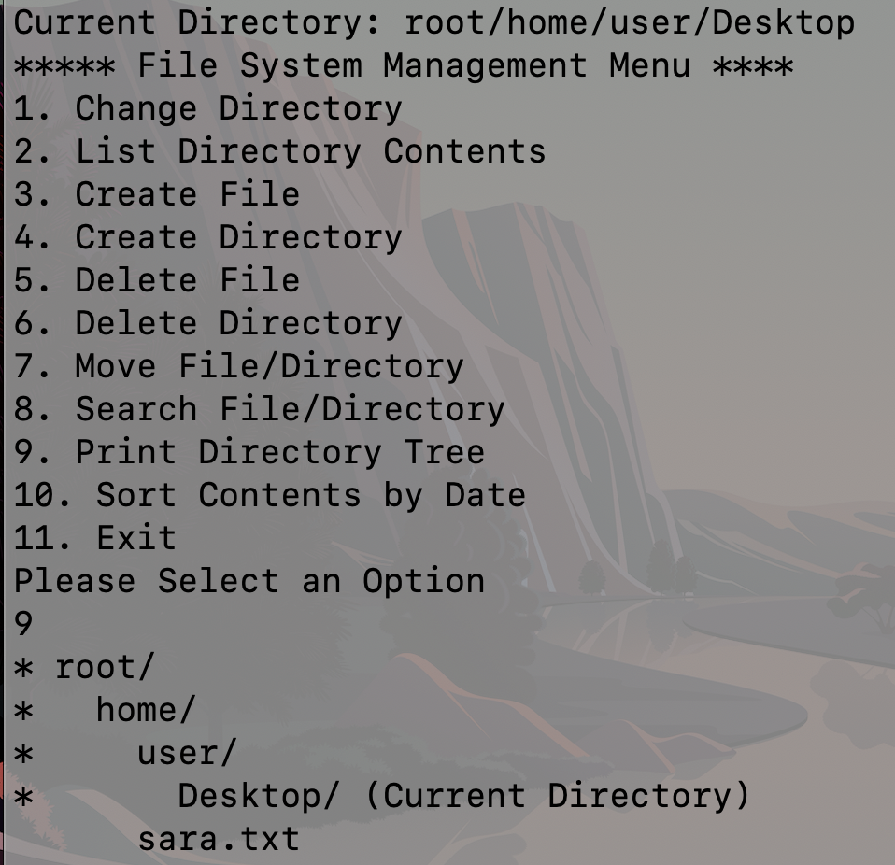
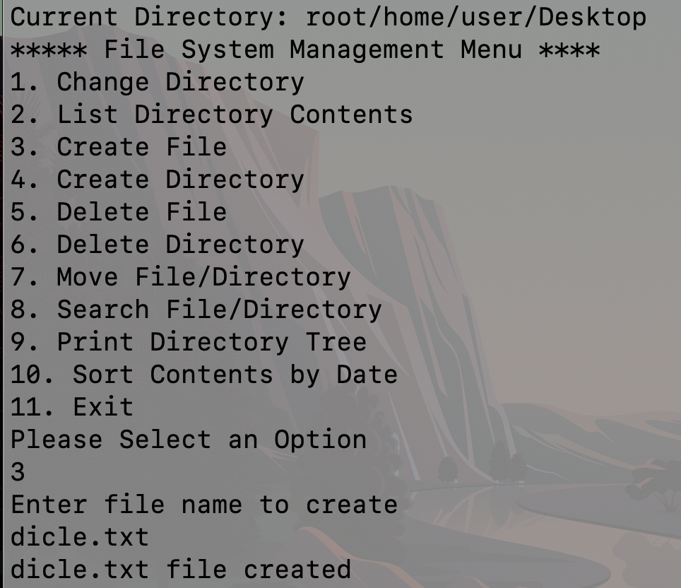
Creating a dicle.txt file again
Showing while using printing the tree diagram that sara.txt file inside of user directory

Slide 9
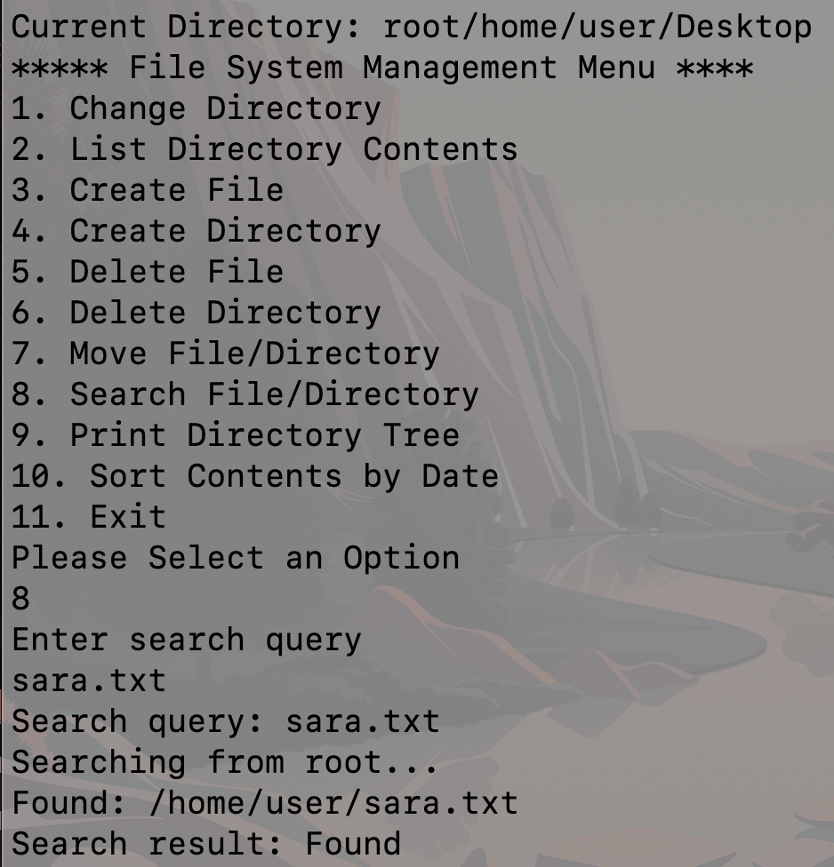
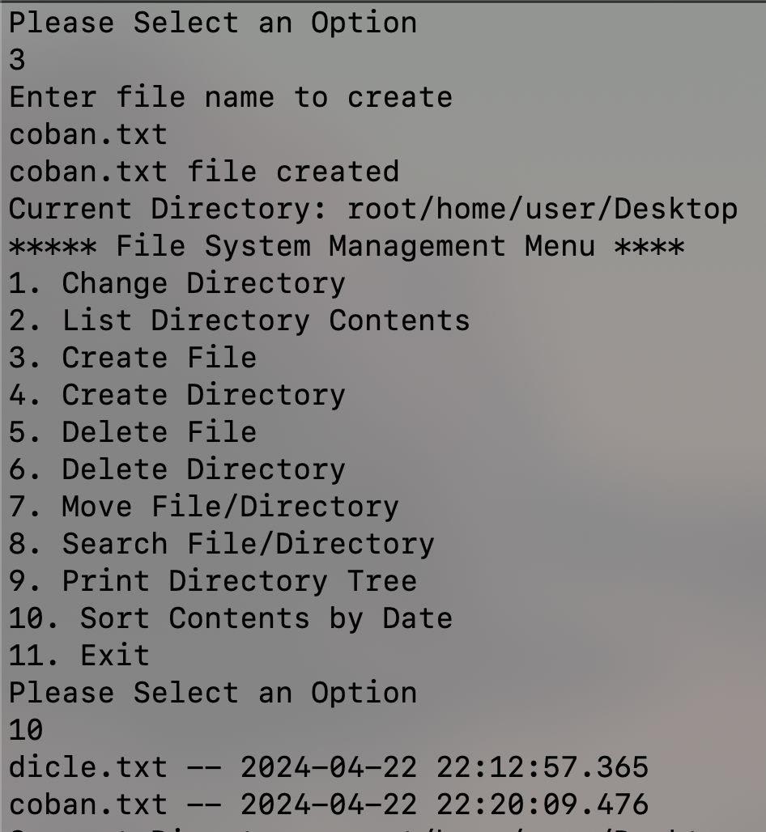
Search sara.txt file and it exists into the /home/user directory
Sorting the files according to their created dates

Slide 10
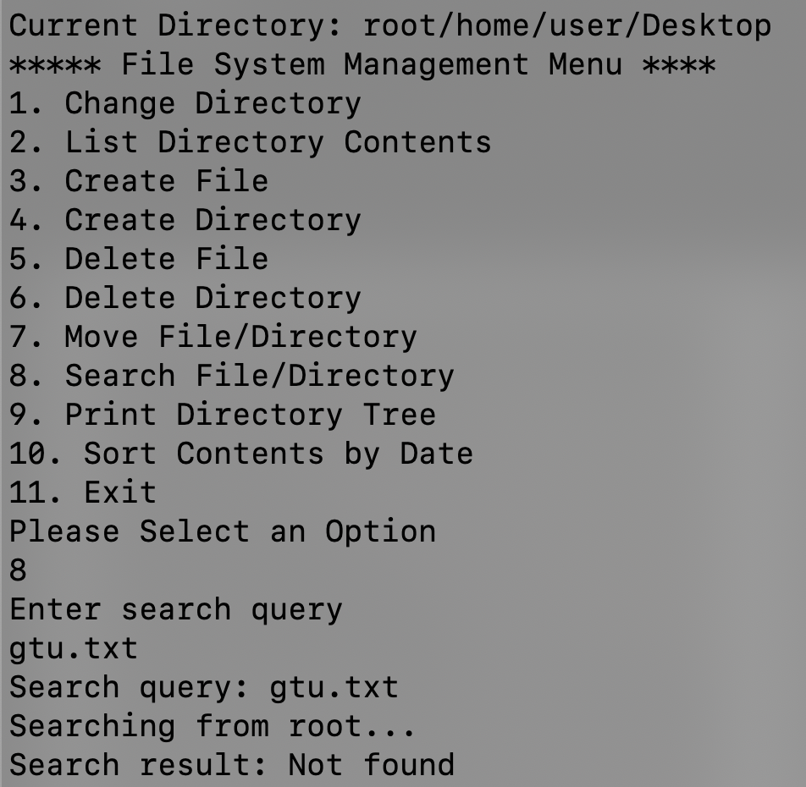
Searching gtu.txt. I didn’t create it so the function can’t found it

