Slide 1

AI-Powered Battery System Performance Prediction
CSE 496
Final Presentation
Dicle Çoban
Advisor: Asst. Prof. Salih SARP
Asst. Prof. Osman Safa ÇİFÇİ
January 2026
www.gtu.edu.tr

Slide 2
Contents
Motivation
Goal of the Project
Technologies and Data Sources
Pipeline
System Architecture
Exploratory Data Analysis
Engineered Features
Machine Learning Models
Evaluation Strategy
Feature Importance Analysis
Baseline Results
Final Model Selection
Limitations and Future Work
Conclusion
References
www.gtu.edu.tr
CSE496 – First Presentation
14.10.2025
2

Slide 3
Motivation
Battery performance prediction is criticial for: Electric vehicles Energy storage systems Safety and cost optimization
Battery degradation is: Nonlinear Cell-specific Difficult to model physically
www.gtu.edu.tr
CSE496 – First Presentation
14.10.2025
3

Slide 4
Goal of the Project
Battery Data
This project aims to estimate the total lifespan of the battery using sensor and performance data obtained from the first 100–50–25 charge/discharge cycles of the batteries.
AI Models
Confidence / Reliability
www.gtu.edu.tr
CSE496 – First Presentation
14.10.2025
3

Slide 5
Technologies and Data Sources
Technologies: only Python
H5py and Pandas
NumPy
Scikit-learn
XGBoost
Matplotlib
Conformal Prediction for uncertainty estimation
Dataset: Stanford-Toyota lithium-ion battery aging dataset (MATR)
93 lithium-ion pouch cells
46 long-lived
47 short-lived
Two experimental batches
Each cell cycles until failure
Rich measurements:
Voltage, current, capacity, temperature
www.gtu.edu.tr
CSE496 – First Presentation
14.10.2025
4

Slide 6
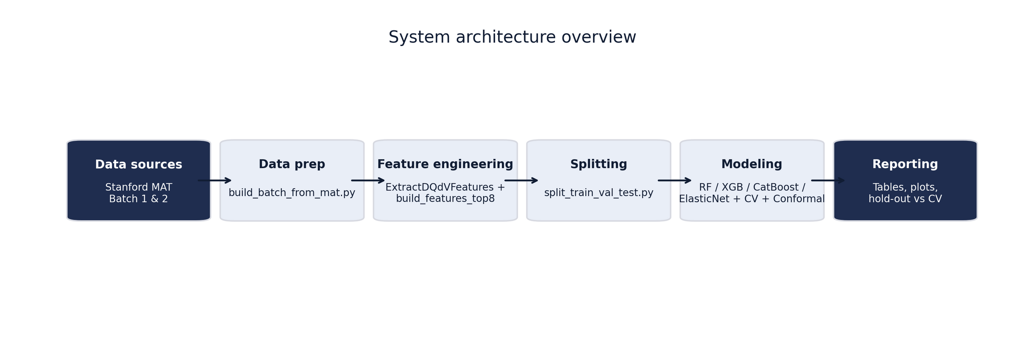
System Architecture
www.gtu.edu.tr
CSE496 – First Presentation
14.10.2025
6

Slide 7
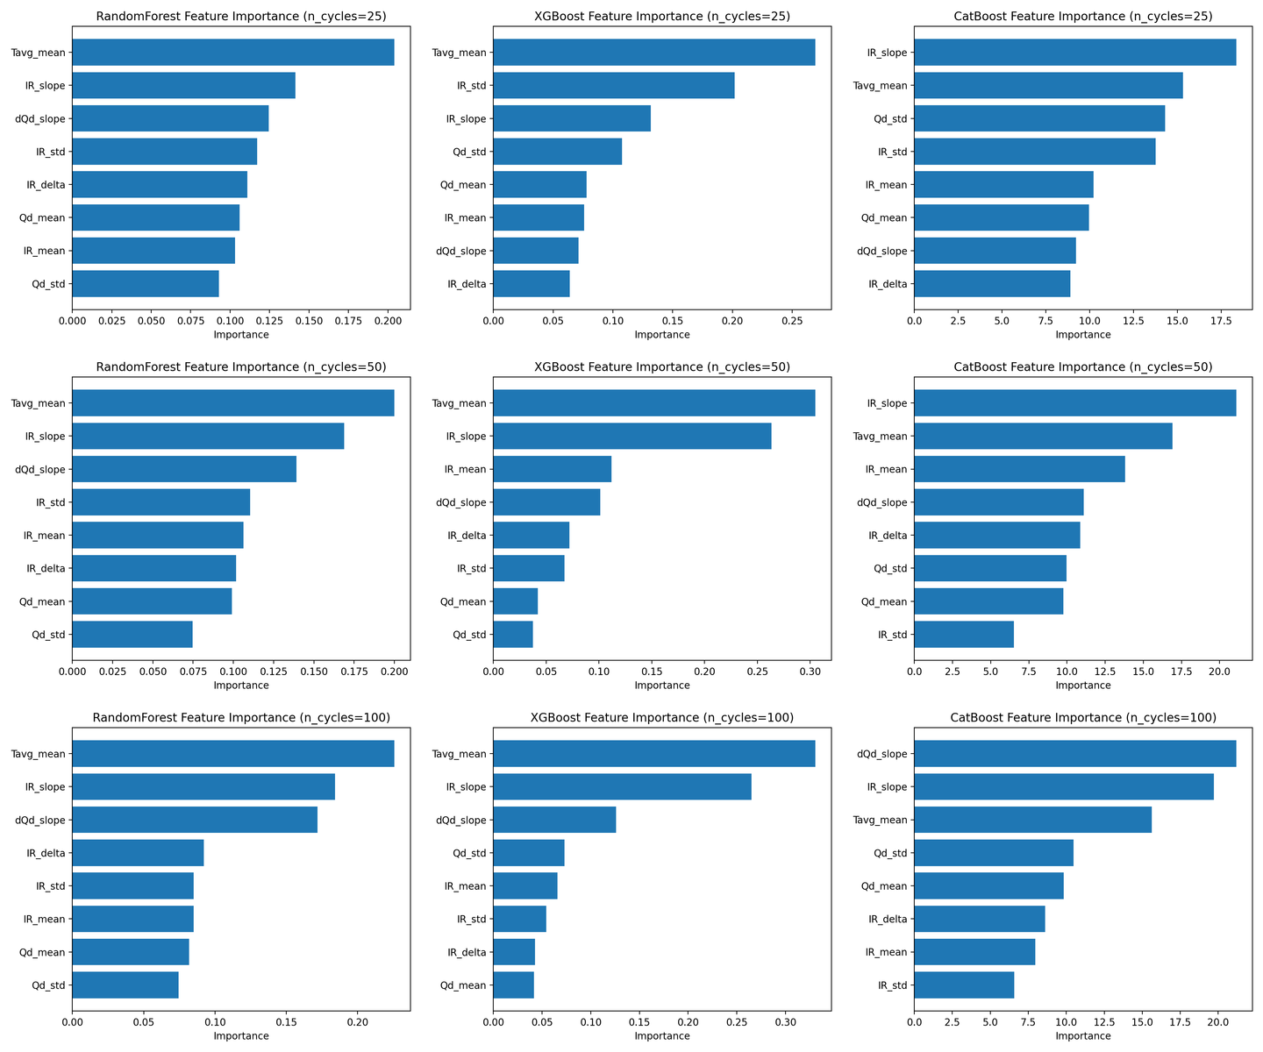
Engineered Features
Internal resistance:
Mean, slope, change
Discharge capacity:
Mean, standard deviation
Temperature:
Average temperature
Electrochemical behavior:
dQ/dV slope proxy
Final feature set:
8 physically motivated features
www.gtu.edu.tr
CSE496 – First Presentation
14.10.2025
6

Slide 8
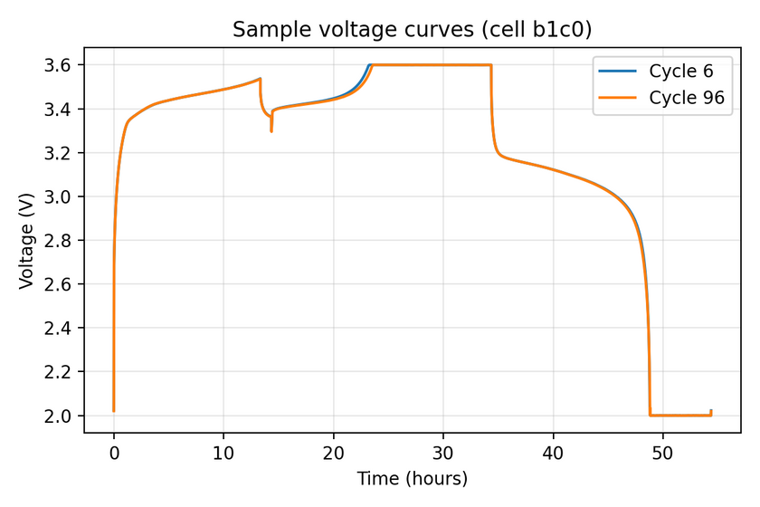
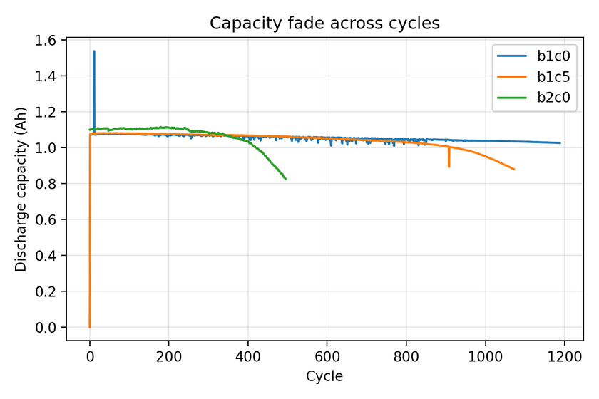
Exploratory Data Analysis
Capacity decreases monotonically with cycling
Strong lifetime difference between batches
Early voltage and capacity behavior:
Contains predictive degradation signatures
Confirms bimodal lifetime distribution
www.gtu.edu.tr
CSE496 – First Presentation
14.10.2025
6

Slide 9
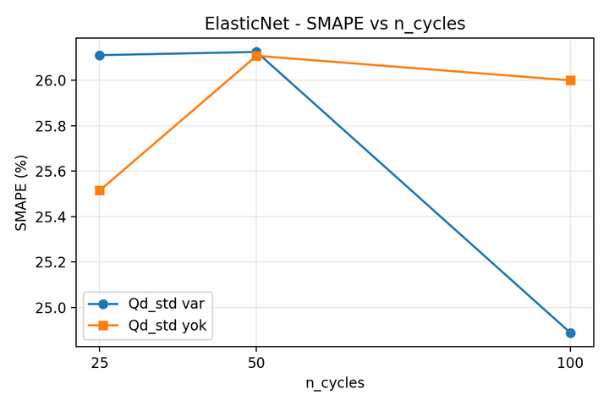
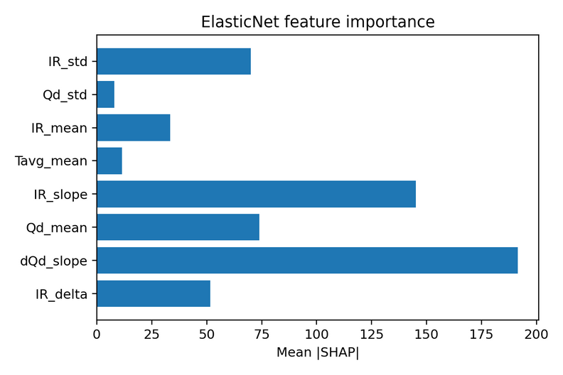
Machine Learning Models
Linear baseline:
ElasticNet
Tree-based ensemble models:
Random Forest
XGBoost
CatBoost
Motivation:
Capture nonlinear degradation behavior
Robust performance on tabular data
www.gtu.edu.tr
CSE496 – First Presentation
14.10.2025
6

Slide 10
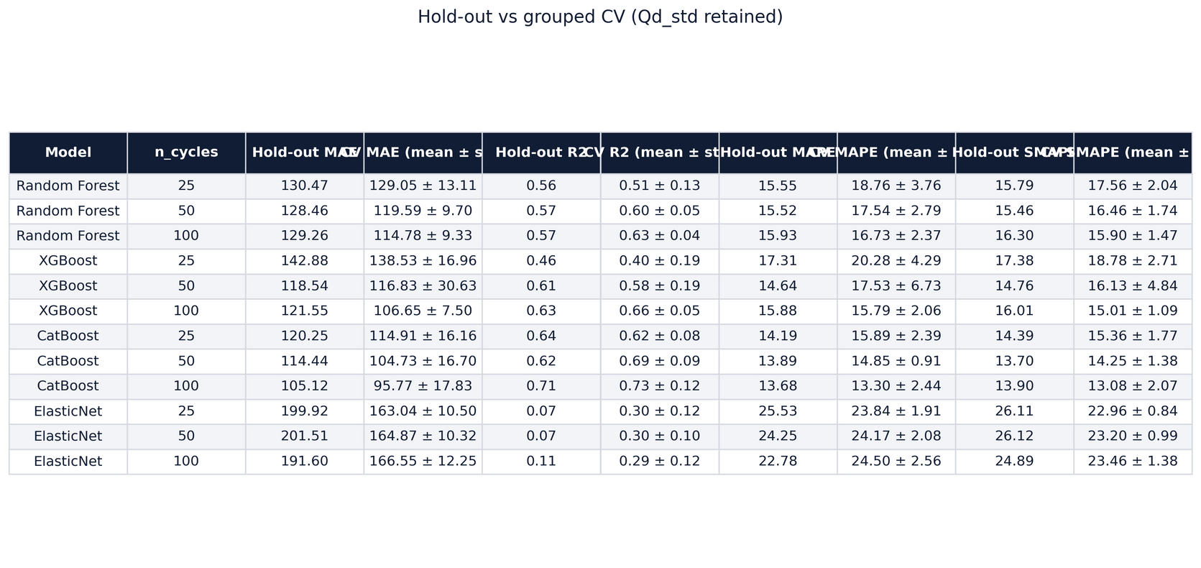
Evaluation Strategy
Cell-aware deterministic split
Train / validation / test by cell
GroupKFold cross-validation
Prevents information leakage
Evaluation metrics:
MAE (primary)
R²
MAPE
SMAPE
www.gtu.edu.tr
CSE496 – First Presentation
14.10.2025
6

Slide 11
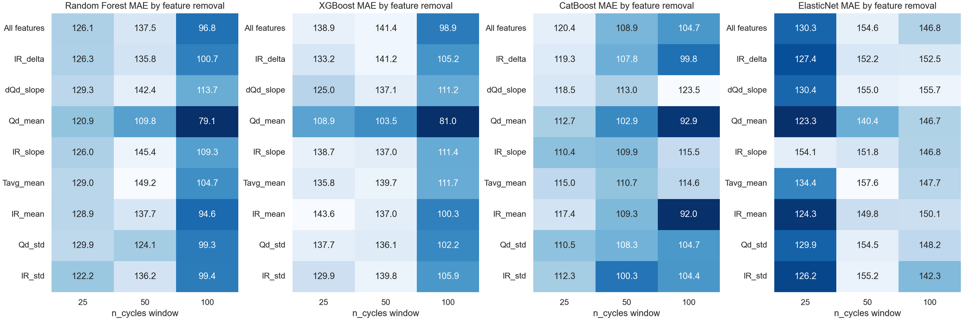
Feature Importance Analysis
www.gtu.edu.tr
CSE496 – First Presentation
14.10.2025
6

Slide 12
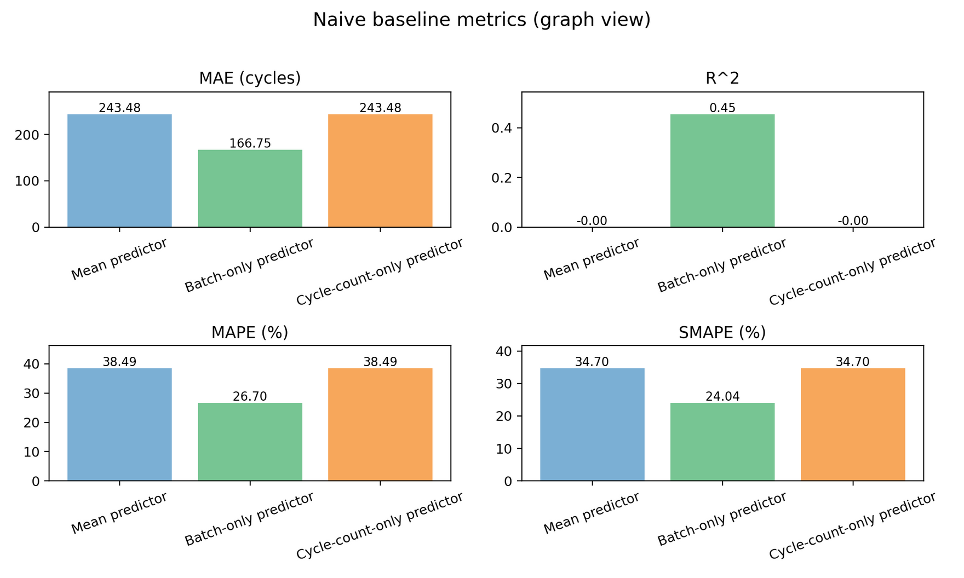
Baseline Results
www.gtu.edu.tr
CSE496 – First Presentation
14.10.2025
6

Slide 13
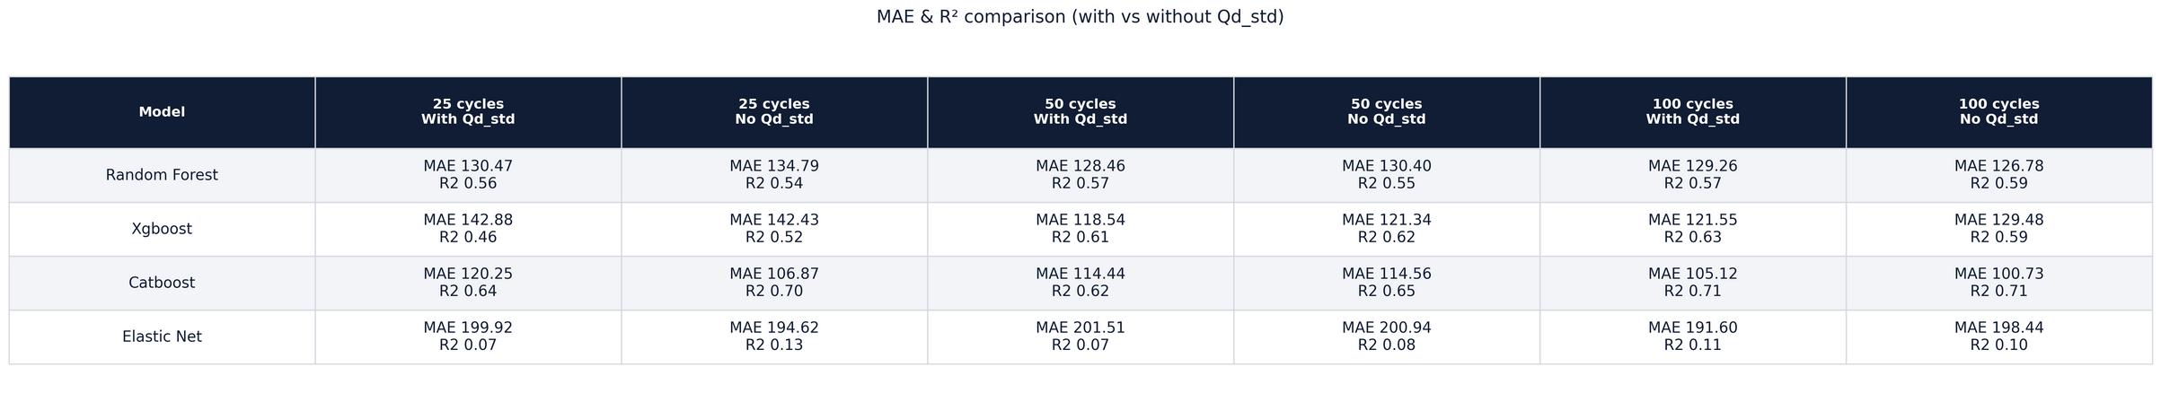
Baseline Results
www.gtu.edu.tr
CSE496 – First Presentation
14.10.2025
6

Slide 14
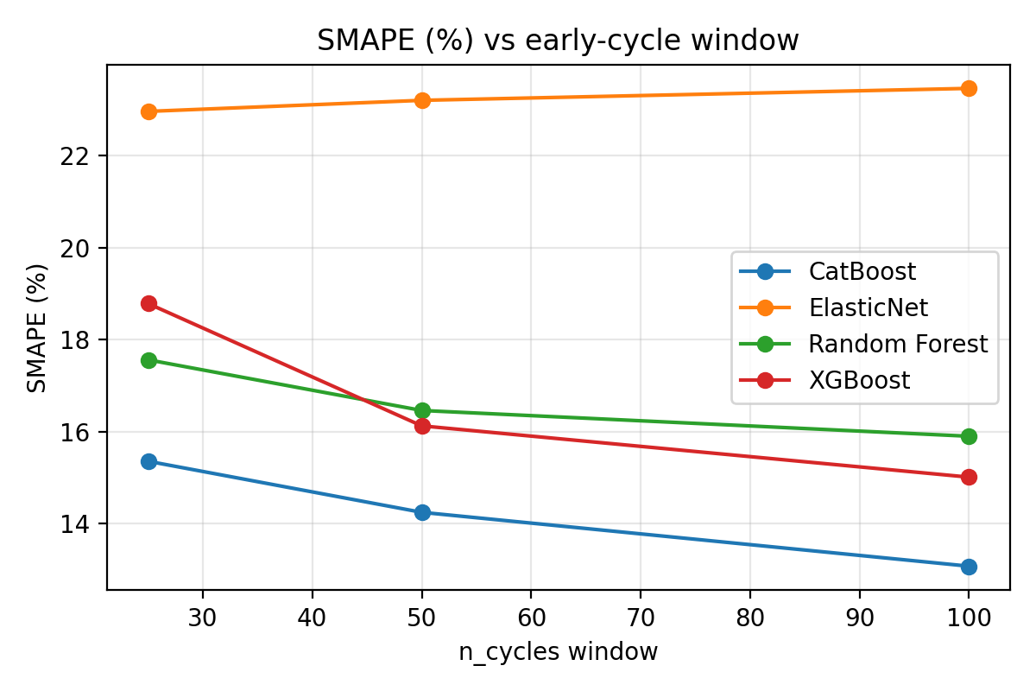
Baseline Results
www.gtu.edu.tr
CSE496 – First Presentation
14.10.2025
6

Slide 15
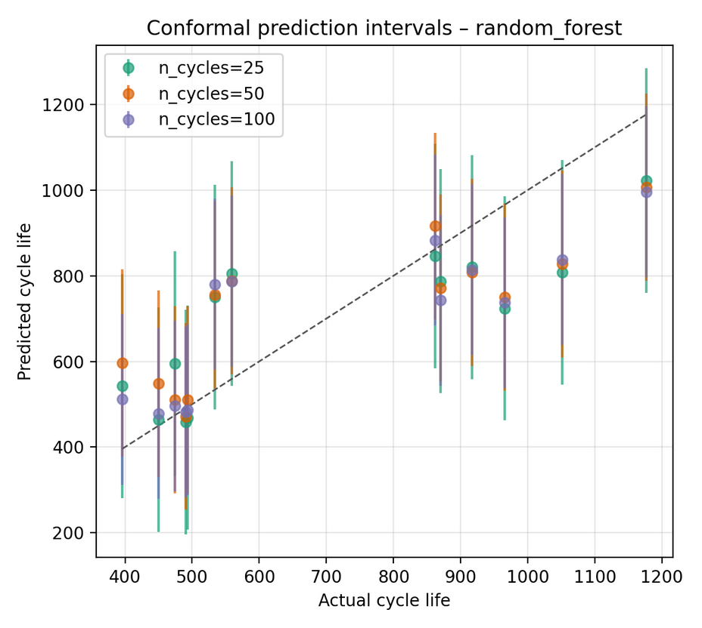
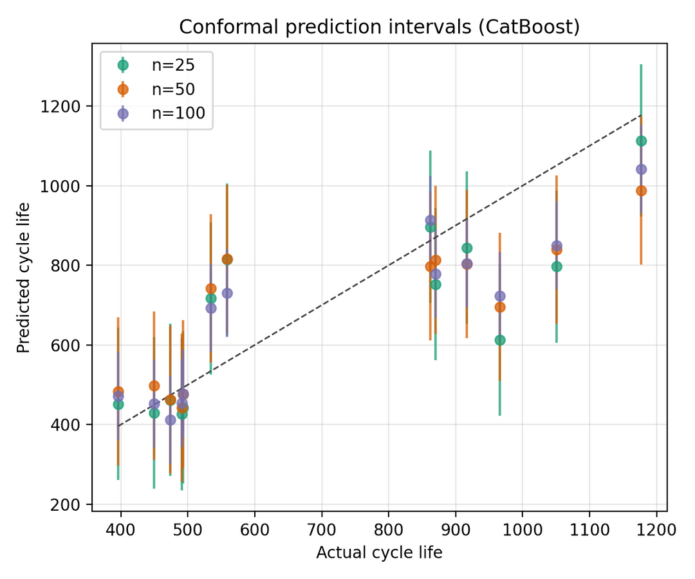
Uncertainty Estimation
www.gtu.edu.tr
CSE496 – First Presentation
14.10.2025
6

Slide 16
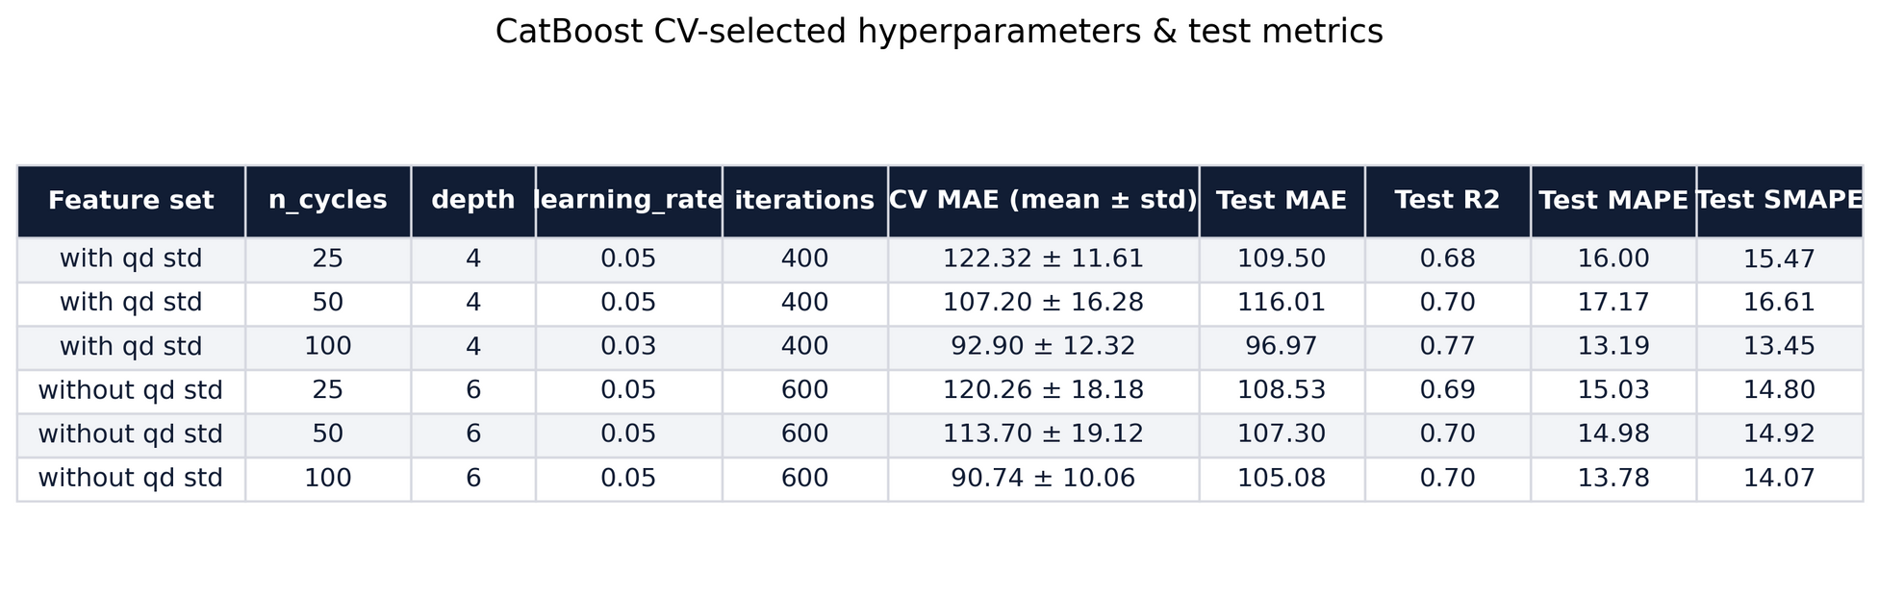
Final Model Selection
CatBoost chosen for:
Best accuracy
Stable performance
Robust generalization
www.gtu.edu.tr
CSE496 – First Presentation
14.10.2025
6

Slide 17
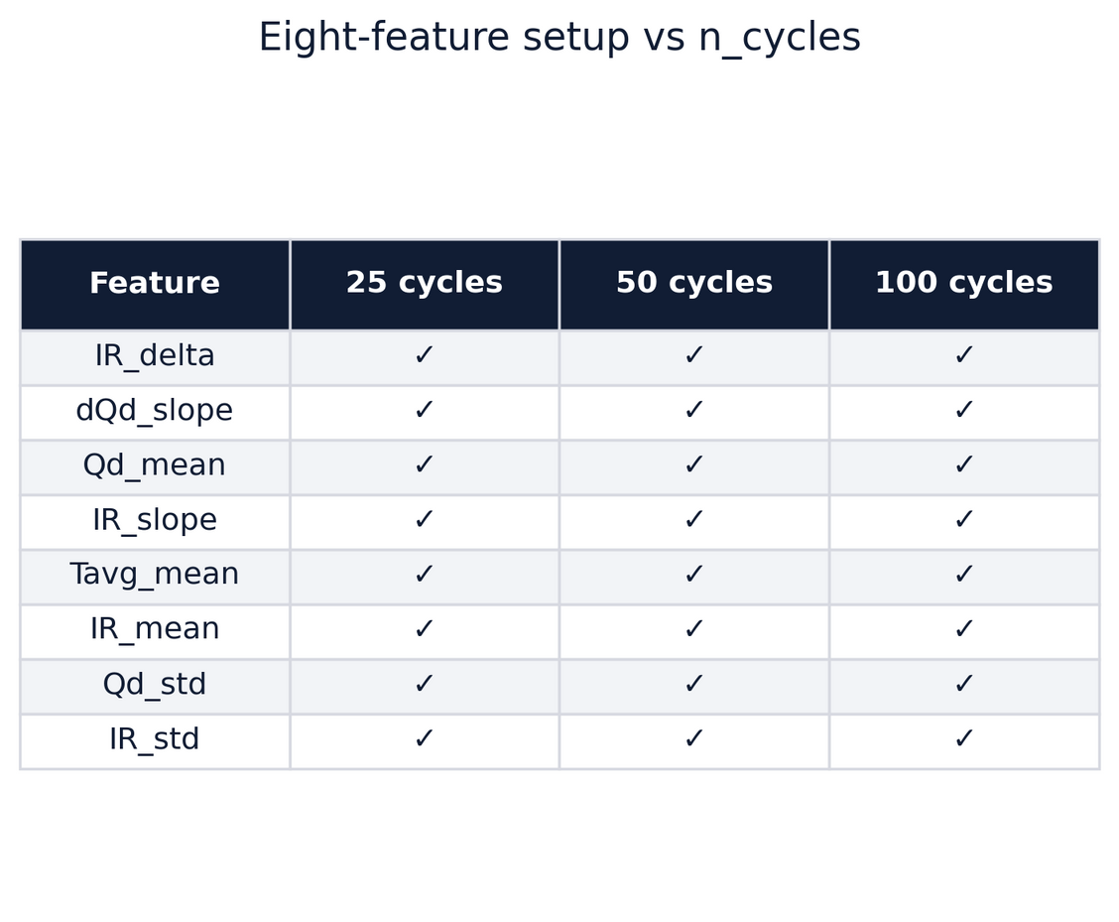
Limitations and Future Work
Limitations:
Single Dataset
Fixed chemistry and lab conditions
Future Work:
Larger and more diverse datasets
Online / incremental learning
Improved uncertainty modeling
Expand features
Integration into battery management systems
Hybrid physics-informed ML models
www.gtu.edu.tr
CSE496 – First Presentation
14.10.2025
6

Slide 18
Conclusion
Cell-aware learning works: Grouped CV and CatBoost-based modeling accurately predict unseen battery cells, cutting MAE roughly in half versus naïve baselines.
Early-cycle signals matter:The engineered eight-feature set plus dQ/dV insights consistently improves accuracy as the cycle window grows (25→100 cycles).
Robust evaluation is essential: Random splits were overly optimistic; more realistic within-dataset generalization.
www.gtu.edu.tr
CSE496 – First Presentation
14.10.2025
6

Slide 19
References
Battery health prediction using fusion-based feature selection and machine learning Xiaosong Hu, Senior Member, IEEE, Yunhong Che, Xianke Lin, Member, IEEE and Simona Onori, Senior Member, IEEE 2020
Nasa Open Data Portal Li-ion Battery Aging Datasets 2022
Data-driven capacity estimation of commercial lithium-ion batteries from voltage relaxation 2022
Data-driven prediction of battery cycle life before capacity degradation 2019
Lisinger, B., Attia, P. M., Severson, K. A., Jiang, B., Yang, Z., Chen, M. H., Greenstein, J. L., Harris, S. J., Chueh, W. C., & Braatz, R. D. (2019). Data-driven prediction of battery cycle life before capacity degradation. Nature Energy, 4, 383–391.
www.gtu.edu.tr
CSE496 – First Presentation
14.10.2025
8

Slide 20
Thank You
Written by Dicle Çoban
Supervisor: Asst. Prof. Salih SARP
Asst. Prof. Osman Safa Çifçi
Student ID: 220104004088
www.gtu.edu.tr
CSE496 – First Presentation
14.10.2025
13

