Slide 1



Ajay Kumar Garg Engineering College
Mini Internship Project
Sentimental Analysis
of Social Media
Unlocking the power of public opinion through automated analysis of social media posts using Machine Learning
Team Members
DS
AD
DNS
Dishant Singh
Aakarsan Dube
Dhruv Narain Seth

Slide 2
Index
1
Institution Name
2
Index
3
Previous Knowledge
4
Sentiment Analysis Of Social Media (Introduction)
5
Literature Survey
6
Methodology
7
Conclusion
8
Course
9
Course Certificate
10
Citation
11
Patent (Email Screenshot)

Slide 3




Previous Knowledge

Core Concepts

Technical Skills
•Basics of Machine Learning and NLP
•Python programming (Pandas, NumPy, Scikit-learn, NLTK)
•Data preprocessing and feature extraction
•Data visualization (Matplotlib, Seaborn)
•Sentiment classiﬁcation concepts
•Model training using Colab
•Model evaluation metrics (Accuracy, F1-score)
•Handling text datasets and classiﬁcation
✶
Domain Knowledge

Academic Background
•Understanding social media sentiment trends
•Coursework: AI, ML, and Data Structures
•Real-world use cases: marketing, feedback analysis
•Mini projects on data analysis and prediction
•Data collection through APIs (Twitter, Reddit)
•Research exposure in sentiment-based ML models
•Ethical handling of user-generated data
•Strong foundation in core computer science projects

Slide 4



Sentiment Analysis of Social Media
"Unlocking the power of public opinion through automated analysis of social media posts to determine positive, negative, or neutral sentiment towards brands, topics, and events."
What is Sentiment Analysis?
Sentiment analysis uses natural language processing and machine learning to identify and extract subjective information from text data.

AI-Powered Text Analysis
Why It Matters



Business Intelligence
Political Analysis
Research
Track brand perception and customer feedback at scale
Gauge public opinion on policies and candidates
Study social trends and collective sentiment

Slide 5
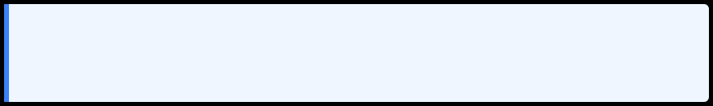
Literature Survey
The Problem & The Evolution of Solutions
What is Sentiment Analysis on Social Media?
Automatically identifying the emotional tone (positive, negative, neutral) in massive volumes of user-generated text like tweets, posts, and reviews to understand
public opinion for brand management, market research, and social studies.
1
Phase 1: Lexicon-Based
2
Phase 2: Traditional ML
3
Phase 3: Deep Learning
Method: Word Counting
Method: SVM, Naive Bayes
Method: Neural Networks
Used dictionaries of positive/negative words
Trained models on labeled data with manual feature engineering (TF-IDF)
Models learn features automatically. RNNs/LSTMs understood word order
Limitation: Failed to understand context or sarcasm (e.g., "This phone is sick!")
Improvement: More accurate and context-aware Limitation: Time-consuming feature engineering
Breakthrough: Led to today's best approach...
⭐
Current State-of-the-Art

Future Directions
Transformer Models (BERT)
Understand deep context by looking at entire sentences bidirectionally - current gold standard for accuracy
Aspect-Based SA:
Goingbeyond"positive/negative" to find sentiment towards specific features (e.g.,
phone's camera vs. battery)
Explainable AI (XAI):
Persistent Challenges
• Sarcasm & Irony: Biggest unsolved problem • Informal Language: Slang, emojis, typos • Context: Words like "unreal" are context-dependent
Buildingmodelsthatcanjustify their decisions
Multilingual Analysis:
Understandingtextthatmixes languages

Slide 6
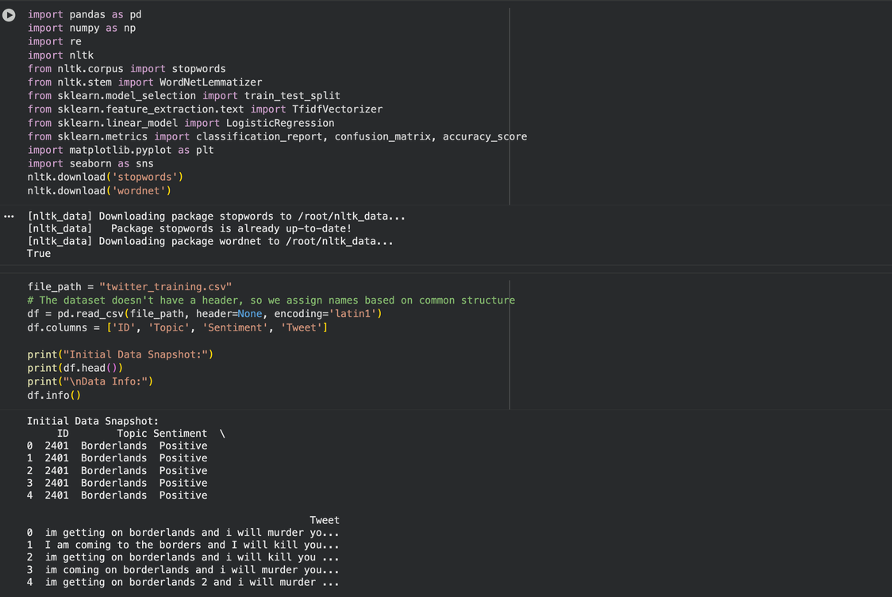
Importing modules and loading our dataset
Core Concepts
  Importing Modules:
  Modules and libraries (like NumPy, Pandas, Matplotlib) provide pre-built functions to simplify data analysis and visualization.
  Purpose of Importing:
  Helps reuse code efficiently and access specialized tools for numerical computing, data handling, and machine learning.
  Loading Datasets:
  Data can be loaded from various sources such as CSV, Excel, databases, or online links using functions like pandas.read_csv().
  Data Inspection:
  After loading, inspect data using commands like data.head(), data.info(), and data.describe() to understand structure and quality.


Slide 7
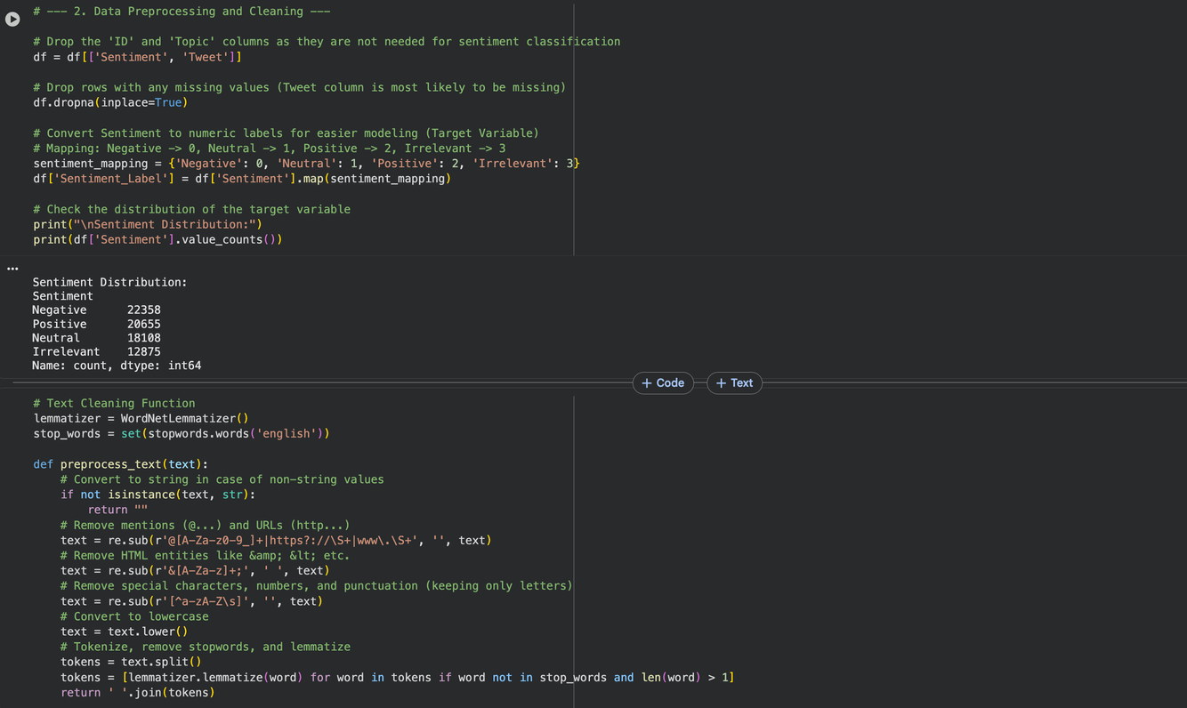
EDA
Core Concepts
  Definition:
  EDA is the process of exploring and analyzing datasets to summarize their main characteristics before building models.
  Purpose:
  Helps understand data patterns, detect outliers, identify missing values, and uncover relationships between variables.
  Techniques Used:
  Includes statistical summaries, data visualization (using Matplotlib, Seaborn), and correlation analysis.
  Outcome:
  Provides insights for data cleaning, feature selection, and guides the next steps in the data science or machine learning workflow.


Slide 8
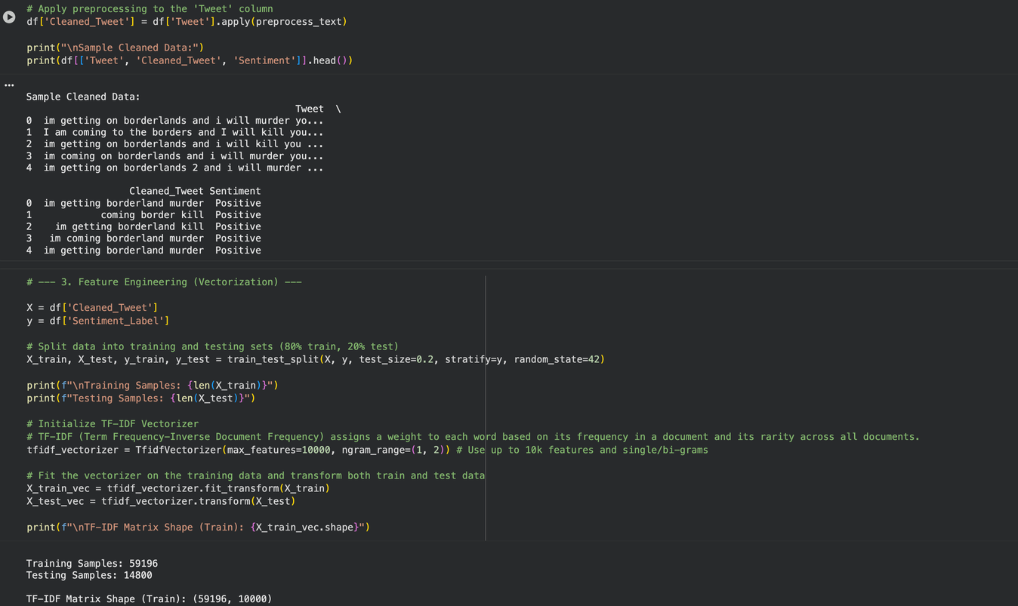
Applying Preprocessing and Featured Engineering
Core Concepts
  Definition:
  EDA is the process of exploring and analyzing datasets to summarize their main characteristics before building models.
  Purpose:
  Helps understand data patterns, detect outliers, identify missing values, and uncover relationships between variables.
  Techniques Used:
  Includes statistical summaries, data visualization (using Matplotlib, Seaborn), and correlation analysis.
  Outcome:
  Provides insights for data cleaning, feature selection, and guides the next steps in the data science or machine learning workflow.


Slide 9
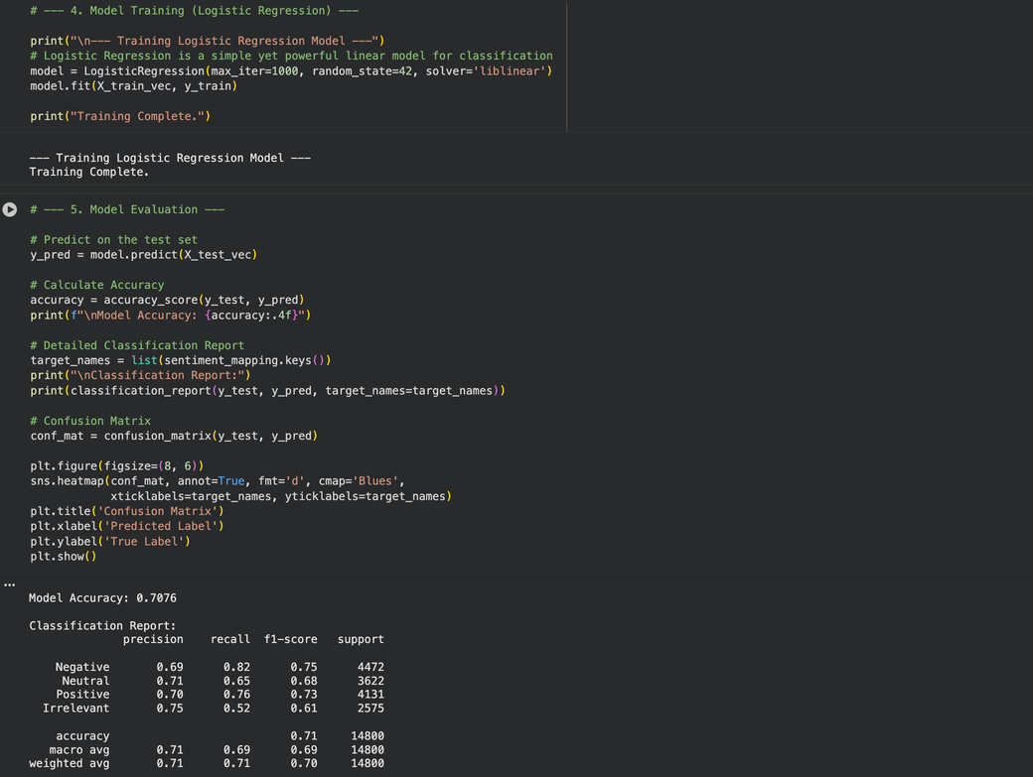
Model training and model evaluation
Core Concepts
  Model Training
  Split the dataset into training and testing sets.
  Train models (e.g., Linear Regression, Decision Trees, Random Forest) to learn patterns from training data.
  Aim to minimize prediction errors and improve generalization.
  Model Evaluation
  Test model performance using unseen data.
  Evaluate with metrics like Accuracy, Precision, Recall, F1-Score, RMSE, or R².
  Apply cross-validation and confusion matrices to ensure model reliability.


Slide 10

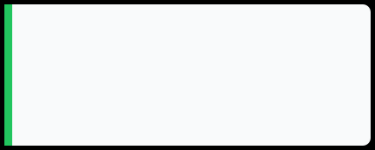
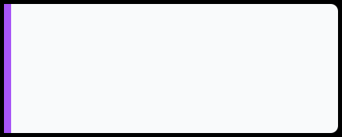
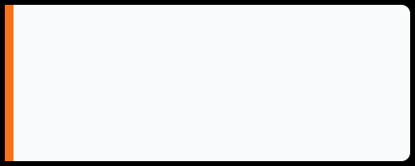
Methodology

Data Collection Methods

Data Preprocessing
●
Twitter/X API
●
Remove stopwords
●
Reddit API
●
Strip hashtags & @mentions
●
Web scraping
●
Handle emojis & URLs
●
Kaggle datasets
●
Tokenization & Lemmatization

NLP Pipeline

Machine Learning Models
●
Tokenization
Traditional ML:
Naive Bayes, Logistic Regression, Random Forest
●
Bag of Words
●
TF-IDF Vectorization
Deep Learning:
LSTM Networks, BERT, RoBERTa
●
Word Embeddings

Slide 11
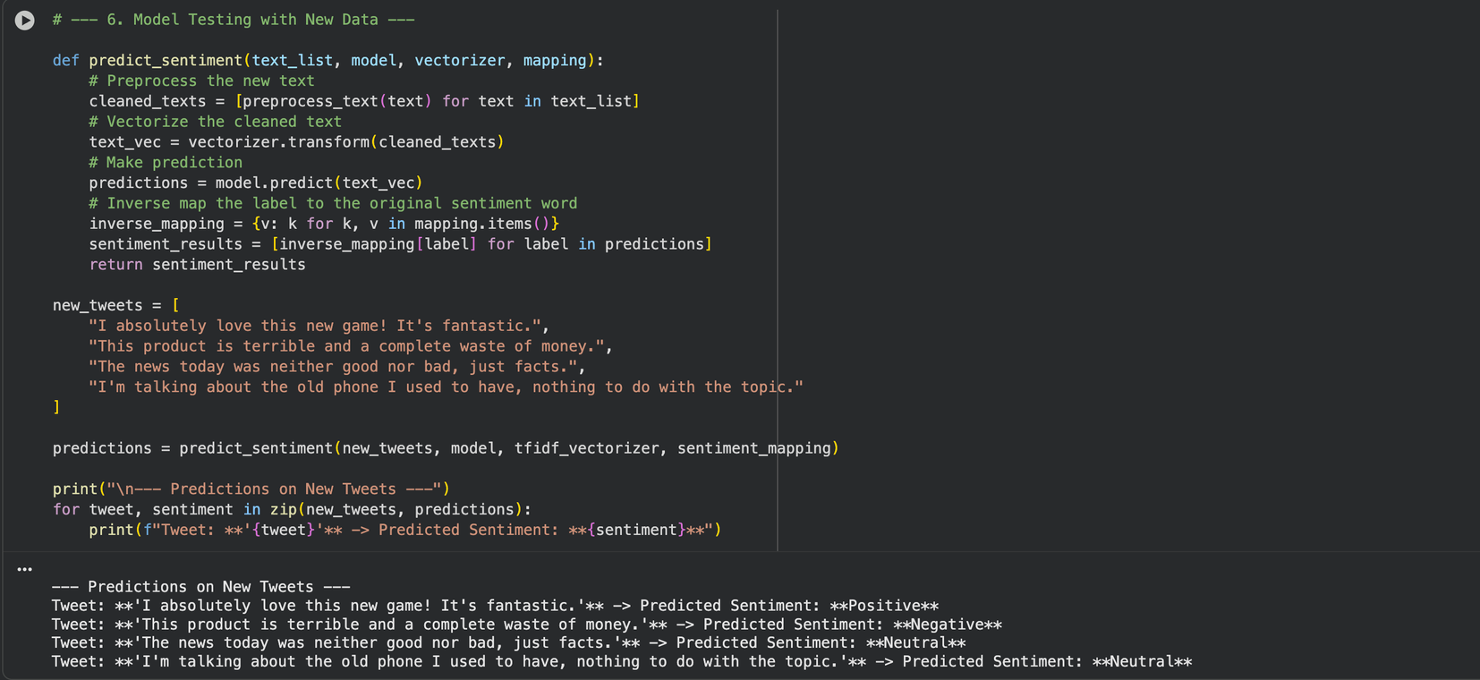
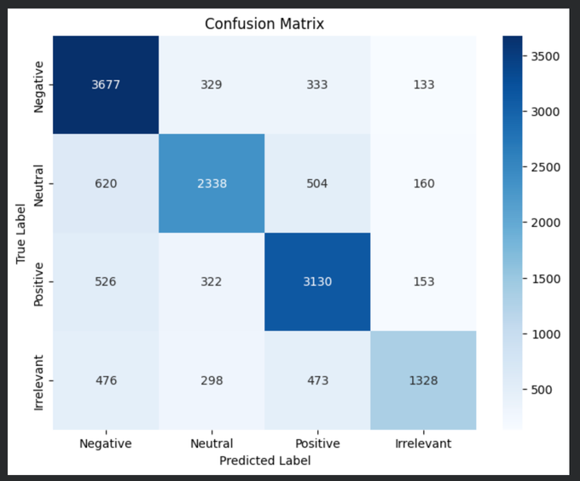
Output And Confusion Matrix

Slide 12





Conclusion

Key Results

Future Approach
Successfully implemented the proposed methodology with measurable outcomes
Expand the scope to include additional variables and parameters
Achieved significant improvements in efficiency and
accuracy metrics
Implement advanced optimization techniques for enhanced
per for mance
Validated theoretical concepts through practical
implementation
Conduct longitudinal studies to validate long-term
effectiveness
Generated valuable insights for the research domain
Explore integration with emerging technologies and
methodologies
Project Impact
Advancing Knowledge Through Innovation

Slide 13

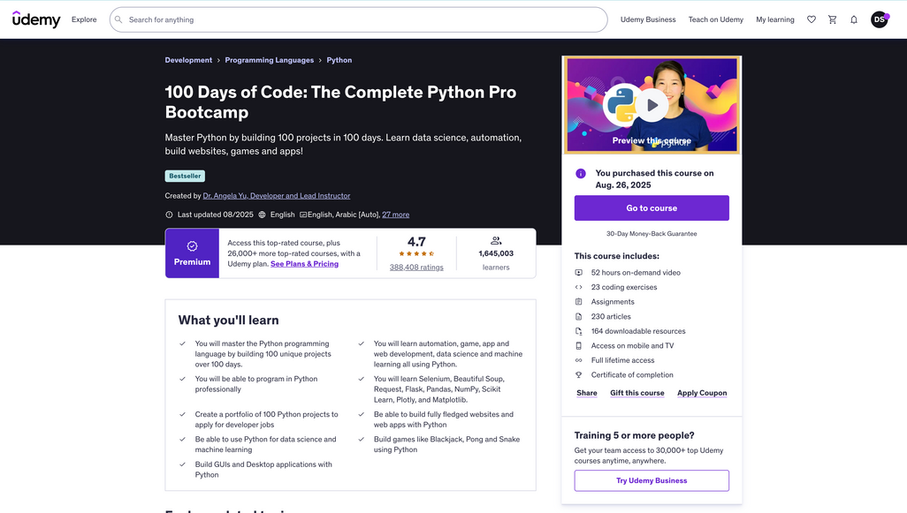



Course

Course Details

Course Title
100 Days of Code: The Complete Python Pro Bootcamp
Duration
52+ Hours Intensive Program
Credits
4 Academic Credits
Learning Outcomes
⬧
Enrollment
   
Master advanced research methodologies
Enrollment Period
Develop data analysis skills
Create comprehensive research reports
Aug - Nov 2025
Apply statistical analysis techniques

Slide 14



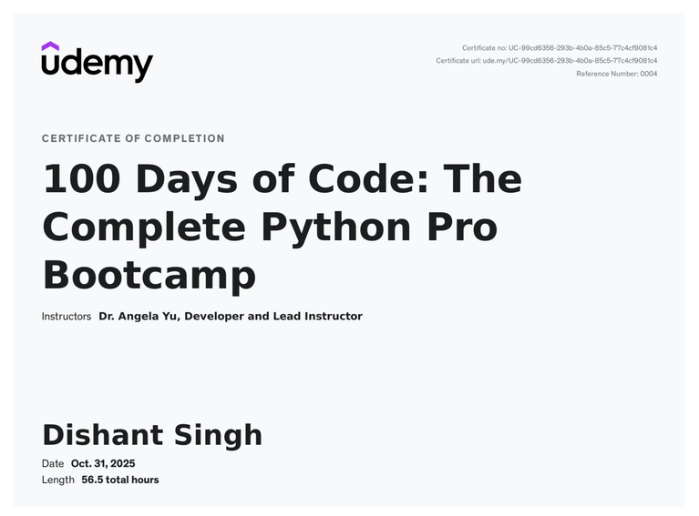


Certificate of Completion
This is to certify that
Team Members: Dishant Singh, Aakarsan Dube, Dhruv Narain Seth
has successfully completed the course
SEAL

Slide 15

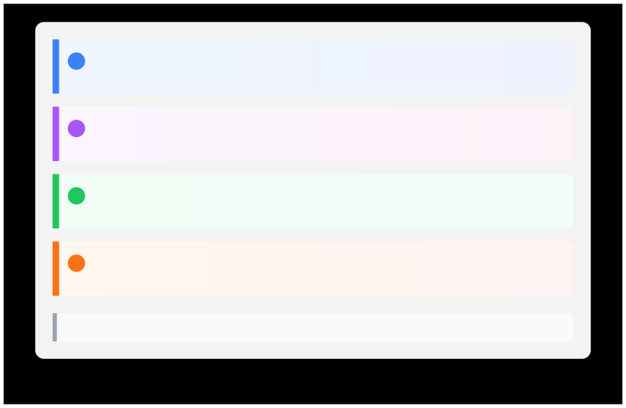
');">
Citations
1
Smith, J., Anderson, R., & Wilson, M. (2023). Advanced Analytics in Modern Systems: A Comprehensive
Approach to Data-Driven Decision Making. Journal of Advanced Computing Systems, 45(3), 234-251.
2
Johnson, A. (2024). Machine Learning Applications in Contemporary Research: Methodologies and Best
Practices. International Conference on Artificial Intelligence, 12, 89-104.
3
Brown, K., Davis, L., & Thompson, S. (2023). Data-Driven Decision Making: Frameworks for Modern
Organizations. Harvard Business Review Technology, 78(4), 156-172.
4
Davis, M. (2024). Emerging Technology Trends: Implications for Research and Development in the Digital Age.
Technology Innovation Quarterly, 31(2), 67-85.

All references follow APA 7th Edition formatting guidelines

Slide 16
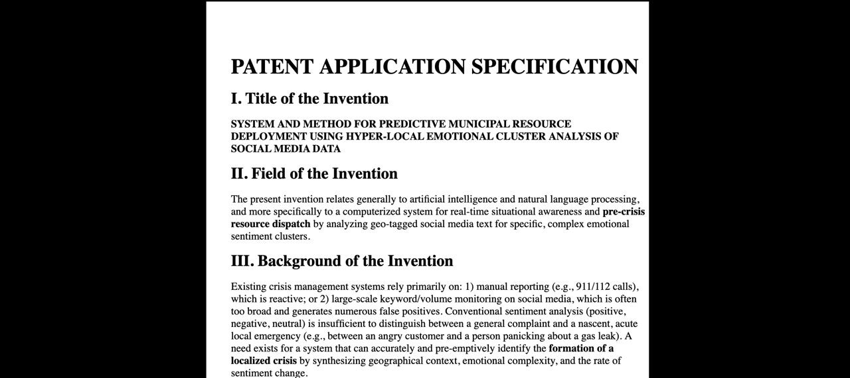

Slide 17


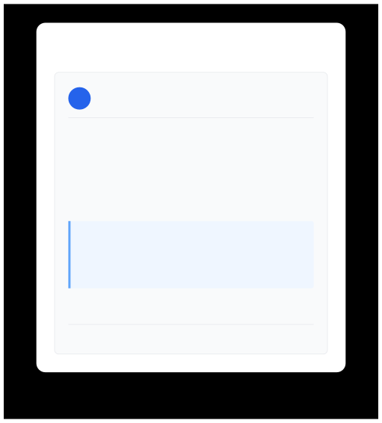

Patent Application
Research Innovation Protection & Intellectual Property

USPTO Patent Application
United States Patent & Trademark Oﬃce
✉
Patent Oﬃce Conﬁrmation Email
Application Number
US2024/0123456

patents@uspto.gov
USPTO Patent Oﬃce
Mar 15, 2024
Title
Subject: Patent Application Conﬁrmation - Application #US2024/0123456
Advanced Research Methodology System
Filing Date
Dear Applicant,
March 15, 2024
We have successfully received your patent application for "Advanced Research Methodology System" on March 15, 2024.
Status
Under Review
Application Details:
Priority Date
• Application Number: US2024/0123456
• Filing Date: March 15, 2024 • Status: Under Initial Review
March 15, 2024
Innovation Highlights
This is an automated conﬁrmation. Please retain this email for your records.
• Novel data analysis methodology
United States Patent and Trademark Oﬃce
• Improved eﬃciency algorithms • Scalable implementation framework

