Slide 1
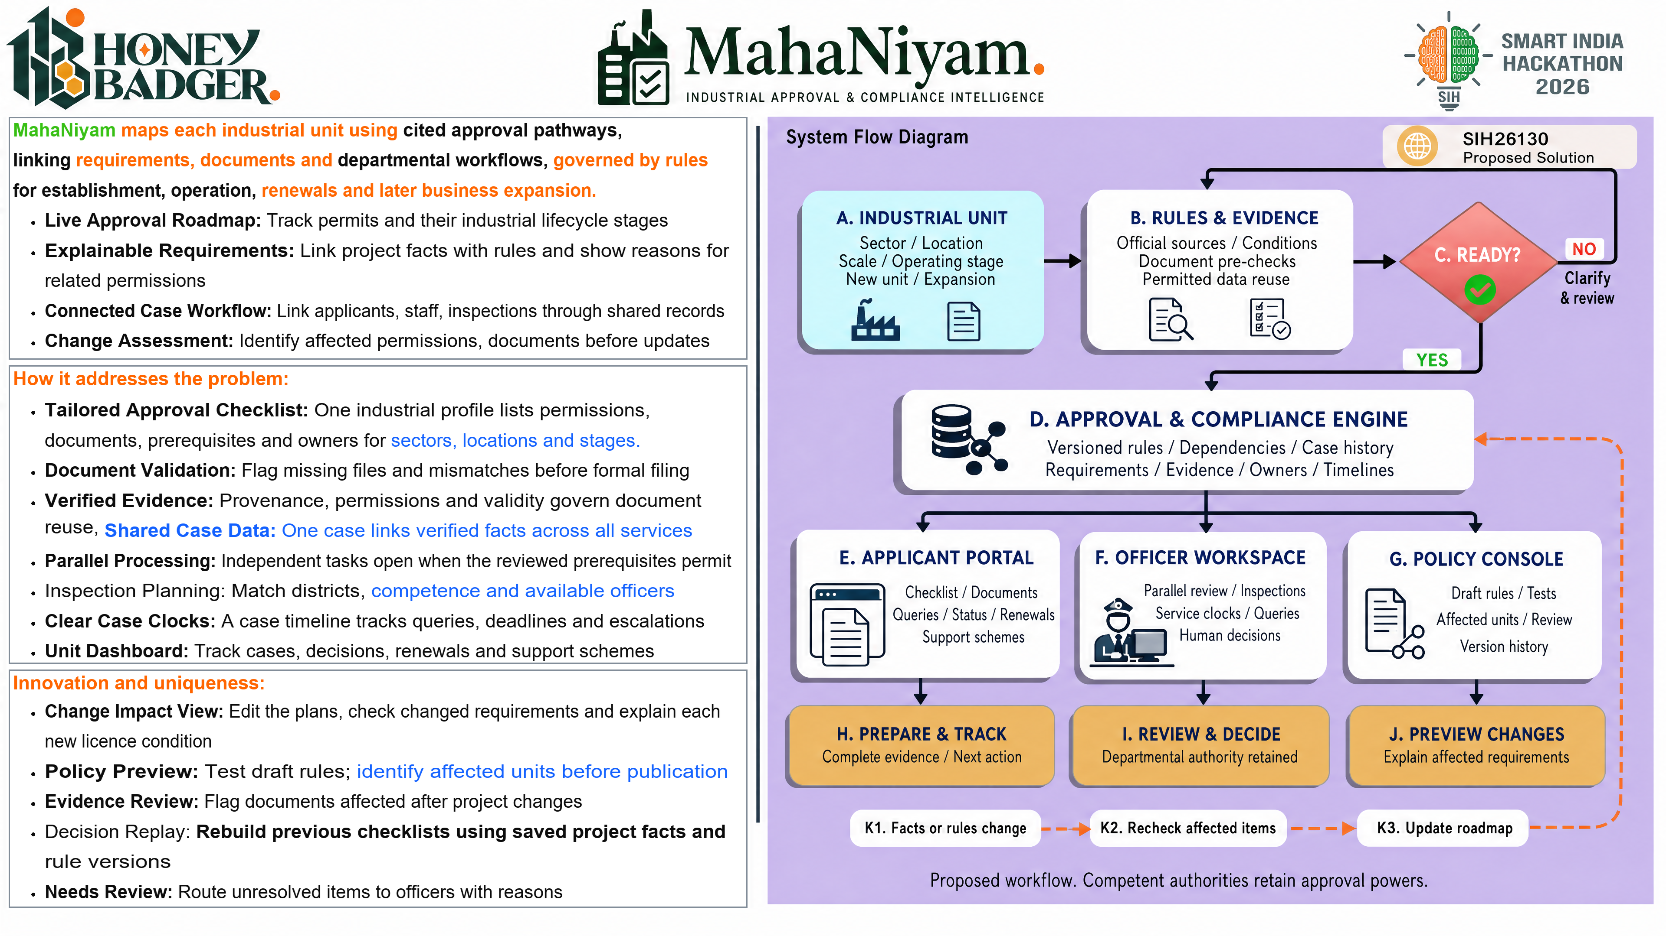
Notes:
SIH26130 — MahaNiyam
This slide uses a high-resolution composed image to preserve the matched layout. Text and diagrams are flattened. The source copy, count audit and full reference URLs are provided in the accompanying Markdown file.
# SIH26130 — remaining slides: copy and matching audit
The four outputs follow the corresponding SIH26096 screenshots. The duplicate research screenshot represents one slide.
53 body lines across the four slides match the reference in both character and whitespace-delimited word counts. Counts include spaces and punctuation and exclude bullets/indentation. Line breaks are explicit; bold labels and orange headings follow the reference. Arial letter widths differ, so each replacement is fitted to its reference line width. Headings, diagram labels, reference titles and URLs are adapted for this problem and are not included in the 53-line claim.
## Line audit
| Slide | Line | Characters (both) | Words (both) | Replacement |
|---|---:|---:|---:|---|
| technical | 1 | 75 | 13 | Rule Sources: Link each approval to the official act and service rule [1,2] |
| technical | 2 | 41 | 5 | with sources, jurisdictions and validity. |
| technical | 3 | 73 | 12 | Rule Encoding: OPA / Rego checks typed facts; returns reasons or warnings |
| technical | 4 | 32 | 4 | for unresolved requirements. [9] |
| technical | 5 | 73 | 10 | Case Records: Store profiles, source clauses, versions and saved evidence |
| technical | 6 | 33 | 5 | links beside every case snapshot. |
| technical | 7 | 79 | 12 | Dependency Plan: Use NetworkX to order tasks and check prerequisites [10], with |
| technical | 8 | 35 | 3 | reviewed departmental dependencies. |
| technical | 9 | 77 | 9 | Document Intake: pypdf extracts; Tesseract transcribes scanned documents [11] |
| technical | 10 | 38 | 7 | then ask staff to check parsed fields. |
| technical | 11 | 71 | 9 | Case Workflow: Track submission, officer queries and inspection booking |
| technical | 12 | 35 | 6 | with the decision made by officers. |
| technical | 13 | 68 | 10 | Service Clocks: Track receipt, query and response events per service |
| technical | 14 | 68 | 8 | with service-specific calendars and applicable pause conditions. [2] |
| technical | 15 | 73 | 8 | Change Processing: Operational changes flag requirements; review, compare |
| technical | 16 | 40 | 5 | documents and retain previous snapshots. |
| technical | 17 | 78 | 15 | Portal UI: React and TypeScript give each role a view of the same shared case. |
| technical | 18 | 75 | 12 | API Service: FastAPI validates each case and records its state with events. |
| technical | 19 | 77 | 13 | Rule Engine: OPA checks facts and NetworkX labels each task ready or blocked. |
| technical | 20 | 75 | 13 | Batch Jobs: Queue OCR and alerts, then retry safe calls to each department. |
| technical | 21 | 74 | 12 | Data Store: Log case records in PostgreSQL and files with access controls. |
| technical | 22 | 74 | 10 | Integration: API adapters sync official status; demo calls stay simulated. |
| feasibility | 1 | 39 | 7 | Test Units: Model two factories and one |
| feasibility | 2 | 28 | 5 | change in a working profile. |
| feasibility | 3 | 41 | 6 | Pilot Checks: Twenty profiles plus twelve |
| feasibility | 4 | 30 | 6 | files and ten case flow tests. |
| feasibility | 5 | 45 | 6 | Workload Control: Schedule OCR and extraction |
| feasibility | 6 | 28 | 3 | before departmental reviews. |
| feasibility | 7 | 46 | 6 | Adapter Checks: Log events, receipt, deadlines |
| feasibility | 8 | 25 | 4 | and failed API responses. |
| feasibility | 9 | 45 | 6 | Portal Fit: Connect authorised interfaces and |
| feasibility | 10 | 29 | 4 | imports with tracked sources. |
| feasibility | 11 | 45 | 8 | AI Usage Costs: Cap optional model usage fees |
| feasibility | 12 | 27 | 4 | and retain source excerpts. |
| feasibility | 13 | 46 | 6 | Evidence Reuse: Check permissions and validity |
| feasibility | 14 | 27 | 4 | before each new submission. |
| feasibility | 15 | 45 | 6 | Policy Ownership: Reviewers approve rules; IT |
| feasibility | 16 | 28 | 4 | manages systems and backups. |
| impact | 1 | 117 | 16 | Expected impact: Fewer filing errors and clear next actions, with recorded decisions across the industrial lifecycle. |
| impact | 2 | 74 | 10 | Applicants: See required approvals and understand the next action clearly. |
| impact | 3 | 75 | 9 | Industrial Units: Identify renewal requirements and review planned business |
| impact | 4 | 8 | 1 | changes. |
| impact | 5 | 66 | 10 | Officers: Review evidence changes and queries within one full case |
| impact | 6 | 11 | 1 | chronology. |
| impact | 7 | 76 | 9 | Inspectors: Coordinate selected visits and review assigned case information. |
| impact | 8 | 76 | 9 | Submission Readiness: Catch omissions upfront and reuse authorised evidence. |
| impact | 9 | 80 | 10 | Visible Accountability: Separate applicant response time from the officer clock. |
| impact | 10 | 82 | 10 | Multilingual Guidance: Explain requirements with Marathi and English source links. |
| impact | 11 | 73 | 9 | Scheme Discovery: Assess eligibility criteria and documents with official |
| impact | 12 | 9 | 1 | services. |
| research | 1 | 97 | 12 | Workflow: MAITRI regulations inform case histories, service deadlines and query processing. [1,2] |
| research | 2 | 90 | 11 | Services: NSWS and departmental portals inform applications and evidence checklists. [4–7] |
| research | 3 | 97 | 11 | Implementation: OPA, NetworkX, PostgreSQL and OCR enable explainable, auditable workflows. [9–12] |
## Research applied
Workflow: MAITRI regulations inform case histories, service deadlines and query processing. [1,2]
Services: NSWS and departmental portals inform applications and evidence checklists. [4–7]
Implementation: OPA, NetworkX, PostgreSQL and OCR enable explainable, auditable workflows. [9–12]
## Full reference register
1. **Maharashtra Legislature: [MAITRI Act, 2023](https://lj.maharashtra.gov.in/en/document/the-maharashtra-industry-trade-and-investment-facilitation-act-2023-text-as-on-11th-december-2024/).** Statutory basis for single-window facilitation.
2. **Industries Department: [MAITRI Rules, 2025](https://industry.maharashtra.gov.in/sites/default/files/2025-12/maitri-rules-2025_1.pdf).** Service workflow and applicable query-time treatment; English pp. 10–11.
3. **Government of Maharashtra: [Industries, Investment & Services Policy, 2025](https://industry.maharashtra.gov.in/sites/default/files/2025-12/202512311332497910.pdf).** Policy context; scheme eligibility needs its own verified rules.
4. **Invest India / NSWS: [National Single Window System](https://www.nsws.gov.in/).** Approval discovery, applications, documents and tracking.
5. **MPCB: [Water & Air Act consent management](https://mpcb.gov.in/en/consentmgt/water-and-air-act).** Consent stages and department-specific requirements.
6. **DISH Maharashtra: [Online Services](https://mahadish.in/online_services).** Factory-related services and official department interfaces.
7. **FSSAI: [FoSCoS](https://foscos.fssai.gov.in/).** Food licensing and registration; category-specific requirements.
8. **Ministry of MSME: [MSME Schemes, 2025](https://msme.gov.in/sites/default/files/MSMESchemebooklet2025.pdf).** ZED and other scheme context; current criteria need verification.
9. **Open Policy Agent: [OPA documentation](https://www.openpolicyagent.org/docs).** Rego policy evaluation over structured facts.
10. **NetworkX: [Directed acyclic graphs](https://networkx.org/documentation/stable/reference/algorithms/dag.html).** Dependency ordering and cycle checks for approval tasks.
11. **pypdf / Tesseract: [Text extraction and OCR documentation](https://pypdf.readthedocs.io/en/stable/user/extract-text.html).** Parse PDFs and scans; confirm uncertain fields.
12. **PostgreSQL: [Row Security Policies](https://www.postgresql.org/docs/current/ddl-rowsecurity.html).** Row-level access controls support case permissions.
13. **GIGW: [Scope and Objective](https://guidelines.india.gov.in/scope-and-objective/).** Government website and application quality guidance.
Additional OCR documentation: https://tesseract-ocr.github.io/tessdoc/
Sources support the proposed design. Department adapters are simulated for the pilot unless authorised access is available. UI screens are proposed interface concepts, not evidence of a deployed product. Benefits are expected and require pilot validation.
## Generation and construction
Diagrams were generated using the OpenAI Images API with gpt-image-2, high quality, at 3840 × 2160. The three saved prompt files document each edit. Typography and research references were placed deterministically for spelling, line-count and citation accuracy. Generated panels were fitted to the reference panel geometry. The accepted idea slide is included unchanged.

Slide 2
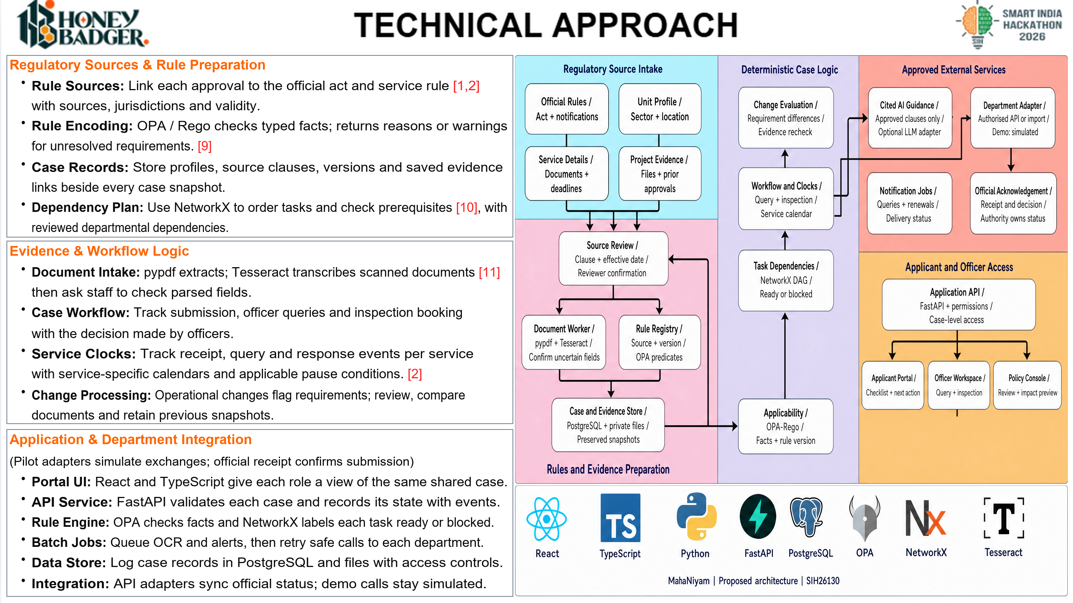
Notes:
SIH26130 — MahaNiyam
This slide uses a high-resolution composed image to preserve the matched layout. Text and diagrams are flattened. The source copy, count audit and full reference URLs are provided in the accompanying Markdown file.
Rule Sources: Link each approval to the official act and service rule [1,2]
with sources, jurisdictions and validity.
Rule Encoding: OPA / Rego checks typed facts; returns reasons or warnings
for unresolved requirements. [9]
Case Records: Store profiles, source clauses, versions and saved evidence
links beside every case snapshot.
Dependency Plan: Use NetworkX to order tasks and check prerequisites [10], with
reviewed departmental dependencies.
Document Intake: pypdf extracts; Tesseract transcribes scanned documents [11]
then ask staff to check parsed fields.
Case Workflow: Track submission, officer queries and inspection booking
with the decision made by officers.
Service Clocks: Track receipt, query and response events per service
with service-specific calendars and applicable pause conditions. [2]
Change Processing: Operational changes flag requirements; review, compare
documents and retain previous snapshots.
Portal UI: React and TypeScript give each role a view of the same shared case.
API Service: FastAPI validates each case and records its state with events.
Rule Engine: OPA checks facts and NetworkX labels each task ready or blocked.
Batch Jobs: Queue OCR and alerts, then retry safe calls to each department.
Data Store: Log case records in PostgreSQL and files with access controls.
Integration: API adapters sync official status; demo calls stay simulated.
# SIH26130 — remaining slides: copy and matching audit
The four outputs follow the corresponding SIH26096 screenshots. The duplicate research screenshot represents one slide.
53 body lines across the four slides match the reference in both character and whitespace-delimited word counts. Counts include spaces and punctuation and exclude bullets/indentation. Line breaks are explicit; bold labels and orange headings follow the reference. Arial letter widths differ, so each replacement is fitted to its reference line width. Headings, diagram labels, reference titles and URLs are adapted for this problem and are not included in the 53-line claim.
## Line audit
| Slide | Line | Characters (both) | Words (both) | Replacement |
|---|---:|---:|---:|---|
| technical | 1 | 75 | 13 | Rule Sources: Link each approval to the official act and service rule [1,2] |
| technical | 2 | 41 | 5 | with sources, jurisdictions and validity. |
| technical | 3 | 73 | 12 | Rule Encoding: OPA / Rego checks typed facts; returns reasons or warnings |
| technical | 4 | 32 | 4 | for unresolved requirements. [9] |
| technical | 5 | 73 | 10 | Case Records: Store profiles, source clauses, versions and saved evidence |
| technical | 6 | 33 | 5 | links beside every case snapshot. |
| technical | 7 | 79 | 12 | Dependency Plan: Use NetworkX to order tasks and check prerequisites [10], with |
| technical | 8 | 35 | 3 | reviewed departmental dependencies. |
| technical | 9 | 77 | 9 | Document Intake: pypdf extracts; Tesseract transcribes scanned documents [11] |
| technical | 10 | 38 | 7 | then ask staff to check parsed fields. |
| technical | 11 | 71 | 9 | Case Workflow: Track submission, officer queries and inspection booking |
| technical | 12 | 35 | 6 | with the decision made by officers. |
| technical | 13 | 68 | 10 | Service Clocks: Track receipt, query and response events per service |
| technical | 14 | 68 | 8 | with service-specific calendars and applicable pause conditions. [2] |
| technical | 15 | 73 | 8 | Change Processing: Operational changes flag requirements; review, compare |
| technical | 16 | 40 | 5 | documents and retain previous snapshots. |
| technical | 17 | 78 | 15 | Portal UI: React and TypeScript give each role a view of the same shared case. |
| technical | 18 | 75 | 12 | API Service: FastAPI validates each case and records its state with events. |
| technical | 19 | 77 | 13 | Rule Engine: OPA checks facts and NetworkX labels each task ready or blocked. |
| technical | 20 | 75 | 13 | Batch Jobs: Queue OCR and alerts, then retry safe calls to each department. |
| technical | 21 | 74 | 12 | Data Store: Log case records in PostgreSQL and files with access controls. |
| technical | 22 | 74 | 10 | Integration: API adapters sync official status; demo calls stay simulated. |
| feasibility | 1 | 39 | 7 | Test Units: Model two factories and one |
| feasibility | 2 | 28 | 5 | change in a working profile. |
| feasibility | 3 | 41 | 6 | Pilot Checks: Twenty profiles plus twelve |
| feasibility | 4 | 30 | 6 | files and ten case flow tests. |
| feasibility | 5 | 45 | 6 | Workload Control: Schedule OCR and extraction |
| feasibility | 6 | 28 | 3 | before departmental reviews. |
| feasibility | 7 | 46 | 6 | Adapter Checks: Log events, receipt, deadlines |
| feasibility | 8 | 25 | 4 | and failed API responses. |
| feasibility | 9 | 45 | 6 | Portal Fit: Connect authorised interfaces and |
| feasibility | 10 | 29 | 4 | imports with tracked sources. |
| feasibility | 11 | 45 | 8 | AI Usage Costs: Cap optional model usage fees |
| feasibility | 12 | 27 | 4 | and retain source excerpts. |
| feasibility | 13 | 46 | 6 | Evidence Reuse: Check permissions and validity |
| feasibility | 14 | 27 | 4 | before each new submission. |
| feasibility | 15 | 45 | 6 | Policy Ownership: Reviewers approve rules; IT |
| feasibility | 16 | 28 | 4 | manages systems and backups. |
| impact | 1 | 117 | 16 | Expected impact: Fewer filing errors and clear next actions, with recorded decisions across the industrial lifecycle. |
| impact | 2 | 74 | 10 | Applicants: See required approvals and understand the next action clearly. |
| impact | 3 | 75 | 9 | Industrial Units: Identify renewal requirements and review planned business |
| impact | 4 | 8 | 1 | changes. |
| impact | 5 | 66 | 10 | Officers: Review evidence changes and queries within one full case |
| impact | 6 | 11 | 1 | chronology. |
| impact | 7 | 76 | 9 | Inspectors: Coordinate selected visits and review assigned case information. |
| impact | 8 | 76 | 9 | Submission Readiness: Catch omissions upfront and reuse authorised evidence. |
| impact | 9 | 80 | 10 | Visible Accountability: Separate applicant response time from the officer clock. |
| impact | 10 | 82 | 10 | Multilingual Guidance: Explain requirements with Marathi and English source links. |
| impact | 11 | 73 | 9 | Scheme Discovery: Assess eligibility criteria and documents with official |
| impact | 12 | 9 | 1 | services. |
| research | 1 | 97 | 12 | Workflow: MAITRI regulations inform case histories, service deadlines and query processing. [1,2] |
| research | 2 | 90 | 11 | Services: NSWS and departmental portals inform applications and evidence checklists. [4–7] |
| research | 3 | 97 | 11 | Implementation: OPA, NetworkX, PostgreSQL and OCR enable explainable, auditable workflows. [9–12] |
## Research applied
Workflow: MAITRI regulations inform case histories, service deadlines and query processing. [1,2]
Services: NSWS and departmental portals inform applications and evidence checklists. [4–7]
Implementation: OPA, NetworkX, PostgreSQL and OCR enable explainable, auditable workflows. [9–12]
## Full reference register
1. **Maharashtra Legislature: [MAITRI Act, 2023](https://lj.maharashtra.gov.in/en/document/the-maharashtra-industry-trade-and-investment-facilitation-act-2023-text-as-on-11th-december-2024/).** Statutory basis for single-window facilitation.
2. **Industries Department: [MAITRI Rules, 2025](https://industry.maharashtra.gov.in/sites/default/files/2025-12/maitri-rules-2025_1.pdf).** Service workflow and applicable query-time treatment; English pp. 10–11.
3. **Government of Maharashtra: [Industries, Investment & Services Policy, 2025](https://industry.maharashtra.gov.in/sites/default/files/2025-12/202512311332497910.pdf).** Policy context; scheme eligibility needs its own verified rules.
4. **Invest India / NSWS: [National Single Window System](https://www.nsws.gov.in/).** Approval discovery, applications, documents and tracking.
5. **MPCB: [Water & Air Act consent management](https://mpcb.gov.in/en/consentmgt/water-and-air-act).** Consent stages and department-specific requirements.
6. **DISH Maharashtra: [Online Services](https://mahadish.in/online_services).** Factory-related services and official department interfaces.
7. **FSSAI: [FoSCoS](https://foscos.fssai.gov.in/).** Food licensing and registration; category-specific requirements.
8. **Ministry of MSME: [MSME Schemes, 2025](https://msme.gov.in/sites/default/files/MSMESchemebooklet2025.pdf).** ZED and other scheme context; current criteria need verification.
9. **Open Policy Agent: [OPA documentation](https://www.openpolicyagent.org/docs).** Rego policy evaluation over structured facts.
10. **NetworkX: [Directed acyclic graphs](https://networkx.org/documentation/stable/reference/algorithms/dag.html).** Dependency ordering and cycle checks for approval tasks.
11. **pypdf / Tesseract: [Text extraction and OCR documentation](https://pypdf.readthedocs.io/en/stable/user/extract-text.html).** Parse PDFs and scans; confirm uncertain fields.
12. **PostgreSQL: [Row Security Policies](https://www.postgresql.org/docs/current/ddl-rowsecurity.html).** Row-level access controls support case permissions.
13. **GIGW: [Scope and Objective](https://guidelines.india.gov.in/scope-and-objective/).** Government website and application quality guidance.
Additional OCR documentation: https://tesseract-ocr.github.io/tessdoc/
Sources support the proposed design. Department adapters are simulated for the pilot unless authorised access is available. UI screens are proposed interface concepts, not evidence of a deployed product. Benefits are expected and require pilot validation.
## Generation and construction
Diagrams were generated using the OpenAI Images API with gpt-image-2, high quality, at 3840 × 2160. The three saved prompt files document each edit. Typography and research references were placed deterministically for spelling, line-count and citation accuracy. Generated panels were fitted to the reference panel geometry. The accepted idea slide is included unchanged.

Slide 3
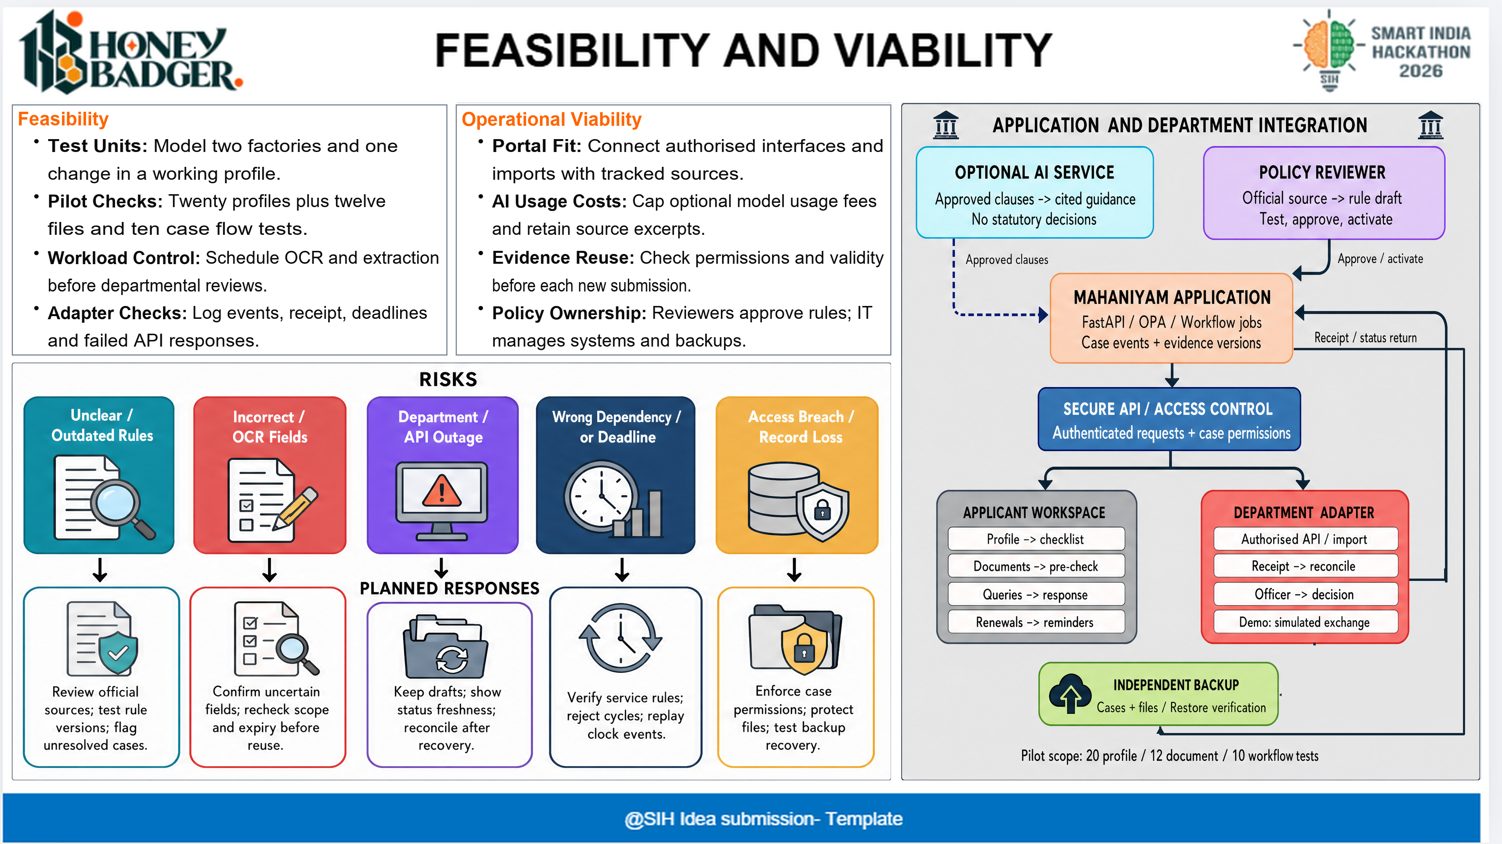
Notes:
SIH26130 — MahaNiyam
This slide uses a high-resolution composed image to preserve the matched layout. Text and diagrams are flattened. The source copy, count audit and full reference URLs are provided in the accompanying Markdown file.
Test Units: Model two factories and one
change in a working profile.
Pilot Checks: Twenty profiles plus twelve
files and ten case flow tests.
Workload Control: Schedule OCR and extraction
before departmental reviews.
Adapter Checks: Log events, receipt, deadlines
and failed API responses.
Portal Fit: Connect authorised interfaces and
imports with tracked sources.
AI Usage Costs: Cap optional model usage fees
and retain source excerpts.
Evidence Reuse: Check permissions and validity
before each new submission.
Policy Ownership: Reviewers approve rules; IT
manages systems and backups.
# SIH26130 — remaining slides: copy and matching audit
The four outputs follow the corresponding SIH26096 screenshots. The duplicate research screenshot represents one slide.
53 body lines across the four slides match the reference in both character and whitespace-delimited word counts. Counts include spaces and punctuation and exclude bullets/indentation. Line breaks are explicit; bold labels and orange headings follow the reference. Arial letter widths differ, so each replacement is fitted to its reference line width. Headings, diagram labels, reference titles and URLs are adapted for this problem and are not included in the 53-line claim.
## Line audit
| Slide | Line | Characters (both) | Words (both) | Replacement |
|---|---:|---:|---:|---|
| technical | 1 | 75 | 13 | Rule Sources: Link each approval to the official act and service rule [1,2] |
| technical | 2 | 41 | 5 | with sources, jurisdictions and validity. |
| technical | 3 | 73 | 12 | Rule Encoding: OPA / Rego checks typed facts; returns reasons or warnings |
| technical | 4 | 32 | 4 | for unresolved requirements. [9] |
| technical | 5 | 73 | 10 | Case Records: Store profiles, source clauses, versions and saved evidence |
| technical | 6 | 33 | 5 | links beside every case snapshot. |
| technical | 7 | 79 | 12 | Dependency Plan: Use NetworkX to order tasks and check prerequisites [10], with |
| technical | 8 | 35 | 3 | reviewed departmental dependencies. |
| technical | 9 | 77 | 9 | Document Intake: pypdf extracts; Tesseract transcribes scanned documents [11] |
| technical | 10 | 38 | 7 | then ask staff to check parsed fields. |
| technical | 11 | 71 | 9 | Case Workflow: Track submission, officer queries and inspection booking |
| technical | 12 | 35 | 6 | with the decision made by officers. |
| technical | 13 | 68 | 10 | Service Clocks: Track receipt, query and response events per service |
| technical | 14 | 68 | 8 | with service-specific calendars and applicable pause conditions. [2] |
| technical | 15 | 73 | 8 | Change Processing: Operational changes flag requirements; review, compare |
| technical | 16 | 40 | 5 | documents and retain previous snapshots. |
| technical | 17 | 78 | 15 | Portal UI: React and TypeScript give each role a view of the same shared case. |
| technical | 18 | 75 | 12 | API Service: FastAPI validates each case and records its state with events. |
| technical | 19 | 77 | 13 | Rule Engine: OPA checks facts and NetworkX labels each task ready or blocked. |
| technical | 20 | 75 | 13 | Batch Jobs: Queue OCR and alerts, then retry safe calls to each department. |
| technical | 21 | 74 | 12 | Data Store: Log case records in PostgreSQL and files with access controls. |
| technical | 22 | 74 | 10 | Integration: API adapters sync official status; demo calls stay simulated. |
| feasibility | 1 | 39 | 7 | Test Units: Model two factories and one |
| feasibility | 2 | 28 | 5 | change in a working profile. |
| feasibility | 3 | 41 | 6 | Pilot Checks: Twenty profiles plus twelve |
| feasibility | 4 | 30 | 6 | files and ten case flow tests. |
| feasibility | 5 | 45 | 6 | Workload Control: Schedule OCR and extraction |
| feasibility | 6 | 28 | 3 | before departmental reviews. |
| feasibility | 7 | 46 | 6 | Adapter Checks: Log events, receipt, deadlines |
| feasibility | 8 | 25 | 4 | and failed API responses. |
| feasibility | 9 | 45 | 6 | Portal Fit: Connect authorised interfaces and |
| feasibility | 10 | 29 | 4 | imports with tracked sources. |
| feasibility | 11 | 45 | 8 | AI Usage Costs: Cap optional model usage fees |
| feasibility | 12 | 27 | 4 | and retain source excerpts. |
| feasibility | 13 | 46 | 6 | Evidence Reuse: Check permissions and validity |
| feasibility | 14 | 27 | 4 | before each new submission. |
| feasibility | 15 | 45 | 6 | Policy Ownership: Reviewers approve rules; IT |
| feasibility | 16 | 28 | 4 | manages systems and backups. |
| impact | 1 | 117 | 16 | Expected impact: Fewer filing errors and clear next actions, with recorded decisions across the industrial lifecycle. |
| impact | 2 | 74 | 10 | Applicants: See required approvals and understand the next action clearly. |
| impact | 3 | 75 | 9 | Industrial Units: Identify renewal requirements and review planned business |
| impact | 4 | 8 | 1 | changes. |
| impact | 5 | 66 | 10 | Officers: Review evidence changes and queries within one full case |
| impact | 6 | 11 | 1 | chronology. |
| impact | 7 | 76 | 9 | Inspectors: Coordinate selected visits and review assigned case information. |
| impact | 8 | 76 | 9 | Submission Readiness: Catch omissions upfront and reuse authorised evidence. |
| impact | 9 | 80 | 10 | Visible Accountability: Separate applicant response time from the officer clock. |
| impact | 10 | 82 | 10 | Multilingual Guidance: Explain requirements with Marathi and English source links. |
| impact | 11 | 73 | 9 | Scheme Discovery: Assess eligibility criteria and documents with official |
| impact | 12 | 9 | 1 | services. |
| research | 1 | 97 | 12 | Workflow: MAITRI regulations inform case histories, service deadlines and query processing. [1,2] |
| research | 2 | 90 | 11 | Services: NSWS and departmental portals inform applications and evidence checklists. [4–7] |
| research | 3 | 97 | 11 | Implementation: OPA, NetworkX, PostgreSQL and OCR enable explainable, auditable workflows. [9–12] |
## Research applied
Workflow: MAITRI regulations inform case histories, service deadlines and query processing. [1,2]
Services: NSWS and departmental portals inform applications and evidence checklists. [4–7]
Implementation: OPA, NetworkX, PostgreSQL and OCR enable explainable, auditable workflows. [9–12]
## Full reference register
1. **Maharashtra Legislature: [MAITRI Act, 2023](https://lj.maharashtra.gov.in/en/document/the-maharashtra-industry-trade-and-investment-facilitation-act-2023-text-as-on-11th-december-2024/).** Statutory basis for single-window facilitation.
2. **Industries Department: [MAITRI Rules, 2025](https://industry.maharashtra.gov.in/sites/default/files/2025-12/maitri-rules-2025_1.pdf).** Service workflow and applicable query-time treatment; English pp. 10–11.
3. **Government of Maharashtra: [Industries, Investment & Services Policy, 2025](https://industry.maharashtra.gov.in/sites/default/files/2025-12/202512311332497910.pdf).** Policy context; scheme eligibility needs its own verified rules.
4. **Invest India / NSWS: [National Single Window System](https://www.nsws.gov.in/).** Approval discovery, applications, documents and tracking.
5. **MPCB: [Water & Air Act consent management](https://mpcb.gov.in/en/consentmgt/water-and-air-act).** Consent stages and department-specific requirements.
6. **DISH Maharashtra: [Online Services](https://mahadish.in/online_services).** Factory-related services and official department interfaces.
7. **FSSAI: [FoSCoS](https://foscos.fssai.gov.in/).** Food licensing and registration; category-specific requirements.
8. **Ministry of MSME: [MSME Schemes, 2025](https://msme.gov.in/sites/default/files/MSMESchemebooklet2025.pdf).** ZED and other scheme context; current criteria need verification.
9. **Open Policy Agent: [OPA documentation](https://www.openpolicyagent.org/docs).** Rego policy evaluation over structured facts.
10. **NetworkX: [Directed acyclic graphs](https://networkx.org/documentation/stable/reference/algorithms/dag.html).** Dependency ordering and cycle checks for approval tasks.
11. **pypdf / Tesseract: [Text extraction and OCR documentation](https://pypdf.readthedocs.io/en/stable/user/extract-text.html).** Parse PDFs and scans; confirm uncertain fields.
12. **PostgreSQL: [Row Security Policies](https://www.postgresql.org/docs/current/ddl-rowsecurity.html).** Row-level access controls support case permissions.
13. **GIGW: [Scope and Objective](https://guidelines.india.gov.in/scope-and-objective/).** Government website and application quality guidance.
Additional OCR documentation: https://tesseract-ocr.github.io/tessdoc/
Sources support the proposed design. Department adapters are simulated for the pilot unless authorised access is available. UI screens are proposed interface concepts, not evidence of a deployed product. Benefits are expected and require pilot validation.
## Generation and construction
Diagrams were generated using the OpenAI Images API with gpt-image-2, high quality, at 3840 × 2160. The three saved prompt files document each edit. Typography and research references were placed deterministically for spelling, line-count and citation accuracy. Generated panels were fitted to the reference panel geometry. The accepted idea slide is included unchanged.

Slide 4
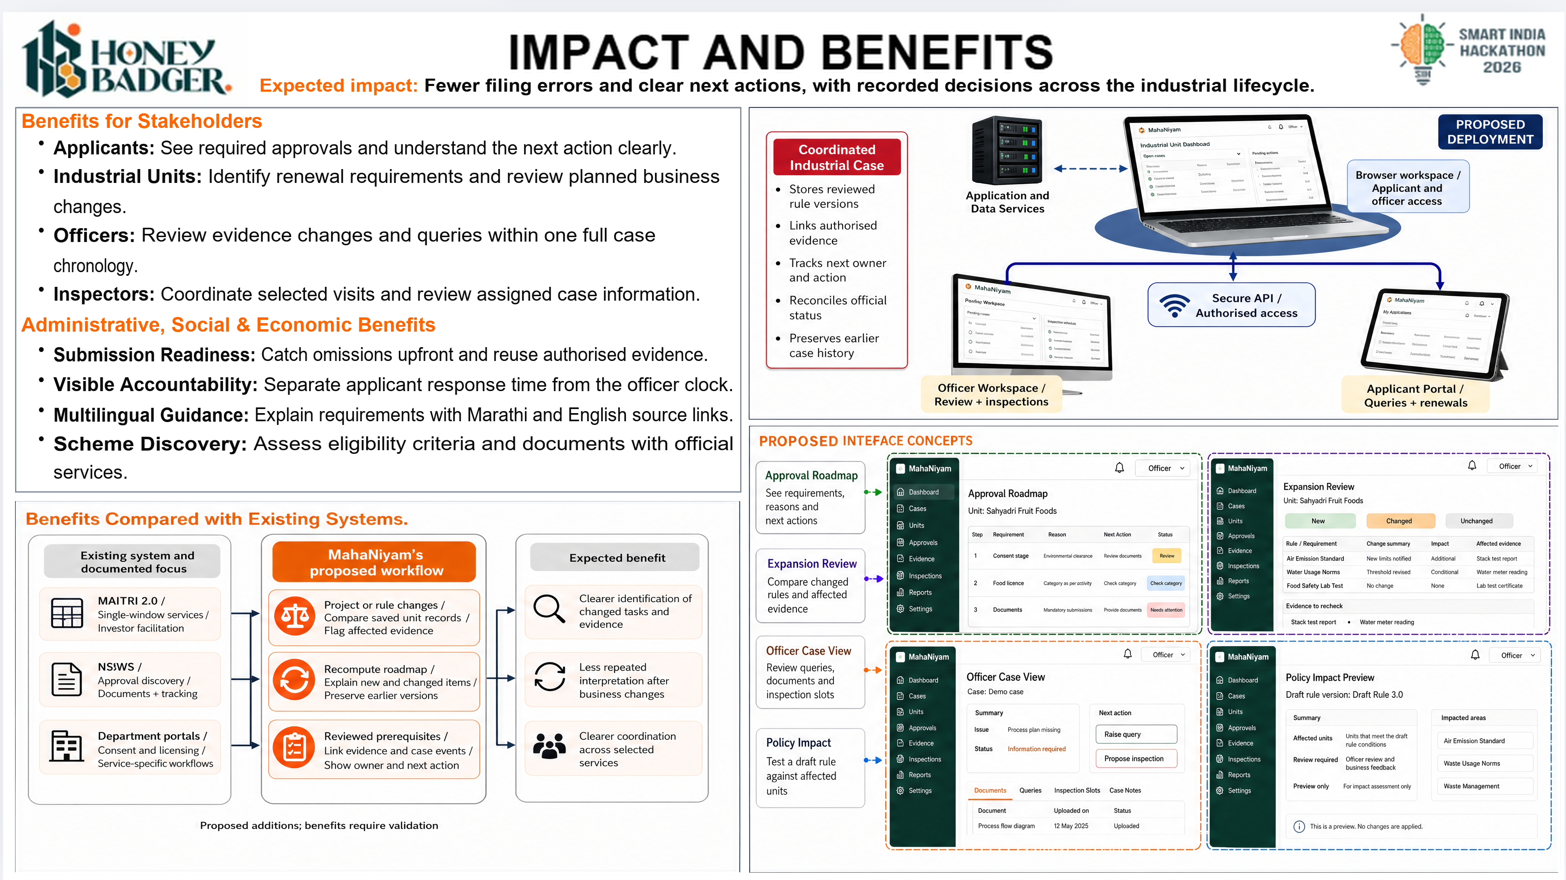
Notes:
SIH26130 — MahaNiyam
This slide uses a high-resolution composed image to preserve the matched layout. Text and diagrams are flattened. The source copy, count audit and full reference URLs are provided in the accompanying Markdown file.
Expected impact: Fewer filing errors and clear next actions, with recorded decisions across the industrial lifecycle.
Applicants: See required approvals and understand the next action clearly.
Industrial Units: Identify renewal requirements and review planned business
changes.
Officers: Review evidence changes and queries within one full case
chronology.
Inspectors: Coordinate selected visits and review assigned case information.
Submission Readiness: Catch omissions upfront and reuse authorised evidence.
Visible Accountability: Separate applicant response time from the officer clock.
Multilingual Guidance: Explain requirements with Marathi and English source links.
Scheme Discovery: Assess eligibility criteria and documents with official
services.
# SIH26130 — remaining slides: copy and matching audit
The four outputs follow the corresponding SIH26096 screenshots. The duplicate research screenshot represents one slide.
53 body lines across the four slides match the reference in both character and whitespace-delimited word counts. Counts include spaces and punctuation and exclude bullets/indentation. Line breaks are explicit; bold labels and orange headings follow the reference. Arial letter widths differ, so each replacement is fitted to its reference line width. Headings, diagram labels, reference titles and URLs are adapted for this problem and are not included in the 53-line claim.
## Line audit
| Slide | Line | Characters (both) | Words (both) | Replacement |
|---|---:|---:|---:|---|
| technical | 1 | 75 | 13 | Rule Sources: Link each approval to the official act and service rule [1,2] |
| technical | 2 | 41 | 5 | with sources, jurisdictions and validity. |
| technical | 3 | 73 | 12 | Rule Encoding: OPA / Rego checks typed facts; returns reasons or warnings |
| technical | 4 | 32 | 4 | for unresolved requirements. [9] |
| technical | 5 | 73 | 10 | Case Records: Store profiles, source clauses, versions and saved evidence |
| technical | 6 | 33 | 5 | links beside every case snapshot. |
| technical | 7 | 79 | 12 | Dependency Plan: Use NetworkX to order tasks and check prerequisites [10], with |
| technical | 8 | 35 | 3 | reviewed departmental dependencies. |
| technical | 9 | 77 | 9 | Document Intake: pypdf extracts; Tesseract transcribes scanned documents [11] |
| technical | 10 | 38 | 7 | then ask staff to check parsed fields. |
| technical | 11 | 71 | 9 | Case Workflow: Track submission, officer queries and inspection booking |
| technical | 12 | 35 | 6 | with the decision made by officers. |
| technical | 13 | 68 | 10 | Service Clocks: Track receipt, query and response events per service |
| technical | 14 | 68 | 8 | with service-specific calendars and applicable pause conditions. [2] |
| technical | 15 | 73 | 8 | Change Processing: Operational changes flag requirements; review, compare |
| technical | 16 | 40 | 5 | documents and retain previous snapshots. |
| technical | 17 | 78 | 15 | Portal UI: React and TypeScript give each role a view of the same shared case. |
| technical | 18 | 75 | 12 | API Service: FastAPI validates each case and records its state with events. |
| technical | 19 | 77 | 13 | Rule Engine: OPA checks facts and NetworkX labels each task ready or blocked. |
| technical | 20 | 75 | 13 | Batch Jobs: Queue OCR and alerts, then retry safe calls to each department. |
| technical | 21 | 74 | 12 | Data Store: Log case records in PostgreSQL and files with access controls. |
| technical | 22 | 74 | 10 | Integration: API adapters sync official status; demo calls stay simulated. |
| feasibility | 1 | 39 | 7 | Test Units: Model two factories and one |
| feasibility | 2 | 28 | 5 | change in a working profile. |
| feasibility | 3 | 41 | 6 | Pilot Checks: Twenty profiles plus twelve |
| feasibility | 4 | 30 | 6 | files and ten case flow tests. |
| feasibility | 5 | 45 | 6 | Workload Control: Schedule OCR and extraction |
| feasibility | 6 | 28 | 3 | before departmental reviews. |
| feasibility | 7 | 46 | 6 | Adapter Checks: Log events, receipt, deadlines |
| feasibility | 8 | 25 | 4 | and failed API responses. |
| feasibility | 9 | 45 | 6 | Portal Fit: Connect authorised interfaces and |
| feasibility | 10 | 29 | 4 | imports with tracked sources. |
| feasibility | 11 | 45 | 8 | AI Usage Costs: Cap optional model usage fees |
| feasibility | 12 | 27 | 4 | and retain source excerpts. |
| feasibility | 13 | 46 | 6 | Evidence Reuse: Check permissions and validity |
| feasibility | 14 | 27 | 4 | before each new submission. |
| feasibility | 15 | 45 | 6 | Policy Ownership: Reviewers approve rules; IT |
| feasibility | 16 | 28 | 4 | manages systems and backups. |
| impact | 1 | 117 | 16 | Expected impact: Fewer filing errors and clear next actions, with recorded decisions across the industrial lifecycle. |
| impact | 2 | 74 | 10 | Applicants: See required approvals and understand the next action clearly. |
| impact | 3 | 75 | 9 | Industrial Units: Identify renewal requirements and review planned business |
| impact | 4 | 8 | 1 | changes. |
| impact | 5 | 66 | 10 | Officers: Review evidence changes and queries within one full case |
| impact | 6 | 11 | 1 | chronology. |
| impact | 7 | 76 | 9 | Inspectors: Coordinate selected visits and review assigned case information. |
| impact | 8 | 76 | 9 | Submission Readiness: Catch omissions upfront and reuse authorised evidence. |
| impact | 9 | 80 | 10 | Visible Accountability: Separate applicant response time from the officer clock. |
| impact | 10 | 82 | 10 | Multilingual Guidance: Explain requirements with Marathi and English source links. |
| impact | 11 | 73 | 9 | Scheme Discovery: Assess eligibility criteria and documents with official |
| impact | 12 | 9 | 1 | services. |
| research | 1 | 97 | 12 | Workflow: MAITRI regulations inform case histories, service deadlines and query processing. [1,2] |
| research | 2 | 90 | 11 | Services: NSWS and departmental portals inform applications and evidence checklists. [4–7] |
| research | 3 | 97 | 11 | Implementation: OPA, NetworkX, PostgreSQL and OCR enable explainable, auditable workflows. [9–12] |
## Research applied
Workflow: MAITRI regulations inform case histories, service deadlines and query processing. [1,2]
Services: NSWS and departmental portals inform applications and evidence checklists. [4–7]
Implementation: OPA, NetworkX, PostgreSQL and OCR enable explainable, auditable workflows. [9–12]
## Full reference register
1. **Maharashtra Legislature: [MAITRI Act, 2023](https://lj.maharashtra.gov.in/en/document/the-maharashtra-industry-trade-and-investment-facilitation-act-2023-text-as-on-11th-december-2024/).** Statutory basis for single-window facilitation.
2. **Industries Department: [MAITRI Rules, 2025](https://industry.maharashtra.gov.in/sites/default/files/2025-12/maitri-rules-2025_1.pdf).** Service workflow and applicable query-time treatment; English pp. 10–11.
3. **Government of Maharashtra: [Industries, Investment & Services Policy, 2025](https://industry.maharashtra.gov.in/sites/default/files/2025-12/202512311332497910.pdf).** Policy context; scheme eligibility needs its own verified rules.
4. **Invest India / NSWS: [National Single Window System](https://www.nsws.gov.in/).** Approval discovery, applications, documents and tracking.
5. **MPCB: [Water & Air Act consent management](https://mpcb.gov.in/en/consentmgt/water-and-air-act).** Consent stages and department-specific requirements.
6. **DISH Maharashtra: [Online Services](https://mahadish.in/online_services).** Factory-related services and official department interfaces.
7. **FSSAI: [FoSCoS](https://foscos.fssai.gov.in/).** Food licensing and registration; category-specific requirements.
8. **Ministry of MSME: [MSME Schemes, 2025](https://msme.gov.in/sites/default/files/MSMESchemebooklet2025.pdf).** ZED and other scheme context; current criteria need verification.
9. **Open Policy Agent: [OPA documentation](https://www.openpolicyagent.org/docs).** Rego policy evaluation over structured facts.
10. **NetworkX: [Directed acyclic graphs](https://networkx.org/documentation/stable/reference/algorithms/dag.html).** Dependency ordering and cycle checks for approval tasks.
11. **pypdf / Tesseract: [Text extraction and OCR documentation](https://pypdf.readthedocs.io/en/stable/user/extract-text.html).** Parse PDFs and scans; confirm uncertain fields.
12. **PostgreSQL: [Row Security Policies](https://www.postgresql.org/docs/current/ddl-rowsecurity.html).** Row-level access controls support case permissions.
13. **GIGW: [Scope and Objective](https://guidelines.india.gov.in/scope-and-objective/).** Government website and application quality guidance.
Additional OCR documentation: https://tesseract-ocr.github.io/tessdoc/
Sources support the proposed design. Department adapters are simulated for the pilot unless authorised access is available. UI screens are proposed interface concepts, not evidence of a deployed product. Benefits are expected and require pilot validation.
## Generation and construction
Diagrams were generated using the OpenAI Images API with gpt-image-2, high quality, at 3840 × 2160. The three saved prompt files document each edit. Typography and research references were placed deterministically for spelling, line-count and citation accuracy. Generated panels were fitted to the reference panel geometry. The accepted idea slide is included unchanged.

Slide 5
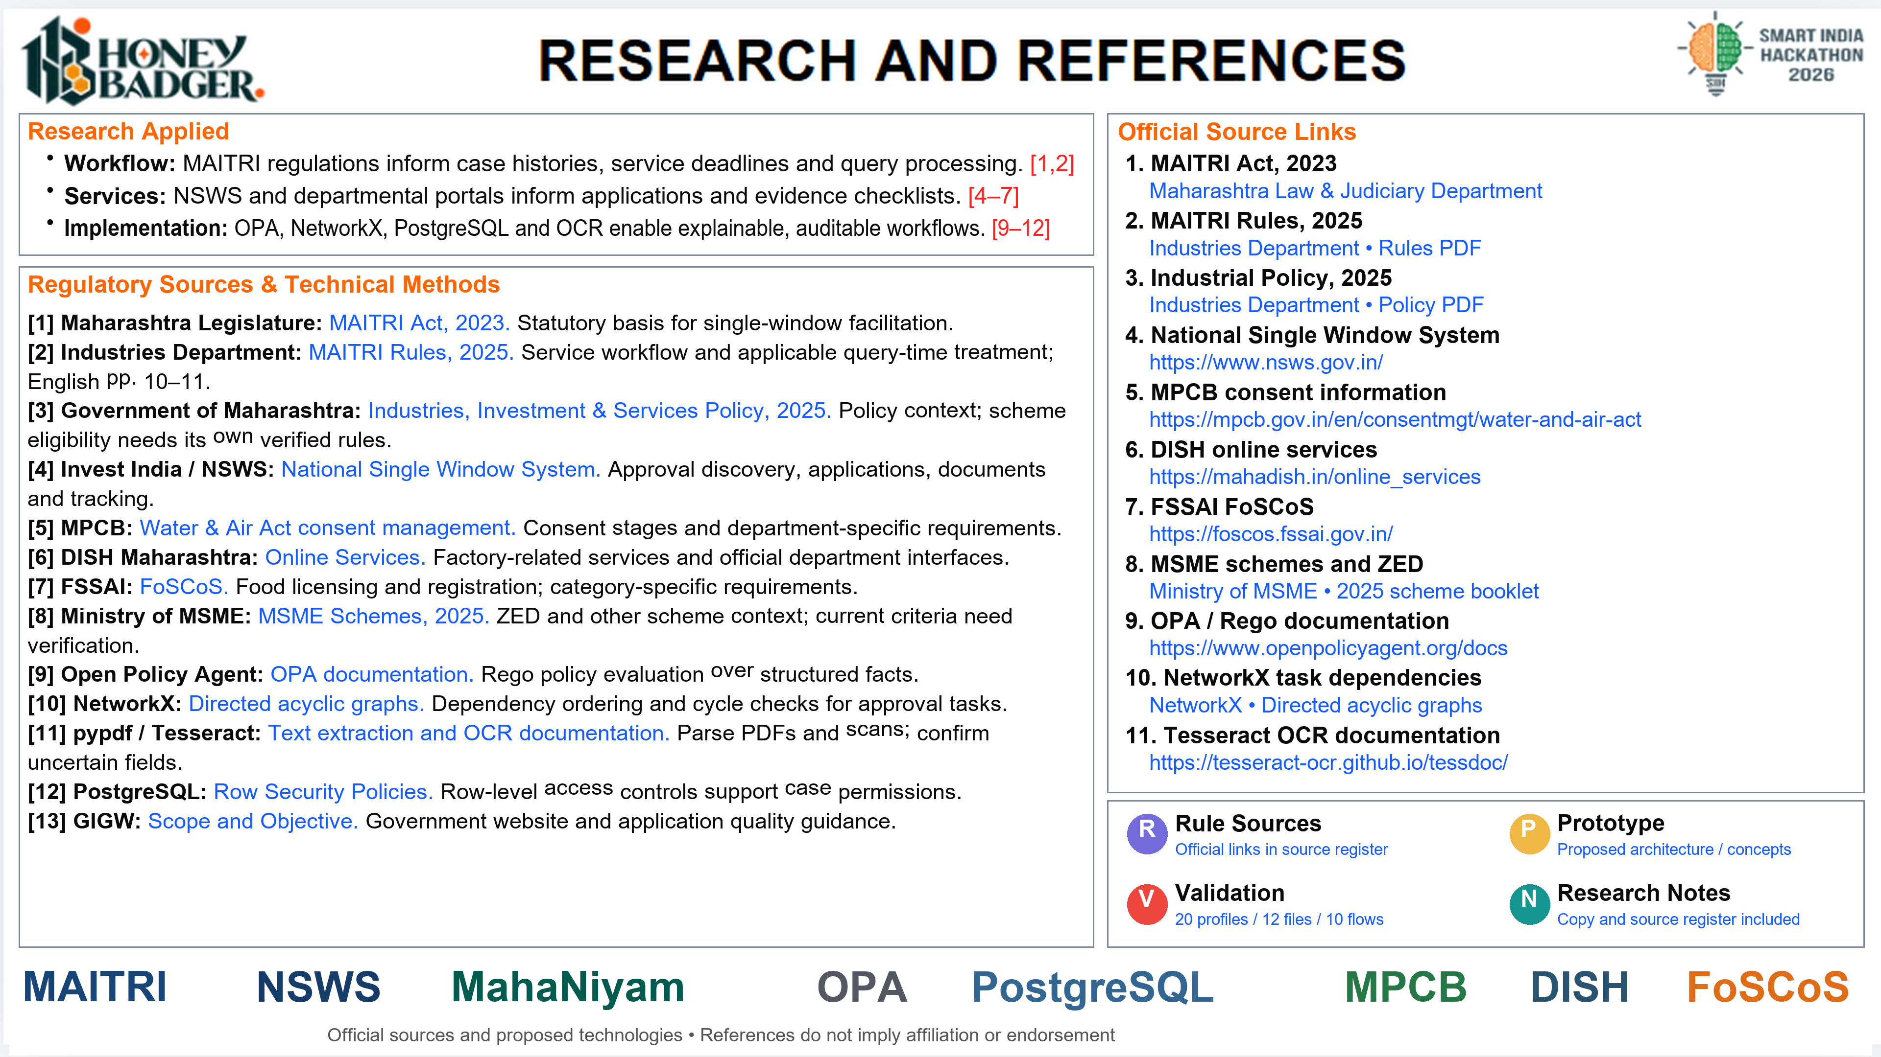
Notes:
SIH26130 — MahaNiyam
This slide uses a high-resolution composed image to preserve the matched layout. Text and diagrams are flattened. The source copy, count audit and full reference URLs are provided in the accompanying Markdown file.
# SIH26130 — remaining slides: copy and matching audit
The four outputs follow the corresponding SIH26096 screenshots. The duplicate research screenshot represents one slide.
53 body lines across the four slides match the reference in both character and whitespace-delimited word counts. Counts include spaces and punctuation and exclude bullets/indentation. Line breaks are explicit; bold labels and orange headings follow the reference. Arial letter widths differ, so each replacement is fitted to its reference line width. Headings, diagram labels, reference titles and URLs are adapted for this problem and are not included in the 53-line claim.
## Line audit
| Slide | Line | Characters (both) | Words (both) | Replacement |
|---|---:|---:|---:|---|
| technical | 1 | 75 | 13 | Rule Sources: Link each approval to the official act and service rule [1,2] |
| technical | 2 | 41 | 5 | with sources, jurisdictions and validity. |
| technical | 3 | 73 | 12 | Rule Encoding: OPA / Rego checks typed facts; returns reasons or warnings |
| technical | 4 | 32 | 4 | for unresolved requirements. [9] |
| technical | 5 | 73 | 10 | Case Records: Store profiles, source clauses, versions and saved evidence |
| technical | 6 | 33 | 5 | links beside every case snapshot. |
| technical | 7 | 79 | 12 | Dependency Plan: Use NetworkX to order tasks and check prerequisites [10], with |
| technical | 8 | 35 | 3 | reviewed departmental dependencies. |
| technical | 9 | 77 | 9 | Document Intake: pypdf extracts; Tesseract transcribes scanned documents [11] |
| technical | 10 | 38 | 7 | then ask staff to check parsed fields. |
| technical | 11 | 71 | 9 | Case Workflow: Track submission, officer queries and inspection booking |
| technical | 12 | 35 | 6 | with the decision made by officers. |
| technical | 13 | 68 | 10 | Service Clocks: Track receipt, query and response events per service |
| technical | 14 | 68 | 8 | with service-specific calendars and applicable pause conditions. [2] |
| technical | 15 | 73 | 8 | Change Processing: Operational changes flag requirements; review, compare |
| technical | 16 | 40 | 5 | documents and retain previous snapshots. |
| technical | 17 | 78 | 15 | Portal UI: React and TypeScript give each role a view of the same shared case. |
| technical | 18 | 75 | 12 | API Service: FastAPI validates each case and records its state with events. |
| technical | 19 | 77 | 13 | Rule Engine: OPA checks facts and NetworkX labels each task ready or blocked. |
| technical | 20 | 75 | 13 | Batch Jobs: Queue OCR and alerts, then retry safe calls to each department. |
| technical | 21 | 74 | 12 | Data Store: Log case records in PostgreSQL and files with access controls. |
| technical | 22 | 74 | 10 | Integration: API adapters sync official status; demo calls stay simulated. |
| feasibility | 1 | 39 | 7 | Test Units: Model two factories and one |
| feasibility | 2 | 28 | 5 | change in a working profile. |
| feasibility | 3 | 41 | 6 | Pilot Checks: Twenty profiles plus twelve |
| feasibility | 4 | 30 | 6 | files and ten case flow tests. |
| feasibility | 5 | 45 | 6 | Workload Control: Schedule OCR and extraction |
| feasibility | 6 | 28 | 3 | before departmental reviews. |
| feasibility | 7 | 46 | 6 | Adapter Checks: Log events, receipt, deadlines |
| feasibility | 8 | 25 | 4 | and failed API responses. |
| feasibility | 9 | 45 | 6 | Portal Fit: Connect authorised interfaces and |
| feasibility | 10 | 29 | 4 | imports with tracked sources. |
| feasibility | 11 | 45 | 8 | AI Usage Costs: Cap optional model usage fees |
| feasibility | 12 | 27 | 4 | and retain source excerpts. |
| feasibility | 13 | 46 | 6 | Evidence Reuse: Check permissions and validity |
| feasibility | 14 | 27 | 4 | before each new submission. |
| feasibility | 15 | 45 | 6 | Policy Ownership: Reviewers approve rules; IT |
| feasibility | 16 | 28 | 4 | manages systems and backups. |
| impact | 1 | 117 | 16 | Expected impact: Fewer filing errors and clear next actions, with recorded decisions across the industrial lifecycle. |
| impact | 2 | 74 | 10 | Applicants: See required approvals and understand the next action clearly. |
| impact | 3 | 75 | 9 | Industrial Units: Identify renewal requirements and review planned business |
| impact | 4 | 8 | 1 | changes. |
| impact | 5 | 66 | 10 | Officers: Review evidence changes and queries within one full case |
| impact | 6 | 11 | 1 | chronology. |
| impact | 7 | 76 | 9 | Inspectors: Coordinate selected visits and review assigned case information. |
| impact | 8 | 76 | 9 | Submission Readiness: Catch omissions upfront and reuse authorised evidence. |
| impact | 9 | 80 | 10 | Visible Accountability: Separate applicant response time from the officer clock. |
| impact | 10 | 82 | 10 | Multilingual Guidance: Explain requirements with Marathi and English source links. |
| impact | 11 | 73 | 9 | Scheme Discovery: Assess eligibility criteria and documents with official |
| impact | 12 | 9 | 1 | services. |
| research | 1 | 97 | 12 | Workflow: MAITRI regulations inform case histories, service deadlines and query processing. [1,2] |
| research | 2 | 90 | 11 | Services: NSWS and departmental portals inform applications and evidence checklists. [4–7] |
| research | 3 | 97 | 11 | Implementation: OPA, NetworkX, PostgreSQL and OCR enable explainable, auditable workflows. [9–12] |
## Research applied
Workflow: MAITRI regulations inform case histories, service deadlines and query processing. [1,2]
Services: NSWS and departmental portals inform applications and evidence checklists. [4–7]
Implementation: OPA, NetworkX, PostgreSQL and OCR enable explainable, auditable workflows. [9–12]
## Full reference register
1. **Maharashtra Legislature: [MAITRI Act, 2023](https://lj.maharashtra.gov.in/en/document/the-maharashtra-industry-trade-and-investment-facilitation-act-2023-text-as-on-11th-december-2024/).** Statutory basis for single-window facilitation.
2. **Industries Department: [MAITRI Rules, 2025](https://industry.maharashtra.gov.in/sites/default/files/2025-12/maitri-rules-2025_1.pdf).** Service workflow and applicable query-time treatment; English pp. 10–11.
3. **Government of Maharashtra: [Industries, Investment & Services Policy, 2025](https://industry.maharashtra.gov.in/sites/default/files/2025-12/202512311332497910.pdf).** Policy context; scheme eligibility needs its own verified rules.
4. **Invest India / NSWS: [National Single Window System](https://www.nsws.gov.in/).** Approval discovery, applications, documents and tracking.
5. **MPCB: [Water & Air Act consent management](https://mpcb.gov.in/en/consentmgt/water-and-air-act).** Consent stages and department-specific requirements.
6. **DISH Maharashtra: [Online Services](https://mahadish.in/online_services).** Factory-related services and official department interfaces.
7. **FSSAI: [FoSCoS](https://foscos.fssai.gov.in/).** Food licensing and registration; category-specific requirements.
8. **Ministry of MSME: [MSME Schemes, 2025](https://msme.gov.in/sites/default/files/MSMESchemebooklet2025.pdf).** ZED and other scheme context; current criteria need verification.
9. **Open Policy Agent: [OPA documentation](https://www.openpolicyagent.org/docs).** Rego policy evaluation over structured facts.
10. **NetworkX: [Directed acyclic graphs](https://networkx.org/documentation/stable/reference/algorithms/dag.html).** Dependency ordering and cycle checks for approval tasks.
11. **pypdf / Tesseract: [Text extraction and OCR documentation](https://pypdf.readthedocs.io/en/stable/user/extract-text.html).** Parse PDFs and scans; confirm uncertain fields.
12. **PostgreSQL: [Row Security Policies](https://www.postgresql.org/docs/current/ddl-rowsecurity.html).** Row-level access controls support case permissions.
13. **GIGW: [Scope and Objective](https://guidelines.india.gov.in/scope-and-objective/).** Government website and application quality guidance.
Additional OCR documentation: https://tesseract-ocr.github.io/tessdoc/
Sources support the proposed design. Department adapters are simulated for the pilot unless authorised access is available. UI screens are proposed interface concepts, not evidence of a deployed product. Benefits are expected and require pilot validation.
## Generation and construction
Diagrams were generated using the OpenAI Images API with gpt-image-2, high quality, at 3840 × 2160. The three saved prompt files document each edit. Typography and research references were placed deterministically for spelling, line-count and citation accuracy. Generated panels were fitted to the reference panel geometry. The accepted idea slide is included unchanged.

