Slide 1
Sacchon A Diabetes Management Web Application by
Code.Hub | Pfizer - Software & Cloud Engineering Bootcamp
16-05-2021
Vasilis Didaggelos

Slide 2
Agenda
What is Maven?
The Clean Architecture overview
Sacchon Service requirements
Sacchon drawbacks
Aws cloud computing
Sacchon Implementation

Slide 3
What is Maven?
A Java project management and integration build tool.
Based on the concept of XML Project Object Model (POM).
Originally developed for building Turbine.
Notes:
Two scenarios drove Maven to us:
As a Java developer who is involved with building the application. Like to be able to reuse the build scripts, as simple as making a Java API call.
As a project manager/team lead who is trying to keep up-to-date with inter-dependencies among components.

Slide 4
Architecture Overview
Build System
project.xml (pom)
maven.xml (goals)
http
Remote
Repo
Local
Repo
maven

Slide 5
Artifact Repository
Local Repository
  A local mirror/cache of downloaded artifacts from remote repositories.
  Located at ${user.home}/.maven/repository

Slide 6
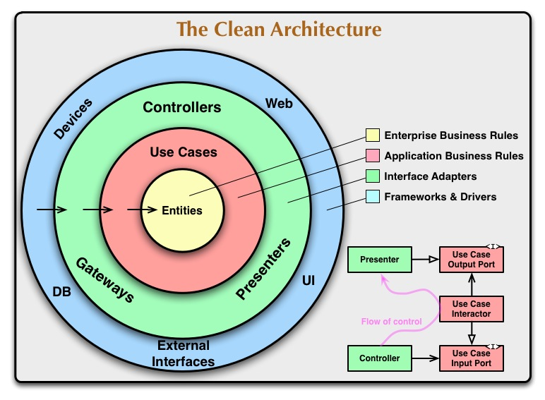
The Clean Architecture

Slide 7
Sacchon Service requirements
For building and running the application use:
Java 11
Maven
Microsoft SQL Server
Restlet
Hibernate
Mulesoft
Lombok
Logback
Deploying the application to AWS

Slide 8
Sacchon Service overview
Sacchon is workflow automation software
Maintain the medical records of the patient
Maintain the contact details of the patient
Keep track of the appointment dates
Save the insurance information for later reference

Slide 9
Sacchon Service overview
MediDataRepo: Patient can signup account, manage account, store medical data related to glucose, view data and update.
DoctorAdvice: Doctor can signup, remove account, view patient record, search data and update consultation data.
Reporter: Chief Doctor can see reports and monitor patient data, monitor doctor data, list of patients awaiting consultation, list of doctors no actwithivity.

Slide 10
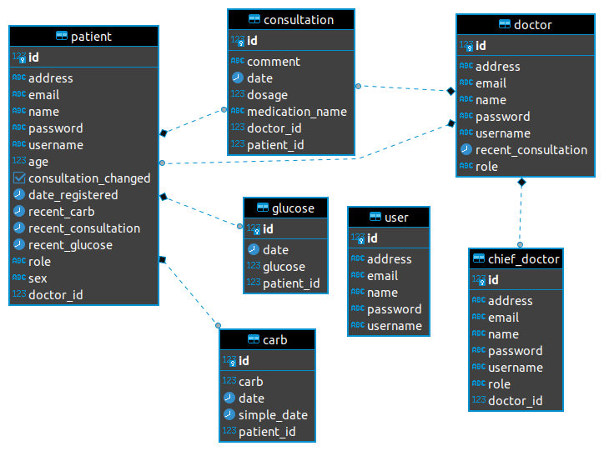
Sacchon Service ER-Diagram
Notes:
Entity Relationship Diagram

Slide 11
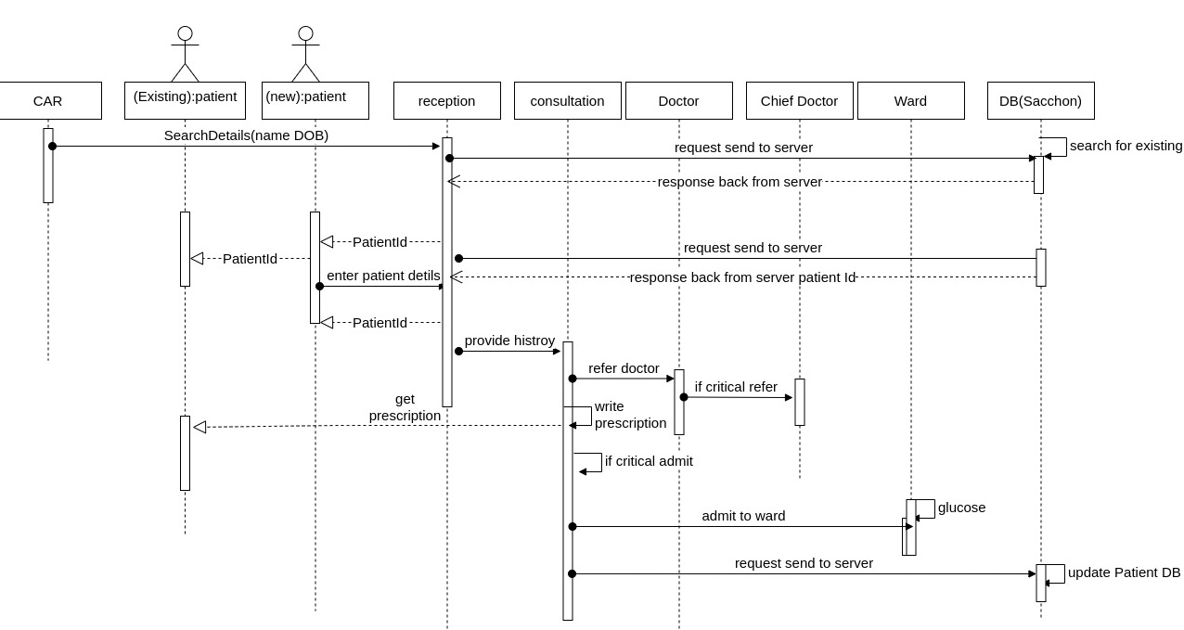
Sequence Diagram
Notes:
Object interactions arranged in time sequence

Slide 12
Sacchon drawbacks
Sacchon drawbacks
  Service layer/business logic layer
  not maintain layering –eg controller layer
  Api documentation
  No Global Error handling implemented
  API validation not implemented
  Authorizatuion needs to be done using jwt token.
  Gdpr rules also need to be checked
  Tester classes complete test case writing
  Api redesigning application structure needs improvement

Slide 13
Implementation
Compile the projects on IntelJ Idea
Make the public repository on GitHub make push and commit
Compile and make the connection on localhost
Create account on aws root and iam user
Create Rds on aws and configuration
Create Ec2 , instance machine and configuration
Then connect database and run query to migration
Change pom.file to load plugin maven assembly
Built the jar.file
Make the service on Aws to run the .jar
Setup some services like start , stop to reload my .jar file
Make some endpoints with postman using http: calls

Slide 14

Questions

