Slide 1




Real Time Computer Vision and Neural Network based defect inspection system in Steel Manufacturing
Didarul Amin &
Arif Billah
Supervised By
Prof Dr. Shamim Akhter
1

Slide 2
Motivation of The Research
Surface quality is an essential parameter for steel sheet
Manual defect inspection is a tedious assignment
Difficult to guarantee the surety of a flawless steel surface
Machine learning and Computer Vision-based automatic steel surface investigation strategies can be a robust solution in steel manufacturing.
2

Slide 3
Related Works & Background
Various machine learning methods have been used to solve classifying the steel surface defect problem.
Many Researches that analyze defects through :
1.SVM [1]
2.CNN [2]
3.PCA [3]
4.Self Organizing Maps(SOM) [4]
.
3

Slide 4
Objective
Implementing modern Deep Learning techniques and algorithms to detect steel defects and classify them.
Detect the location of the defects using image segmentation technique.
Apply Deep neural networks including U-net and Mask R-CNN.
Analyze their performances using statistical and mathematical methods.
Build a real time inspection system combination of Hardware and software.
.
4

Slide 5
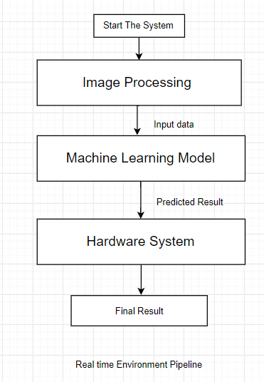
Real-time Environment Pipeline
5

Slide 6
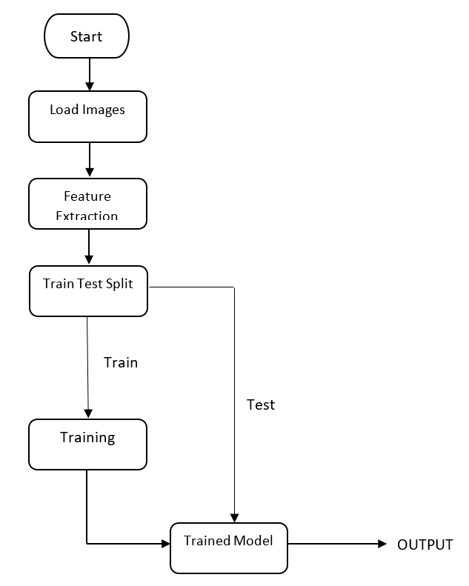
Deep Neural Network Training Pipeline
6

Slide 7
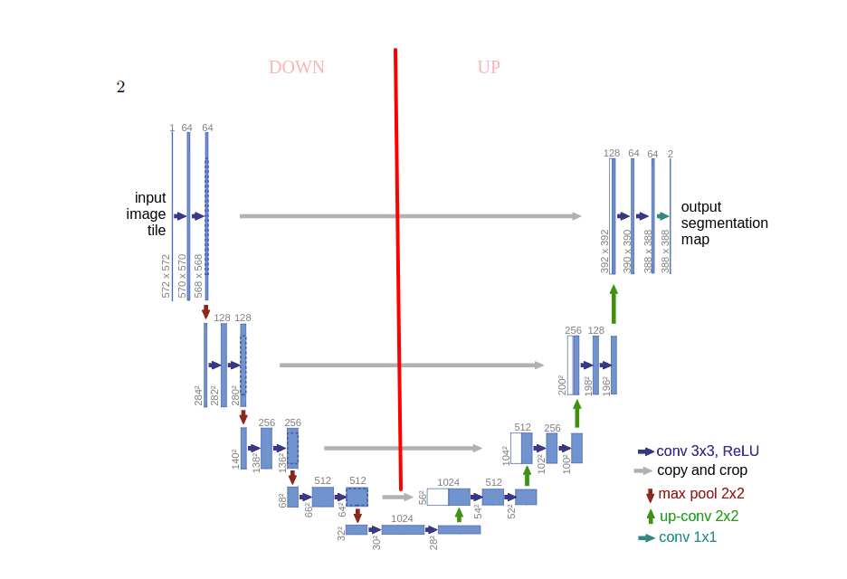
Neural Network Architecture
The architecture looks like a ‘U’ which justifies its name
This architecture consists of three sections: The contraction, The bottleneck, and the expansion section
7

Slide 8
Neural Network Architecture
The contraction section is made of many contraction blocks.
Each block takes an input applies two 3X3 convolution layers followed by a 2X2 max pooling.
kernels or feature maps after each block doubles.
The bottommost layer mediates between the contraction layer and the expansion layer.
Expansion section uses two 3X3 CNN layers followed by 2X2 up up sampling layer.

Slide 9
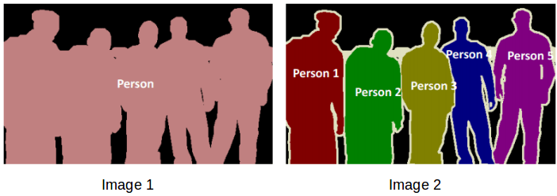
Why U-net?
First and most efficient strategy is using a segmentation model
Segmentation models used because they partitions an image into regions and can classify objects in a image
8

Slide 10
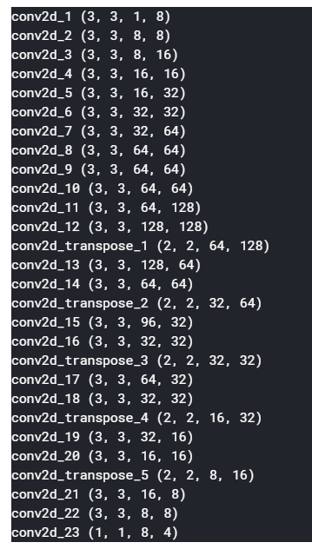
Suitable U-Net network For Steel defect detection
Our network contain 22 hidden layers with one input layer 8 neuron output layer with 4 neurons.
We used ‘Exponential Linear Unit’ function to activate neuron.
Optimizer Function ‘ADAM’
Validation Function ‘Dice Coefficient ’
Model train time 1.30hrs.
9

Slide 11
Data Source & Description
Train Data: containing all train images(12568 unique)
Test Data: containing all test images(1801 unique)
Train.csv: containing Image id and Encoded Pixels columns
Each Image may have no defects, a defect of a single class, or defects of multiple classes (Class Id = [1, 2, 3, 4]).
https://www.kaggle.com/c/severstal-steel-defect-detection/data
10

Slide 12
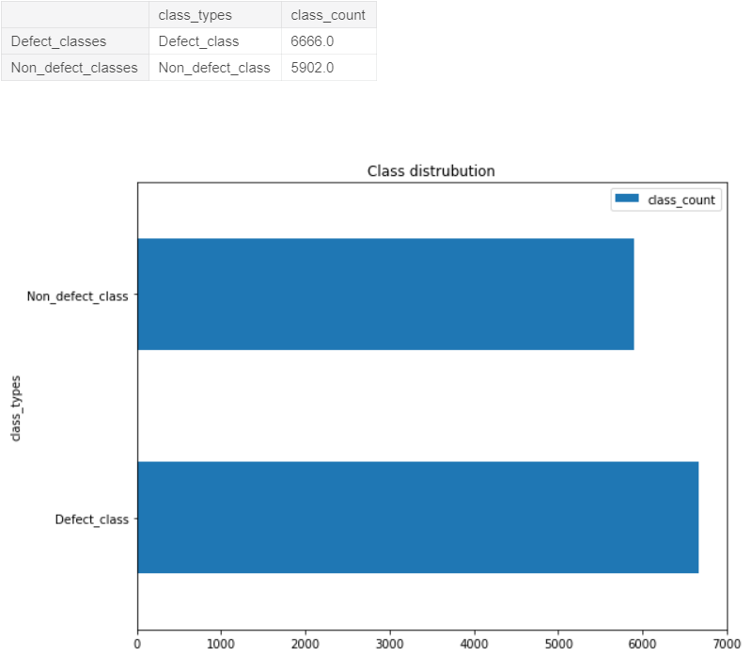
Data Source & Description
11

Slide 13
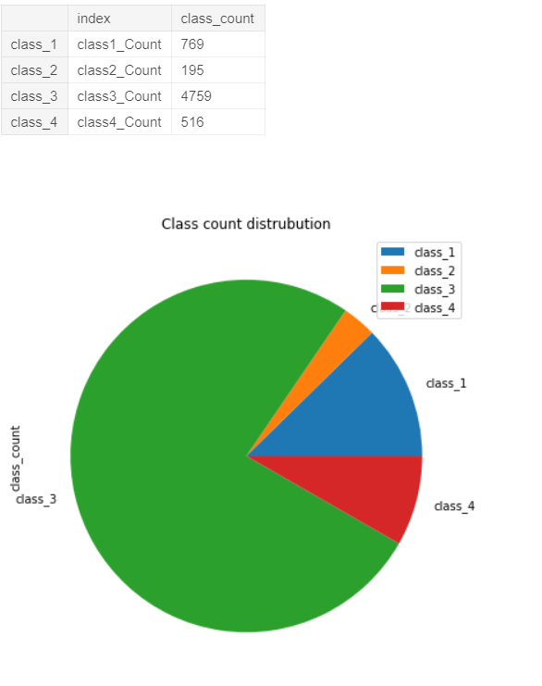
Defect Class Distribution
Our multi label classification is imbalance in data
Class-2 defected images are very small in data size and class-1 defects are very huge in data, classes 3,4 are somewhat balanced.
Challenging problem
12

Slide 14
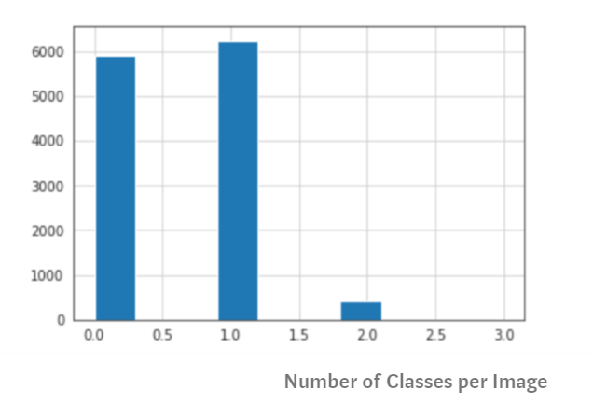
Number of Classes per image
We can observe that distribution first 2 classes are more and 3,4 classes are almost null in images
13

Slide 15
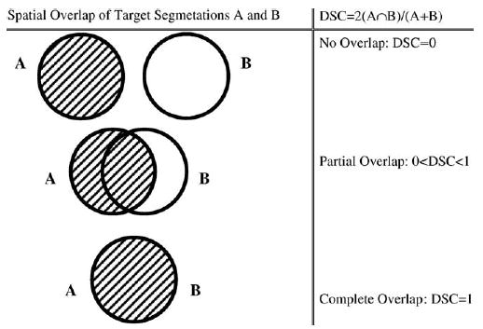
Dice-coefficient
Metrics to Evaluate your Semantic Segmentation Model
Used to compare the pixel-wise agreement between a predicted segmentation and its corresponding ground truth
14

Slide 16
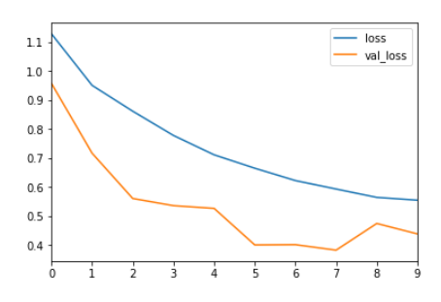
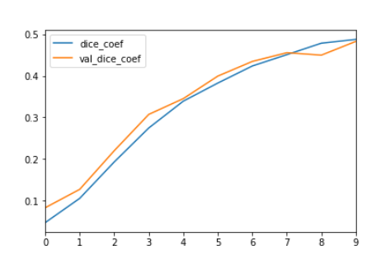
Model Evaluation after training
Optimization Graph
Dice-coefficient
15

Slide 17
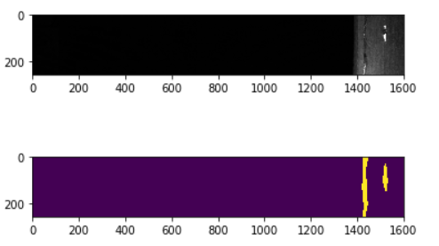
Some random mask prediction results
Class 1
16

Slide 18
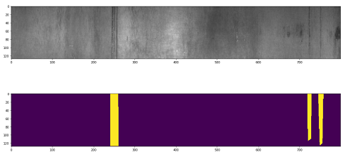
Some random mask prediction results
Class 2
17

Slide 19
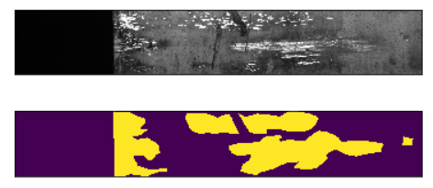
Some random mask prediction results
Class 3
18

Slide 20
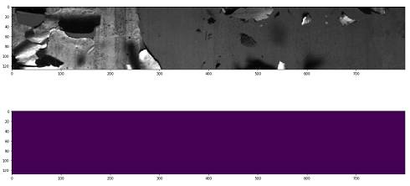
Some random mask prediction results
Class 4
19

Slide 21
Reference Paper
[1][2] [4] KIM, SU Min; Taesu Park, PooGyeon Park. Classification of Steel Surface Defect Using Convolutional Neural Network with Few Images. In: IECON 2010-36th Annual Conference on IEEE Industrial Electronics Society. IEEE, 2010. p. 1081-1086.
[2] [3]D. Soukup , R. Huber-Mork. Convolutional Neural Networks for Steel Surface Defect Detection from Photometric Stereo Images.Source : https://arxiv.org/abs/1505.04597
[5] Olaf Ronneberger, Philipp Fischer, Thomas Brox .U-Net: Convolutional Networks for Biomedical Image Segmentation . Source :https://arxiv.org/abs/1505.04597
.
20

Slide 22
Conclusion & Future plan
These Results show that performance of our model is good
We got more than 60% accuracy.
Will apply ‘Mask RCCN’ neural network and explore more
Will try to increase accuracy of model
Use a better pipeline, which may perform better than this
21

Slide 23
Thanks

