Slide 1
NEW BUSINESS LOCATION SELECTION IN SEATTLE

Slide 2
BIG MARKET, HARD TO DECIDE
Seattle has been one of the fastest growing large American cities for nearly a decade
Big city – 15th largest city in the United States
Diverse market – over 30 neighborhoods
Hard to decide where to start a new business in Seattle

Slide 3
PROBLEM SOLVING APPROACH
This analysis goes through the data of each Seattle neighborhood from the following aspects. A bakery is used for market defining and data acquisition purposes.
median age
household income
crime rate
current market saturation

Slide 4
DATA ACQUISITION AND CLEANING
Median age by Seattle neighborhoods (2010 U.S. Census) – link
Individual Income Tax Statistics by Washington zip code (2017 IRS data) - link
United States zip codes
Seattle Police Department crime data (2018-present) - link
Foursquare location data that shows bakeries within Seattle city limit

Slide 5
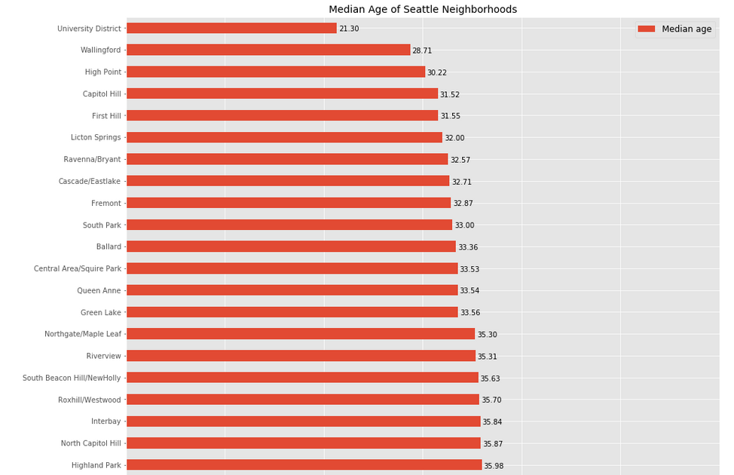
Median Age by Neighborhood
Bakery target market: young individuals and families (35 years old and under)
The data is from 2010 U.S. Census
The neighborhoods with median age under 36 is shown

Slide 6
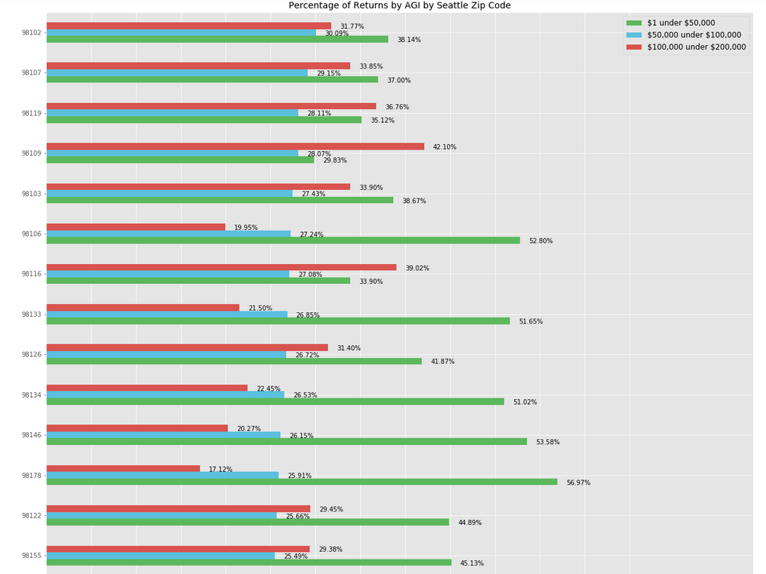
Adjusted Gross Income (AGI) by Seattle Zip Code
Bakery Target Market: individuals or families with medium to high income level ($50,000 < AGI < $100,000)
The data is based on Federal income tax returns filed in 2017
The blue bars represent the percentage of individuals/families with annual income between $50,000 and $100,000 in each Seattle zip code (top 14 is showing here)

Slide 7
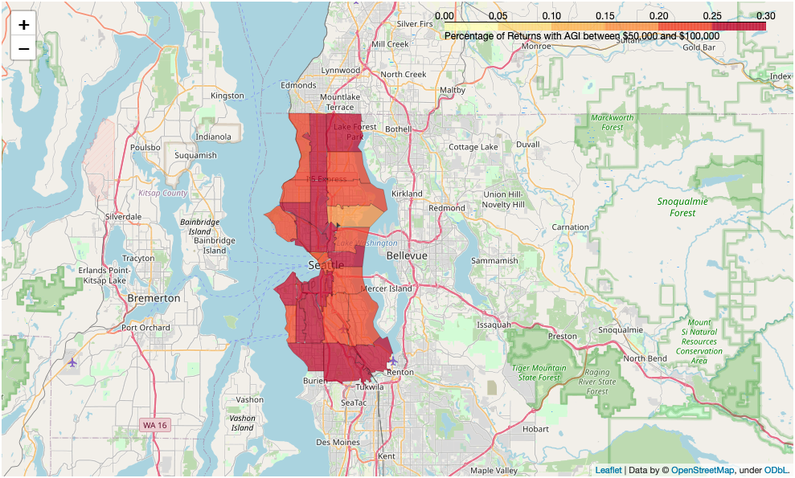
Adjusted Gross Income (AGI) by Seattle Zip Code
The neighborhoods with the highest percentage of annual income between $50,000 and $100,000:
East Lake (98102)
Adams/Ballard (98107)
Queen Anne (98119)
West Lake (98109)
Woodland Park/Green Lake (98103)
Riverview/South Delridge (98106)
Alki (98116)
High Point/Delridge (98126)

Slide 8
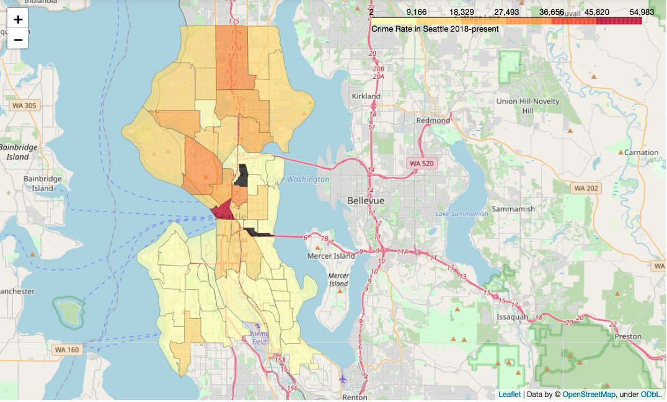
Crime Data
The bakery wants to provide a safe environment for its customers
The safeness of each neighborhood is measured using Seattle PD crime rate data from 2018 – present
The safer neighborhoods include:
Eastlake
Madison Park
South and North Delridge
South Beacon Hill
Alki

Slide 9
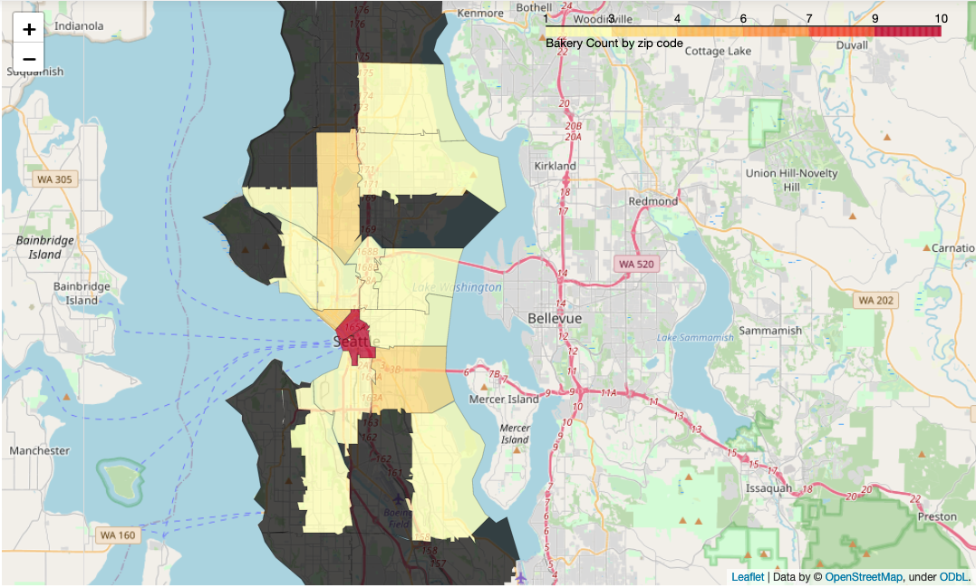
Current Market Saturation
Foursquare REST API
Venues in bakery category within Seattle city limit
Neighborhoods with few or no bakery based on Foursquare data:
Ballard
Magnolia
Queen Anne
University District
Delridge

Slide 10
Conclusion and future directions
After evaluating the median age, annual income (AGI), crime rate, and current market saturation of each Seattle neighborhoods, the general recommendation for a new bakery will be in Ballard, Queen Anne, Alki, Green Lake and Delridge.
This is just a general overview of the Seattle market. To improve the accuracy of the analysis and further narrow down the location selection, the following can be considered:
Population size of each neighborhood and look at crime rate per capita and number of bakery per capita
Average/median rental cost of each neighborhood
Zoning and permit requirement of each neighborhood
Update the median age and AGI analysis using latest census and IRS data
Improve the data availability of current market saturation by using different API such as Yelp

