Slide 1
中文題目 自動化預測空氣品質AQI
ENGLISH TITLE Automatically predicts air quality
組別:第四組
專題學生: 系級資電三 學號 s04351034 姓名 林瓏穎
系級資電三 學號 s04351035 姓名 徐偉軒
系級資電三 學號 s04351048 姓名 陳一洋
指導教授:楊朝棟 April 1, 2018

Slide 2
大綱
林瓏穎 TPOT
徐偉軒 python繪製台灣地圖
陳一洋 Ubuntu Python Machine Learning

Slide 3
TPOT
自動化特徵預處理和模型優化工具
使用遺傳算法

Slide 4
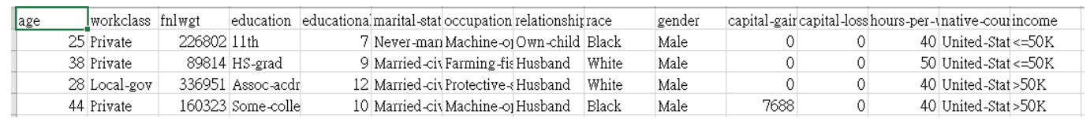
TPOT—實作
Data取自UCI開源數據集，預測個人年收入

Slide 5
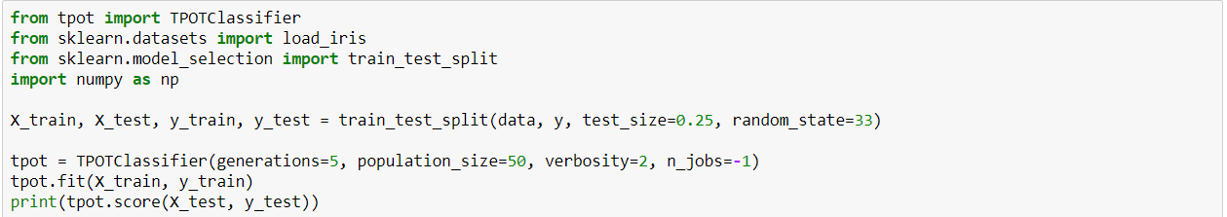
TPOT—實作程式碼

Slide 6
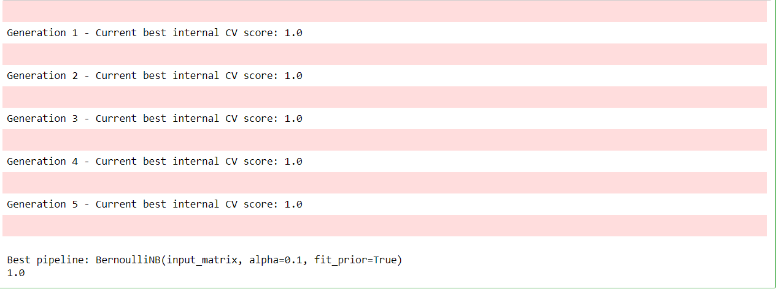
TPOT—實作結果

Slide 7
參考資料
自動化機器學習——TPOT
https://zhuanlan.zhihu.com/p/28149981
TPOT：機器學習傻瓜式工作流
https://www.jianshu.com/p/2d7f1bbf2af2
自動化機器學習(AutoML)
http://www.sohu.com/a/194959844_747818

Slide 8
製圖
繪製台灣地圖並補上各縣市邊界
再標上各測站位置

Slide 9
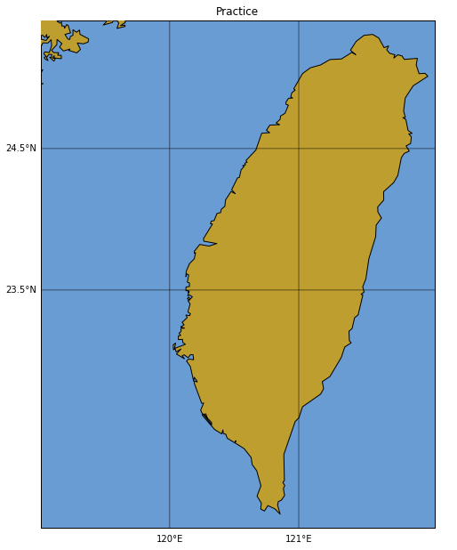
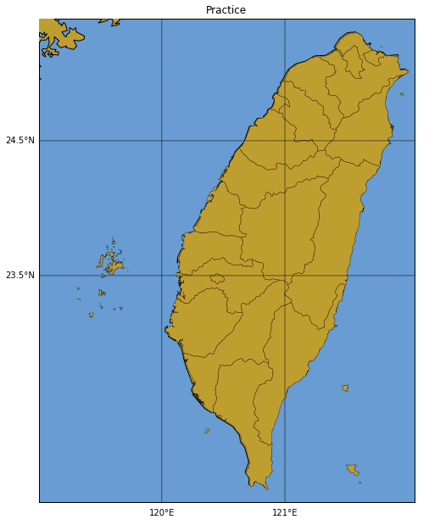
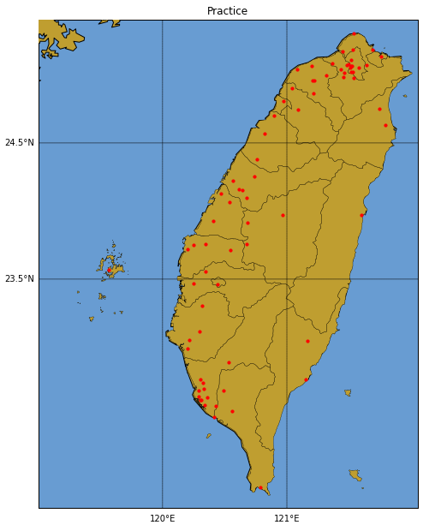
Mpl_toolkits.basemap

Slide 10
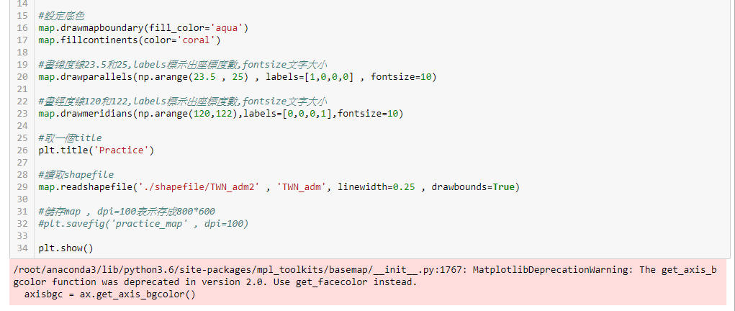
Error code1

Slide 11
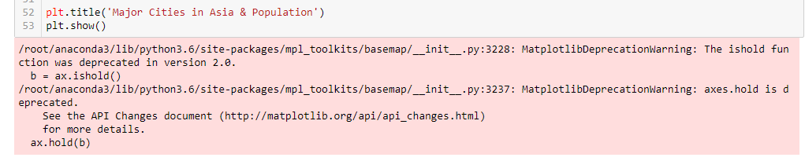
Error code2

Slide 12
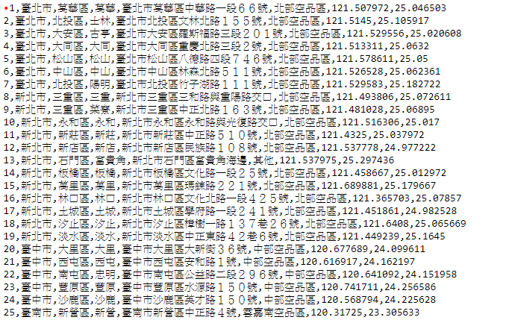
測站資料

Slide 13
參考資料
Errorcode1 https://github.com/matplotlib/basemap/blob/master/lib/mpl_toolkits/basemap/__init__.py#L1753
Errorcode2 https://github.com/matplotlib/matplotlib/issues/7808
測站資料 https://goo.gl/o58KB7

Slide 14



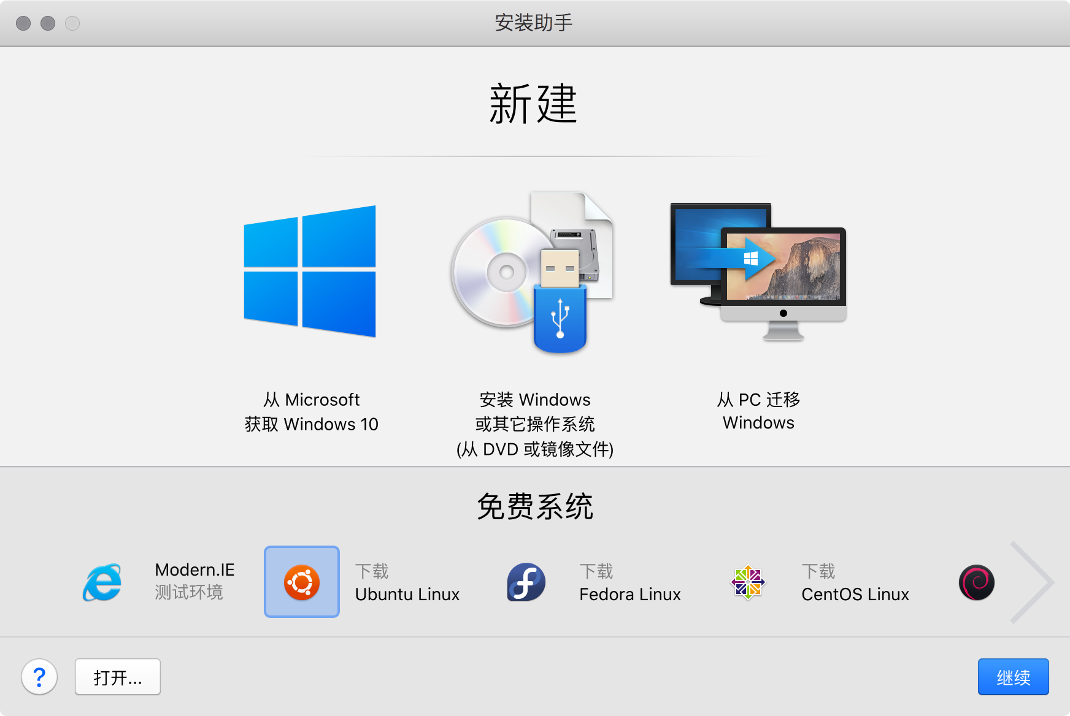
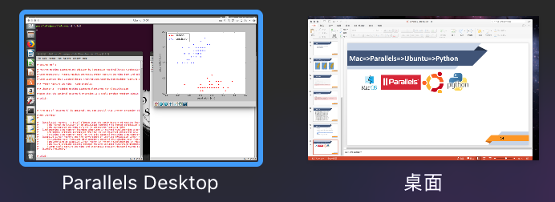
Mac=>Parallels=>Ubuntu=>Python
在Ubuntu下 安裝配置numpy,scipy,matplotlib, pandas, sklearn,etc.

Slide 15
參考資料
https://www.parallels.com
https://www.cnblogs.com/luckyalan/p/6703590.html
https://blog.csdn.net/title71/article/details/78344520
https://www.cnblogs.com/dorra/p/8127878.html
https://blog.csdn.net/u010126792/article/details/62427958
https://www.cnblogs.com/Jeb15/p/6080331.html
https://www.cnblogs.com/GarfieldTom/archive/2012/12/06/2804965.html
https://blog.csdn.net/Yakumoyukarilan/article/details/51340358
https://www.zhihu.com/question/47003185
https://blog.csdn.net/xiaopihaierletian/article/details/72935120

Slide 16
Training a Perceptron Model on the Iris Dataset
The Iris flower data set or Fisher‘s Iris data set is a multivariate data set introduced by the British statistician and biologist Ronald Fisher in his 1936 paper The use of multiple measurements in taxonomic problems as an example of linear discriminant analysis. It is sometimes called Anderson’s Iris data set because Edgar Anderson collected the data to quantify the morphologic variation of Iris flowers of three related species. Two of the three species were collected in the Gaspé Peninsula "all from the same pasture, and picked on the same day and measured at the same time by the same person with the same apparatus".

Slide 17
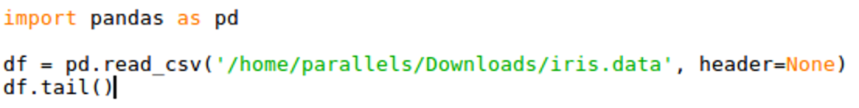
Use the Pandas Library to Load the Iris Dataset
Use the pandas library:
To load the Iris dataset directly from the UCI Machine Learning Repository into a DataFrame object
To print the last five lines via the tail method to check the data was loaded correctly

Slide 18
Training Data Preprocessing and Visualization
We extract the first 100 class labels that correspond to the 50 Iris-setosa and 50 Iris-versicolor flowers
Then we convert the class labels into the two integer
class labels that we assign to a vector y:
Label 1 (versicolor)
Label -1 (setosa)
Note that the values method of a pandas DataFrame yields the corresponding NumPy representation.
We extract the first feature column (sepal length) and the third feature column (petal length) of those 100 training samples:
Then assign them to a feature matrix X
We can visualize the matrix X via a two-dimensional scatter plot using Matplotlib

Slide 19
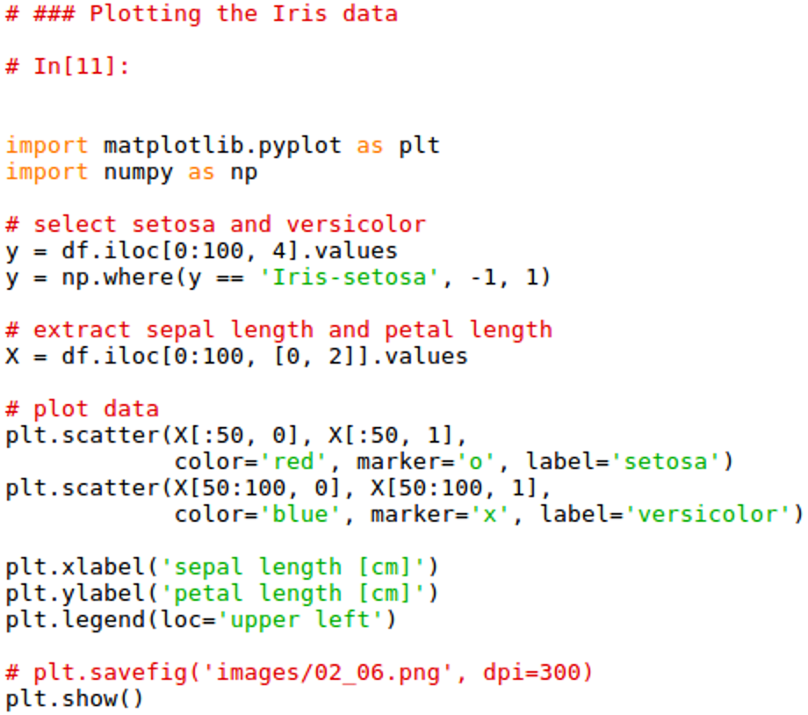
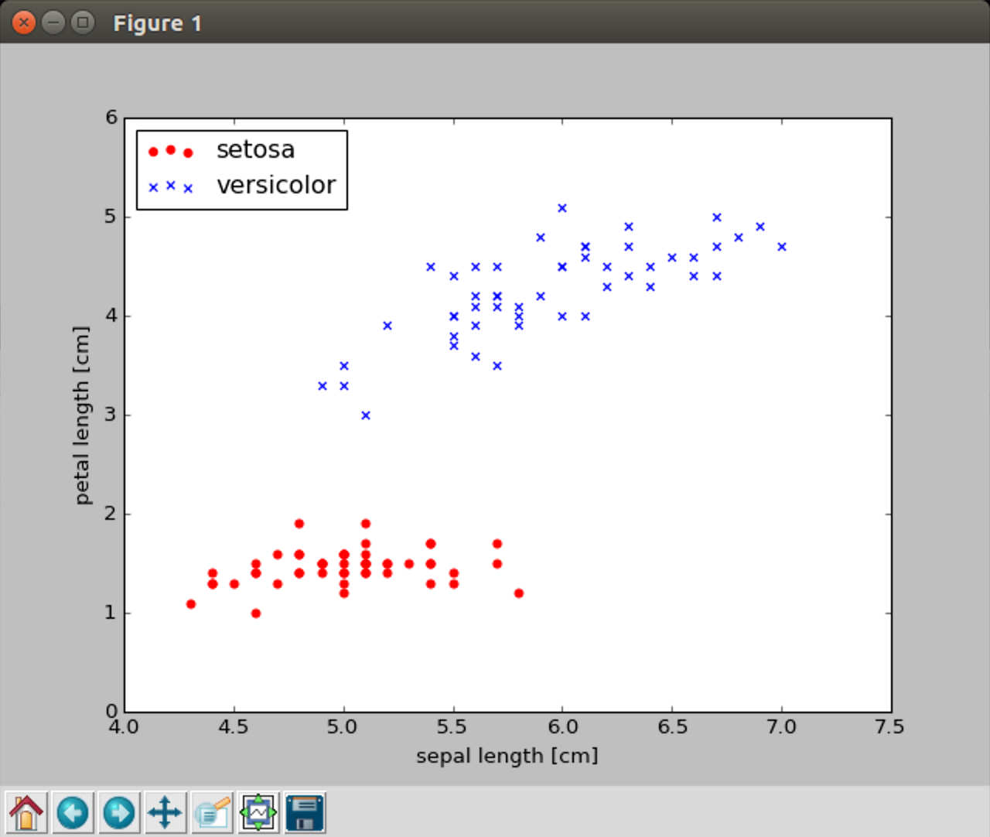
Python Code & Result(scatterplot of training sample)

Slide 20
Analyze
The preceding scatterplot shows:
The distribution of flower samples in the Iris dataset along the two feature axes, petal length and sepal length.
We can find a linear decision boundary:
It is sufficient to separate Setosa from Versicolor flowers.
Thus, a linear classifier such as the perceptron should be able to classify the flowers in this dataset perfectly.

Slide 21
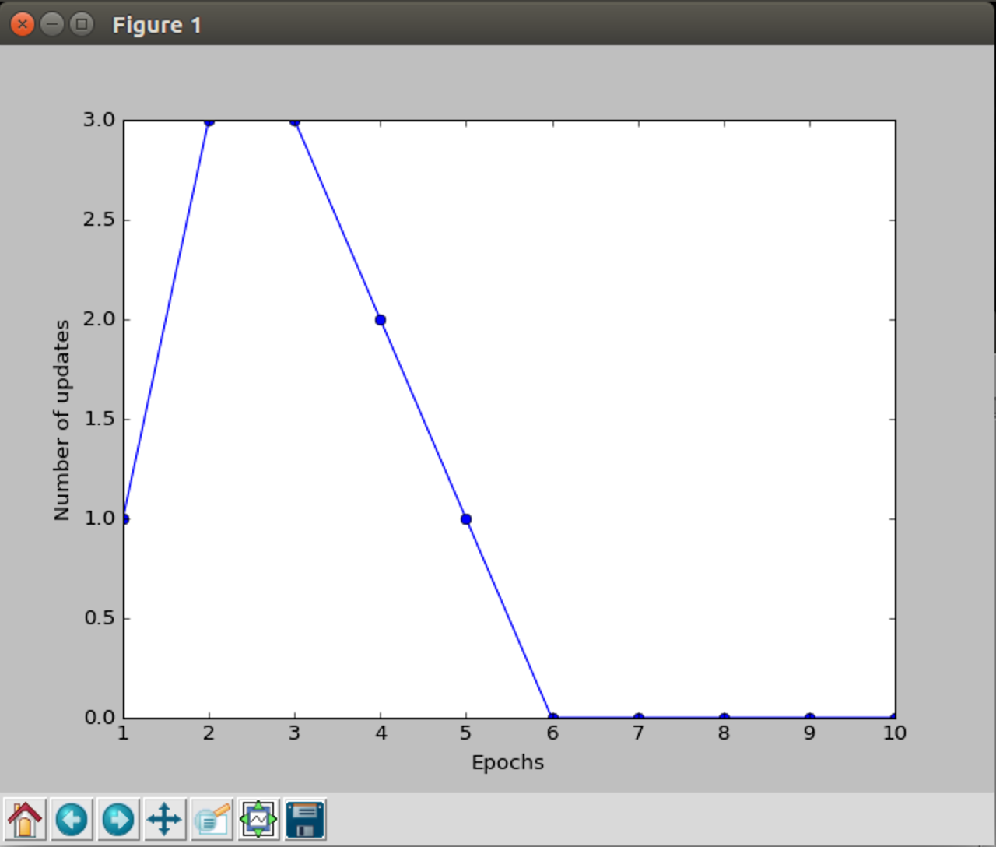
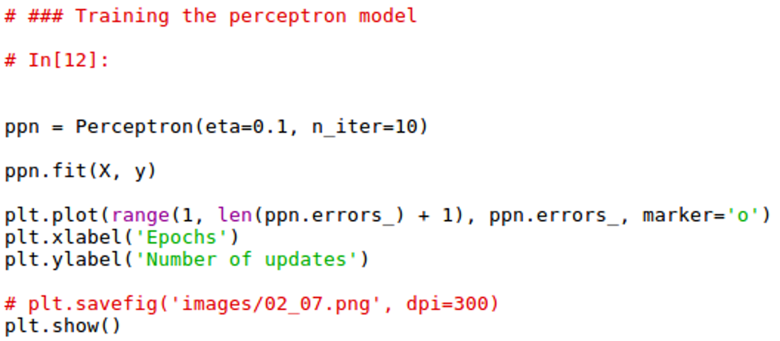
Training the Perceptron Algorithm
To train the perceptron algorithm on the Iris data subset just extracted.
We will plot the misclassification error for each epoch to check whether the algorithm converged.

Slide 22
To Visualize the Decision Boundaries
To implement a function to visualize the decision boundaries for two-dimensional datasets:
We define a number of colors and markers and create a colormap from the list of colors via ListedColormap.
We determine the minimum and maximum values for the two features: Use those feature vectors to create a pair of grid arrays xx1 and xx2 via the NumPy meshgrid function
To flatten the grid arrays and create a matrix that has the same number of columns as the Iris training subset
Then we can use the predict method to predict the class labels Z of the corresponding grid points

Slide 23
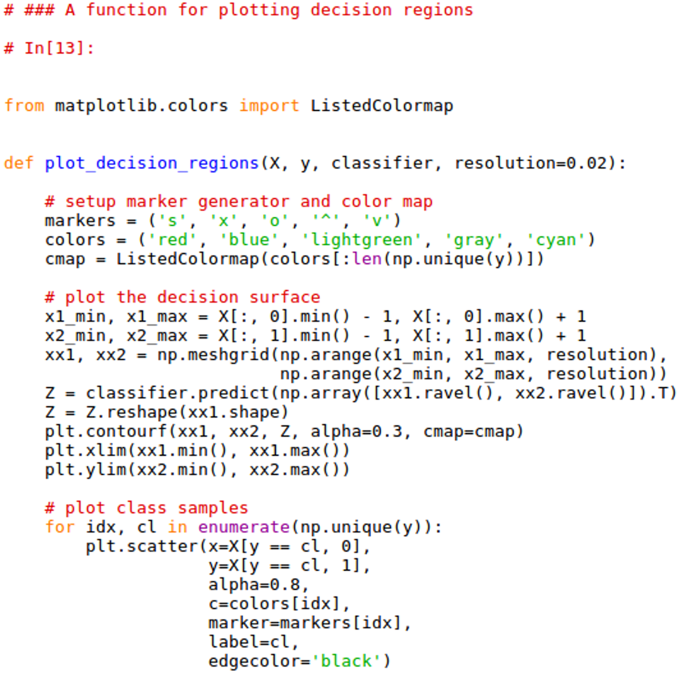
To Visualize the Decision Boundaries(cont.)
Reshaping the predicted class labels Z into a grid with the same dimensions as xx1 and xx2
To draw a contour plot via Matplotlib's contourf function:
It maps the different decision regions to different colors for each predicted class in the grid array

Slide 24
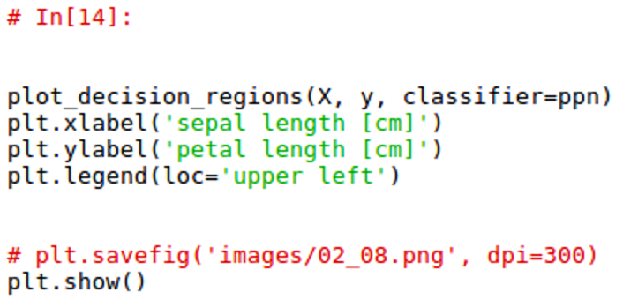
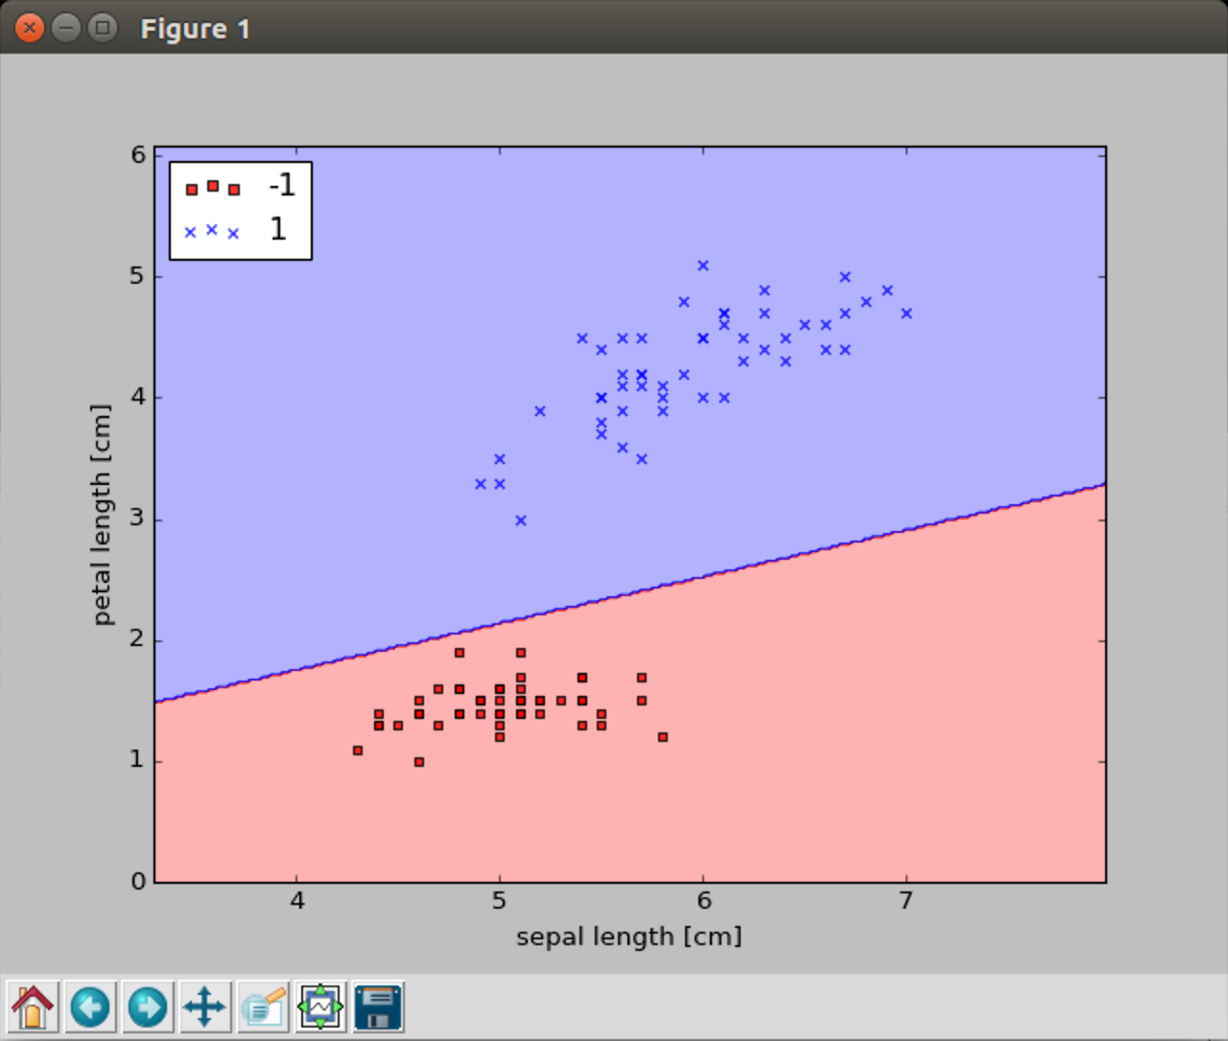
Result(plot of decision boundaries)

Slide 25
References
https://baike.baidu.com/item/IRIS/4061453
https://en.wikipedia.org/wiki/Iris_flower_data_set
https://archive.ics.uci.edu/ml/machine-learning-databases/iris/iris.data
https://moodle.thu.edu.tw/pluginfile.php/866640/mod_resource/content/1/軟式計算%20-%20第%203%20週課程%20%28Mar.%2014%2C%202018%29.pdf

Slide 26
About Perceptron Algorithm
https://en.wikipedia.org/wiki/Perceptron
https://blog.csdn.net/blackyuanc/article/details/70210888
https://blog.csdn.net/andrewseu/article/details/52649992
https://blog.csdn.net/chenxiqilin/article/details/50395905

Slide 27
Task of next week(interim)
Python爬蟲練習 https://drive.google.com/file/d/0B4VP7a8ewj_2NjA0anNBX0VXMGc/view
Machine Learning練習 https://www.kaggle.com/c/titanic
Etc.

