Slide 1

Intro to Missing Data
Hannah Han, PhD Candidate

Slide 2
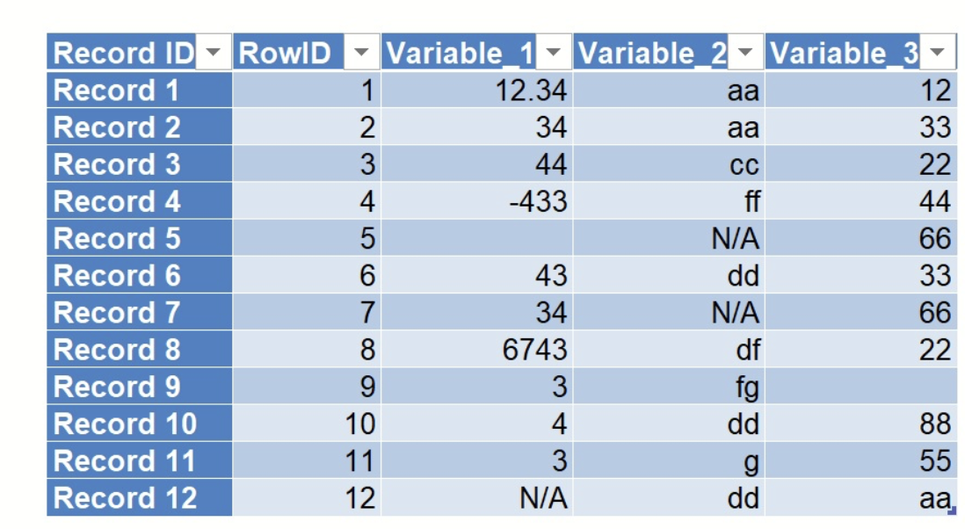
What is missing data
Data defined as not available values
“ “
“ . “
NA, NaN
9, 99, 999, 79, 99, etc
check your data dictionary and your summary statistics!
AND those value would be meaningful if observed
An unavoidable problem in epidemiological and clinical research
More like an art than stat…

Slide 3
Why dealing with missing data?
Complete case analysis
Delete fraction of observations -> reduce power
Biased caused by missingness -> misleading results
Reduce sample representativeness
Goals
Minimize bias
Maximize use of available information
Get good estimates of uncertainty
NOT a goal: get ”real” values

Slide 4


Type of missingness
Missing Completely At Random
Missing At Random
Missing Not At Random
$$P\left(Y missing | X,Y\right)=$$
$$P\left(Y missing\right)$$
Probability of Y is missing is unrelated to Y or other variables
Missingness has nothing to do with the observations being studied
i.e. missing by design, an equipment failure, random lost
Ideal, but often not the case
$$P\left(Y missing | X,Y\right)=$$
$$P\left(Y missing|X\right)$$
Probability of Y is missing doesn’t depend on Y, after controlling for X
Missingness has a relationship with other variables, but not with Y iteself
i.e. missingness in income vs. marital status
An weaker assumption
Data are missing NOT at random or predictable
Missingness is related to what is missing
i.e. age is missing due to some patients refusing the answer it
Very challenging to deal, need to collect more info on why the data is missing

Slide 5
We are NOT generating the real values! We aim to estimate correlation and association

Slide 6
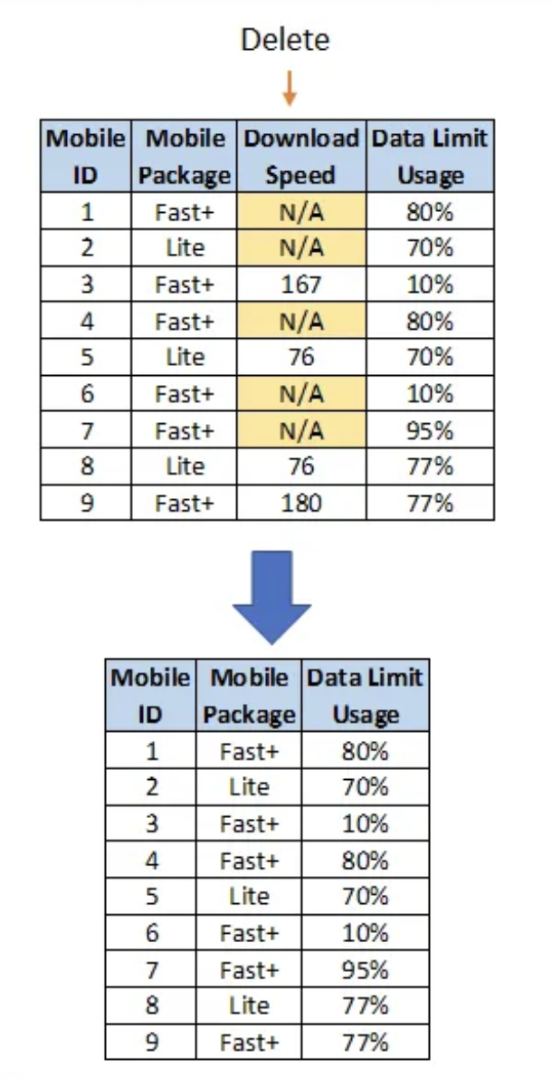
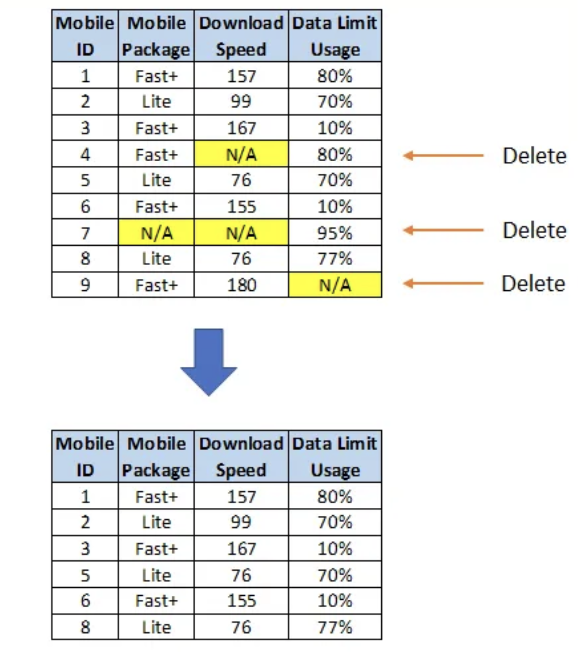
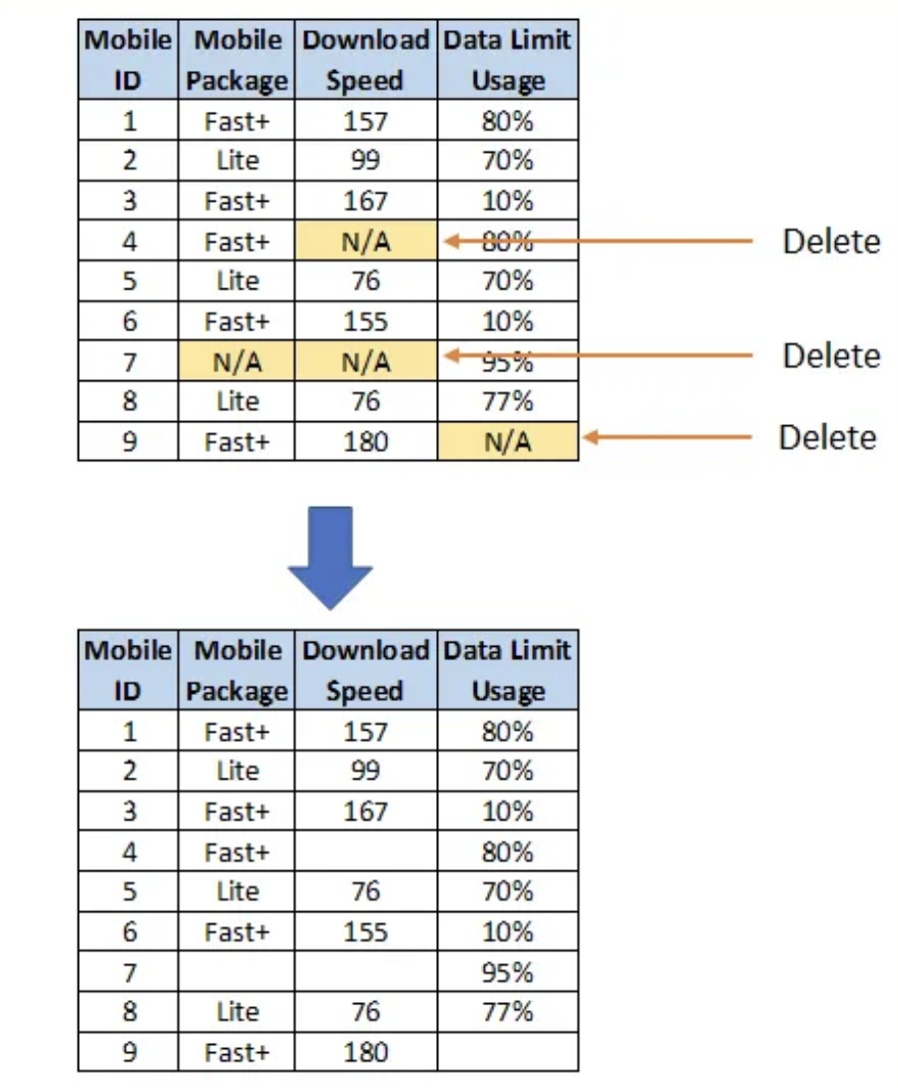
Ways to deal with missing data
1. Try to obtain the missing data
2. Educated guess
3. Discard the data
Complete case analysis: assume MCAR, reduce sample size
Pairwise deletion: assume at least MAR, preserve more info, but can’t handle too many missingness. Can’t compare between analyses
Drop variables
Pictures’ source: https://towardsdatascience.com/all-about-missing-data-handling-b94b8b5d2184

Slide 7
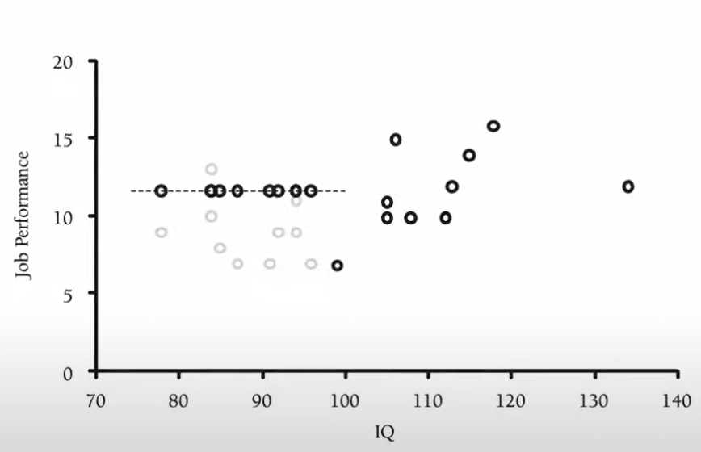
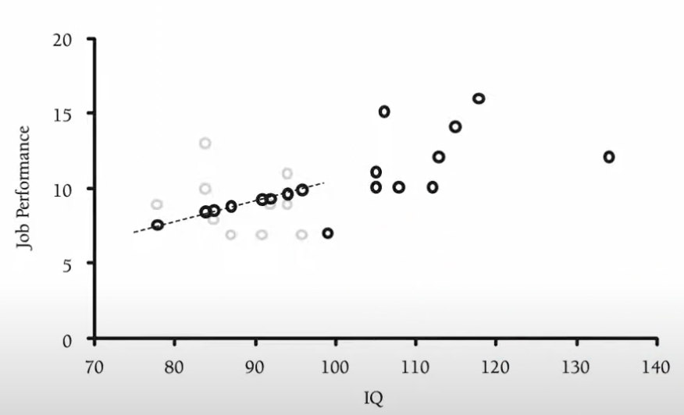
Ways to deal with missingness – imputation
1. Unconditional Mean Imputation
Easy
Reduce variability, attenuate correlations between imputed variable & other variables
2. Regression Mean Imputation
use complete info to impute predicted value, less biased
reduce variability, can’t know the error associated with imputed values, may inflate associations
3. Stochastic Imputation
4. Multiple Imputation
Enders, C. K. (2010)

Slide 8
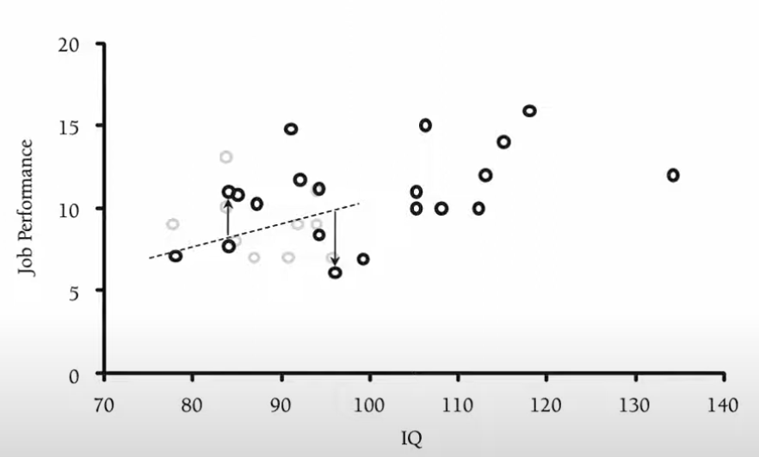
Stochastic imputation: ”adding back” the lost variability
like regression mean imputation, we calculate predicted value, then add random noise based on the model
Pro: restored some lost variability,
Produce unbiased estimates under MAR
Cons: still guesses -> doesn’t take
uncertainty of estimates into account
Enders, C. K. (2010)

Slide 9
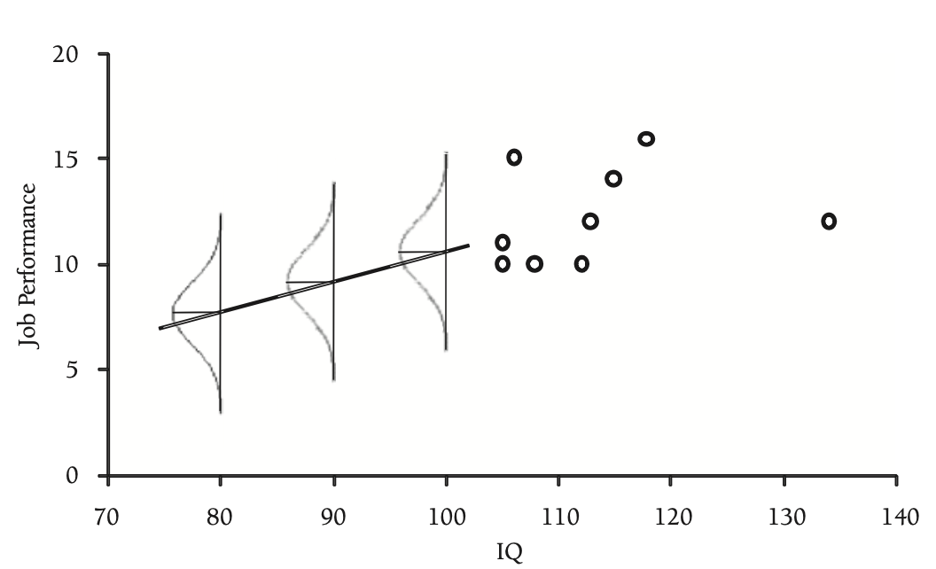
Multiple imputation
Repeat stochastic imputation many times
Use distribution of observed data to estimate a set of plausible values for missing data
Add a level of uncertainty around the “truthfulness” of the imputed values
Enders, C. K. (2010)
https://towardsdatascience.com/all-about-missing-data-handling-b94b8b5d2184

Slide 10
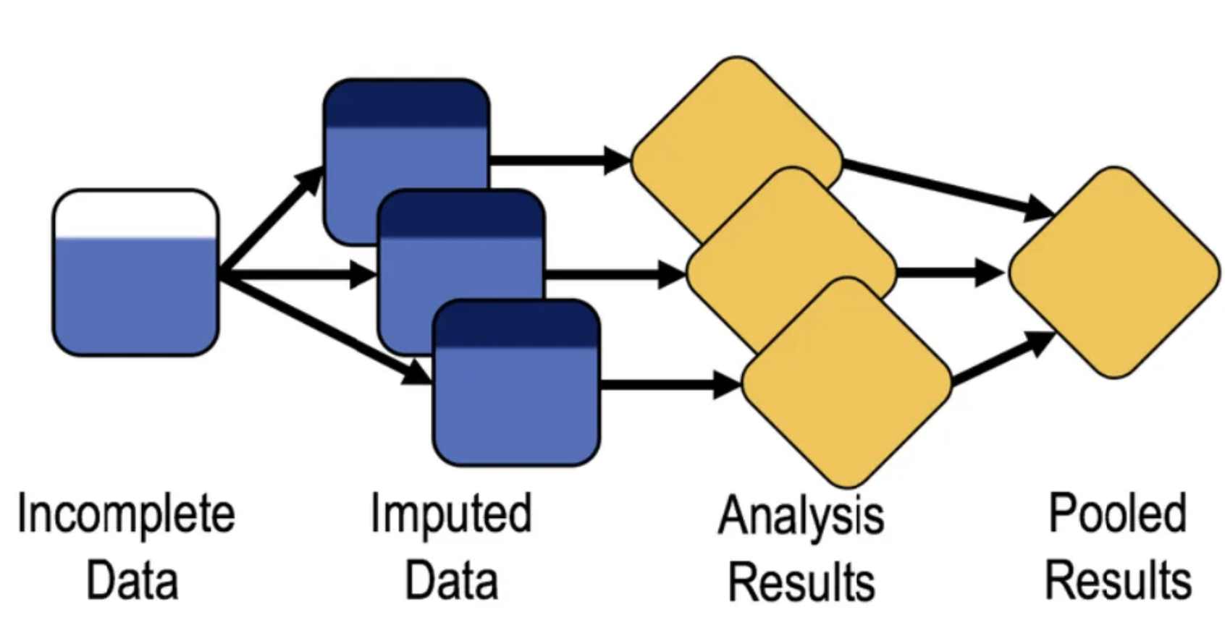
Imputation model: Bayesian inference
- need to be consistent with your analytic model
- i.e. multivariate normal distribution, chained equation, etc
Parameter: arithmetic mean
Standard error: use variance/covariance matrix
Analytical model:
- The model of your interest

Slide 11
Multiple imputation pitfalls
Outcome variable often carries useful info and need to be used!
Ensure variables are roughly normally distributed
Would avoid bias only if enough variables predictive of missing values are included in the imputation model
May be misleading if data is Not Missing at Random
Computationally intensive
Sterne et al.,. (2009)

Slide 12
Reference
Allison, P. D. (2001). Missing Data. SAGE Publications. https://books.google.ca/books?id=uvklAQAAIAAJ
Enders, C. K. (2022). Applied Missing Data Analysis. Guilford Publications. https://books.google.ca/books?id=b294EAAAQBAJ
Sterne, J. A. C., White, I. R., Carlin, J. B., Spratt, M., Royston, P., Kenward, M. G., Wood, A. M., & Carpenter, J. R. (2009). Multiple imputation for missing data in epidemiological and clinical research: potential and pitfalls. BMJ, 338, b2393. https://doi.org/10.1136/bmj.b2393
Multiple Imputation in SAS. UCLA: Statistical Consulting Group. From https://stats.oarc.ucla.edu/sas/seminars/multiple-imputation-in-sas/mi_new_1/ (accessed April 27, 2023)

