Slide 1
Quick Java 8+ UPdate
HIGHLIGHTS Java

Slide 2
What’s Covered
Agenda
Java 8
Lambdas
Stream API
Default Methods
Optionals
Java 9
Collection Factories
Java 10
Local Type Inference

Slide 4

Lambdas
Because Everyone Else Is Doing it

Slide 5
Why Lambdas
Lambdas
Less Boiler Plate
Potentially More Readable
// Lots of scaffolding here
Thread t = new Thread(new Runnable() {
@Override
public void run() {
System.out.println("I'm a Thread!");
}
});
t.start();
// This is more to the point
Thread t = new Thread(() -> System.out.println("I'm a Thread!"));
t.start();

Slide 6

How Lambdas
Lambdas
How did Java add Lambdas?
Lambdas were implemented as syntactic sugar on top of Functional Interfaces.
There is no Lambda (or function) type!
We were fed lies…

Slide 7
Functional Interface
Lambdas
An Interface with exactly one abstract method.
interface Stringify {
String of(Object o);
}
@FunctionalInterface
public interface Runnable {
public abstract void run();
}

Slide 8
LambDa Syntax
Lambdas
It’s -> easy
Lambdas use the formal arguments and body of a function
interface Foo {
void bar(Object o, String s, int c);
}
static void tada(Foo foo) {}
// The parameters to the Functional Interface are passed in
tada((Object o, String s, int c) -> { /* Do Stuff */ });

Slide 9
Lamb-duhs
Lambdas
Let’s look at that example again…
// Equivalent to passing a concrete implementation or using an
// anonymous class
Thread t = new Thread(() -> System.out.println("I'm a Thread!"));
t.start();
@FunctionalInterface
public interface Runnable {
public abstract void run();
}

Slide 10
Built-in Functional Interfaces
Lambdas
Built-in Functional Interfaces
Pre-Java 8 Classes: Runnable, Comparator, etc.
New Java 8 Classes: Predicate, Consumer, Supplier, Function, etc.
https://docs.oracle.com/javase/8/docs/api/java/util/function/package-summary.html

Slide 11
Method References
Lambdas
A Method Reference can be used instead of a lambda
There two Types:
// Static method of a class.
Sample::tada;
// Instance method of an object.
sample::tada;
// Can be cleaner than a lambda.
test(Sample::tada);
test(sample::tada);

Slide 12
Lambda Examples

Slide 13

Streams API
For When You’ve Got to Go

Slide 14
Why Streams
Streams
Functional Approach to Problem Solving
Potentially Parallelizable
Less Boiler Plate
More Maintainable
List<String> strings = List.of("a", "b", "c", "d");
strings.stream()
.map(s -> s.toUpperCase())
.forEach(System.out::println);

Slide 15
StREAM API
Streams
Collection.stream()
Stream.map()
Stream.filter()
Stream.forEach()
Stream.reduce()
Stream.peek()
Stream.collect()
Stream.limit()
Stream.takeWhile()
Stream.distinct()
Stream.flatMap()
Stream.sorted()
Stream.noneMatch()
Stream.max()
Stream.dropWhile()
Stream.findAny()
Stream.findFirst()
…

Slide 16
WHY NOT Stream Collections?
Streams
Why couldn’t the .map() methods be directly added to the Collections API?
Because of External/Internal Iteration. Streams promised pARALLEL EXECUTION.
external ITERATION would break that
List<String> strings = List.of("a", "b", "c", "d");
// External Iteration.
for (String s : strings) {
System.out.println(s.toUpperCase());
}
// Internal Iteration.
strings.stream()
.map(String::toUpperCase)
.forEach(System.out::println);

Slide 17
STREAM Facts
Streams
Single Use - Can only be used once!
Declarative - What to do vs How to do it.
Composable - Can be added together (See flatMap).
Parallelizable - Allow for parallel processing.

Slide 18
SINGLE USE STREAM
Streams
Streams represent a flow of data. Once the flow is complete the stream can not be re-started or re-used.
Stream<String> stringStream = strings.stream();
// Ok
stringStream.map(String::toUpperCase)
.forEach(System.out::println);
// Exception
stringStream.map(String::toUpperCase)
.forEach(System.out::println);

Slide 19
Streams are declarative
Streams
Streams are declarative which means we express what we want to do, not how to do it.
List<String> strings = List.of("a", "b", "c", "d");
// For each String in the stream, make it upper case and print it!
strings.stream()
.map(s -> s.toUpperCase())
.forEach(System.out::println);

Slide 20
Streams are COMPOSABLE
Streams
Streams can be joined to compose other streams.
List<String> words = List.of("Apples", "Bananas", “Oranges");
words.stream()
.flatMap(s -> List.of(s.split("")).stream())
.forEach(System.out::println);

Slide 21
Parallel Streams
Streams
Streams can be parallelized.
Using streamParallel() or parallel()
// Single stream
strings.stream()
.map(String::toUpperCase)
.forEach(System.out::println);
// Parallel stream
strings.parallelStream()
.map(String::toUpperCase)
.forEach(System.out::println);

Slide 22

No Way!
Streams
How can streamParallel() magically make a task parallel?
ThaT’s Crazy!
Flat Earth

Slide 23
Parallel How?
Streams
How are streams parallelized?
How is work split?
Where do the threads come from?
Work is Split and sent to different threads that (hopefully) run on different CPUs.
Work is Split by a Spliterator. A new Splitable Iterator that can handle being split.
From the ForkJoinPool. A thread pool used with the Fork/Join framework that was added
in java 7.

Slide 24
Stream Examples

Slide 25

Default Methods
Because You Didn’t Get It Right the First Time

Slide 26
HOW Default Methods
DeFault Methods
Because Changing Interfaces Breaks Things
Bonus: Allows State-Less Multiple Inheritance
interface Countable {
void add(Object o);
default int count() {
return 0;
}
}

Slide 27
Why Default Methods
Default Methods
Default methods can be overridden
interface Countable {
default int count() {
return 0;
}
}
public static class MyCountable implements Countable {
@Override
public int count() {
return 5;
}
}

Slide 28

Optionals
The Answer to What’s in the Box

Slide 29
Why Optionals
Optionals
Safer Code Through Awareness
Can Remove Some Boiler Plate
public static void main(String[] args) {
Optional<String> name = getName();
}
private static Optional<String> getName() {
Optional<String> name = Optional.empty();
if (System.currentTimeMillis() % 2 == 0) {
name = Optional.of("Jay Vollstedt");
}
return name;
}

Slide 30
HOW optionals
Optionals
Optionals are not automatically better.
Optional<String> name = getName();
// Not really better
String justGetName = name.get();
// More Boiler-Plate-y
boolean present = name.isPresent();
if (present) {
// blah
String presentName = name.get();
}
// Better
String defaultName = name.orElse("DEFAULT NAME");

Slide 31
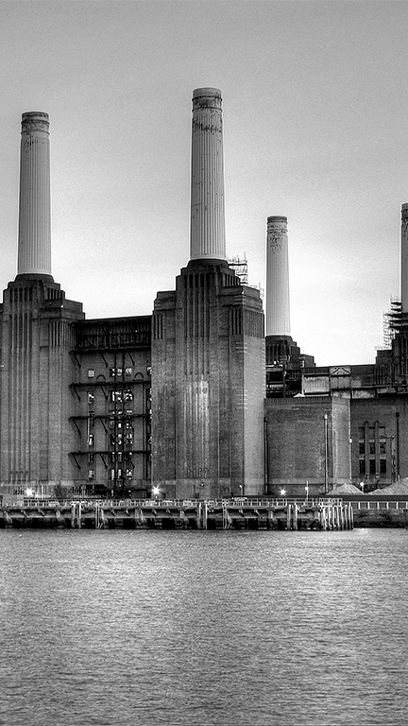
Collection Factories
Because Typing is Hard

Slide 32
Why Collection Factories
Collection Factories
Simplifies Tedious Tasks
Note: Collections Returned are Immutable
List<Integer> list = List.of(1, 2, 3, 4, 5, 6);
Map<String, String> map = Map.of("key1", "val1", "key2", "val2");
Set<Integer> set = Set.of(1, 2, 3, 4, 5);

Slide 33

Local Variables
Because Types are Stooopid

Slide 34
Why Local Variables
Local Variables
Because we want to be cool too.
var a = 1;
var b = "huh";
var c = new HashMap<String, Long>();
c.put(b, Long.valueOf(a));
// Nope
a = "hi";
b = 3;
c = new Object();

Slide 35
Get Rid of Audience

