Slide 1
Mobile Application
Karin Wilding (0931297)
Dietmar Watzinger (0930406)
Notes:
08.11.2007
Dr.-Ing. Detlef Heck, Dipl.-Ing. Dieter Schlagbauer

Slide 2
Entwicklungsumgebung
Eclipse
  Android Developer Tool
  Android SDK Version 11
  Junit Test
  Robotium

Slide 3
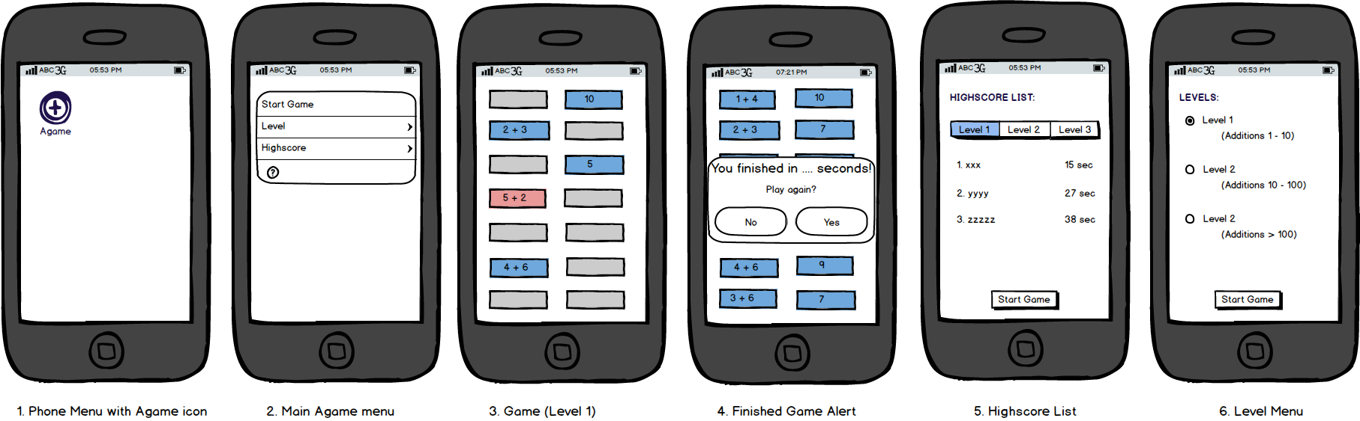
MockUp

Slide 4
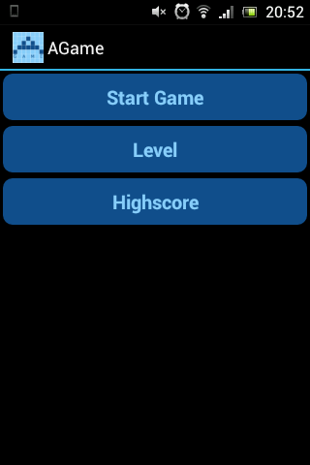
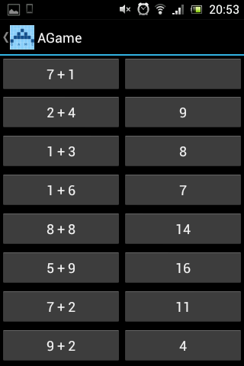
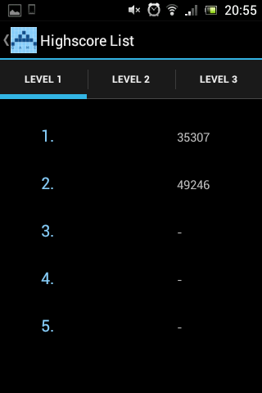
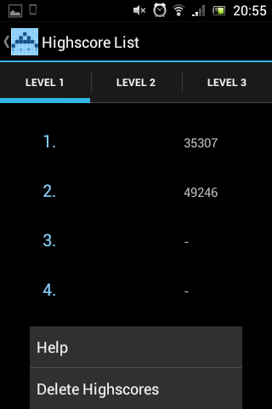
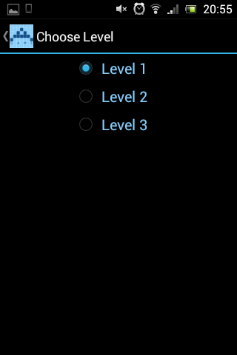

Slide 5
Example Video

Slide 6
Thank you.

