Slide 1
Mini-Project 2 Checkpoint 1 ECE/CS 498DS Spring 2020
Jiashuo Tong (jtong8), Rongqi Gao (rongqig2), Yilin Zhu (yilinz10)

Slide 2
Task 1 - Question 0
Why do biologists need multiple samples to identify microbes with significantly altered abundance?
Using multiple samples, we will be more confident in rejecting a null hypothesis if a significantly altered
abundance occurs. If we use a two-sample Z-test, larger sample sizes will yield a larger Z score, which
allows us to reject H_0 with greater confidence level. If we use a two sample K-S test, larger sample sizes
will give smaller critical values (on the right hand side). Thus, we can achieve higher confidence level with
the same D value (K–S statistic).
2. Number of samples analyzed: 764
3. Number of microbes identified: 149

Slide 3
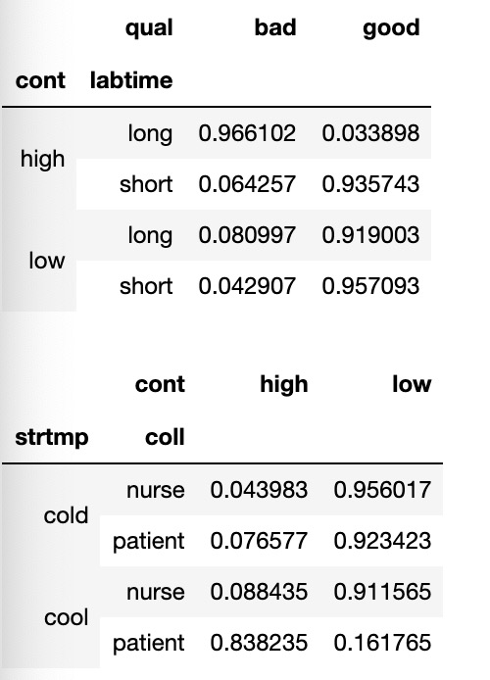
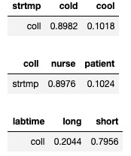
Task 1 – Question 1
a. Factorization of joint probability distribution:
b. Number of parameters needed to define conditional probability distribution: 11 parameters
c. Conditional probability tables:

Slide 4
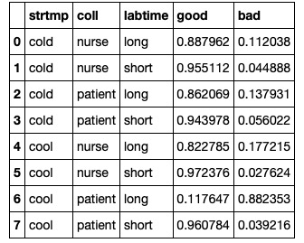
Task 1 – Question 1 (continued)
d. Table of P(Quality|Storage Temp, Collection Method, Lab Time):
e. Total number of samples dropped: We dropped samples from HE0Sample_699 t0 HE0Sample_763, and HE1Sample_699 t0 HE1Sample_763, totally 65 * 2 = 130

Slide 5
Task 1 – Question 2
1. Number of samples removed: Zero.
2. What are the benefits and drawbacks to using relative abundance data? Is there information that we lose when the normalization is performed?
Advantage: The absolute abundance for microbes might vary from person to person, so it cannot be used to measure the abundance level. The relative abundance is a standardized variable, so we can use it to compare the abundance levels of two samples.
Drawback: The relative abundance loses information about how much of each microbe exists. This information can be critical in the sense that the amount of microbes may also change to whether a person has HE or not.

Slide 6
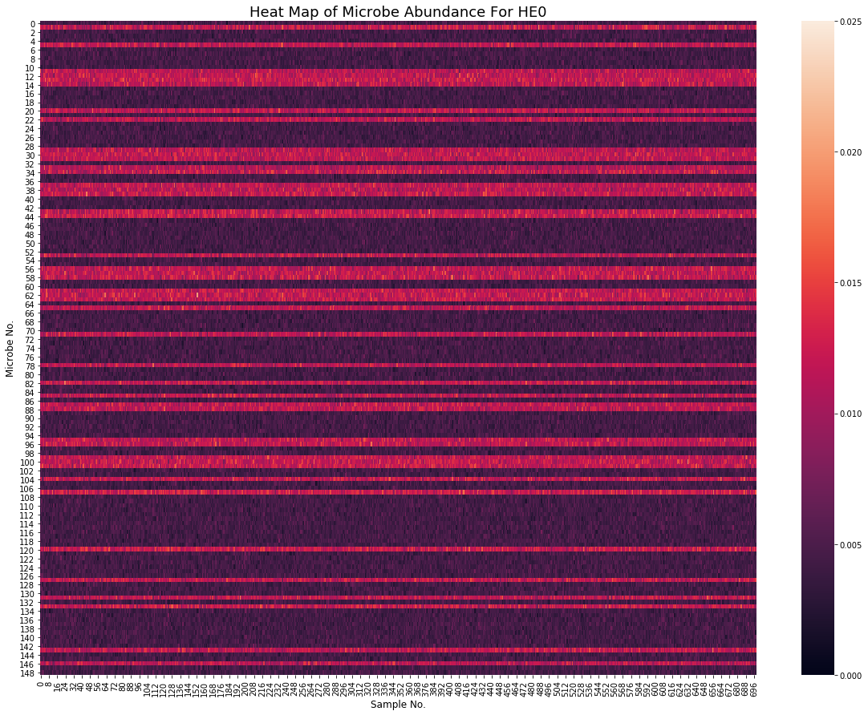
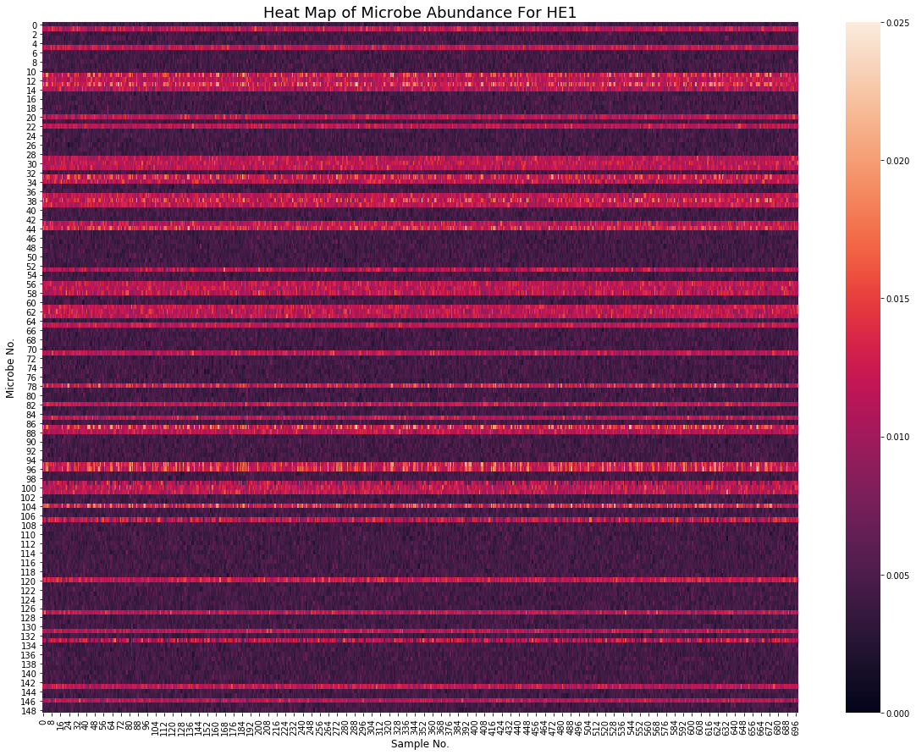
Task 1 – Question 3
Heatmaps (HE0 on left HE1 on right):
Summarize your observations
From the two heatmaps, we could find that the pattern of the relative abundance of microbe of HE0 and HE1 samples are approximately the same, for each sample the relative abundance of microbe is similar.

Slide 7
Task 1 – Question 3 (continued)
Which aspects of the data are the heatmaps good at highlighting? What types of things are heatmaps less suitable for?
Pros: The heatmaps are good at highlighting the data distribute pattern of a two-dimensional data set. Since it uses color to represent the amount of each data point, we can easily find out how the larger and smaller data points distributed. And for the same reason, we can easily get the information from a huge data set.
Cons: The shortcoming of heatmaps is that we are poor at comparing the amount of data points in non-adjacent regions, in some situations we might misread the heatmaps.

Slide 8
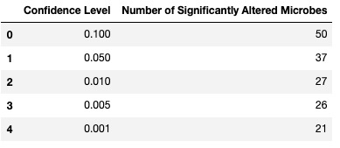
Task 2 – Question 1
b. What is the null hypothesis of the KS test in our context? Use one microbe as an example to explain your answer.
Our null hypothesis is that the HE0 samples and HE1 samples obey the same distribution.
c. Count the number of microbes with significantly altered expression at alpha=0.1, 0.05, 0.01, 0.005 and 0.001 level? Summarize your answers in a table below:

Slide 9
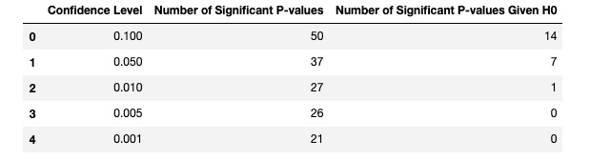
Task 2 – Question 2
a. What does a p-value of 0.05 represent in our context?
A p-value of 0.05 from KS test on a microbe means the probability of observing the HE0 & HE1 samples is only 5%,
given that the null hypothesis (the microbe is not altered) is true.
b. If the null hypothesis is true, what distribution will the p-values follow?
Uniform distribution. The p-value or probability value is the probability of obtaining test results at least as extreme
as the results actually observed during the test, assuming that the null hypothesis is correct. Thus, given the null
hypothesis is true, the cdf for the random variable P will be F(P) = P. The corresponding pdf will be f(P) = 1, which is
Uniform distribution
c. If no microbe’s abundance was altered, how many significant p-values does one expect to see at alpha=0.1, 0.05, 0.01, 0.005 and 0.001 level? Compare your answers with your results in Task 2.1.c. Show the comparison in a table below:

Slide 10
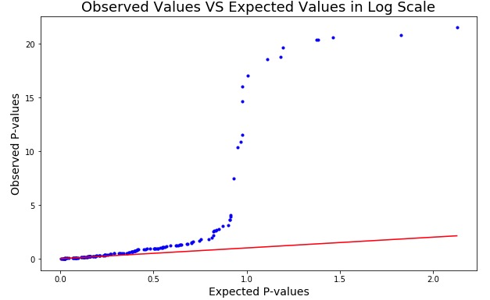
Task 2 – Question 2 (continued)
d. Q-Q plot:

Slide 11
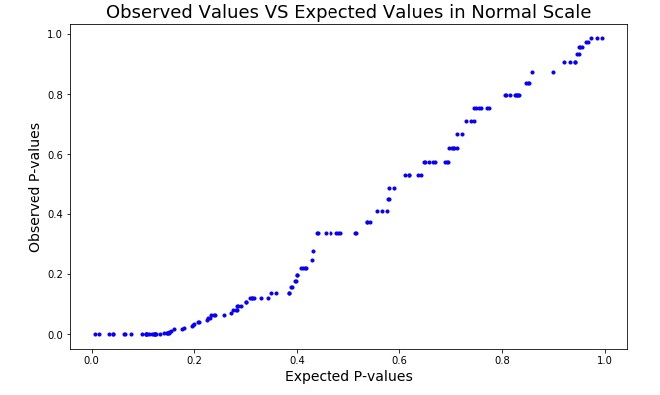
Task 2 – Question 2 (continued)
e.i. How does taking the -log10() of the p-values help you visualize the p-value distribution?
Taking the -log10() of the p-values magnifies the deviation of the observed from the expected. Say we have a data point (0.001, 0.1). If it is plotted with the original values, it will be very close to the x=y line. The -log10() values, which are (3,1), stay off x=y by a large margin. Thus, if we used the original p-values, we would have created an approximately 'linear' curve (as shown in the figure on the right), and we would have drawn a wrong conclusion. Hence, the -log10() values help us easily identify the non-linear nature of the curve which leads to the correct conclusion.
e.ii. What can you conclude from the Q-Q plot?
We can conclude from the Q-Q plot that the null hypothesis should be rejected. Reason: If the null hypothesis is true, the Q-Q plot should approximately align with the x=y line. However, our Q-Q plot obviously deviates from the x=y line. Therefore, the null hypothesis is likely to be false.

