Slide 1
Mini-Project 3 Checkpoint 1 ECE/CS 498DS Spring 2020
Name1 (NetID1), Name2 (NetID2), Name3 (NetID3)

Slide 2
Task 0
0.6.(a) Which http pcap file represents legitimate activity, and which represents attacker activity?
http.pcap' represents attacker activity, and 'http2.pcap' represents legitimate activity.
0.6.(b) Are there any Content-Type headers in legitimate activity pcap file? If there are, list those Content-Type headers.
Since no packets in http2.pcap has an HTTP layer, we cannot find content-type in http2.pcap.

Slide 3
Task 1 – HTTP Traffic Analysis
Task 1. 1. a Report the UNIX timestamp of the first attempted scan on the vulnerable server
Answer: e UNIX timestamp of the first attempted scan on the vulnerable server is 2018-03-18 12:41:43.610774
Task 1. 1.b What is the IP address of the vulnerable server?
Answer: The IP address of the vulnerable server is 172.17.0.2
Task 1. 1.c What is the port of the vulnerable server?
Answer: The port of the vulnerable server is 8080

Slide 4
Task 1 – HTTP Traffic Analysis
2.a Provide a list of the Content-Type headers sent to the vulnerable server from the provided HTTP packet capture. For each Content-Type header, provide its length as well.
index | content_type | len_content_type
407 | .multipart/form-data~${#context["com.opensymph... | 144
423 | .multipart/form-data~${#context["com.opensymph... | 144
439 | .multipart/form-data~${#context["com.opensymph... | 144
519 | %{(#_='multipart/form-data').(#dm=@ognl.OgnlCo... | 806
529 | %{(#_='multipart/form-data').(#dm=@ognl.OgnlCo... | 810
539 | %{(#_='multipart/form-data').(#dm=@ognl.OgnlCo... | 845
551 | %{(#_='multipart/form-data').(#dm=@ognl.OgnlCo... | 845
577 | %{(#_='multipart/form-data').(#dm=@ognl.OgnlCo... | 818
587 | %{(#_='multipart/form-data').(#dm=@ognl.OgnlCo... | 818
597 | %{(#_='multipart/form-data').(#dm=@ognl.OgnlCo... | 818

Slide 5
Task 1 – HTTP Traffic Analysis
2.b Fill in the blanks in the table below
Command Name | Present in the attack? | Interpretation of the command
whoami | Yes | Displays the name of the current user
wget | Yes | Retrieves content from web servers
ls | Yes | Lists computer files in Unix and Unix-like operating systems
cat | No
cd | No
insmod | Yes | Loads the specified kernel modules into the kernel
ssh | No
lsmod | No

Slide 6
Task 1 – Host Logs Analysis
1.a Provide a list of kernel modules added or removed from the system: (Output table from code)
 | name | columns.name | action
42 | kernel_module | rk | added
43 | kernel_module | ipt_MASQUERADE | added
44 | kernel_module | nf_nat_masquerade_ipv4 | added
45 | kernel_module | nf_conntrack_netlink | added
46 | kernel_module | nfnetlink | added
... | ... | ... | ...
2339 | kernel_module | nfnetlink_queue | added
2340 | kernel_module | nfnetlink_log | added
2341 | kernel_module | bluetooth | added
2882 | kernel_module | rk | added
2883 | kernel_module | rk | removed
1.b What is the attacker-controlled kernel module?
The attacker-controlled module is rk.ko.

Slide 7
Task 1 – Host Logs Analysis
1.c How did you verify that the module was loaded onto the server?
Answer: "The module was loaded onto the server because the following command is run:"
#cmd=‘insmod rk.ko.1’
Also, from df_oslogs, we identify the following items:
 | name | columns.name | action | calendarTime
42 | kernel_module | rk | added | Tue Feb 6 00:34:09 2018 UTC
113 | kernel_module | rk | removed | Tue Feb 6 00:34:50 2018 UTC
2882 | kernel_module | rk | added | Mon Mar 19 15:58:54 2018 UTC
2883 | kernel_module | rk | removed | Mon Mar 19 15:58:58 2018 UTC

Slide 8
Task 1 – Host Logs Analysis
2. What is the file name that contains the internal hostnames?
The file name that contains the internal hostnames is 'known_hosts”.

Slide 9
Task 1 – Host Logs Analysis
3. Do you observe any evidence that the attacker extracted the internal host names via HTTP in the logs? (If yes, report the log line. If not, briefly explain why not. )
From the HTTP content type headers, we have found nothing related to the internal hostname file. Therefore, we conclude that the attacker is not using HTTP to access the file.

Slide 10
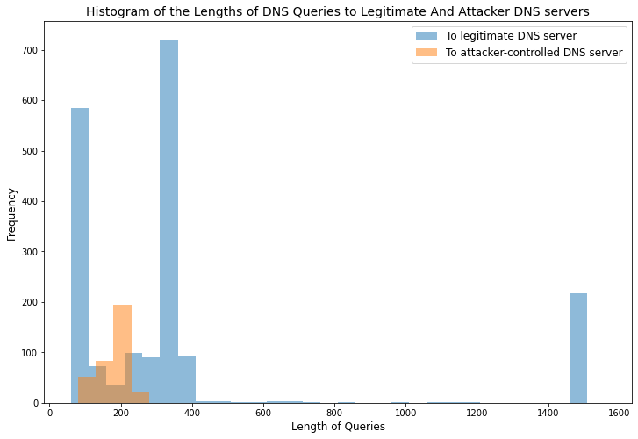
Task 1 – DNS Traffic Analysis
1(a) Provide the IP address of the attacker-controlled DNS server:
Answer: From the content type headers, we find the IP address '162.212.156.148' following wget. Therefore, the attacker-controlled server is 162.212.156.148.
1(b) Provide the IP address of the legitimate DNS server:
Answer: We can identify the legitimate server by finding the source IP when destination IP is the bad server. The legitimate server is 10.0.2.15.
2. Histogram of the length of DNS queries:

