Slide 1
Mini-Project 3 Checkpoint 1 ECE/CS 498DS Spring 2020
Jiashuo Tong (jtong8), Rongqi Gao (rongqig2), Yilin Zhu (yilinz10)

Slide 2
Task 0
0.6.(a) Which http pcap file represents legitimate activity, and which represents attacker activity?
http.pcap' represents attacker activity, and 'http2.pcap' represents legitimate activity.
0.6.(b) Are there any Content-Type headers in legitimate activity pcap file? If there are, list those Content-Type headers.
Since no packets in http2.pcap has an HTTP layer, we cannot find content-type in http2.pcap.

Slide 3
Task 1 – HTTP Traffic Analysis
Task 1. 1. a Report the UNIX timestamp of the first attempted scan on the vulnerable server
Answer: e UNIX timestamp of the first attempted scan on the vulnerable server is 2018-03-18 12:41:43.610774
Task 1. 1.b What is the IP address of the vulnerable server?
Answer: The IP address of the vulnerable server is 172.17.0.2
Task 1. 1.c What is the port of the vulnerable server?
Answer: The port of the vulnerable server is 8080

Slide 4
Task 1 – HTTP Traffic Analysis
2.a Provide a list of the Content-Type headers sent to the vulnerable server from the provided HTTP packet capture. For each Content-Type header, provide its length as well.
index | content_type | len_content_type
407 | .multipart/form-data~${#context["com.opensymph... | 144
423 | .multipart/form-data~${#context["com.opensymph... | 144
439 | .multipart/form-data~${#context["com.opensymph... | 144
519 | %{(#_='multipart/form-data').(#dm=@ognl.OgnlCo... | 806
529 | %{(#_='multipart/form-data').(#dm=@ognl.OgnlCo... | 810
539 | %{(#_='multipart/form-data').(#dm=@ognl.OgnlCo... | 845
551 | %{(#_='multipart/form-data').(#dm=@ognl.OgnlCo... | 845
577 | %{(#_='multipart/form-data').(#dm=@ognl.OgnlCo... | 818
587 | %{(#_='multipart/form-data').(#dm=@ognl.OgnlCo... | 818
597 | %{(#_='multipart/form-data').(#dm=@ognl.OgnlCo... | 818

Slide 5
Task 1 – HTTP Traffic Analysis
2.b Fill in the blanks in the table below
Command Name | Present in the attack? | Interpretation of the command
whoami | Yes | Displays the name of the current user
wget | Yes | Retrieves content from web servers
ls | Yes | Lists computer files in Unix and Unix-like operating systems
cat | No
cd | No
insmod | Yes | Loads the specified kernel modules into the kernel
ssh | No
lsmod | No

Slide 6
Task 1 – Host Logs Analysis
1.a Provide a list of kernel modules added or removed from the system: (Output table from code)
 | name | columns.name | action
42 | kernel_module | rk | added
43 | kernel_module | ipt_MASQUERADE | added
44 | kernel_module | nf_nat_masquerade_ipv4 | added
45 | kernel_module | nf_conntrack_netlink | added
46 | kernel_module | nfnetlink | added
... | ... | ... | ...
2339 | kernel_module | nfnetlink_queue | added
2340 | kernel_module | nfnetlink_log | added
2341 | kernel_module | bluetooth | added
2882 | kernel_module | rk | added
2883 | kernel_module | rk | removed
1.b What is the attacker-controlled kernel module?
The attacker-controlled module is rk.ko.

Slide 7
Task 1 – Host Logs Analysis
1.c How did you verify that the module was loaded onto the server?
Answer: "The module was loaded onto the server because the following command is run:"
#cmd=‘insmod rk.ko.1’
Also, from df_oslogs, we identify the following items:
 | name | columns.name | action | calendarTime
42 | kernel_module | rk | added | Tue Feb 6 00:34:09 2018 UTC
113 | kernel_module | rk | removed | Tue Feb 6 00:34:50 2018 UTC
2882 | kernel_module | rk | added | Mon Mar 19 15:58:54 2018 UTC
2883 | kernel_module | rk | removed | Mon Mar 19 15:58:58 2018 UTC

Slide 8
Task 1 – Host Logs Analysis
2. What is the file name that contains the internal hostnames?
The file name that contains the internal hostnames is 'known_hosts”.

Slide 9
Task 1 – Host Logs Analysis
3. Do you observe any evidence that the attacker extracted the internal host names via HTTP in the logs? (If yes, report the log line. If not, briefly explain why not. )
From the HTTP content type headers, we have found nothing related to the internal hostname file. Therefore, we conclude that the attacker is not using HTTP to access the file.

Slide 10
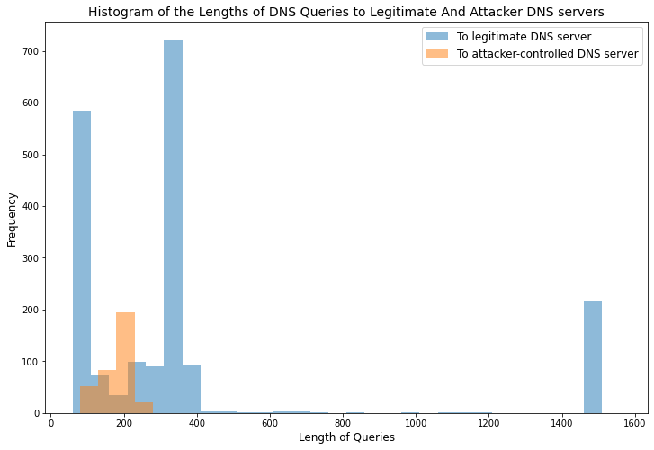
Task 1 – DNS Traffic Analysis
1(a) Provide the IP address of the attacker-controlled DNS server:
Answer: From the content type headers, we find the IP address '162.212.156.148' following wget. Therefore, the attacker-controlled server is 162.212.156.148.
1(b) Provide the IP address of the legitimate DNS server:
Answer: We can identify the legitimate server by finding the source IP when destination IP is the bad server. The legitimate server is 10.0.2.15.
2. Histogram of the length of DNS queries:

Slide 11
Task 2
Task 2.2 Provide the marginal probability P(S1).
S1 | P(S1)
S1(0) | 0.7727
S1(1) | 0.2273
Task 2.3 What value of S1 maximizes the marginal probability P(S1)
S1=0 maximizes the marginal probability P(S1).

Slide 12
Task 2
Task 2.4 Suppose you have already observed the event E1=1, provide the probability P(S1).
S1 | P(S1)
S1(0) | 0.6939
S1(1) | 0.3061
Task 2.5 What's the most probable state of S1 when observing E1=1.
The most probable state when observing E1=1 is S1=0.

Slide 13
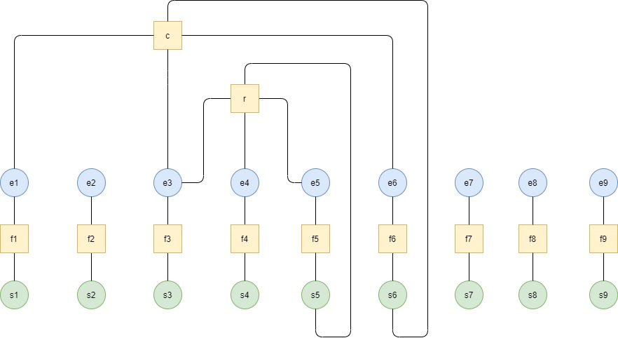
Task 3
Task 3.2 Draw a factor graph for each time t from t=1 to t=9:

Slide 14
Task 3
Task 3.4 (1) Provide the marginal probability for each stage
(hint: every row should add up to be 1)
 | benign | Discovery | access | lateral_movement | privilege_escalation | persistence | defense_evasion | collection | exfiltration | command_control | execution
S_1 | 0.936 | 0.064 | 0 | 0 | 0 | 0 | 0 | 0 | 0 | 0 | 0
S_2 | 1 | 0 | 0 | 0 | 0 | 0 | 0 | 0 | 0 | 0 | 0
S_3 | 0.553333 | 0 | 0 | 0 | 0.446667 | 0 | 0 | 0 | 0 | 0 | 0
S_4 | 0.553333 | 0 | 0 | 0 | 0.446667 | 0 | 0 | 0 | 0 | 0 | 0
S_5 | 0.473947 | 0 | 0 | 0 | 0.526053 | 0 | 0 | 0 | 0 | 0 | 0
S_6 | 0.959677 | 0 | 0 | 0 | 0 | 0.040323 | 0 | 0 | 0 | 0 | 0
S_7 | 0.02 | 0 | 0 | 0 | 0 | 0 | 0 | 0 | 0.98 | 0 | 0
S_8 | 0.02 | 0 | 0 | 0 | 0 | 0 | 0 | 0 | 0.98 | 0 | 0
S_9 | 0.02 | 0 | 0 | 0 | 0 | 0 | 0 | 0 | 0.98 | 0 | 0

Slide 15
Task 3
Task 3.4 (2) Provide the most probable state for each timestamp
Timestamp | 1 | 2 | 3 | 4 | 5 | 6 | 7 | 8 | 9
Most probable state | benign | benign | benign | benign | privilege_escalation | persistence | exfiltration | exfiltration | exfiltration

Slide 16
Task 3
Task 3.5 What action should your model recommend for each time step?
Timestamp | 1 | 2 | 3 | 4 | 5 | 6 | 7 | 8 | 9
Recommended action | No-Op | No-Op | No-Op | No-Op | Monitor | Monitor | Stop Attack | Stop Attack | Stop Attack
Subtask 3.6 What is the earliest timestamp in which your model should recommend stopping the attack?
The earliest stage to stop the attack is s7.

Slide 17
Task 3
Task 3.7 Do the most probable states for s1−s6,s8,s9 remain the same as Task3.2? Why or why not?
The most probable states should remain the same as Task 3.2 because the subgraph e7 and s7 are disconnected to the rest of the graph.

Slide 18
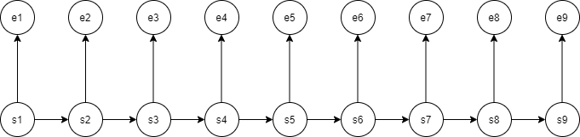
Task 3
Task 3.8.a. Draw an HMM model for the attack scenario given the provided states and events.

Slide 19
Task 3
Task 3.8.b. What parameters are needed for this HMM model to work?
The transition probability matrix, the observation matrix, and the initial distribution for the hidden state: P(S1), P(S2|S1), P(S3|S2), P(S4|S3), P(S5|S4), P(S6|S5), P(S7|S6), P(S8|S7), P(S9|S8), P(E1|S1), P(E2|S2), P(E3|S3), P(E4|S4), P(E5|S5), P(E6|S6), P(E7|S7), P(E8|S8), P(E9|S9).
Task 3.8.c. Give an example of an advantage of the FG over the HMM model.
FG is a generalization of the HMM model. One of its advantages over HMM is that it can model the relationship between multiple evidences and an underlying state. (E.g. links between the repetitive events and the attack stage) This is impossible for HMM because HMM assumes that the hidden states have a temporal order, which does not apply to many situations.

Slide 20
Task 4
Task 4.0. Is it possible to 100% detect this attack using only one event? Briefly explain
No, it is not possible because different events can be caused by benign states. For example, if a system administrator changes the link for the homepage of Equifax, it should be considered as a benign state instead of an attack state. In contrast, a sequence of events (e.g. most common 3-event, repetitive events, etc.) can often help identify an attack state.
Task 4.1. For each of the six events, give an example of a situation in which a false positive could happen
For Scan: when the system admin is doing the scan.
For Login: a user of Equifax has logged in.
For Sensitive URI: the system admin adds an URI (pointing to a downloadable for Equifax users) to a webpage.
For New Executable File: the system admin adds an executable file for Equifax users to download.
For Homepage Overwritten with a new link: the system admin decides to use another link for the homepage of Equifax.
For Webserver restarted: Equifax is experiencing a technical issue, so the IT engineers at Equifax decide to resolve it and restart the webserver.

Slide 21
Task 4
Task 4.2. Provide a visual representation of a factor graph that can model the attack described above, can be hand drawn.
Task 4.3. What variables and factor functions are common to the factor graph in Task 3 and your factor graph in 4.2? Name two.

