Slide 1
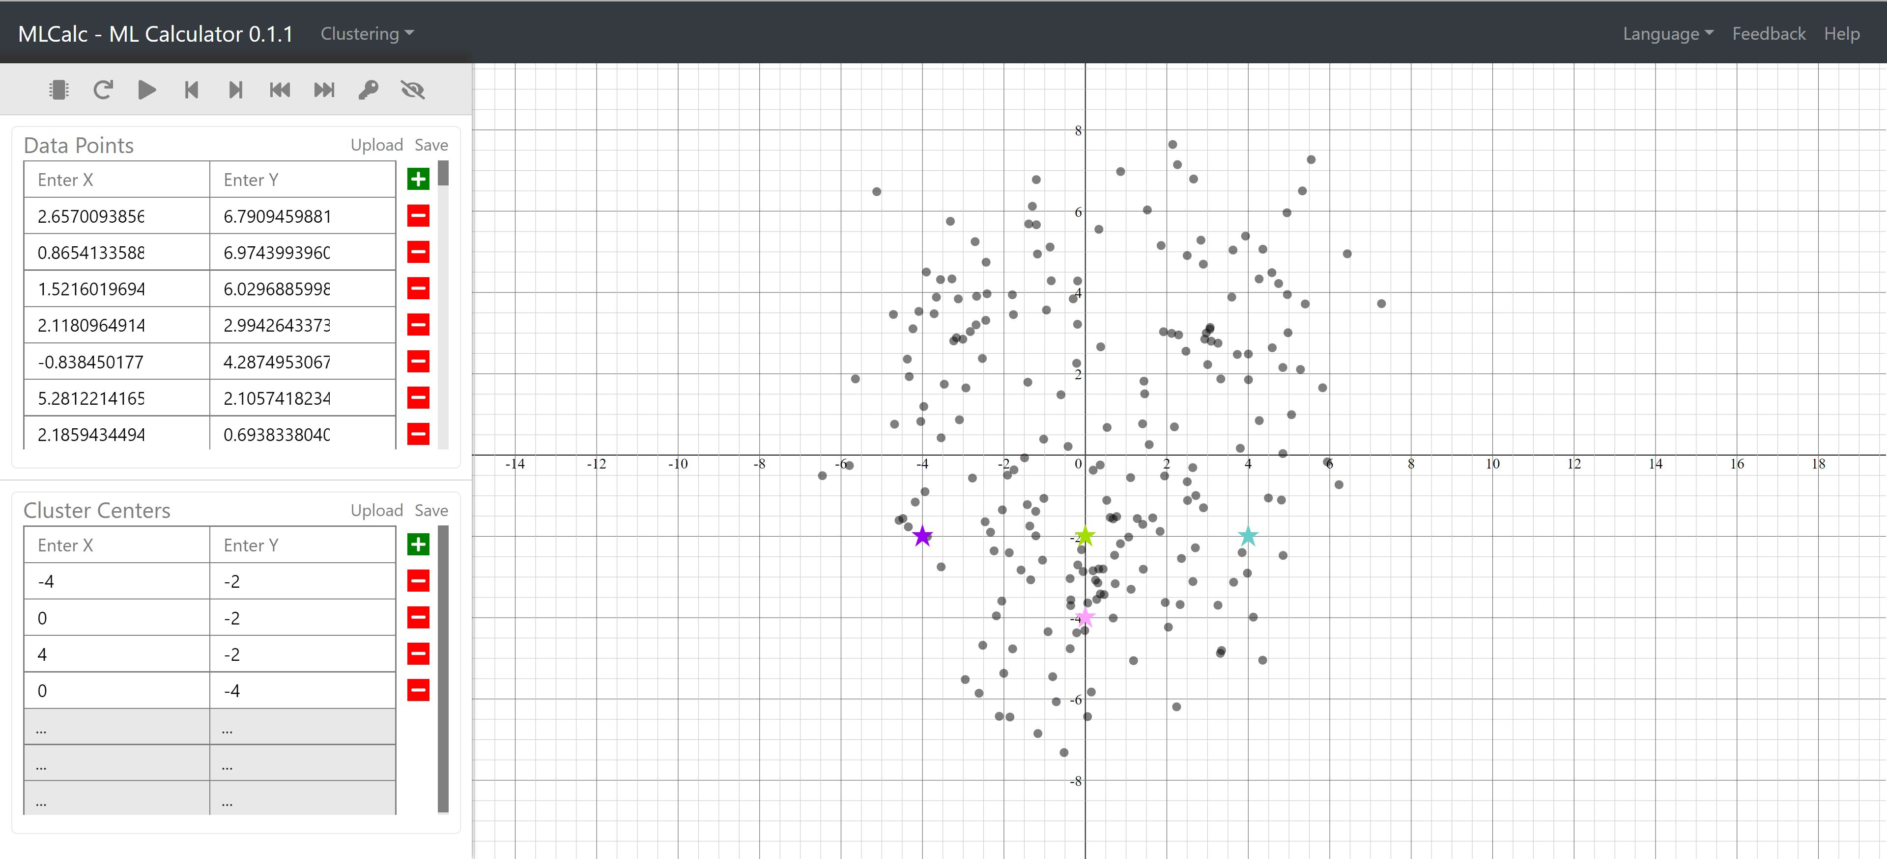
1. Navigator
2. Buttons
4. Canvas
3. Data Table

Slide 2

1
2
3
4
5
6
7
8
9

Slide 3
