Slide 1
Identifying Personal Attacks in Wikipedia Comments CS5100, Di Yang

Slide 2
Introduction
This project is Identifying Personal Attacks in Wikipedia Comments, in this project build 3 ML model to analysis the relationship between non-tack and tack comments.

Slide 3
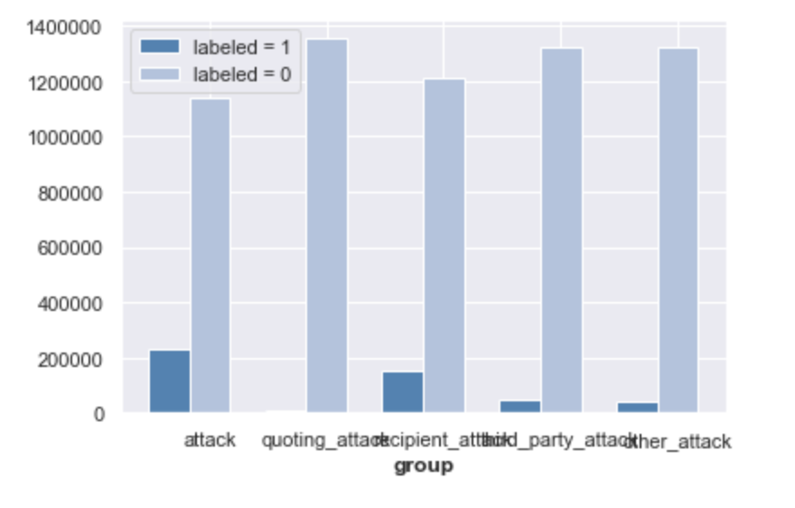
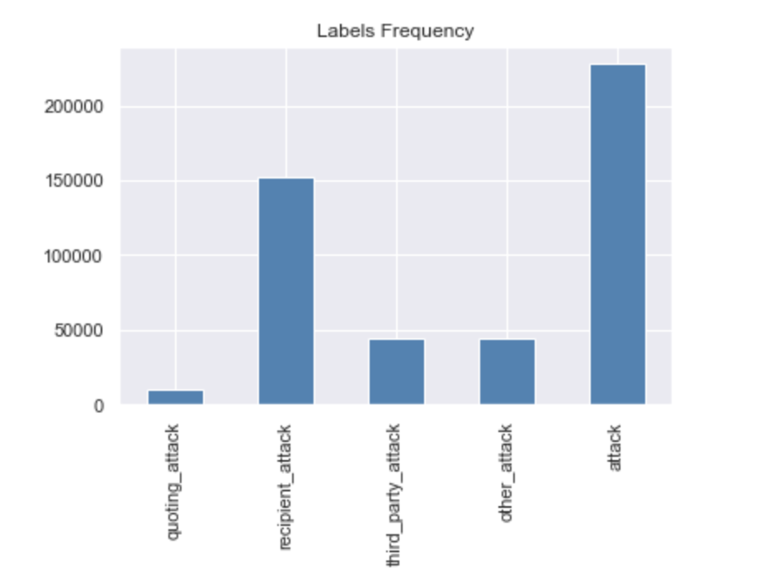
Data Feature

Slide 4
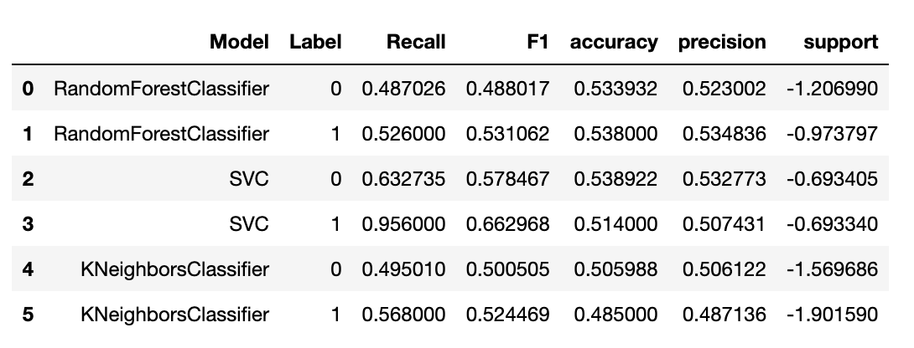
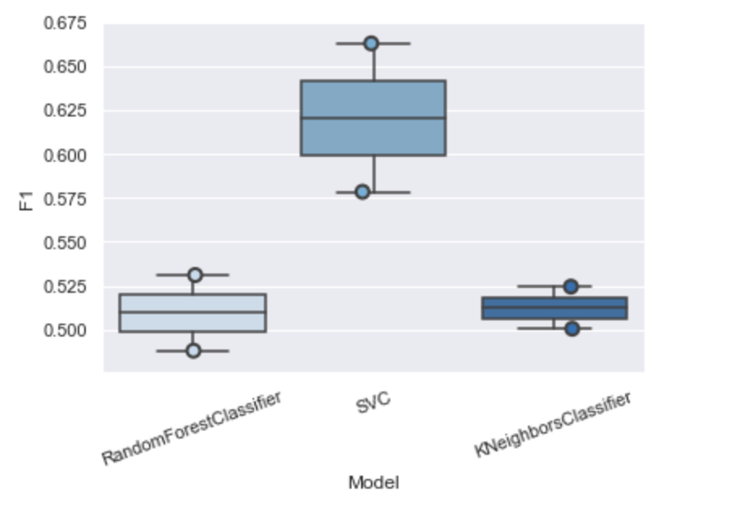
Model Evaluate
F1 Score

Slide 5
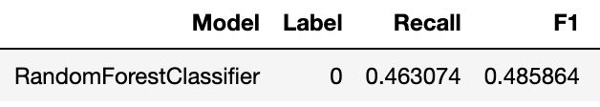

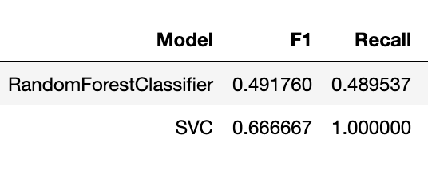
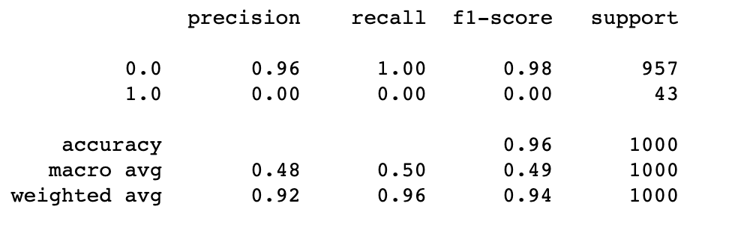
Tuning hyperparameters
Number Threshold

Slide 6
Thanks!

