Slide 1



Anime Recommendation System
Matthew DiDomizio
Maranda Dominguez

Slide 2


Introduction
Goal:
Create a recommendation system that accurately gives anime suggestions to new users based upon their similarity to existing users within the system
Motivation:
Common interest in anime
Sought to get recommendations of our own

Slide 3
Background and History of Recommendation Systems
A recommender system is a construct that seeks to predict user preferences
There are generally two types of recommender systems:
Content-based
Collaborative
Recommender systems are built with machine learning algorithms which learn from users' behaviors and categorize them into groups which contain users of similar behaviors

Slide 4
Approach and Implementation
A MapReduce-based K-means algorithm was used to build our recommender system
The first step was to explore, clean, and transform our dataset using Pandas for better use of our recommender system
The next step was to reduce the high dimensionality of the dataset in order to both improve performance speeds and to create a more accurate overall profile for each user
At this stage, the number of clusters (K) was determined, and initial centroids were chosen
Next, the programming of the algorithm itself took place using Python
Mapper: Imports and parses centroids, as well as creates clusters and emits them to the reducer
Reducer: Using the clusters created by the mapper, generates new centroids to be used in further iterations
Lastly, the program was run with Hadoop and the final centroids and clusters were found after multiple iterations when convergence criteria were met
The system was tested with hypothetical new users who may be trying to get their own recommendations

Slide 5
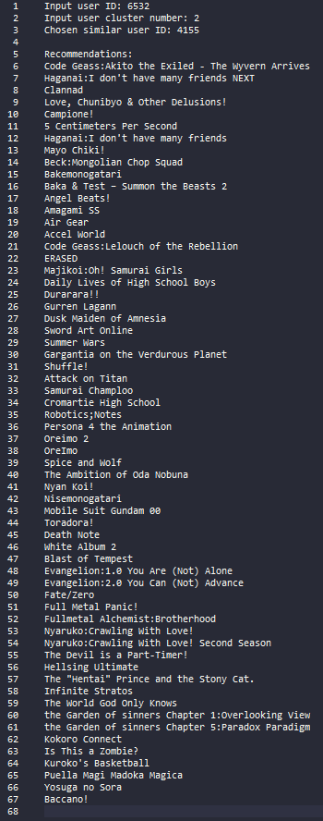
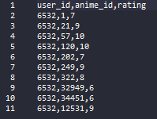
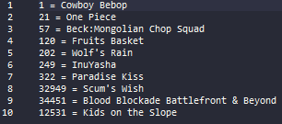
Experiment Results and Discussion
Recommendations
New users were tested against the system to see if user similarity in the clusters is generally accurate
These users were effectively placed into clusters by finding which final centroid they are closest to
Other users at random were chosen within the same cluster and series which they enjoy were fed to the new user as recommendations
Our own personal recommendations were curated well, but since preferences of series are highly subjective, testing with more real human users would be ideal
Test User Input
Test User Input Series Names

Slide 6
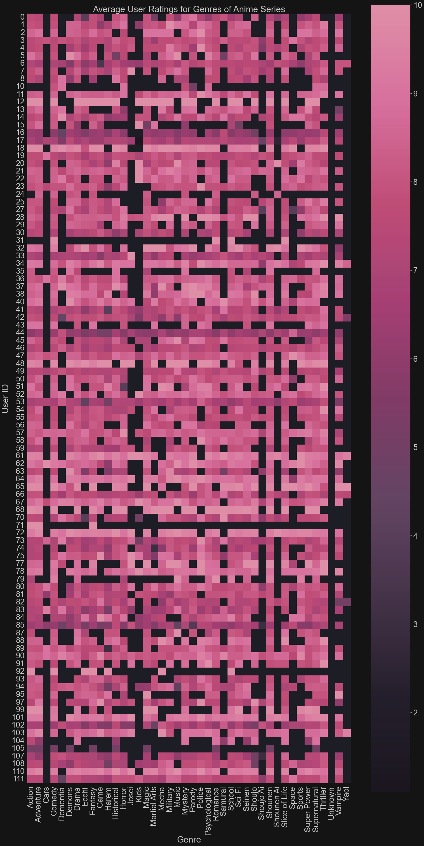
Visualization
Shown is an example of visualization used for this recommender system
The high dimensionality of the data requires a different form of visualization than a scatter plot
This heatmap shows a small sample of the data in the form of users' average ratings for genres
The visualization was attained using the Seaborn and Matplotlib Python modules

Slide 7

Conclusion
Creation of the anime recommender system proved to be successful
New users who feed their preferences into the system will likely enjoy the anime they were recommended based on their previous preferences and their high similarity to users they were grouped with
This system can be readily be expanded upon in the future to act on even larger datasets of user ratings and new anime series/movies and be integrated into a user-friendly GUI program or website.

Slide 8
References
Asad, Syed Muhammad. “AI Movies Recommendation System with Clustering Based K-Means Algorithm.” Medium, Medium, 19 Aug. 2020, asdkazmi.medium.com/ai-movies-recommendation-system-with-clustering- based-k-means-algorithm-f04467e02fcd.
Dey, Victor. “Collaborative Filtering vs Content-Based Filtering for Recommender Systems.” Analytics India Magazine, 25 Aug. 2021, analyticsindiamag.com/collaborative-filtering-vs-content-based-filtering-for- recommender-systems/.
Dwivedi, Rohit. “What Are Recommendation Systems in Machine Learning? | Analytics Steps.” Analytics Steps, 16 Apr. 2020, www.analyticssteps.com/blogs/what-are-recommendation-systems-machine- learning.
Grover, Prince. “Various Implementations of Collaborative Filtering.” Towards Data Science, Towards Data Science, 28 Dec. 2017, towardsdatascience.com/various-implementations-of-collaborative-filtering- 100385c6dfe0.
Rocca, Baptiste. “Introduction to Recommender Systems.” Medium, Towards Data Science, 2 June 2019, towardsdatascience.com/introduction-to-recommender- systems-6c66cf15ada.
Roy, Abhijit. “Introduction to Recommender Systems- 1: Content-Based Filtering and Collaborative Filtering.” Medium, 31 July 2020, towardsdatascience.com/introduction-to-recommender-systems-1- 971bd274f421.

