Slide 1
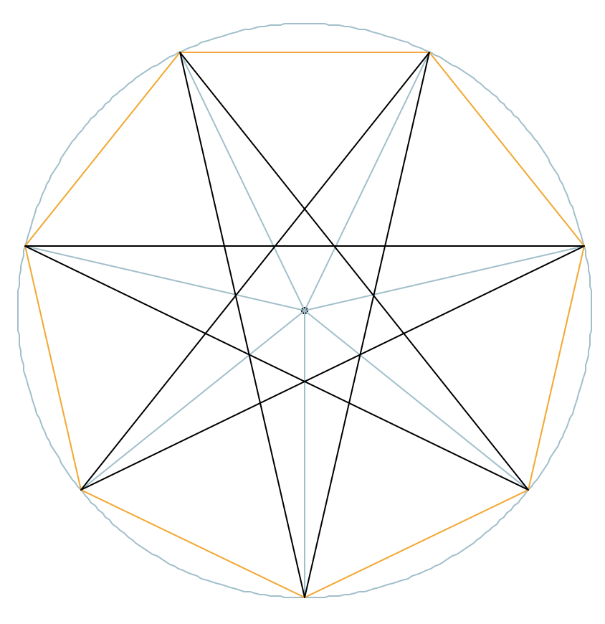
Regular Star Polygons (important angles and lengths)
Input data 1
r : radius of circumscribing circle (in blue) n : number of vertices (numbered from 0 to n-1) m : step to connect edges, vertex i is linked to vertex (I + m) % n 1 corresponds to a convex polygon (orange) n/2 is the “narrowest” concave polygon (in black + red)
Case 1: the star is drawn with internal segments (as done by hand we tracing a 5-points star, i.e. pentagram)
Case 2: the star is drawn without internal segments.
Input data 2
r : radius of circumscribing circle (in blue) n : number of vertices u = length of the edge
Case 3 : from u compute angles 𝜃 and 𝜌 and then as Case 2
Angles (in degrees) and lengths (colors corresponds to values needed In the above cases)
𝛼 = 360 / n
𝛽 = 𝛼 * (m + 1) / 2 or 𝛽 = 𝛾 – 𝜌
𝛾 = 𝛼 * m
𝛿 = (n – 2) / n * 180
𝜃 = 180 – 𝛾 or 𝜃 = 𝛿 - 2 * 𝜌
𝜌 = (𝛿 - 𝜃) / 2 or 𝜌 = acos(s / (2 * u))
𝜆 = 180 – (𝛼 + 𝜃) / 2
𝜎 = 180 – 2 * 𝜌
s = 2 * r * sin(𝛼 / 2)
t = 2 * r * sin(𝛾 / 2)
u = sin(𝛼 / 2) * r / sin(𝜆)
4
3
𝛼
𝜎
5
u
2
𝛼
𝜆
𝛽
r
𝛽
t
s
𝛾
𝜃
𝛿
6
1
𝛾
𝜃
𝜌
𝜌
0
Example: a {7/3} star polygon with its angles and lengths

