Slide 1
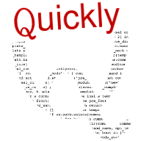
Quickly
Tool for the Opportunistic Programmer
or
Programming on Ubuntu Should Be Easy and Fun
$ sudo apt-get install quickly

Slide 2
Tool for the Opportunistic Programmer
or
Programming on Ubuntu Should Be Easy and Fun

Slide 3
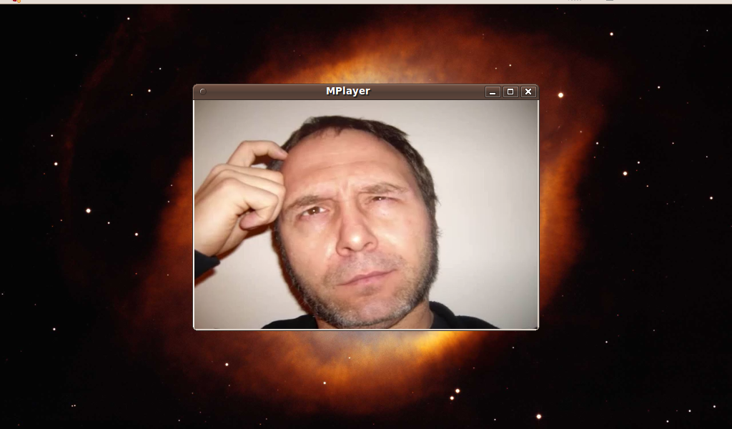

Slide 4
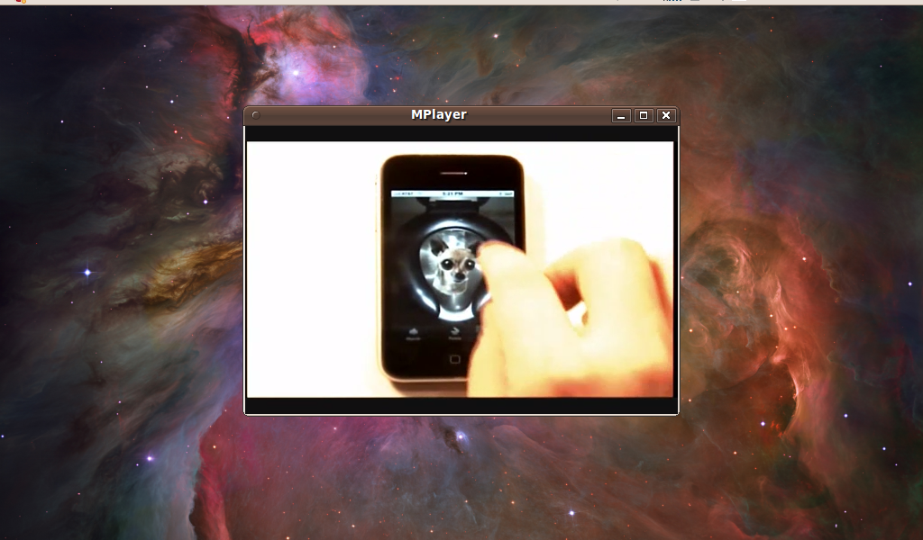

Slide 5
Cloud Layer Cake: Ubuntu … um cloud repository, wait, erm ...
Deploying
Pushing and scaling:
where, how?
Iterating locally
How to refresh his development
branch to be used in production?
Switching between projects:
Mongodb, upstart, juju nodes
Switching between projects:
Mongodb, upstart, juju nodes
Why do my work environment
always starts?
Time
Setup project
Local provider, lxc, vagrant,
Docker… create ssh keys
Juju-quickstart, juju-gui
charms, Debs, PPAs, bundles…
How can I choose
the version of framework I need?
I just see ”precise”, ”oneiric”
Tools
His preferred editor
Juju-python, juju-core?
From cloud repository or a stable
PPA?

Slide 6
Cloud Layer Cake: Ubuntu … um cloud repository, wait, erm ...
Deploying
Pushing and scaling:
where, how?
Iterating locally
How to refresh his development
branch to be used in production?
Switching between projects:
Mongodb, upstart, juju nodes
Why do my work environment
always starts?
Time
Setup project
Local provider, lxc, vagrant,
Docker… create ssh keys
Juju-quickstart, juju-gui
charms, Debs, PPAs, bundles…
How can I choose
the version of framework I need?
I just see ”precise”, ”oneiric”
Tools
His preferred editor
Juju-python, juju-core?
From cloud repository or a stable
PPA?

Slide 7
Application Layer Cake: Ubuntu … um GNOME, wait, erm ...
Discovery and Installation
Add/Remove, repos
Universe, Main, PPAs
Time
Packaging and Distribution
Debs, PPAs, Launchpad
Tools and APIs
GUI Kits: Gtk, Qt, WxWidgets,
Tk, EasyGUI, Zenity, Swing
Languages: Python, C,
C#, Ruby, Javascript
Editor/IDE: Gedit, Glade,
emacs/vi,Kdevelop, Adjunta,
Wing, Dr. Python, Eric, Idle,
etc...

Slide 8
Cloud Layer Cake
Discovery and Installation
PPA
Time
Packaging and Distribution
Debs
Tools and APIs
Python, pygtk, Glade, desktopcouch

Slide 9
Demo
Quicky

Slide 10
Create your own Quickly template
Quickly is:
  Quickly core
  Templates
Two Parts for each template:
  Boiler Plate
  Quickly commands (create, edit, ...)

Slide 11
Create your own Quickly template
Simple to start from scratch:
  Create your own stock application with boiler plate
  Implement create, run…
Or start from another template:
  $ quickly quickly <origin template> <destination template>
  add/tweak/remove commands (think to make them executable)
  No inheritance/dependencies between templates (yet)

Slide 12
Create your own Quickly template
Two directories:
  /usr/share/quickly/templates/ (default in the Ubuntu package, but in fact --home of setup.py install parameter)
  ~/quickly-templates/
Quickly --version/quickly command to check
Choice of language for implementing Quickly commands

Slide 13
Create your own Quickly template
Commands has a context:
  Can be launched only inside or only outside a project or both.
  Defined in commandconfig file:
# define parameters for commands, putting them in a list seperated
# by ';'
# if nothing specified, default is to launch command inside a project
# only and not be followed by a template
COMMANDS_LAUNCHED_IN_OR_OUTSIDE_PROJECT = tutorial
COMMANDS_LAUNCHED_OUTSIDE_PROJECT_ONLY = create
COMMANDS_FOLLOWED_BY_COMMAND =

Slide 14
Create your own Quickly template
Why creating a Quickly templates?
→ Quickly Core does all the hard stuff for you:
  Available commands corresponding to the context
  Shell-completion (ex: tutorial, help)
  → depending on the context too!
  help/shell-completion (quickly license)
  All commands are considered as being launched in the root directory
  .quickly file generated for you

Slide 15
Create your own Quickly template
Bonus, if you are using python:
  Access/modify .quickly content in one line
  Shell-completion made easier
  Common commands like launchpad handling
  Same for bzr/ppa handling
  A lot of other little tools…

