Slide 2
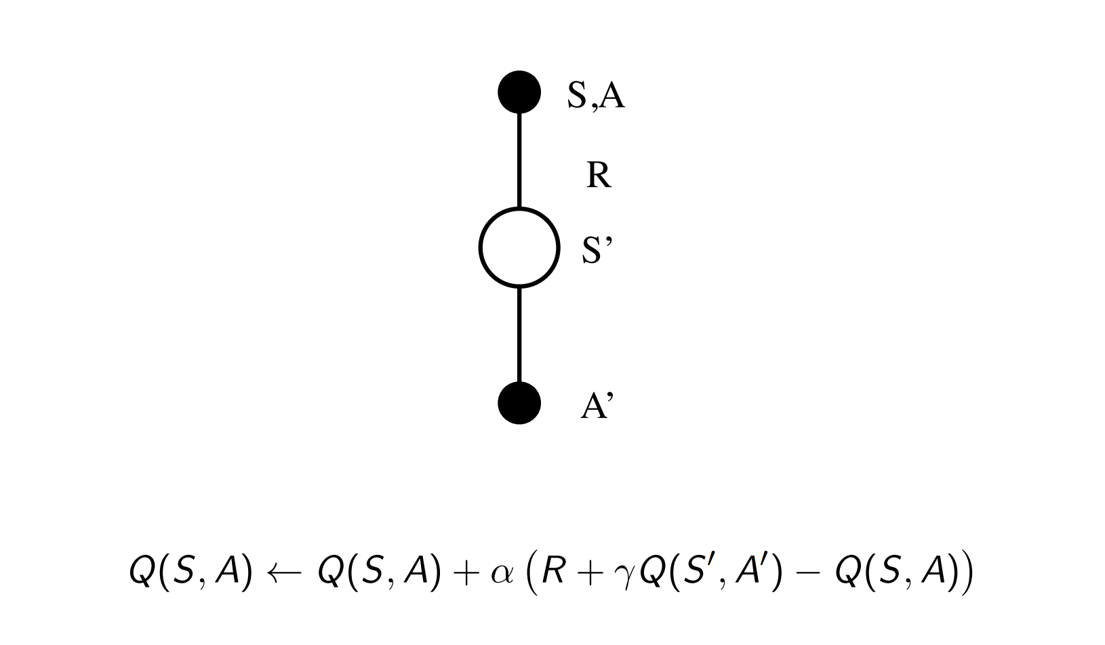
Sarsa

Slide 3
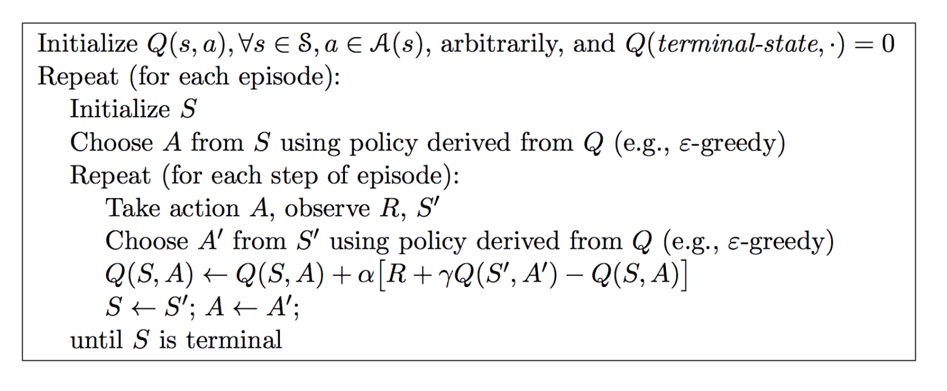
Sarsa

Slide 4
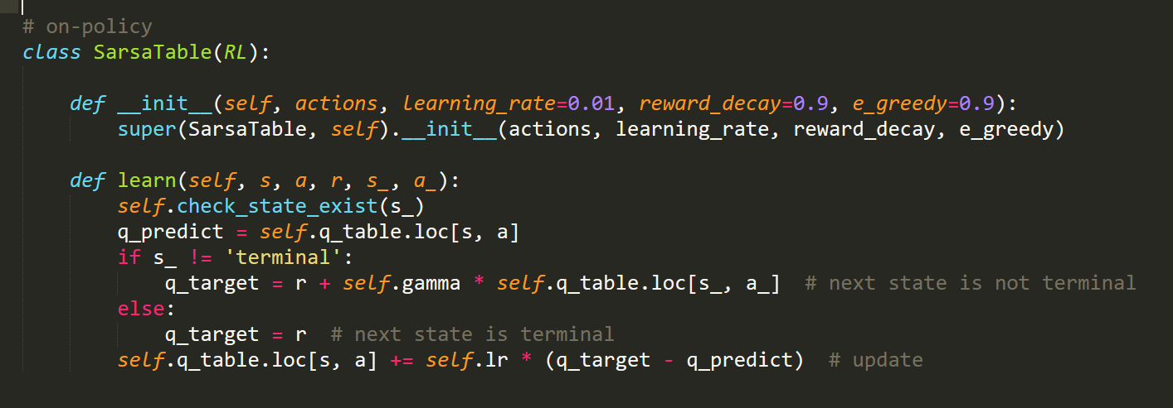
Sarsa

Slide 5
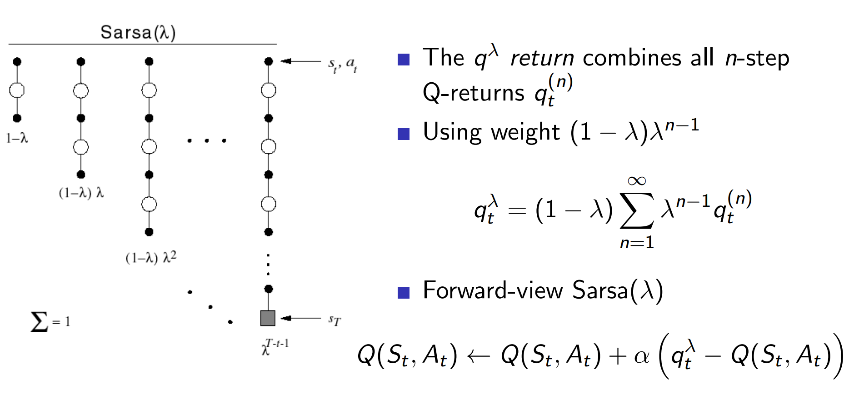
Sarsa(λ)

Slide 6
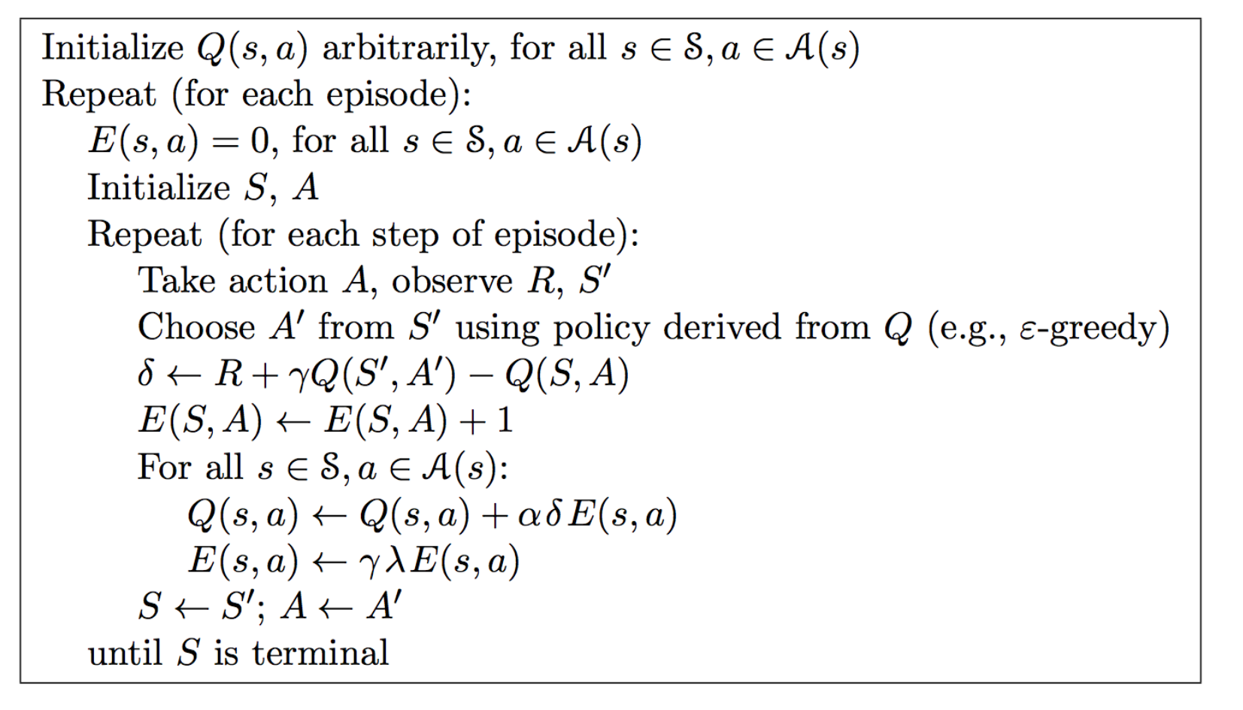
Sarsa(λ)

Slide 7
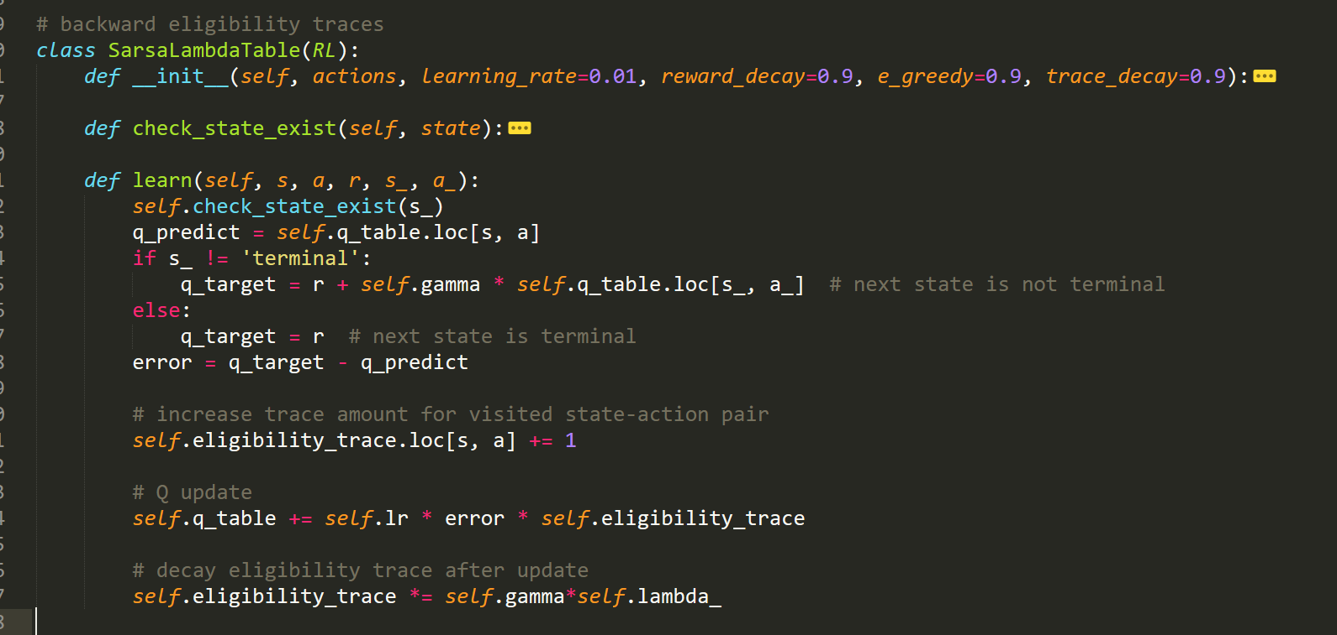
Sarsa(λ)

Slide 8
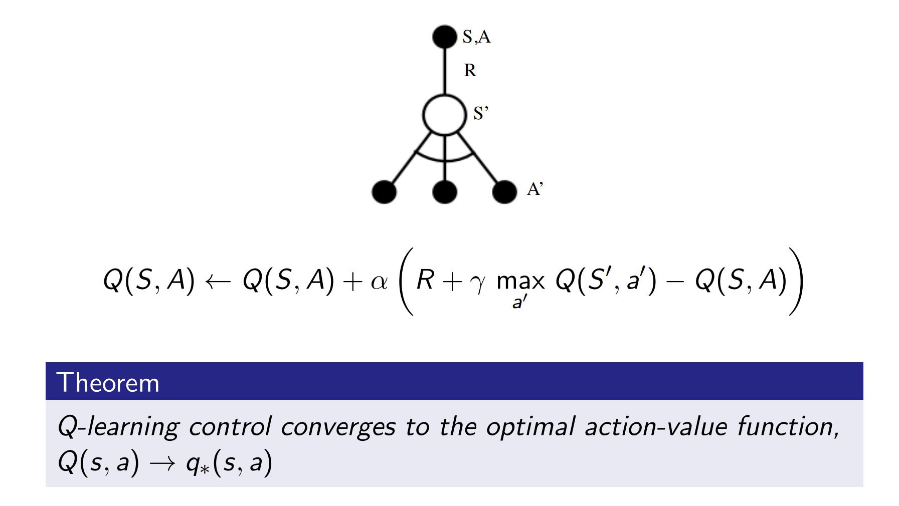
Q-Learning

Slide 9
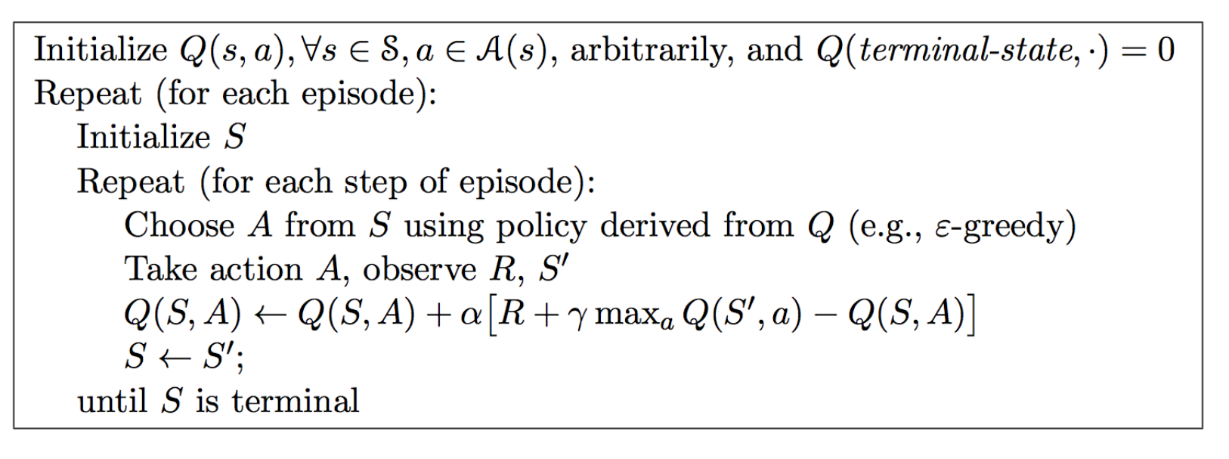
Q-Learning

Slide 10
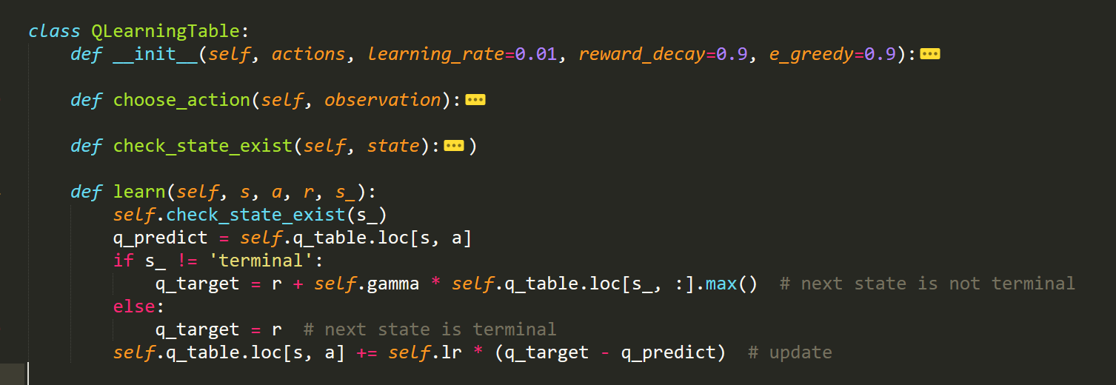
Q-Learning

Slide 11
Sarsa
Sarsa(λ)
Q-Learning

Slide 12
What’s wrong?

Slide 13
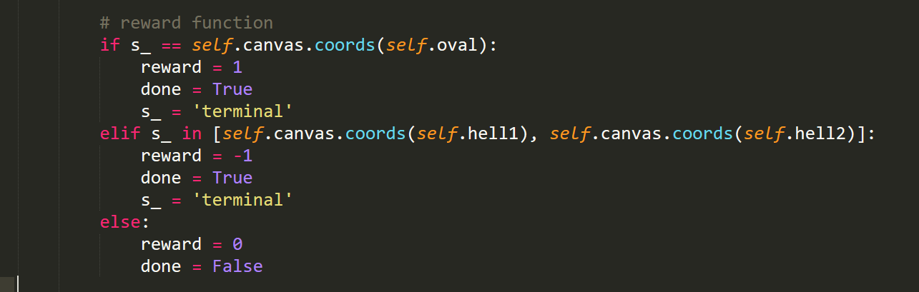
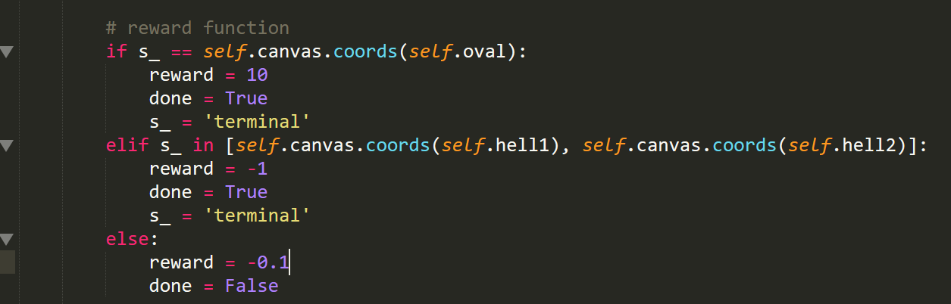
Reward가 문제일까?
변경

Slide 14
Sarsa
Sarsa(λ)
Q-Learning

