Slide 1
음성 합성 기술 세미나
양종열
NCSoft

Slide 2
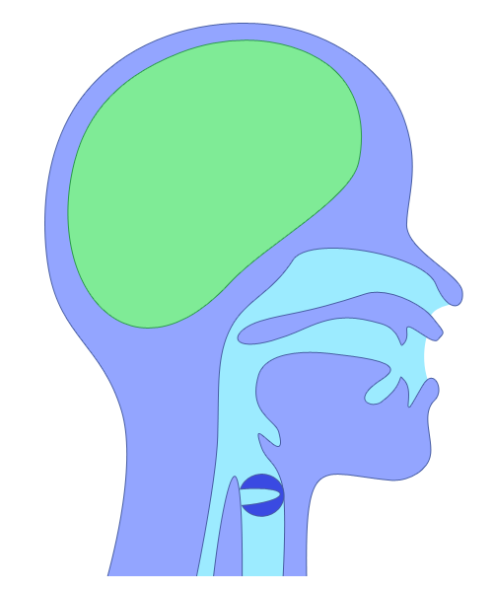
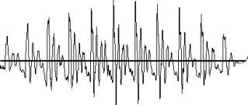
how to make speech?
Modulation of carrier wave
by speech information
Frequency
transfer
characteristics
Speech
Magnitude
start--end
Sound source
Voiced: pulse
Unvoiced: noise
Fundamental
frequency

Slide 3
Very simple structure
Pulse train
Synthesis filter
Vocoded speech
Excitation
White noise

Slide 4

Simple structure
Original speech
F0
Unvoiced / voiced
Mel-cepstrum
Pulse train
Synthesis filter
Vocoded speech
Excitation
White noise
These speech parameters modeled by HMM

Slide 5
Parametric TTS 기본 구조
SPEECH
DATABASE
Speech signal
Training part
Excitation
Parameter
extraction
Spectral
Parameter
Extraction
Excitation
parameters
Spectral
parameters
Training HMMs
Labels
TEXT
Text analysis
Context-dependent HMMs
& state duration models
Parameter generation
from HMMs
Labels
Excitation
parameters
Spectral
parameters
Excitation
generation
Excitation
Synthesis
filter
SYNTHESIZED
SPEECH
Synthesis part

Slide 6
학습과정 (monophone)
Speech data & labels
Compute variance
floor (HCompV)
Calculate minimum variance of speech parameter
Initialize CI-HMMs by
segmental k-means (HInit)
Create monophone HMMs for all phonemes
and initialize these parameters
Reestimate CI-HMMs by
EM algorithm
(HRest & HERest)
Estimate parameters with training data
(Context-independent : CI)
Copy CI-HMMs to
CD-HMMs (HHEd CL)
Concatenate monophone HMMs according to
fullcontext labels
(Context-dependent : CD)
Training fullcontext HMMs
Notes:
The first step in the training process is training monophone HMMs. This is done by first calculating the minimum variance of the speech parameter using speech data. Monophone HMMs are created from each phoneme and initialized these parameters. Then, each monophone HMM is estimated using an EM algorithm with training data. The monophone HMMs are concatenated in accordance with the full context labels to improve model accuracy. The result is that all models become context-dependent models.
(The words shown in blue on the slide are HTS commands.)

Slide 7
학습과정 (fullcontext)
Reestimate CD-HMMs by
EM algorithm (HERest)
Estimate parameters with training data
(parameters are not shared)
Decision tree-based
clustering (HHEd TB)
Construct a decision tree by
the context clustering technique
(Use TB command)
Reestimate CD-HMMs by
EM algorithm (HERest)
Estimate parameters with training data
(parameters are shared)
Untie parameter tying
structure (HHEd UT)
Untying shared structure
(Use UT command)
Synthesis part
Notes:
After full context HMMs are created, the parameters are re-estimated using the EM algorithm.
A decision tree is then constructed using the context-clustering technique, and the parameters of similar HMMs are shared.
The shared HMMs are re-estimated in accordance with each full context label.
These HMMs can be directly used for synthesis or to improve model accuracy by repeating estimation and clustering.

Slide 8
Context-dependent model
Phoneme
sequence
s a cl p a r i w a k a r a n a i
s-a-cl
p-a-r
n-a-i
Context-dependent HMMs
Considering relations between phonemes
Context ⇒ factor of speech variations
Improving model accuracy
Notes:
Let’s start with the context-dependent model. This model considers not only single phonemes but also the context of the target phoneme. Context means “factor of speech variation.” This diagram shows an example of triphone modeling. In this model, the unit of modeling is the center phoneme and its previous and next phoneme. This model is thus more accurate than a center phoneme only model.

Slide 9
Context-dependent modeling
Phoneme
{preceding, succeeding} two phonemes
current phoneme
Syllable
# of phonemes at {preceding, current, succeeding} syllable
{accent, stress} of {preceding, current, succeeding} syllable
Position of current syllable in current word
# of {preceding, succeeding} {accented, stressed} syllable in current phrase
# of syllables {from previous, to next} {accented, stressed} syllable
Vowel within current syllable
Word
Part of speech of {preceding, current, succeeding} word
# of syllables in {preceding, current, succeeding} word
Position of current word in current phrase
# of {preceding, succeeding} content words in current phrase
# of words {from previous, to next} content word
Phrase
# of syllables in {preceding, current, succeeding} phrase
…..
Huge # of combinations ⇒ Difficult to have all possible models

Slide 10
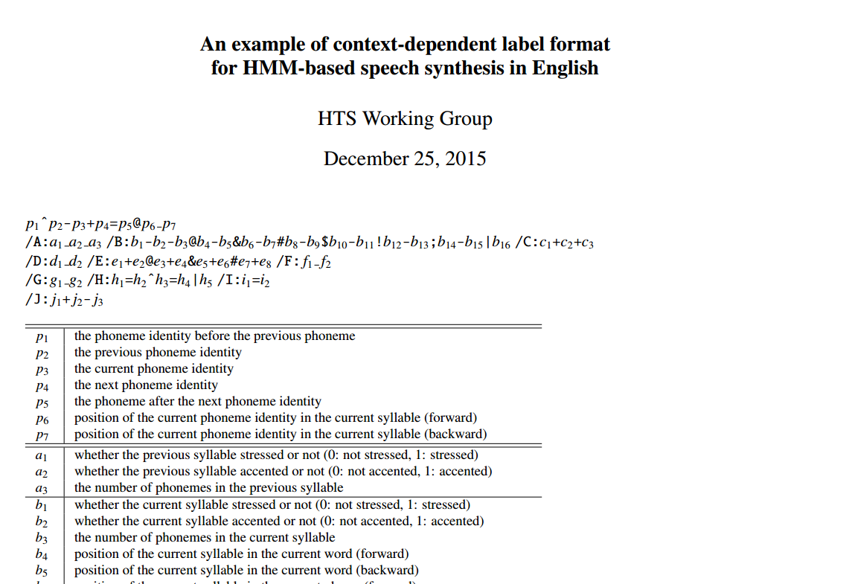

Slide 11
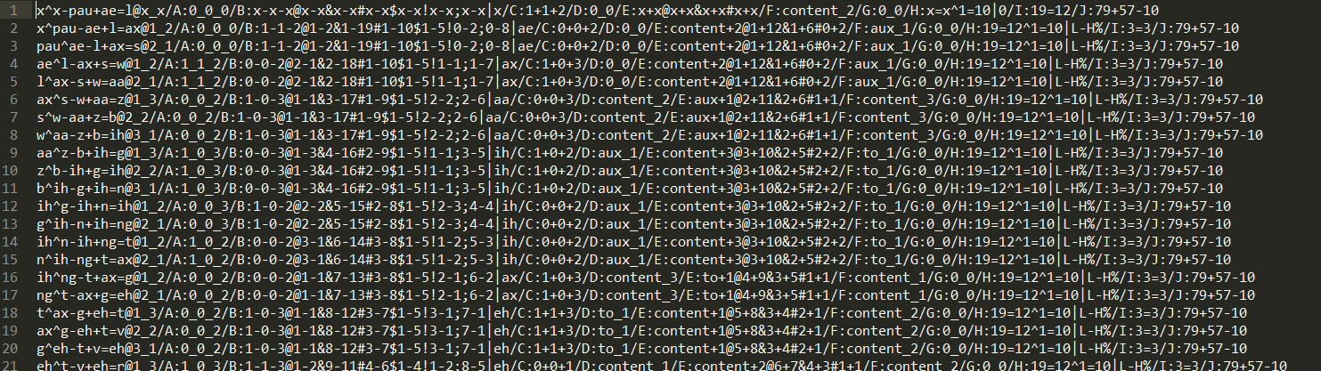
Label File

Slide 12
Decision tree-based state clustering
L=voice?
k-a+b
yes
no
t-a+h
L=“w”?
R=silence?
yes
no
yes
no
s-i+n
R=silence?
L=“gy”?
…
…
yes
no
yes
no
C=unvoice?
C=vowel?
R=silence?
R=“cl”?
L=“gy”?
L=voice?
…
…
Sharing the parameter of HMMs in same leaf node
Each state separated automatically by the optimum question
The optimum question determined for increasing likelihood
Notes:
Context-dependent HMMs are used in the same manner as they are for HMM-based speech recognition. A decision-tree-based context-clustering technique is applied to them.

Slide 13
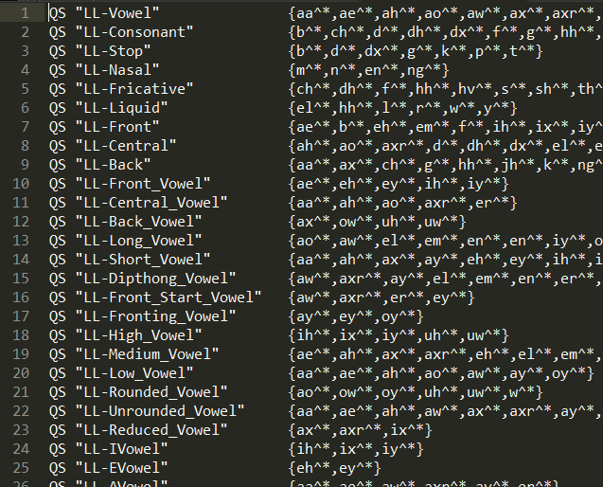
Question File

Slide 14
Tree for Spectrum (1st state)
C-Consonant
yes
no
L-Liquid
C-Not_Affricate
yes
no
yes
no
L-Consonant
L-hh
C-Nasal
C-Voiced_Consonant
yes
no
yes
no
yes
no
yes
no
L-Vowel
L-Nasal
Seg_Fw<=1
C-iy
C-Not_Continuent
L_Vowel
L-Vowel
L-Unrounded
_Vowel
Questions about phonetic attributes
Notes:
This shows an example of the decision tree constructed for the first state of the spectrum part. It shows that the spectrum models are greatly affected by phonetic identity.

Slide 15


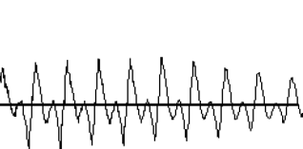
Synthesis part
Speech parameters are generated from HMMs
Spectrum parameters
Excitation parameters (F0)
Vocoding parameters to synthesized speech
⇒ Obtain high-quality synthesized speech
…
Truth is
what …
…
…
SPEECH
DATABASE
Parameter
generation
from HMMs
Training
HMMs
SYNTHESIZED
SPEECH
Text
Notes:
After the HMMs are trained, the speech parameters such as the spectrum and F0 parameters are generated from the HMM parameters using a parameter generation algorithm.
By using these speech parameters and synthesis filter, we can obtain high-quality synthesized speech.

Slide 16
Synthesize from leaf nodes
…
synthesized
states
…
Concatenate states
according to the label
…
w-i+t
gy-u+sil
g-e+pau
…
w-a+sil
w-i+sh
gy-u+pau
Notes:
The HMM states in each leaf node are concatenated in accordance with the synthesis context label to generate an utterance HMM. If an unknown HMM not included in the development set is needed for the synthesis, its parameters can be generated from a similar HMM by tracing the decision tree.

Slide 17
Stream-dependent tree-based clustering
State duration
model
Three dimensional Gaussian
HMM
Decision tree
for state dur.
models
Decision trees
for
mel-cepstrum
Decision trees
for F0
Notes:
Each spectrum, F0 parameter, and duration has a unique set of contextual factors, so the distributions for spectrum parameter, F0 parameter, and state duration should be clustered independently.
As a result, we have 7 three decision trees in this example: three for each spectrum state, three for each F0 parameter, and one for state duration.
The state durations of each HMM are modeled as a three-dimensional Gaussian, and the context-dependent three-dimensional Gaussians are clustered by using the decision tree.

Slide 18
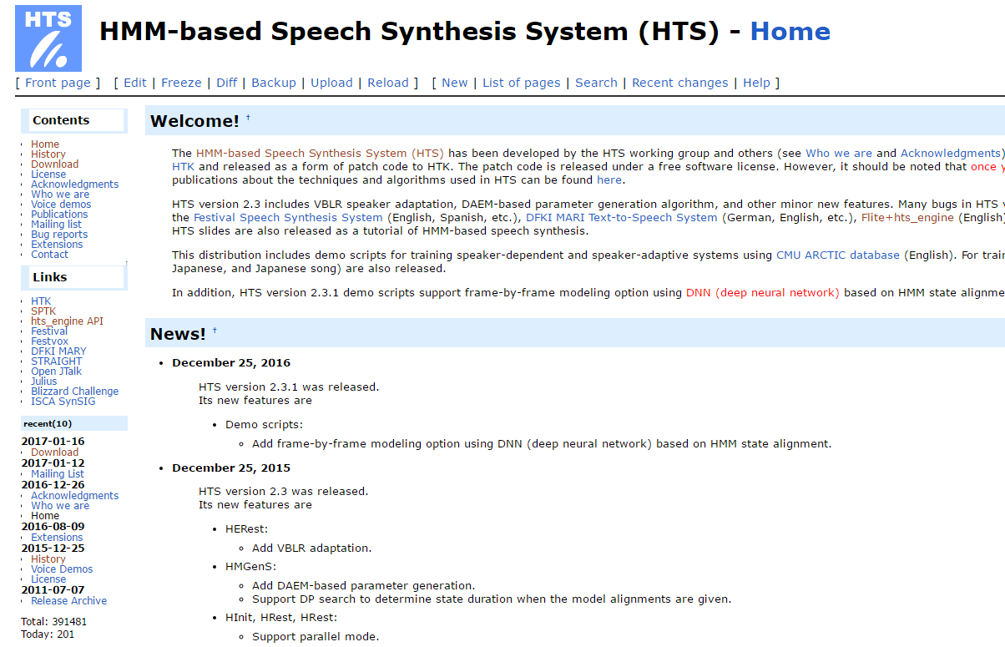

Slide 19

1. festival (2.4)
A general framework for building speech synthesis systems
여기서는 English text를 label 포맷으로 변경해주는 역할을 합니다.
British, English, Spanish 지원
http://festvox.org/packed/festival/2.4/festival-2.4-release.tar.gz
- Dependencies
a. speech_tools
http://festvox.org/packed/festival/2.4/speech_tools-2.4-release.tar.gz
- Dependencies
1. libncurses5-dev (sudo apt-get install libncurses5-dev)
- gcc-4.2~gcc4.8로 빌드해야함
install
ubuntu:~/festival$ ./configuration
ubuntu:~/festival$ ./make

Slide 20
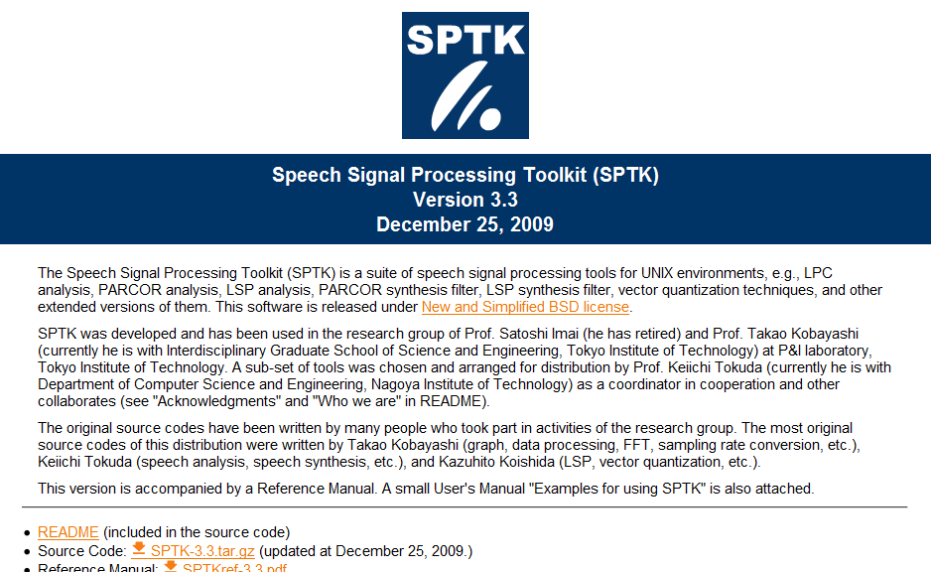
2. SPTK (3.9)
Speech Signal Processing Toolkit
wave 파일로부터 다양한 feature를 추출하는데 사용합니다.
그 외에도 신호처리를 위한 다양한 프로그램이 제공됩니다.
https://sourceforge.net/projects/sp-tk/?source=typ_redirect
- Dependencies
1. csh
- install
ubuntu:~/festival$ ./configure
ubuntu:~/festival$ ./make

Slide 21
3. HTS
Toolkit for HMM-based speech synthesis
acoustic model을 학습하는데 사용됩니다.
Research platform for HMM-based speech synthesis
Released as a patch code for HTK
Speaker dependent (SD) / adaptation (SA) demo scripts
http://hts.sp.nitech.ac.jp/archives/2.3/HTS-2.3_for_HTK-3.4.1.tar.bz2
- Dependencies
1. HTK (http://htk.eng.cam.ac.uk/ftp/software/HTK-3.4.1.tar.gz)
2. HDecode (http://htk.eng.cam.ac.uk/ftp/software/hdecode/HDecode-3.4.1.tar.gz)
3. libx11-dev (sudo apt-get install libx11-dev)

Slide 22
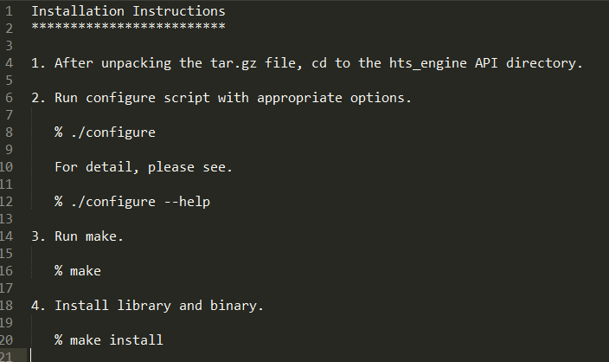
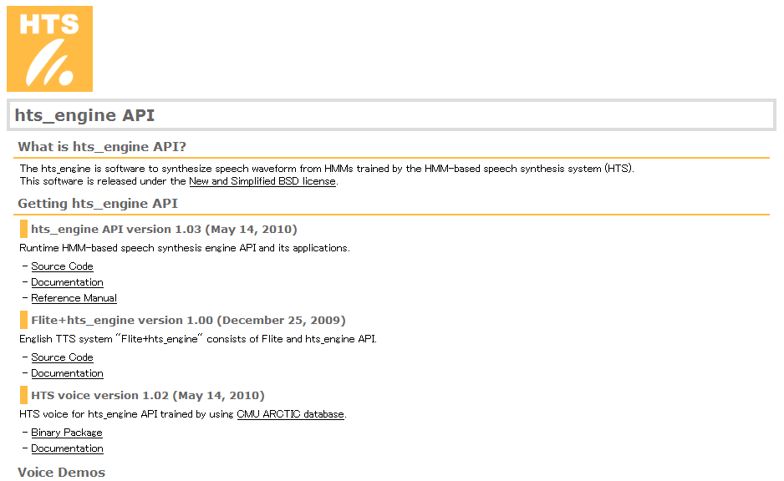
4. hts_engine
Runtime HMM-based speech synthesis engine
Software to synthesize speech waveform from HMMs
(HMMs trained by the HTS)
현재 여러 device에 embedded되어 사용되고 있습니다.
http://downloads.sourceforge.net/hts-engine/hts_engine_API-1.10.tar.gz

Slide 23
Database
음성, text, label
새로운 언어라면 label 포맷을 정의해야 합니다.
question file(decision tree에 사용)
좋은 성우를 선정하는 것과 음성과 text로부터 오류를 제거하는 것이 중요합니다.
Text로부터 Label을 만들어줄 프로그램 (G2P 포함)
입력 Text를 label포맷으로 변경해줄 때 필요합니다.
DB에 label이 포함되어있지 않다면 DB label을 만들 때 사용될 수도 있습니다.
POS는 critical하지 않을 수 있지만 Phoneme은 정확하게 변환할 수 있어야 합니다.

Slide 24
Q & A

