Slide 1
C++17 Preview

Slide 2
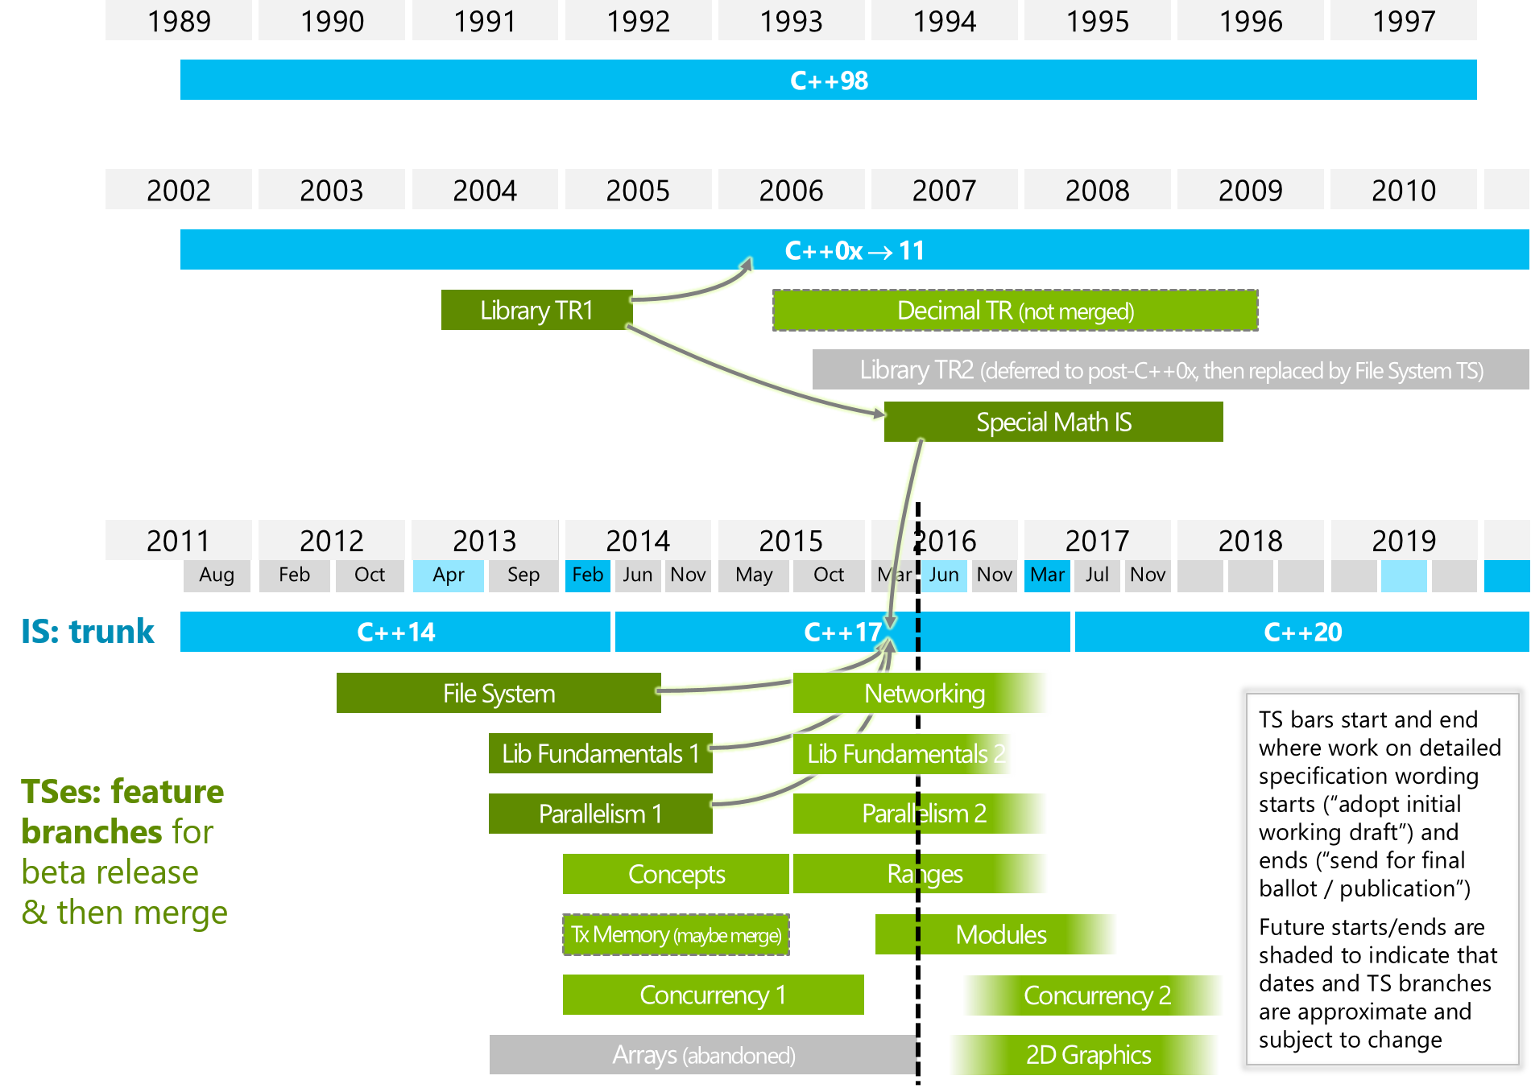
Current C++ Status – www.isocpp.org

Slide 3
C++11/14, C++17/20
C++11/14
Major : Lambda, Perfect forwarding, Move Semantics
Minor : auto, decltype, uniform initialize, Variadic Template,……
C++17/20
Major : Module, Range, Concept
Minor : uniform call syntax, coroutine, contract, asio, parallel, string_view, optional

Slide 4
C++17 주요 특징
Concepts
Modules
Ranges and other key STL components using concepts
Uniform call syntax
Co-routines (should be very fast and simple)
Networking support (based on the asio in the TS)
Contracts
SIMD vector and parallel algorithms
Library “vocabulary types”, such as optional, variant, string_view, and array_view
Boost 라이브러리

Slide 5
C++17 설계시 원하지 않았던 내용
• Turn C++ into a radically different language • Turn parts of C++ into a much higher-level language by providing a segregated sub-language • Have C++ compete with every other language by adding as many as possible of their features • Incrementally modify C++ to support a whole new "paradigm" • Hamper C++'s use for the most demanding systems programming tasks • Increase the complexity of C++ use for the 99% for the benefit of the 1%

