Slide 1
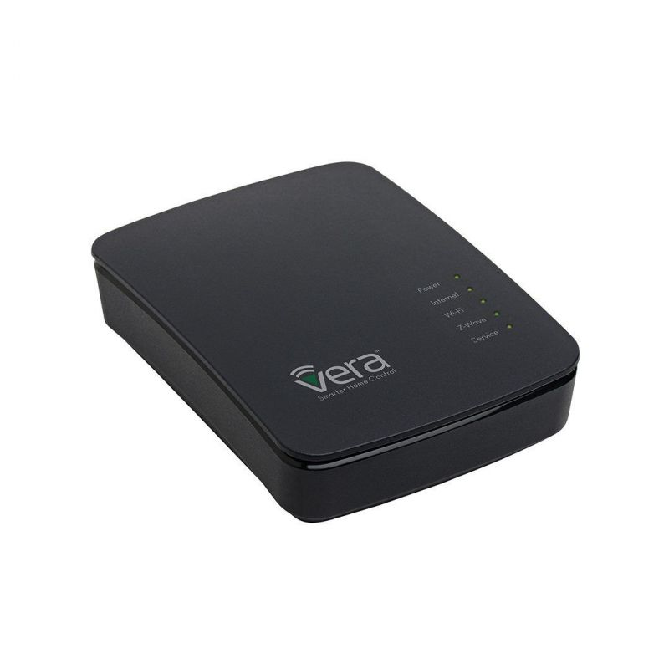
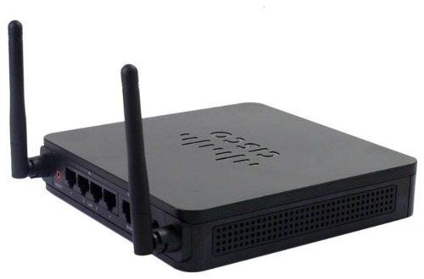

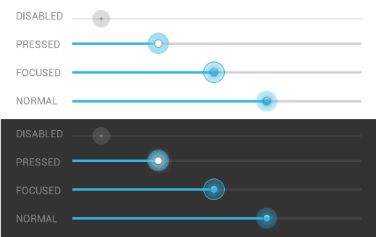

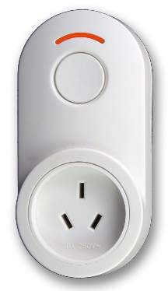
Router
Office Light
Z-Wave Controller
WLAN
HTTP
ZWAVE
Smartphone
Z-Wave Dimmer

Slide 2

Office Light
PUT
Office Light: 70%
SET VALUE 150

Slide 3

Office Light
PUT
Office Light: 100%
SET VALUE 255

Slide 4
Office Light
GET
Office Light
RESPONSE
Office Light = 255
Value = 255
GET
REPORT
Value = 255

