Slide 1
Java collections

Slide 2
Why java collections?
The Java Collections provide Java developers with a set of classes and interfaces that makes it easier to handle collections of objects.

Slide 3
java
java is a general purpose, high-level programming language developed by Sun Microsystems. The Java programming language was developed by a small team of engineers, known as the Green Team, who initiated the language in 1991. The language was originally called OAK, and at the time it was designed for handheld devices and set-top boxes. Oak was unsuccessful and in 1995 Sun changed the name to Java and modified the language to take advantage of the burgeoning World Wide Web

Slide 4
collection
A collection — sometimes called a container — is simply an object that groups multiple elements into a single unit. Collections are used to store, retrieve, manipulate, and communicate aggregate data.

Slide 5
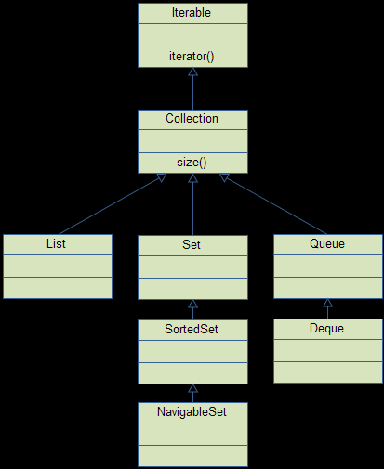
Collection achitecture

Slide 6
Collections Framework:
Interface
Implementations
Aggregate operations
Algorithms

Slide 7
Collection framework
A collections framework is a unified architecture for representing and manipulating collections. All collections frameworks contain the following:

Slide 8
Collection framework
The Java Collections Framework hierarchy consists of two distinct interface trees:
The first tree starts with the Collection interface, which provides for the basic functionality used by all collections, such as add and remove methods. Its subinterfaces — Set, List, and Queue — provide for more specialized collections.
The second tree starts with the Map interface, which maps keys and values similar to a Hashtable.
java collection
classes (ArrayList, Vector, LinkedList, PriorityQueue, HashSet, LinkedHashSet, TreeSet etc).

Slide 9
Java Collections - Iterable
The Iterable interface (java.lang.Iterable) is one of the root interfaces of the Java collection classes. The Collection interface extends Iterable, so all subtypes of Collection also implement the Iterable interface.
A class that implements the Iterable can be used with the new for-loop. Here is such an example:

Slide 10
Java colection
classes
Java Collection simply means a single unit of objects. Java Collection framework provides many interfaces (Set, List, Queue, Deque etc.) and classes (ArrayList, Vector, LinkedList, PriorityQueue, HashSet, LinkedHashSet, TreeSet etc).

Slide 11
linkedlist

Slide 13
classes
classes (ArrayList, Vector, LinkedList, PriorityQueue, HashSet, LinkedHashSet, TreeSet etc).

Slide 14
Arraylist

Slide 15
vectors

Slide 16
prioritylist

Slide 17
hashset

Slide 18
treeset

Slide 20
Set
The Set interface does not allow duplicate elements. This can be useful for storing collections such as a deck of cards or student records. The Set interface has a subinterface, SortedSet, that provides for ordering of elements in the set.

Slide 21
lists
The List interface provides for an ordered collection, for situations in which you need precise control over where each element is inserted. You can retrieve elements from a List by their exact position.

Slide 22
queue
The Queue interface enables additional insertion, extraction, and inspection operations. Elements in a Queue are typically ordered in on a FIFO basis.

Slide 23
Interface
collection interfaces are the heart and soul of the Java Collections Framework.
These are abstract data types that represent collections. Interfaces allow collections to be manipulated independently of the details of their representation. In object-oriented languages, interfaces generally form a hierarchy.

Slide 24
Collection interface
The Collection interface contains methods that perform basic operations, such as int size(), boolean isEmpty(), boolean contains(Object element), boolean add(E element), boolean remove(Object element), and Iterator<E> iterator().
It also contains methods that operate on entire collections, such as boolean containsAll(Collection<?> c), boolean addAll(Collection<? extends E> c), boolean removeAll(Collection<?> c), boolean retainAll(Collection<?> c), and void clear().

Slide 25
implementation
Implementations describes the JDK's general-purpose collection implementations and tells you when to use which implementation.
Implementations: These are the concrete implementations of the collection interfaces. In essence, they are reusable data structures.

Slide 26
agragate
Aggregate Operations iterate over collections on your behalf, which enable you to write more concise and efficient code that process elements stored in collections.
Aggregate Operations
In JDK 8 and later, the preferred method of iterating over a collection is to obtain a stream and perform aggregate operations on it. Aggregate operations are often used in conjunction with lambda expressions to make programming more expressive, using less lines of code. The following code sequentially iterates through a collection of shapes and prints out the red objects:

Slide 27
Algorithms
Algorithms describes the polymorphic algorithms provided by the JDK to operate on collections.
Algorithms: These are the methods that perform useful computations, such as searching and sorting, on objects that implement collection interfaces. The algorithms are said to be polymorphic: that is, the same method can be used on many different implementations of the appropriate collection interface. In essence, algorithms are reusable functionality.

