Slide 1

Opening a Cinema in BA
Battle of the Neighbourhoods (Week 2)

Slide 2
Introduction
Buenos Aires is the singlest biggest city in Argentina and one of the biggest in South America.
As such it has become a hub for all main activities within the country, tourism, education, employment, entertainment and presents a big opportunity for new venues.
Which is the best place to open a new Cinema in Buenos Aires?
We will study the city, feeding from Foursquare data regarding the different venues that might have a positive/negative impact for the deployment of a cinema venue.

Slide 3
Data
To determine the best place to open a Cinema in Buenos Aires we will need the following set of data:
The Barrios and its coordinates from Buenos Aires, Argentina: https://raw.githubusercontent.com/diecou/ds-training/master/buenos_aires_coor.csv
The following venues data from Foursquare:
Cinema venues for each Barrio
Restaurant venues for each Barrio
Theater venues for each Barrio
These venues will be weighted so we can determine which is the best barrio to open a new cinema using a scoring system

Slide 4
Main Article

Slide 5
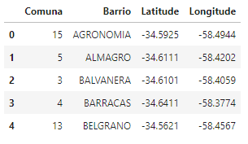
Create the dataset
We create the dataset with all of Buenos Aires ‘barrios’
The dataset includes the coordinates of each ‘barrio’

Slide 6
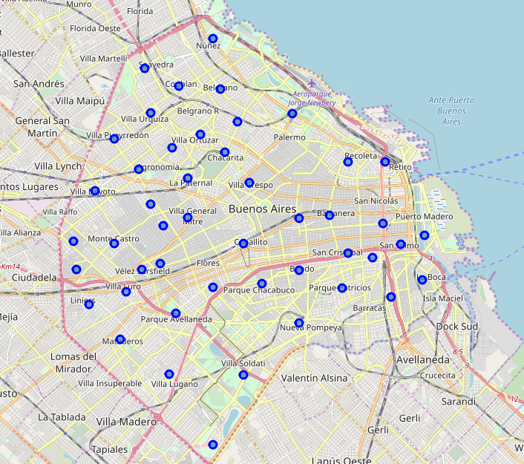
Map of Buenos Aires
This is a map with all of Buenos Aires ‘barrios’

Slide 7
Getting additional data from foursquare
In order to determine where to best open a new Cinema there are three other venues that are considered to have an impact:
Other existing cinemas
Restaurants
Theaters
We will determine how many of these venues are located within each barrio in a radius of 1km

Slide 8
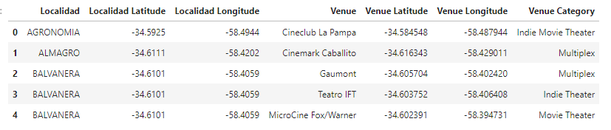
Find existing cinemas
We look for all the currently existing cinemas on each of the ‘barrios’
We also get their coordinates to later draw them in a map

Slide 9
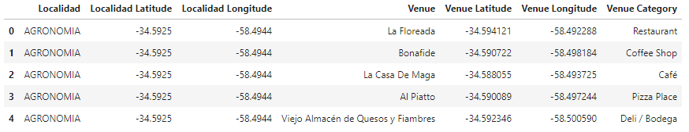
Find existing restaurants
We look for all the currently existing restaurants on each of the ‘barrios’
We also get their coordinates to later draw them in a map

Slide 10
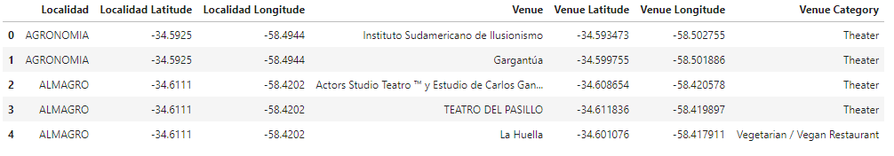
Find existing theaters
We look for all the currently existing theaters on each of the ‘barrios’
We also get their coordinates to later draw them in a map

Slide 11
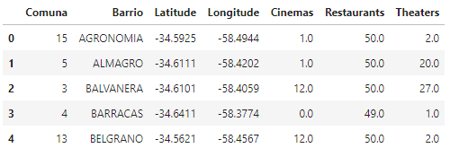
Group all data
We create a new dataset adding all the recently acquired venues data to the previous dataset with all ‘barrios’
We then have a count of all venues per category for each barrio

Slide 12
Group all data
We create a new dataset adding all the recently acquired venues data to the previous dataset with all ‘barrios’
We then have a count of all venues per category for each barrio

Slide 13
Scoring the ‘barrios’
We assign a weight value to each of the venues as follows:
Cinemas
We want to avoid being too close to other existing cinemas.
Therefore we assign each of them a weight of -5.
Restaurants
Being close to restaurants is desirable.
It can provide an ‘edge’ over other cinemas where there are no close places to have dinner.
Encourage people that go out, to go to the cinema.
We assign each restaurant with a score of 1.
Theaters
They are not competition to cinemas but an alternative
Cinemas can Benefit of the people that hang out in these áreas
We assign each Theater with a score of 2

Slide 14
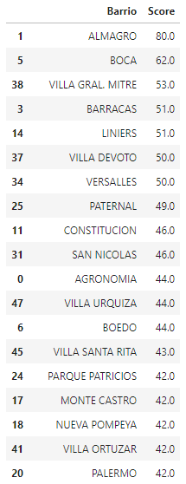
Scoring the ‘barrios’
With the data from each venue gathered from Foursquare we have a total number of each venue per ‘barrio’
We multiply those counts by the weight assigned to each venue
The sum of the total of different venues per ‘barrio’, where each cinema = -5, restaurants = 1 and theaters = 2, provides a score for each ‘barrio’
The ‘barrio’ with the highest score is the one most suitable to open a new cinema given the current conditions
‘Almagro’ is the most suitable ‘barrio’

Slide 15
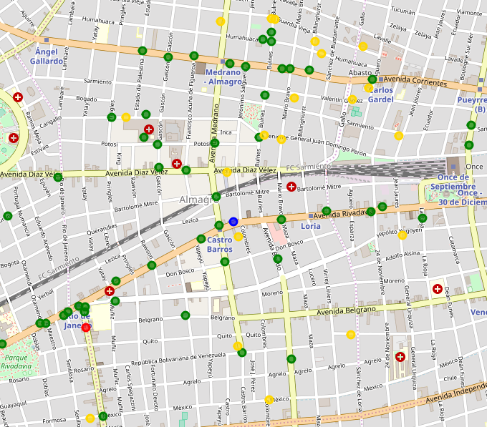
Map of Almagro
This is the map of the ‘barrio’ of Almagro
The venues are marked as follows:
Cinemas (red)
Restaurants (green)
Theaters (yellow)
Within this area it is recommended to open the new cinema

Slide 16
Recommendations
This analysis can be further improved as follows:
Take into consideration other venues:
Shopping malls
Parking spots
Leverage population data for each ‘barrio’ to raise the possibility of attracting a higher number of people
Consider the proximity to bus stops and metro stations

