Slide 1
Protocol Architecture
The “Common Language”

Slide 2
Need for Protocols
Protocols are a set of rules and conventions. By enforcing that communicating parties adhere to a common protocol, communication is made possible.

Slide 3
Network Architecture
A Network Architecture is a structured set of protocols that implement the exchange of information between computers

Slide 4
Programming the Communication
Any complex programming task is made simpler by using several levels of abstraction
Abstraction hides the programming details of lower levels
Communication tasks give rise to standard abstractions
Committees such as the IETF (Internet Engineering Task Force) are in charge for standardizing the abstractions related to internet communication
Copyright by Jorg Liebeherr 98, 99

Slide 5
The Levels of Abstraction
Multiple levels of communication abstractions have been defined by standardization bodies
Each level is enforced by a corresponding protocol
Each level uses the abstract services of the level below
Abstraction achieves separation of concerns
  A protocol needn’t know how the lower-level abstractions are implemented and what the higher level abstractions are.
Copyright by Jorg Liebeherr 98, 99

Slide 6
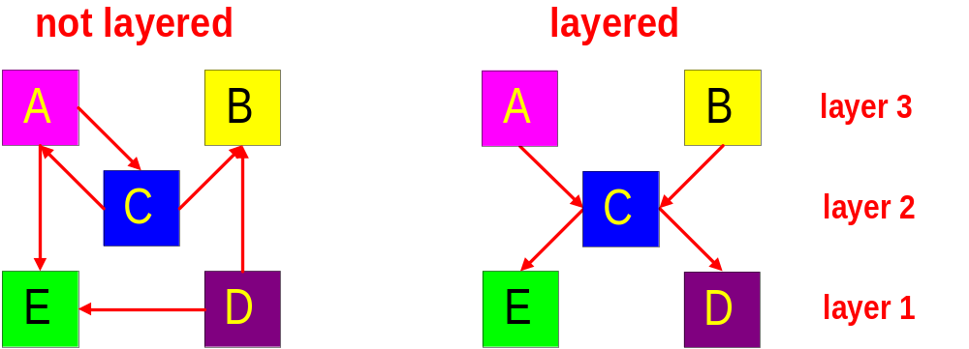
Layered Network Architecture
In a Layered Network Architecture, the services are grouped in a hierarchy of layers.
  A protocol of layer N uses only services of layer N-1.
  A protocol of layer N provides services only to layer N+1.

Slide 7
Service Primitives
Assume that some protocol implements service “X”.
N+1 Layer
Entity
N+1 Layer Protocol
N+1 Layer
Entity
X. Request
X. Confirm
X. Indication
X. Response
N Layer
Entity
N Layer
Entity

Slide 8
Service Primitives
Recall: A layer N+1 protocol entity sees the lower layers only as an abstract service provider
N+1 Layer
Entity
N+1 Layer Protocol
N+1 Layer
Entity
X. Request
X. Confirm
X. Indication
X. Response
Service Provider

Slide 9




Example: Sending a Letter
Bob
Logical flow of information
Alice
Bob’s
mailbox
Alice’s
mailbox
Postman

Slide 10
(Un-)Acknowledged Service
Unconfirmed service:
Acknowledged service:
US Mail
L.Request
L.Indicate
L.Request
US Mail
L.Indicate
L.Confirm
L.Indicate

Slide 11
Protocol Architectures
There are only few protocol architectures that are relevant today:
  OSI Reference Model
  TCP/IP Protocols Suite
  ATM Protocol Stack

Slide 12
OSI Reference Model
The OSI model defines seven layers:
Layer 7: Application Layer
Layer 6: Presentation Layer
Layer 5: Session Layer
Layer 4: Transport Layer
Layer 3: Network Layer
Layer 2: Data Link Layer
Layer 1: Physical Layer
Interconnection Media

Slide 13
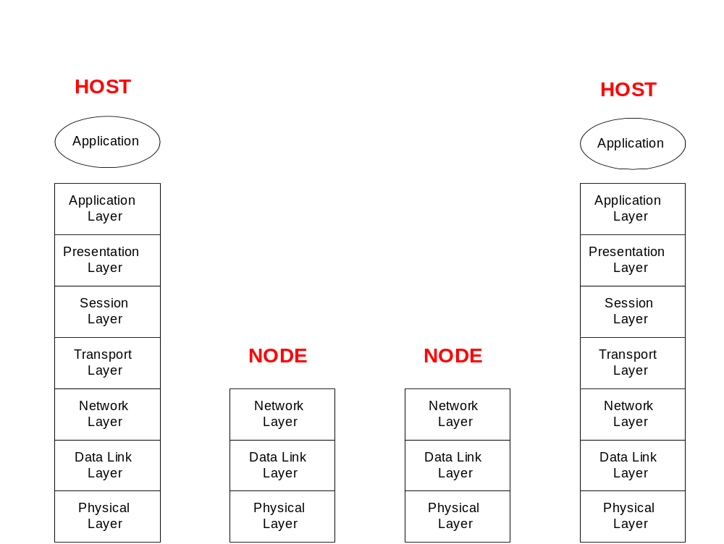
OSI Layers

Slide 14
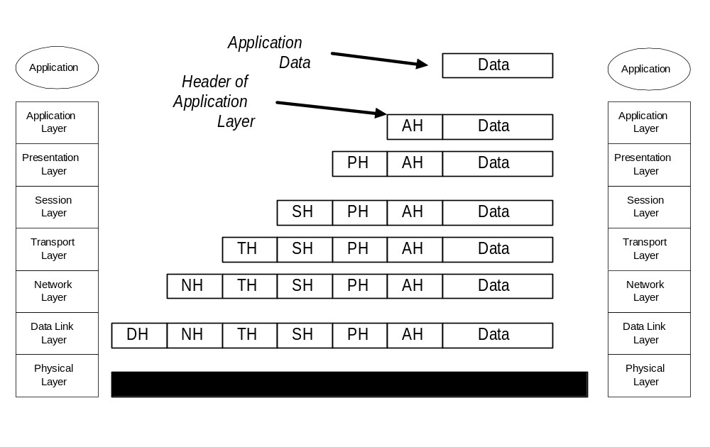
OSI Layers and Encapsulation

Slide 15
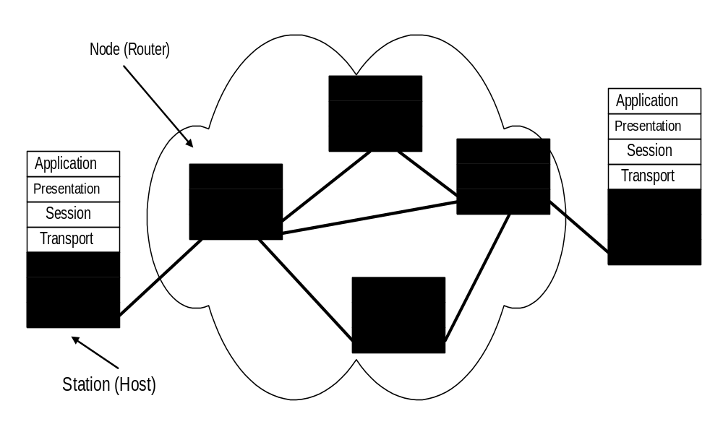
OSI Model in a Switched Communication Network

Slide 16
A Tour of the OSI Layers
Physical Layer (Layer 1):
  Converts bits into electrical or optical signals
  Transmits these signals over the hardware communication medium
  Example: RS-232

Slide 17
A Tour of the OSI Layers
Data Link Layer (Layer 2):
  Reliably transfers frames over a link
  Performs synchronization, error control, flow control
  Example: PPP

Slide 18
A Tour of the OSI Layers
Network Layer (Layer 3):
  Moves packets inside the network
  Performs routing, addressing, switching, congestion control
  Example: IP

Slide 19
A Tour of the OSI Layers
Transport Layer (Layer 4):
  Controls delivery of data between hosts
  Connection management, error control, flow control, multiplexing, TCP, UDP.

Slide 20
A Tour of the OSI Layers
Session Layer (Layer 5):
  Support the dialog between cooperating application programs
  Session management, synchronization
  Example: RPC

Slide 21
A Tour of the OSI Layers
Presentation Layer (Layer 6):
  Data conversion into application format
  Encryption/decryption
  Secure sockets

Slide 22
A Tour of the OSI Layers
Application Layer (Layer 7):
  Provides network access to application programs
  Everything is application specific
  Example: File Transfer, Electronic Mail

Slide 23
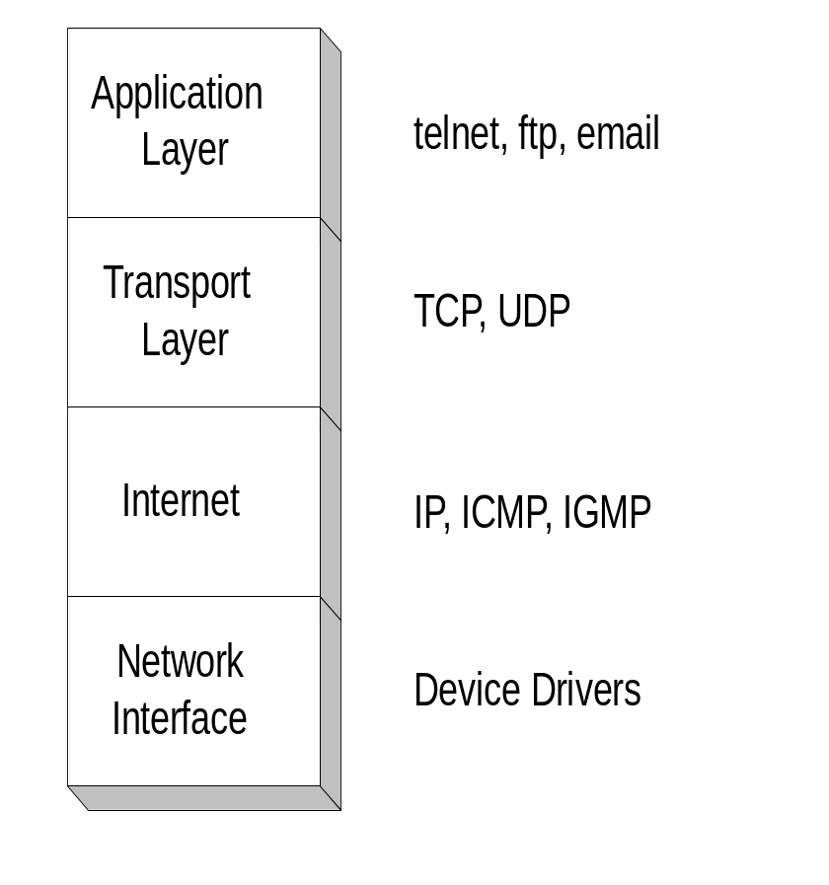
TCP/IP Protocol Suite
The TCP/IP protocol suite was first defined in 1974
The TCP/IP protocol suite is the protocol architecture of the Internet
The TCP/IP suite has four layers:
Application, Transport, Internet, and Network Interface Layer
Copyright by Jorg Liebeherr 98, 99

Slide 24
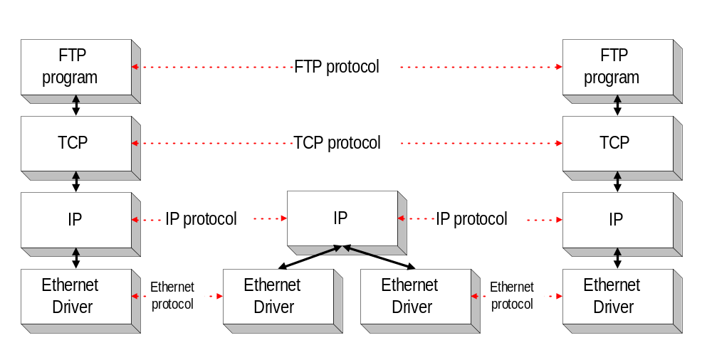
Example: File Transfer
Host A
Router
Host B
Copyright by Jorg Liebeherr 98, 99

Slide 25
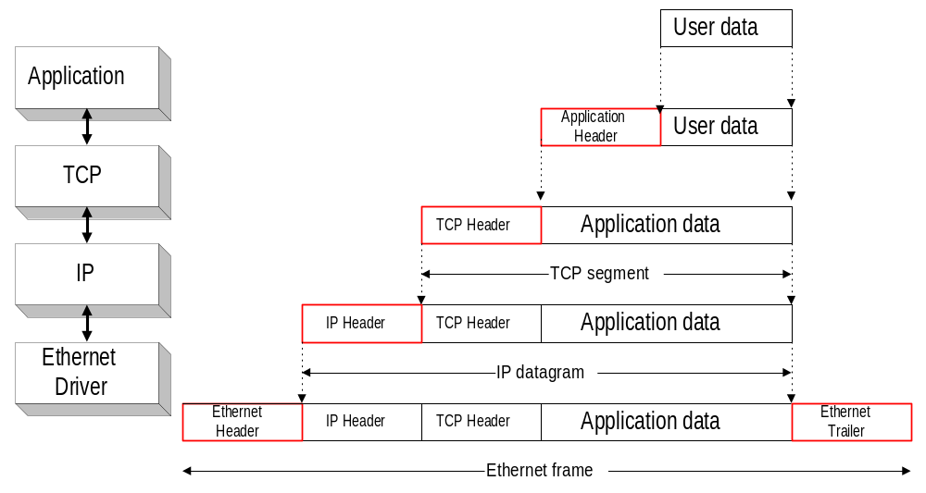
Encapsulation in the TCP/IP Suite
Copyright by Jorg Liebeherr 98, 99

Slide 26
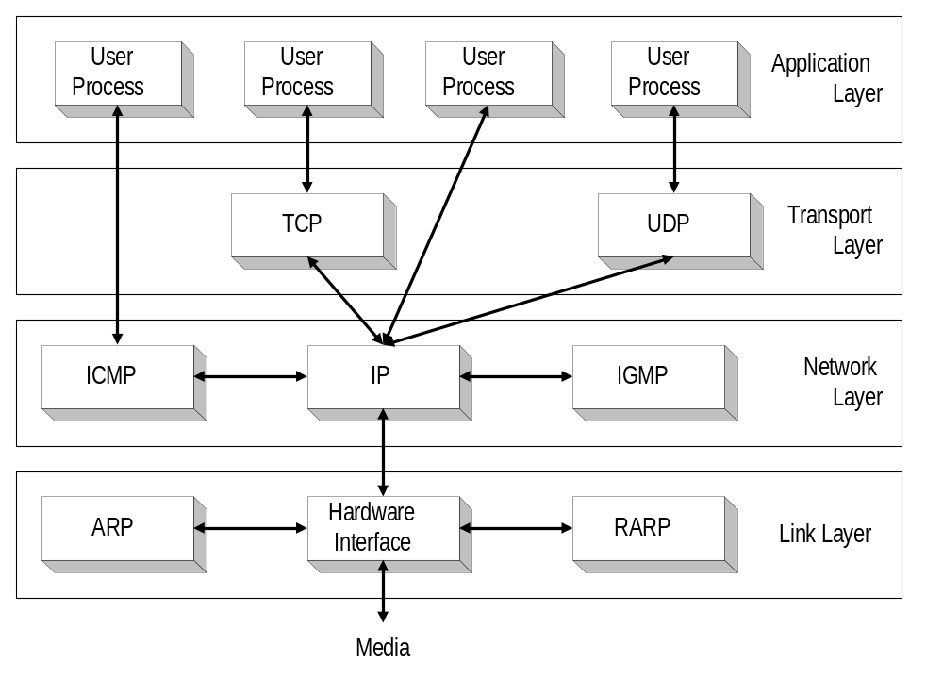
TCP/IP Protocol Suite
Copyright by Jorg Liebeherr 98, 99

Slide 27
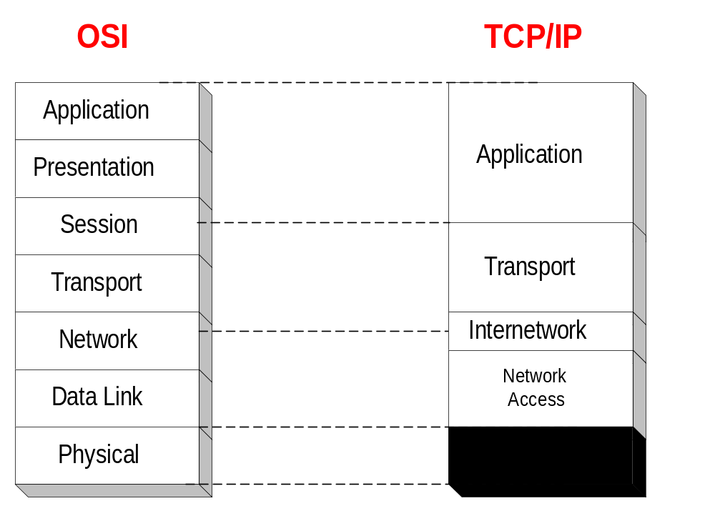
Comparison of OSI Model and TCP/IP Suite
Copyright by Jorg Liebeherr 98, 99

Slide 28

Copyright by Jorg Liebeherr 98, 99

