Slide 1
Eye Tracking for Reading Assistance
Ashkan Bozorgzad, Kyle Diederich, Suhas Kumar, Ziqi Su

Slide 2
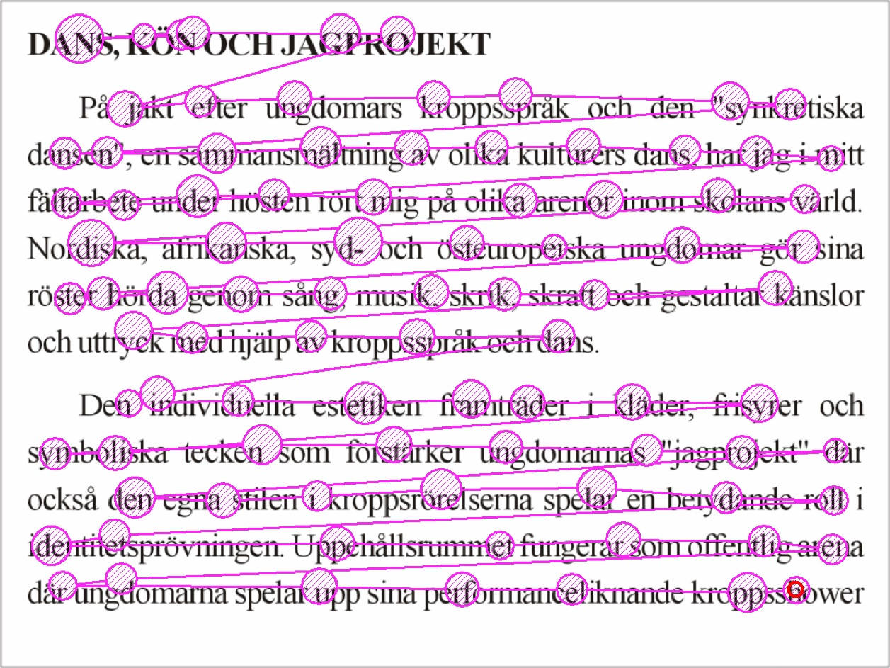
Problem Formulation
Create a story environment to allow reading support
Develop techniques to determine how to convert eye tracking into the precision needed for reading
Create prediction techniques to allow for smooth transitions to between words

Slide 3



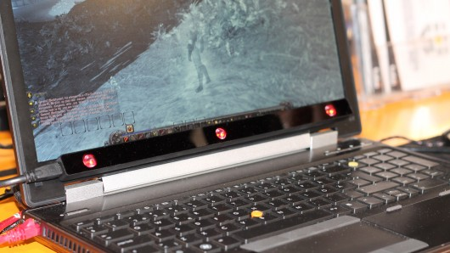
Problem Formulation
Detecting eyes during setup
Aim - Render Voice
Pros Cons
- Accuracy – OK - Detail Accuracy
- Speed - Miss
- Gaze Trace options - Eyes Pain
Touch at gaze - Mounted
Scroll at gaze
Mouse wrap on move
Application switching
Detection of eyes during Gaze Trace
Tobii eye X Tracker

Slide 4
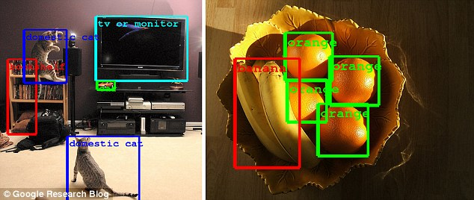
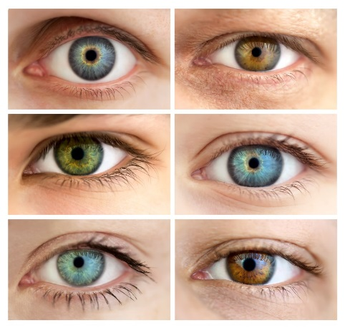
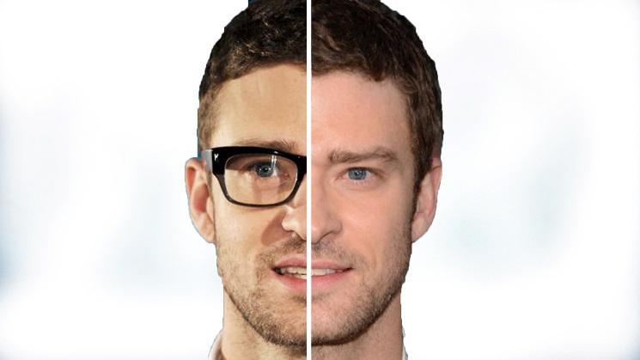
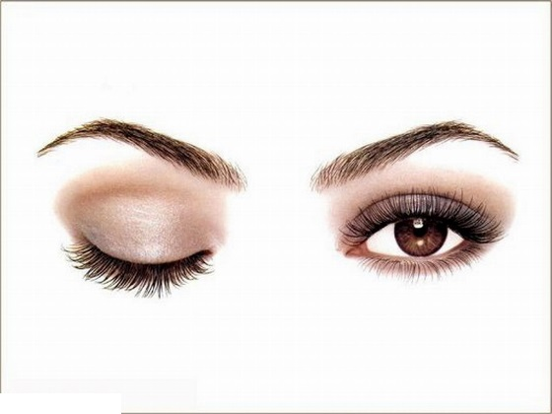
Technical Challenges
Accuracy
Individual differences between eyes and conditions
What works for one set does not always transfer
Account for rapid, random eye movements

Slide 5
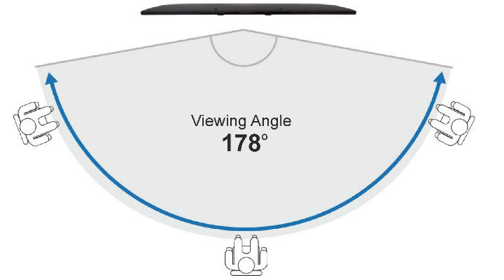
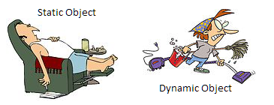
Technical Challenges
Degree of coverage
Constant connection between eye and sensors
Dealing with dynamic positioning of user

Slide 6

Technical Challenges
Ease of setup / portability
Hidden mounting requirement
Write our own program to obtain data from eye tracker and detect text and object
Object detection Software
Eye track Software
Eye tracker sensor
Target Location
Detection object

Slide 7
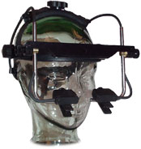
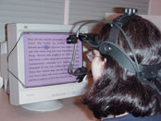
Approach
EyeLink Headband
Mounted to head
Cameras hang below eyes
Overhead camera tracking head position
Only track dominate eye position
Calibration period difficult (unclear of what changes to calibration allowed for greater success)
Currently minimal exploration of text
Capture infrared light reflections on both cornea and retina
Saccades and fixations
Develop a grid based on calibration
Change stimulus based on where eye is looking
Create boundaries to compensate for over/undershooting targets
Notes:
Saccades: rapid ballistic movements that bring the line of gaze from one place to another, are the primary means of acquiring new visual information
Fixations: the eyes stay relatively still to allow for visual perception
Change stimulus helps attract fixation – determine good length of fixation

Slide 8
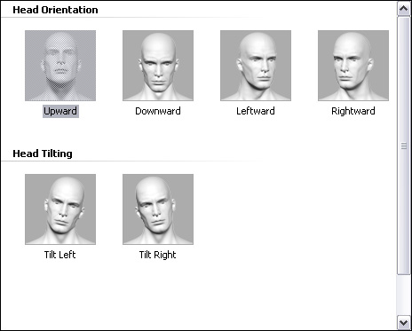
Experiment 1
Configuration time and reconfiguration requirement
Assumption: user sit still and laptop at a fixed position
Record configuration time
Move head to different position

Slide 9
Experiment 2
Whether or not user are look at screen
Assumption: head keep still just eye movement
Look at 8 position outside the screen:
Up
Down
Left
Right
Up right corner
Up left corner
Down left corner
Down right corner
Utilize results to help set up grid for tracking fixation

Slide 10
Experiment 3
Test of various granularity expectations from eye movement data
Assumption: User looks at screen during experiment
Divide screen into 2 by 2, 3 by 3, and so on doing experiment until the accuracy is better than random guessing
User looks at one shape and eye tracker give the one they think user is looking at

Slide 11
Experiment 4
Does tracking the flow of user’s actual reading
Highly depends on the result of experiment 3
Assumption: User reads the article during experiment and does not get distract
Highlight words which software thinks user is reading
Design a questionnaire to collect user’s feedback

Slide 12
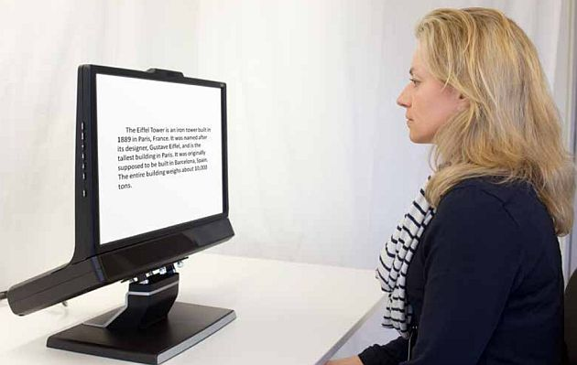
Demo
Eye Tracker is mounted to a laptop and a person is made to sit in front of laptop.
Person is made to see a sentence.
Eye movements are tracked accurately.
Render the voice of the words as the person scans the sentence.

Slide 13
Milestones
Tasks | October | November | December
Programming to get correct output from Eye tracking sensor
Programming for object detection
Writing first draft of report
Combining two programs and writing final report
Writing final report

Slide 14
References
Alghowinem, S., AlShehri, M., Goecke, R., & Wagner, M. (2014). Exploring eye activity as an indication of emotional states using an eye-tracking sensor. In Intelligent systems for science and information (pp. 261-276). Springer International Publishing.
Evans, M. A., & Saint-Aubin, J. (2005). What children are looking at during shared storybook reading evidence from eye movement monitoring.Psychological Science, 16(11), 913-920.
Gary Feng (2011) Eye Tracking: A Brief Guide for Developmental Researchers, Journal of Cognition and Development, 12:1, 1-11, DOI: 10.1080/15248372.2011.547447
Jacob, R. J., & Karn, K. S. (2003). Eye tracking in human-computer interaction and usability research: Ready to deliver the promises. Mind, 2(3), 4.

