Slide 1
Reading With Your Eyes
Ashkan Bozorgzad, Kyle Diederich, Suhas Kumar, Ziqi Su

Slide 2
Approach
Describe how your system will work
by now you should have a clear plan of action
Make sure to include:
a diagram of showing the components of the system and how they interact
a discussion of the technical challenges that you have (or will) overcome
what have you accomplished thus far
Su – general idea with diagrams
Kyle – technical challenges & what has been accomplished (2 slides follow-finished)

Slide 3
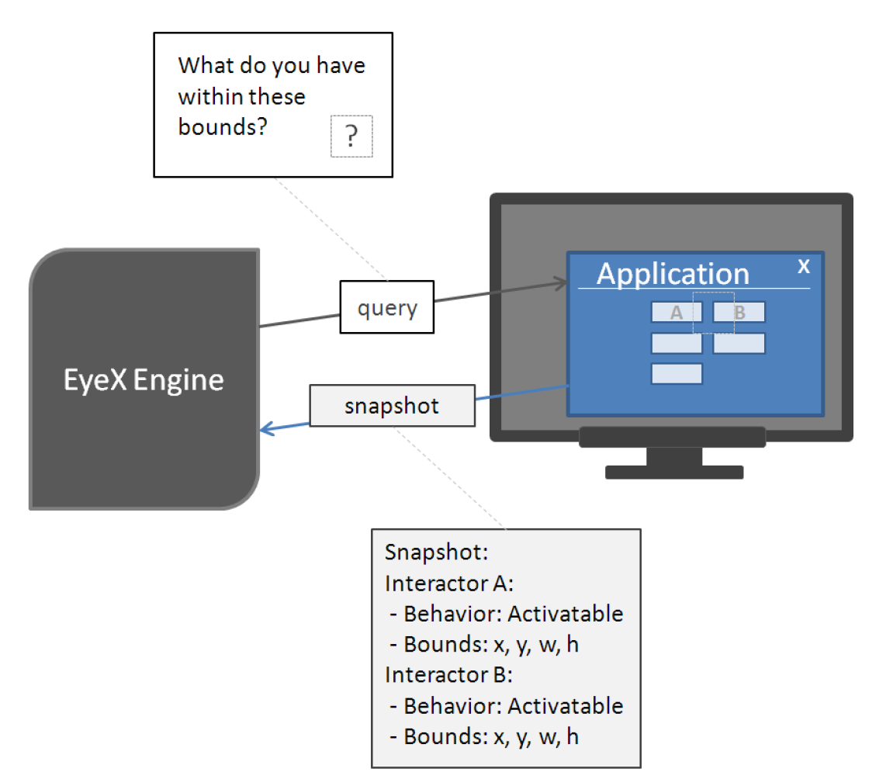
The Query Snapshot Cycle
First attempt to determine how to create interactors within application
Requires both keyboard and gaze in conjunction
Process:
Press key to activate snapshot
EyeX Engine queries screen to determine what item occurs at coordinates of user gaze

Slide 4
Gaze-Aware Behavior
Create a set of items that are interactable subject to user’s eye-gaze
Launch event when user’s gaze enters boundaries of interactor
Apply delay time
Add inertia to account to rapid, random eye movements
Gaze point must start on interactor until response is triggered
Manually adjustable delay parameter
Provide focus points:
Visual hotspot: captions, buttons, etc.
Sufficiently separation. Spacing around/between visual elements and/or increased size. (Tobii developers note: spacing effective than size.)
Care in visual feedback given. Example, highlight only text or visual hotspot of button.

Slide 5
Related Work
Describe how your system builds on prior work
what other systems are related to your work
how did others overcome the challenges that you face
do their solutions apply to your case
if not, what novel ideals did you have to incorporate to make your system work
make sure to include at least two references
Suhas – technical details
Kyle – research in the area (references) - (2 slides follow [finished])

Slide 6
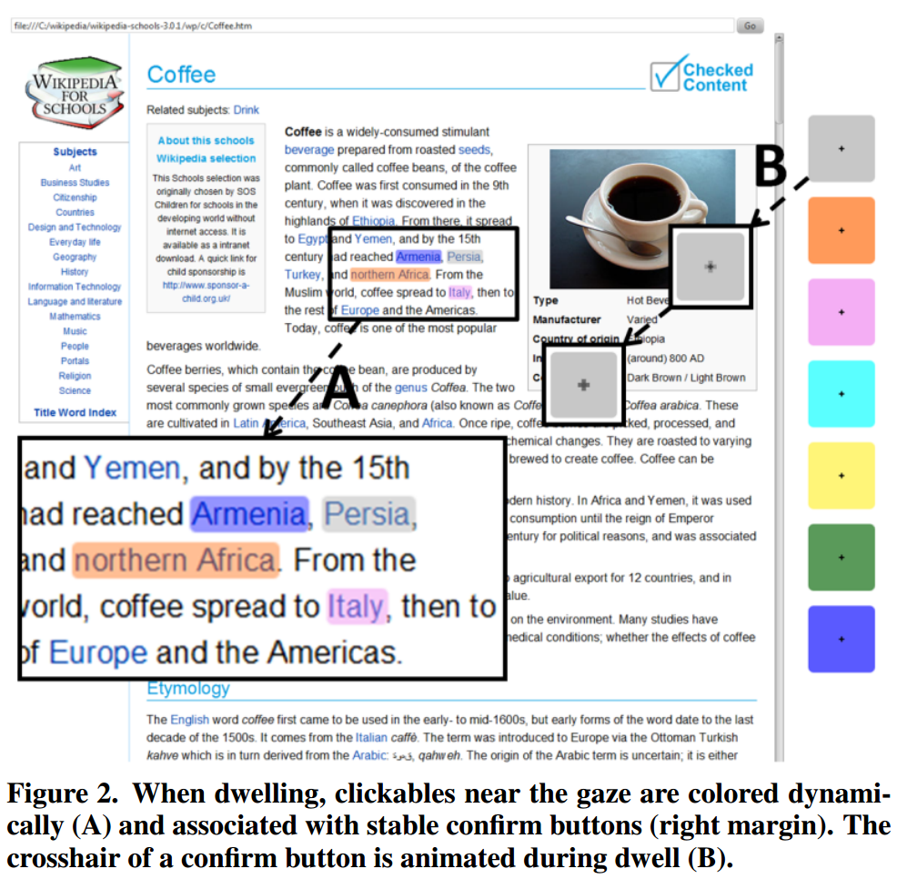
Gaze vs. Mouse
Gaze tends to be quick and natural
Can be slow and error prone
Difficulty distinguishing between intended or unintended gaze
actigaze
Attempts to solve the problem by using color coordination to confirm gaze targets
Allows for hands-free browsing of webpages
Current implementation only on selected Wikipedia articles (offline)
Requires algorithm to correctly identify and highlight clickable links
Lutteroth et al. 2015

Slide 7
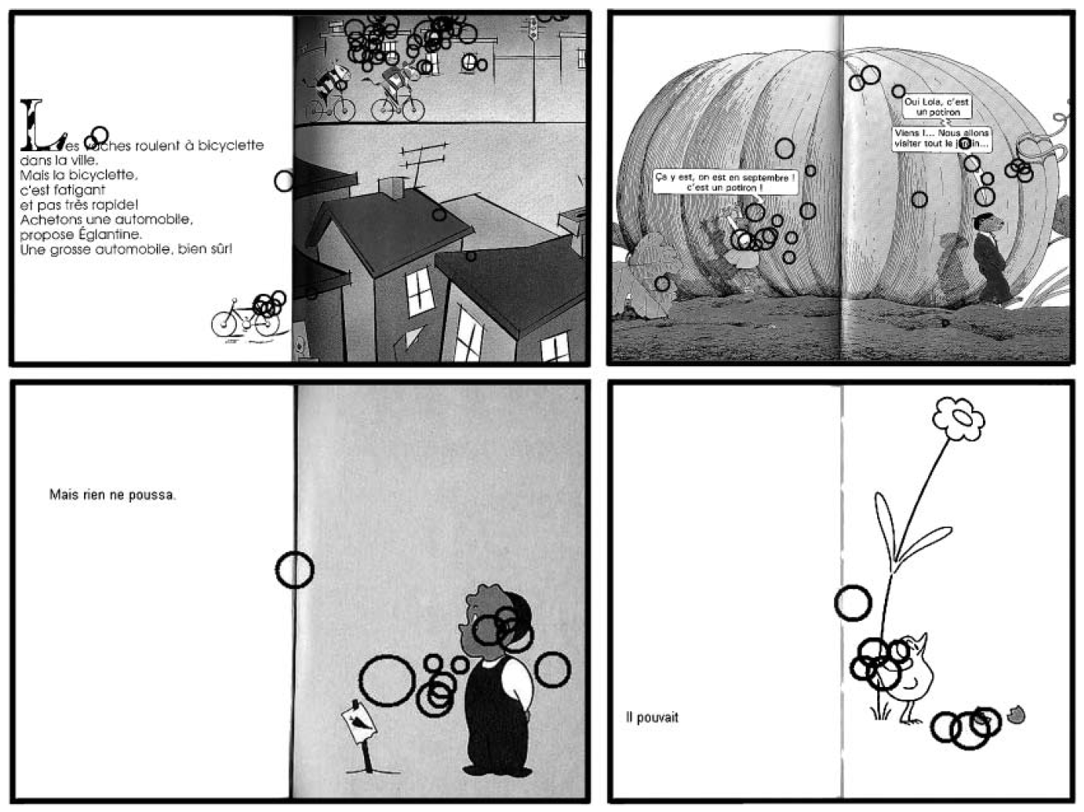
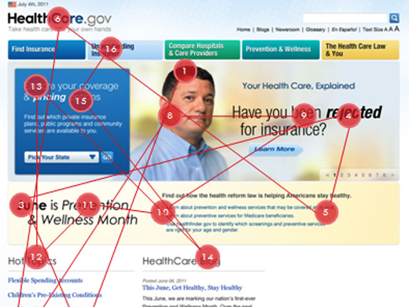
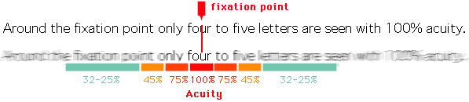
Where does gaze fall?
Evans and Saint-Aubin, 2005
Retrieved from Usability.gov
Retrieved from Wikipedia

Slide 8
Experimentation
Refer back to your experimentation plans and refine them
What aspects of your systems performance will you measure?
Ashkan & Su
Grid experimentation
Kyle & Suhas (included ideas of what to measure in earlier slides – [finished])
Delay experimentation between gaze and dwell (Missing experimental design)

Slide 9
References
Evans, M. A., & Saint-Aubin, J. (2005). What children are looking at during shared storybook reading evidence from eye movement monitoring. Psychological Science, 16(11), 913-920.
Eye Tracking. https://www.usability.gov/how-to-and-tools/methods/eye-tracking.html. (Retrieved Nov 11).
Lutteroth, C., Penkar, M., & Weber, G. (2015, November). Gaze vs. Mouse: A Fast and Accurate Gaze-Only Click Alternative. In Proceedings of the 28th Annual ACM Symposium on User Interface Software & Technology (pp. 385-394). ACM.

