Slide 1
Reading With Your Eyes
Ashkan Bozorgzad, Kyle Diederich, Suhas Kumar, Ziqi Su

Slide 2
Problem Formulation
Description:
Develop techniques to convert eye tracking into the precision text detecting during reading for children
Input:
An environment contains the picture and texts
User who wants detect text
Output:
Highlighted text
Voice of the detected word

Slide 3
Problem Formulation
Technical Challenges:
How detect eyes continuously
The best way of detecting object (Text)
Overcome the limitation of the Tobii eye engine

Slide 4
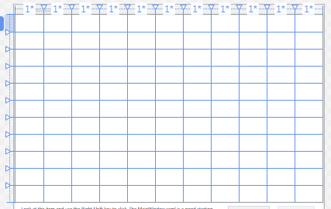
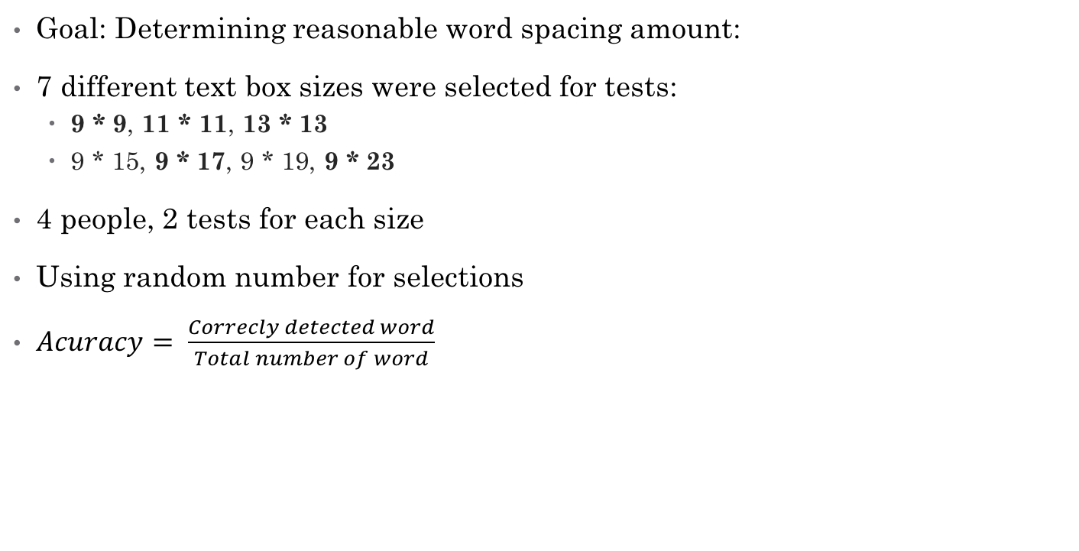
Experimentation for the Textbox Size
Goal: Determining reasonable word spacing amount:
7 different text box sizes were selected for tests:
9 * 9, 11 * 11, 13 * 13
9 * 15, 9 * 17, 9 * 19, 9 * 23
4 people, 2 tests for each size
Using random number for selections
$Acuracy= \frac{Correcly detected word}{Total number of word}$
11 * 11 grid line

Slide 5
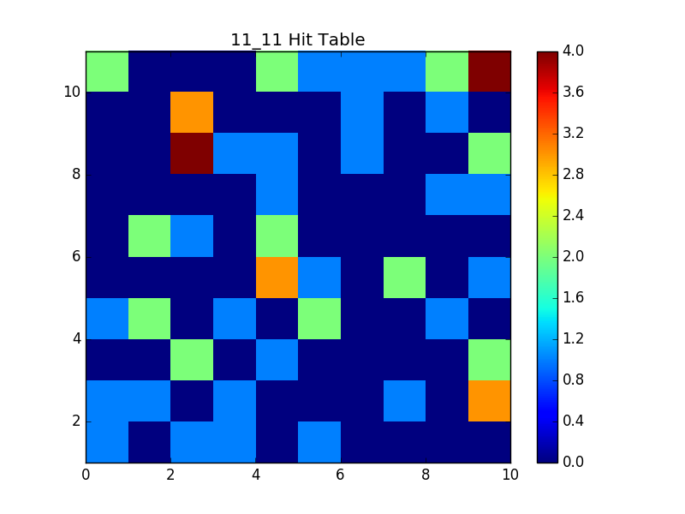
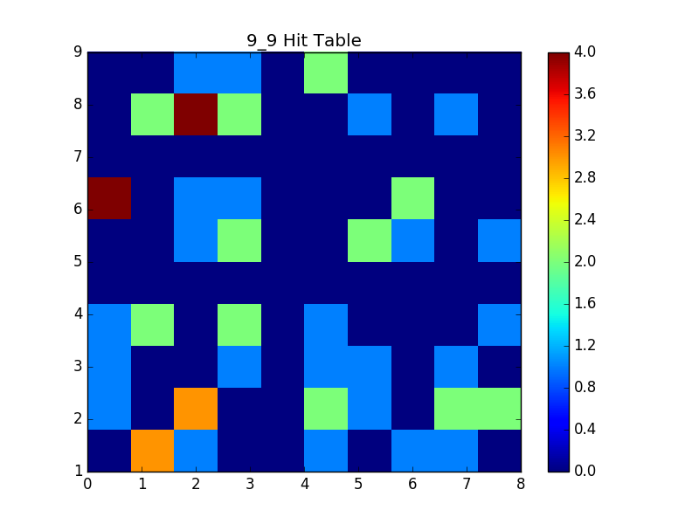
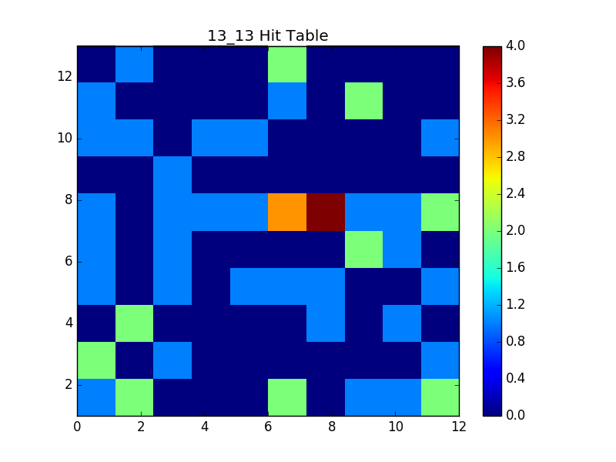
Hit Table

Slide 6
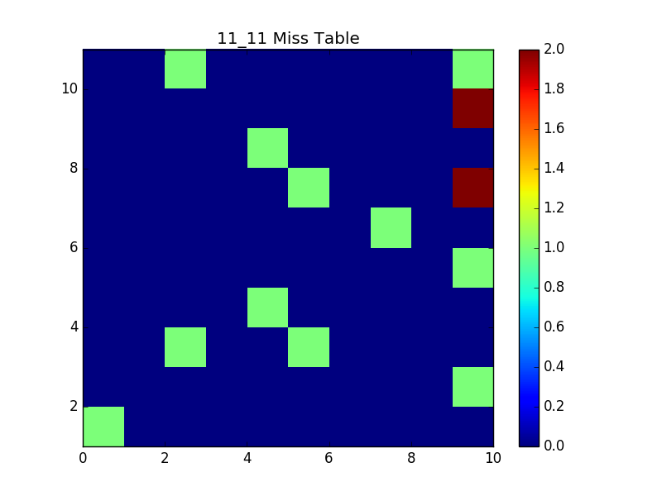
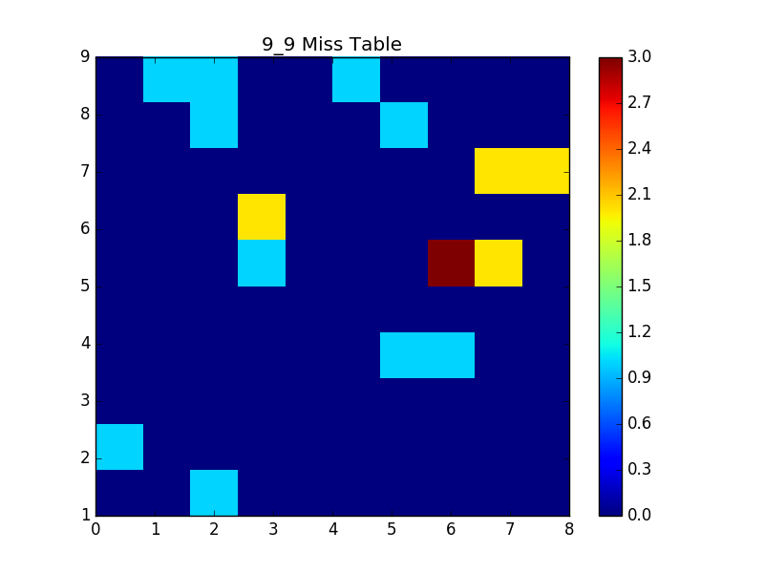
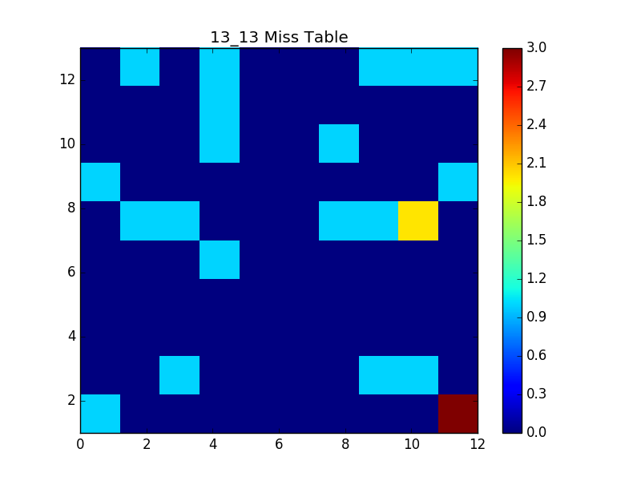
Miss Table

Slide 7
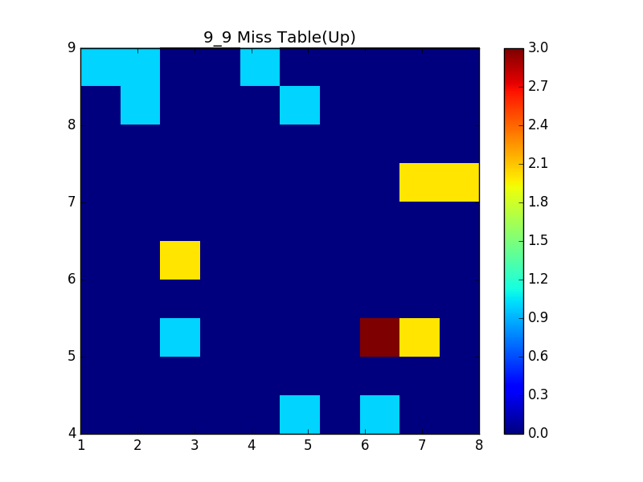
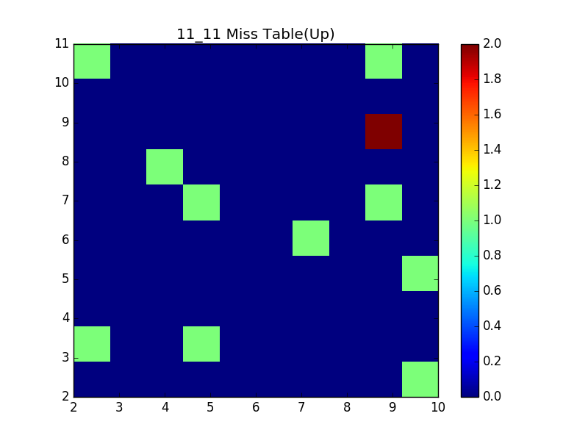
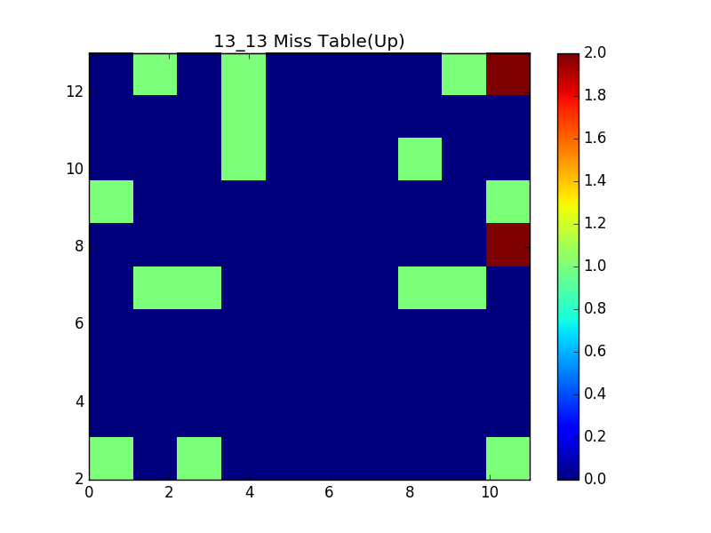
Miss Table Comparison

Slide 8
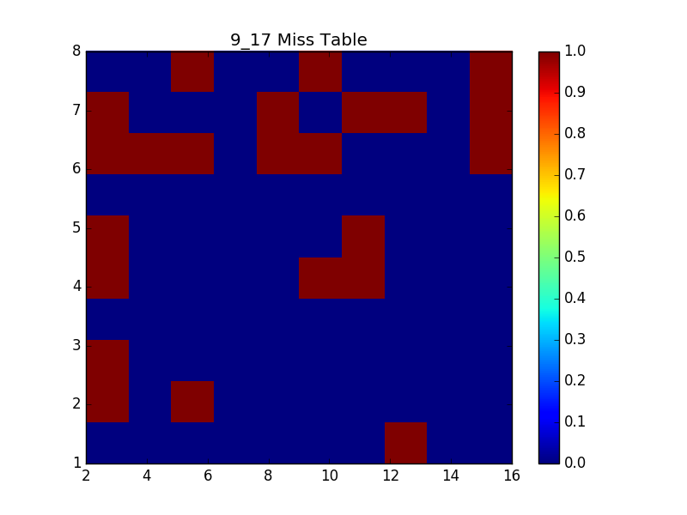
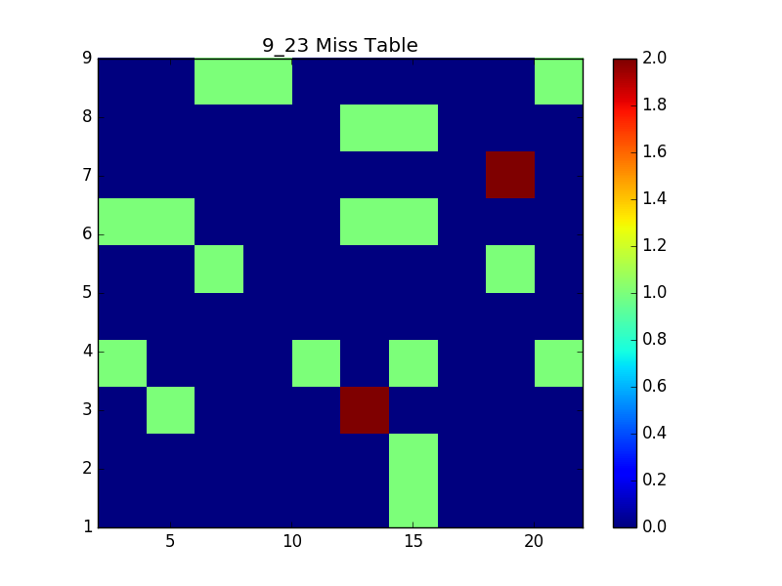
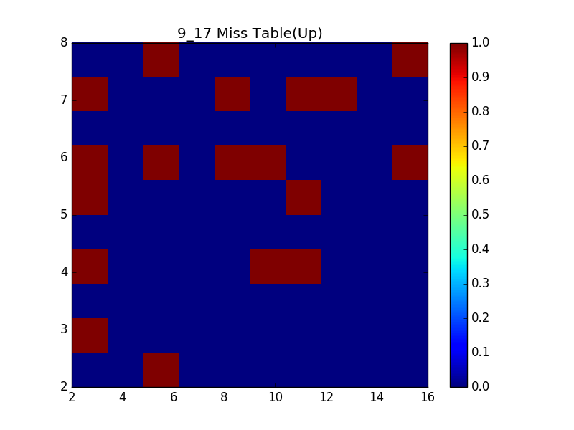
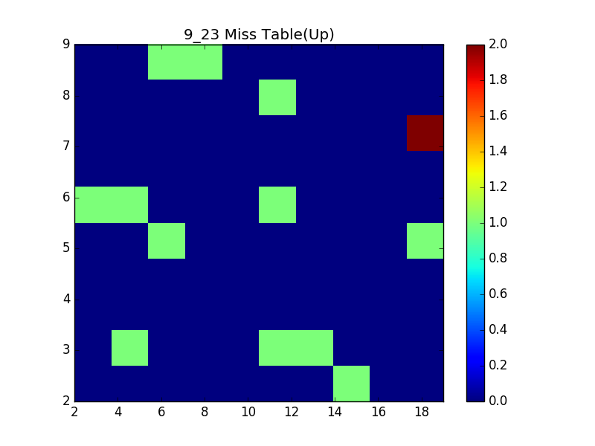
Miss Table

Slide 9
Experimentation for the Textbox Size

Slide 10
Experimentation for the Textbox Size
The reasons of result variability
User learning process during the tests
High sensitivity of calibration process
limited number of experiments
People with individual differences:
Glasses
Contact lenses
Eye shapes

Slide 11
Experiment for the Delay Amounts
Goal: Determine reasonable delay
Delay governs when text is activated
Setup various amounts of manual delay:
Delay in milliseconds: 200, 300, 400, 500, 600
Participants rate user experience on Likert Scale of 1 to 5
Require participants to provide feedback explaining choice
Choose average amount as acceptable delay

