Slide 1
Reading With Your Eyes
Ashkan Bozorgzad, Kyle Diederich, Suhas Kumar, Ziqi Su

Slide 2
Approach
Describe how your system will work
by now you should have a clear plan of action
Make sure to include:
a diagram of showing the components of the system and how they interact
a discussion of the technical challenges that you have (or will) overcome
what have you accomplished thus far
Su – general idea with diagrams
Kyle – technical challenges & what has been accomplished

Slide 3
Related Work
Describe how your system builds on prior work
what other systems are related to your work
how did others overcome the challenges that you face
do their solutions apply to your case
if not, what novel ideals did you have to incorporate to make your system work
make sure to include at least two references
Suhas – technical details
Kyle – research in the area (references)

Slide 4
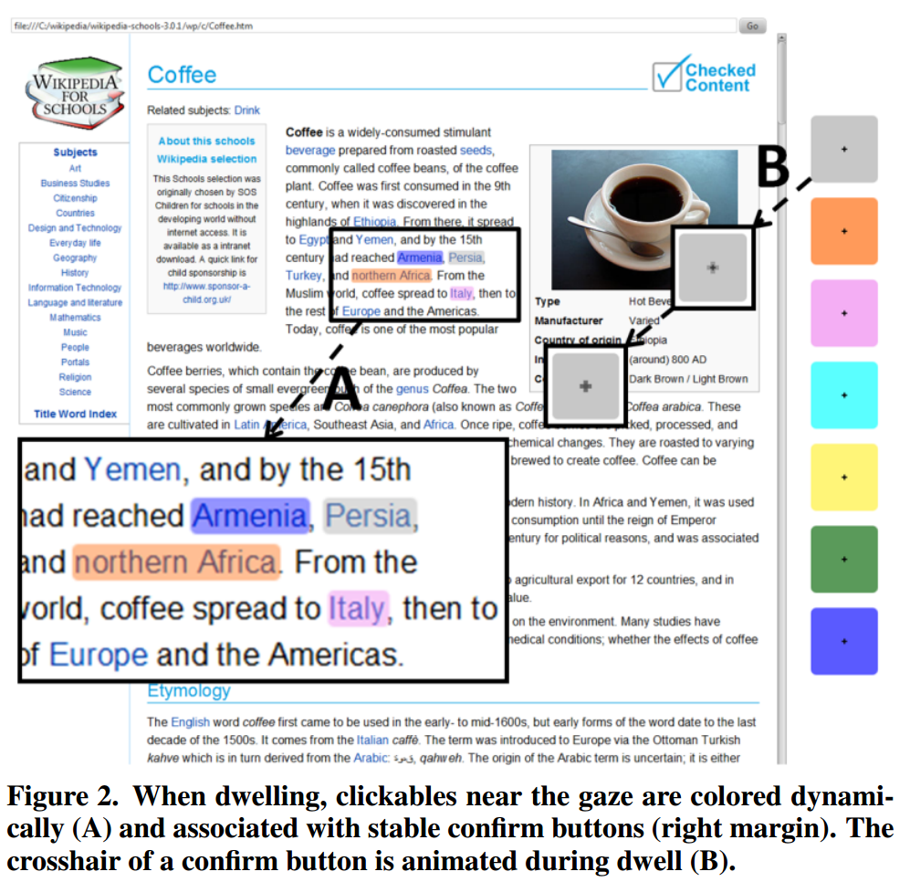
Gaze vs. Mouse
Gaze tends to be quick and natural
Can be slow and error prone
Difficulty distinguishing between intended or unintended gaze
actigaze
Attempts to solve the problem by using color coordination to confirm gaze targets
Allows for hands-free browsing of webpages
Current implementation only on selected Wikipedia articles (offline)
Requires algorithm to correctly identify and highlight clickable links
Lutteroth et al. 2015

Slide 5
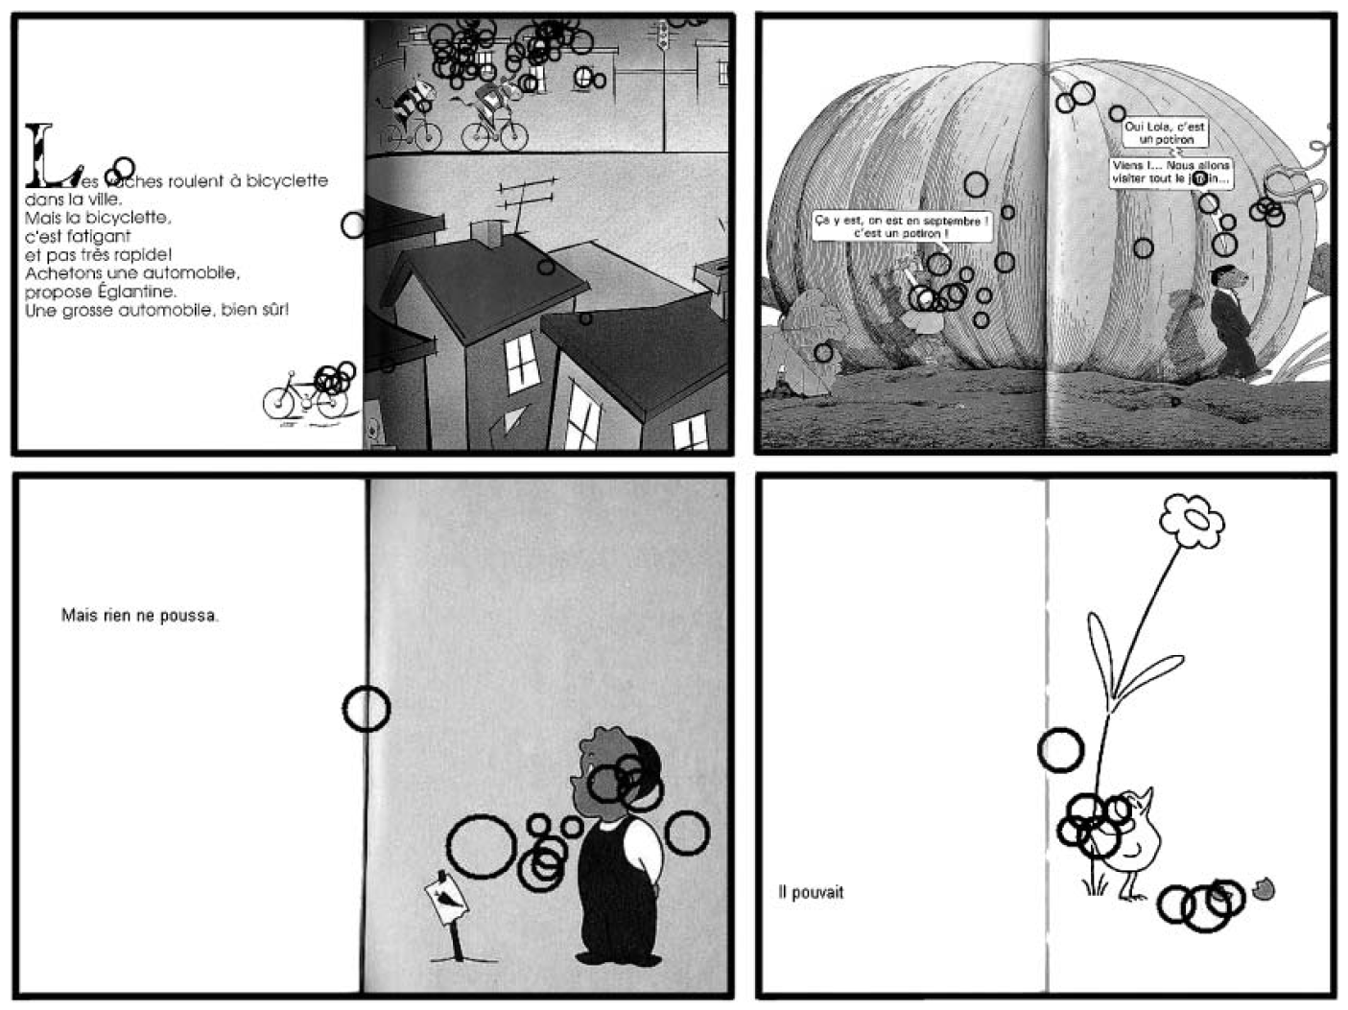
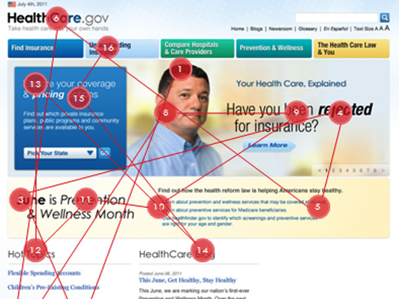
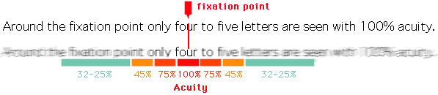
Where does gaze fall?
Evans and Saint-Aubin, 2005
Retrieved from Usability.gov
Retrieved from Wikipedia

Slide 6
Experimentation
Refer back to your experimentation plans and refine them
What aspects of your systems performance will you measure?
Ashkan & Su
Grid experimentation
Kyle & Suhas
Delay experimentation between gaze and dwell

Slide 7
References
Evans, M. A., & Saint-Aubin, J. (2005). What children are looking at during shared storybook reading evidence from eye movement monitoring. Psychological Science, 16(11), 913-920.
Eye Tracking. https://www.usability.gov/how-to-and-tools/methods/eye-tracking.html. (Retrieved Nov 11).
Lutteroth, C., Penkar, M., & Weber, G. (2015, November). Gaze vs. Mouse: A Fast and Accurate Gaze-Only Click Alternative. In Proceedings of the 28th Annual ACM Symposium on User Interface Software & Technology (pp. 385-394). ACM.

