Slide 1
Reading With Your Eyes
Ashkan Bozorgzad, Kyle Diederich, Suhas Kumar, Ziqi Su

Slide 2
Problem Formulation
A clear description of the problem that you are trying to solve
focus on the specific aspects of your problem
Ashkan

Slide 3
Example of Problem Formulation
description
predict the location of a user based on signal strength measurements
input
a database of signal strength measurements
are reference signal collected from the user
output:
the location of the user

Slide 4
Approach
Describe how your system will work
by now you should have a clear plan of action
Make sure to include:
a diagram of showing the components of the system and how they interact
a discussion of the technical challenges that you have (or will) overcome
what have you accomplished thus far
Su – general idea with diagrams
Kyle – technical challenges & what has been accomplished

Slide 5
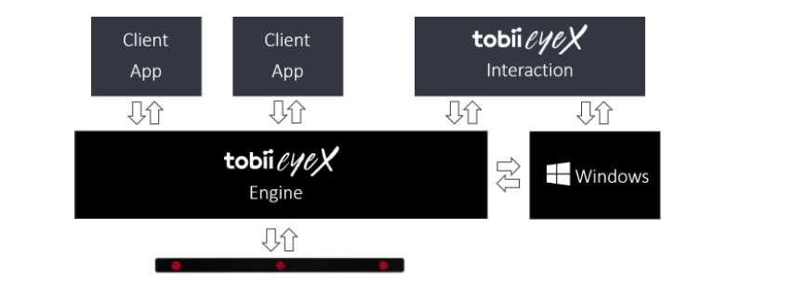
General Idea
Tobii EyeX Engine is the core software. It knows how to configure and talk to the eye tracker.
Client Application get uer’s eye-gazing and other input
Tobii EyeX Interaction is a software built on Tobii eyeX Engine, it offer a set of basic eye-gaze interaction in Windows environment
Tobii EyeX SDK give developer access to Tobii EyeX Engine API

Slide 6
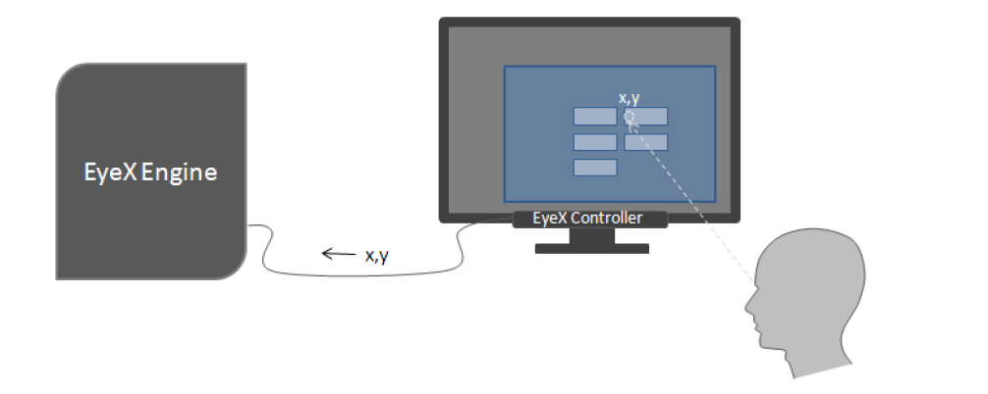
How the engine work
The user looks at the screen, the EyeX controller calculates the coordinates of the gaze point
EyeX engine use information from client application and understand what kind of object the user is looking at and how to interact with it
Client application combine some user input and eye gazing to trigger the click on an object

Slide 7
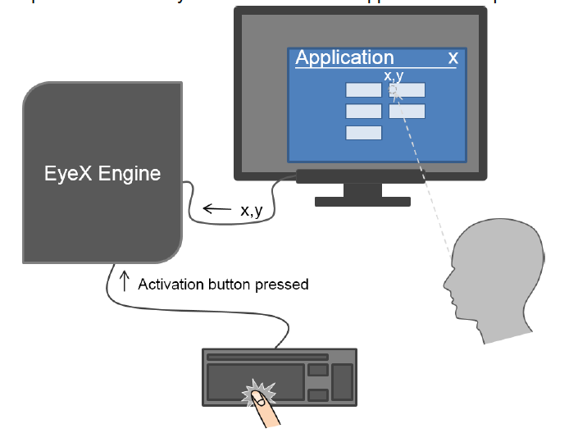
4. The user press space bar when he or she is looking at the object and client application will tell EyeX engine that user want to activate the button. EyeX engine will trigger an event and tell client application to activate the specific button
5. Client application response to the event and give visual feedback.
In step 3, instead of having some user input and eye gazing to trigger an event, we want to only use eye gazing to trigger a click on an object.
We want to trigger an event after eye gazing an object for a period of time

Slide 8
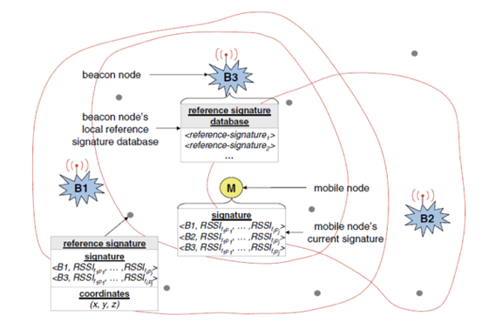
Example of Approach

Slide 9
Related Work
Describe how your system builds on prior work
what other systems are related to your work
how did others overcome the challenges that you face
do their solutions apply to your case
if not, what novel ideals did you have to incorporate to make your system work
make sure to include at least two references
Suhas – technical details
Kyle – research in the area (references)

Slide 10
Experimentation
Refer back to your experimentation plans and refine them
What aspects of your systems performance will you measure?
Ashkan & Su
Grid experimentation
Kyle & Suhas
Delay experimentation between gaze and dwell

Slide 11
Demo
Show what you have accomplished thus far
I expect to see the basic functionality of your system up and running
Suhas

