Slide 1
Eye Tracking for Reading Assistance
Ashkan Bozorgzad, Kyle Diederich, Suhas Kumar, Ziqi Su

Slide 2
Problem Formulation
Large goal: Track eye movement to support reading
Part One: Track word by word movements of eyes along sentences
Part Two: Eye movement highlights and speaks words of page
State the problem and what kind of solution we are working towards
Su(story) – Suhas(tracker)

Slide 3
Technical Challenges
Accuracy
Individual differences between eyes
What works for one set does not always transfer
Arc degree coverage (want a static user)
Dealing with dynamic positioning of user
Constant connection between eye and sensors
Problems with unspecific target goal
Ease of setup / portability
Hidden mounting requirement
Write our own software to obtain data from eye tracker
Account for rapid, random eye movements
Ashkan - Kyle

Slide 4
Approach
Reference 3 research papers
How general approach builds on previous work
Kyle

Slide 5
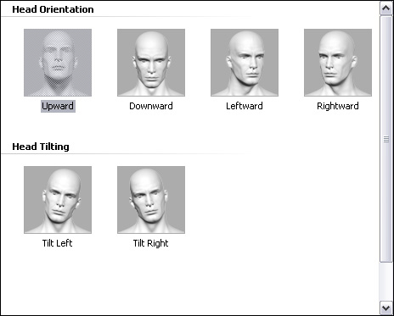
Experiment 1
Configuration time and reconfiguration requirement
Assumption: user sit still and laptop at a fixed position
Record configuration time
Move head to different position

Slide 6
Experiment 2
Whether or not user are look at screen
Assumption: head keep still just eye movement
Look at 8 position outside the screen:
Up
Down
Left
Right
Up right corner
Up left corner
Down left corner
Down right corner

Slide 7
Experiment 3
What granularity we can expect from eye movement data
Assumption: User looks at screen during experiment
Divide screen into 2 by 2, 3 by 3, and so on doing experiment until the accuracy is around 50 percent
User looks at one rectangle and eye tracker give the one they think user is looking at

Slide 8
Experiment 4
Does tracking the flow of user’s actual reading
Highly depends on the result of experiment 3
Assumption: User reads the article during experiment and does not get distract
Highlight words which software thinks user is reading
Design a questionnaire to collect user’s feedback

Slide 9
Demo
Best Case
Set up a profile and allow person to look through a piece of text where the eye movements are tracked accurately
Suhas

Slide 10
Milestones
By end of October
Something
By end of November
Something
By end of first week in December
Done
Ashkan

