Slide 1
Eye Tracking for Reading Assistance
Ashkan Bozorgzad, Kyle Diederich, Suhas Kumar, Ziqi Su

Slide 2
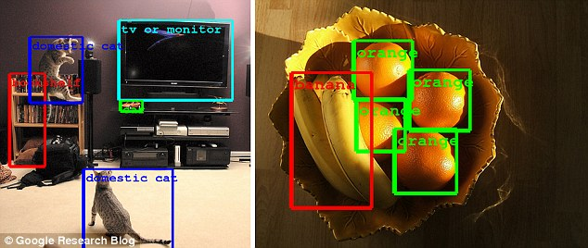
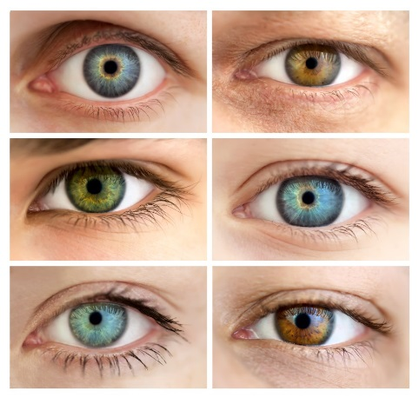
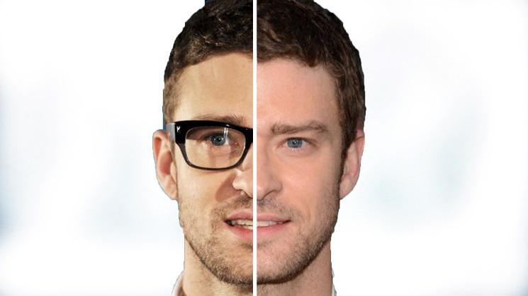

Technical Challenges
Accuracy
Individual differences between eyes and conditions
What works for one set does not always transfer
Account for rapid, random eye movements

Slide 3
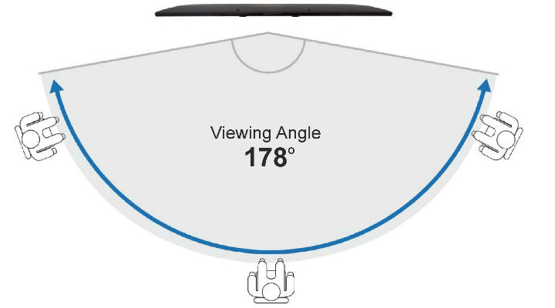

Technical Challenges
Degree of coverage
Constant connection between eye and sensors
Dealing with dynamic positioning of user

Slide 4

Technical Challenges
Ease of setup / portability
Hidden mounting requirement
Write our own software to obtain data from eye tracker and detect text and object
Object detection Software
Eye track Software
Eye tracker sensor
Target Location
Detection object

Slide 5
Milestones
By end of October
Something
By end of November
Something
By end of first week in December
Done

Slide 6
Milestones
Tasks | October | November | December
Programming to get correct output from Eye tracking sensor
Programming for object detection
Writing first draft of report
Combining two programs and writing final report
Writing final report

