Slide 1
Final Presentation and Report
Mobile Computing

Slide 2
Course organization revisited
Programming assignments (10%)
homework 1
Project (70%)
proposal and presentation (10%)
preproposal + proposal
mid-term presentation (30%)
originally stated as approach (15%) and demo (15%)
final report and demo (30%) [TBD]
15% report + 15% presentation
Critique (10%) - critique the assigned reading
the two critiques
Participation (10%) - you are encouraged to participate

Slide 3
Logistics
Final presentations will be on:
Dec 9th in B1C
Final report is due on:
Dec 18th Midnight. No extensions allowed.
Equipment turn by Friday Dec 16

Slide 4
Final Presentation

Slide 5
Presentation Requirements
Problem formulation [10 points]
Approach [40 points]
Related Work [5 points]
Experimentation [15 points]
Demo [30 points]

Slide 6
Problem Formulation
A clear description of the problem that you are trying to solve
focus on the specific aspects of your problem

Slide 7
Example of Problem Formulation
description
predict the location of a user based on signal strength measurements
input
a database of signal strength measurements
are reference signal collected from the user
output:
the location of the user

Slide 8
Approach
Describe how your system will work
by now you should have a clear plan of action
Make sure to include:
a diagram of showing the components of the system and how they interact
a discussion of the technical challenges that you have (or will) overcome
what have you accomplished thus far

Slide 9
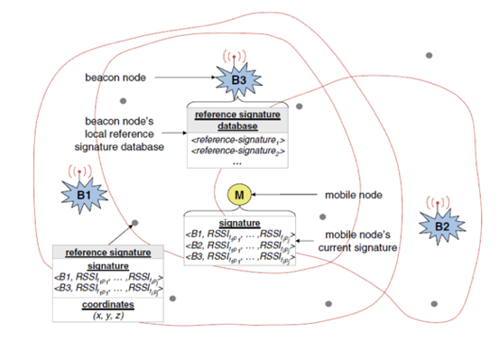
Example of Approach

Slide 10
Related Work
Describe how your system builds on prior work
what other systems are related to your work
how did others overcome the challenges that you face
do their solutions apply to your case
if not, what novel ideals did you have to incorporate to make your system work
make sure to include at least two references

Slide 11
Experimentation
Refer back to your experimentation plans and refine them
What aspects of your systems performance will you measure?

Slide 12
Demo
Show what you have accomplished
I expect that it will work

Slide 13
Final Report

Slide 14
Final Report
Report
Style follows conference papers in the reading list
6 pages, double column, 10 pts fonts
Use templates from http://www.acm.org/publications/proceedings-template
Materials
Slides of your final presentation
Source code
Documents: README, INSTALL, HOW-to-RUN
Video (if any)

Slide 15
Suggested outline
Abstract – Suhas (3 sentences at most)
Introduction – Suhas
Related Works - Su
Goals - Ashkan
Design - Kyle
Implementation - Kyle
Experiments - Ashkan
Lessons Learned - Su
Conclusion and Future Works - Suhas

Slide 16
Example reports
Examples of two good reports are included on ICON

