Slide 1
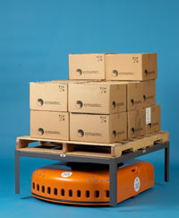
Multiagent and Agent Systems
Project: KIVA Mobile-robotic Warehouse Automation System
Team members:
Argentina Ortega Sáinz
Diego Enrique Ramos Avila
Nicolás Laverde Alfonso

Slide 2
Objective
This project intends to model a Multi-Agent System based on the KIVA Mobile-robotic Warehouse Automation System. Such system uses mobile robots to enhance the efficiency in a warehouse, by attending to real-time orders and bringing the shelves that contain requested pieces or parts to a human employee. For more information about the project, please visit:
KIVA Systems

Slide 3
Software
Programming Language: JAVA
IDE: Eclipse
Framework: JADE (Java Agent Development Framework)

Slide 4
Agents Definition
Warehouse (Single): Handles the orders and assigns them to order pickers.
Order Picker Agent (Multiple): Assigns orders and shelves to robots.
Order Agent (Multiple): Maintains its degree of completeness.
Shelf Agent (Multiple): Provides the needed pieces according to the requested orders.
Robot Agent (Multiple): Fetches corresponding shelves and brings them to the Order Pickers.

Slide 5
Progress
Current Status: Finalized
Possible Future Work: Graphical visualization of the system.

Slide 6
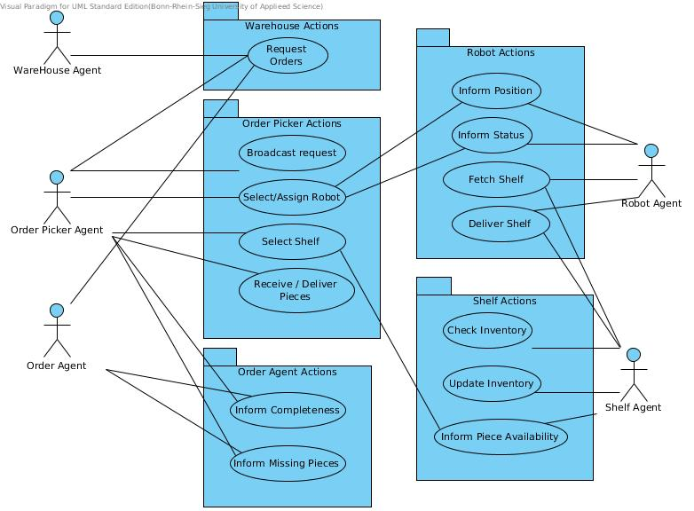
Use Case Diagram

Slide 7
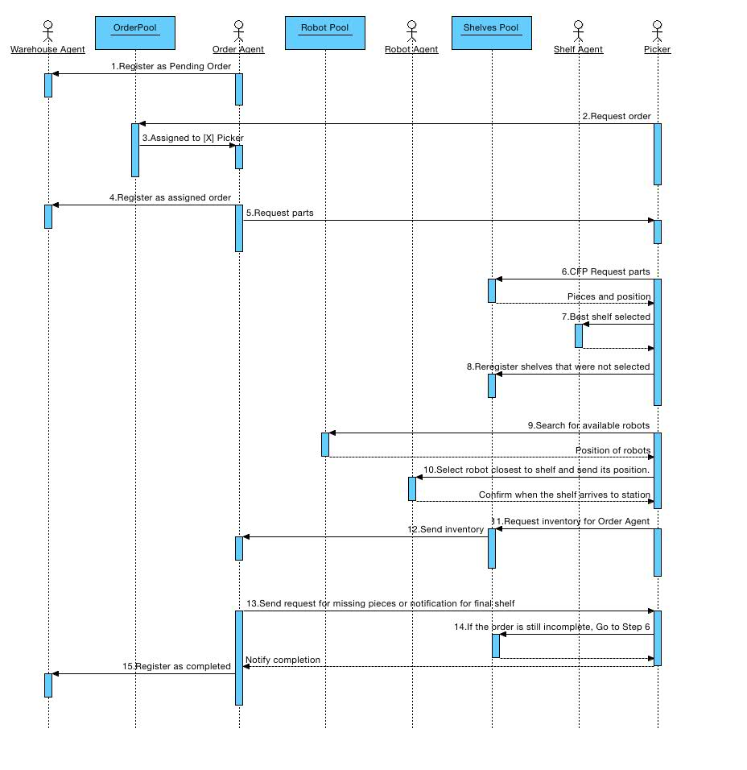
Sequence Diagram

Slide 8
Other Features
XML Writer: Multiple options to define the setup of the system (Number of agents, stock for inventories, etc.).
If the orders can't be fulfilled:
  Send messages from the GUI to restock a shelf.
  Create new shelves dynamically.

Slide 9
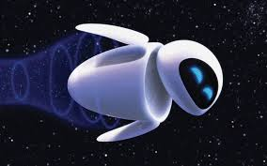
The End
Thanks for your attention!

