Slide 2
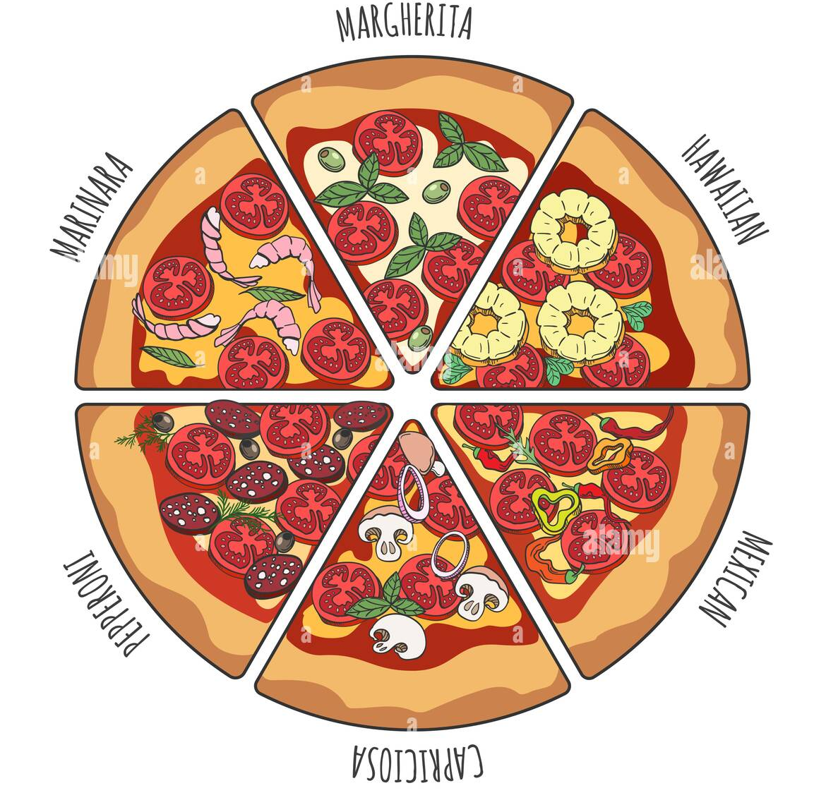

Pizza Price Calculator

Slide 3
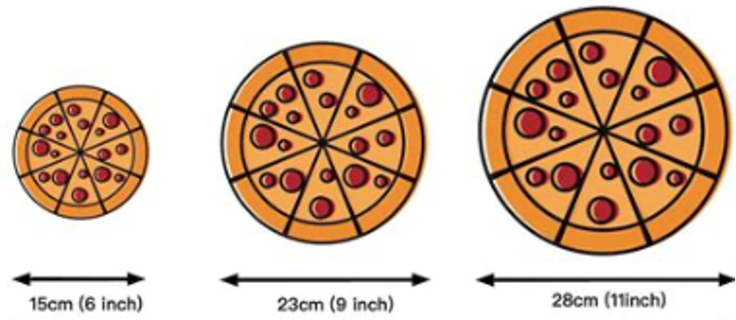
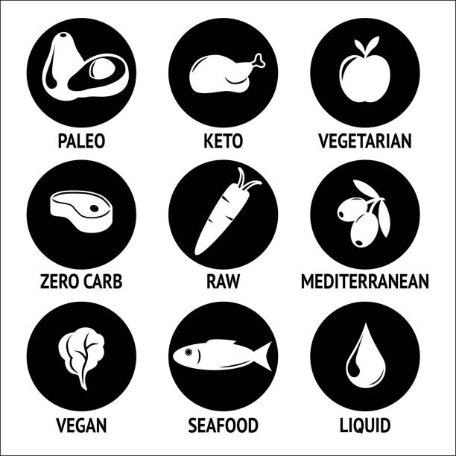
How does it work?
Select the size:
Small, Medium, Large
Select your diet:
Vegan
Vegetarian
Pescatarian
Meat eater
All eater

Slide 4
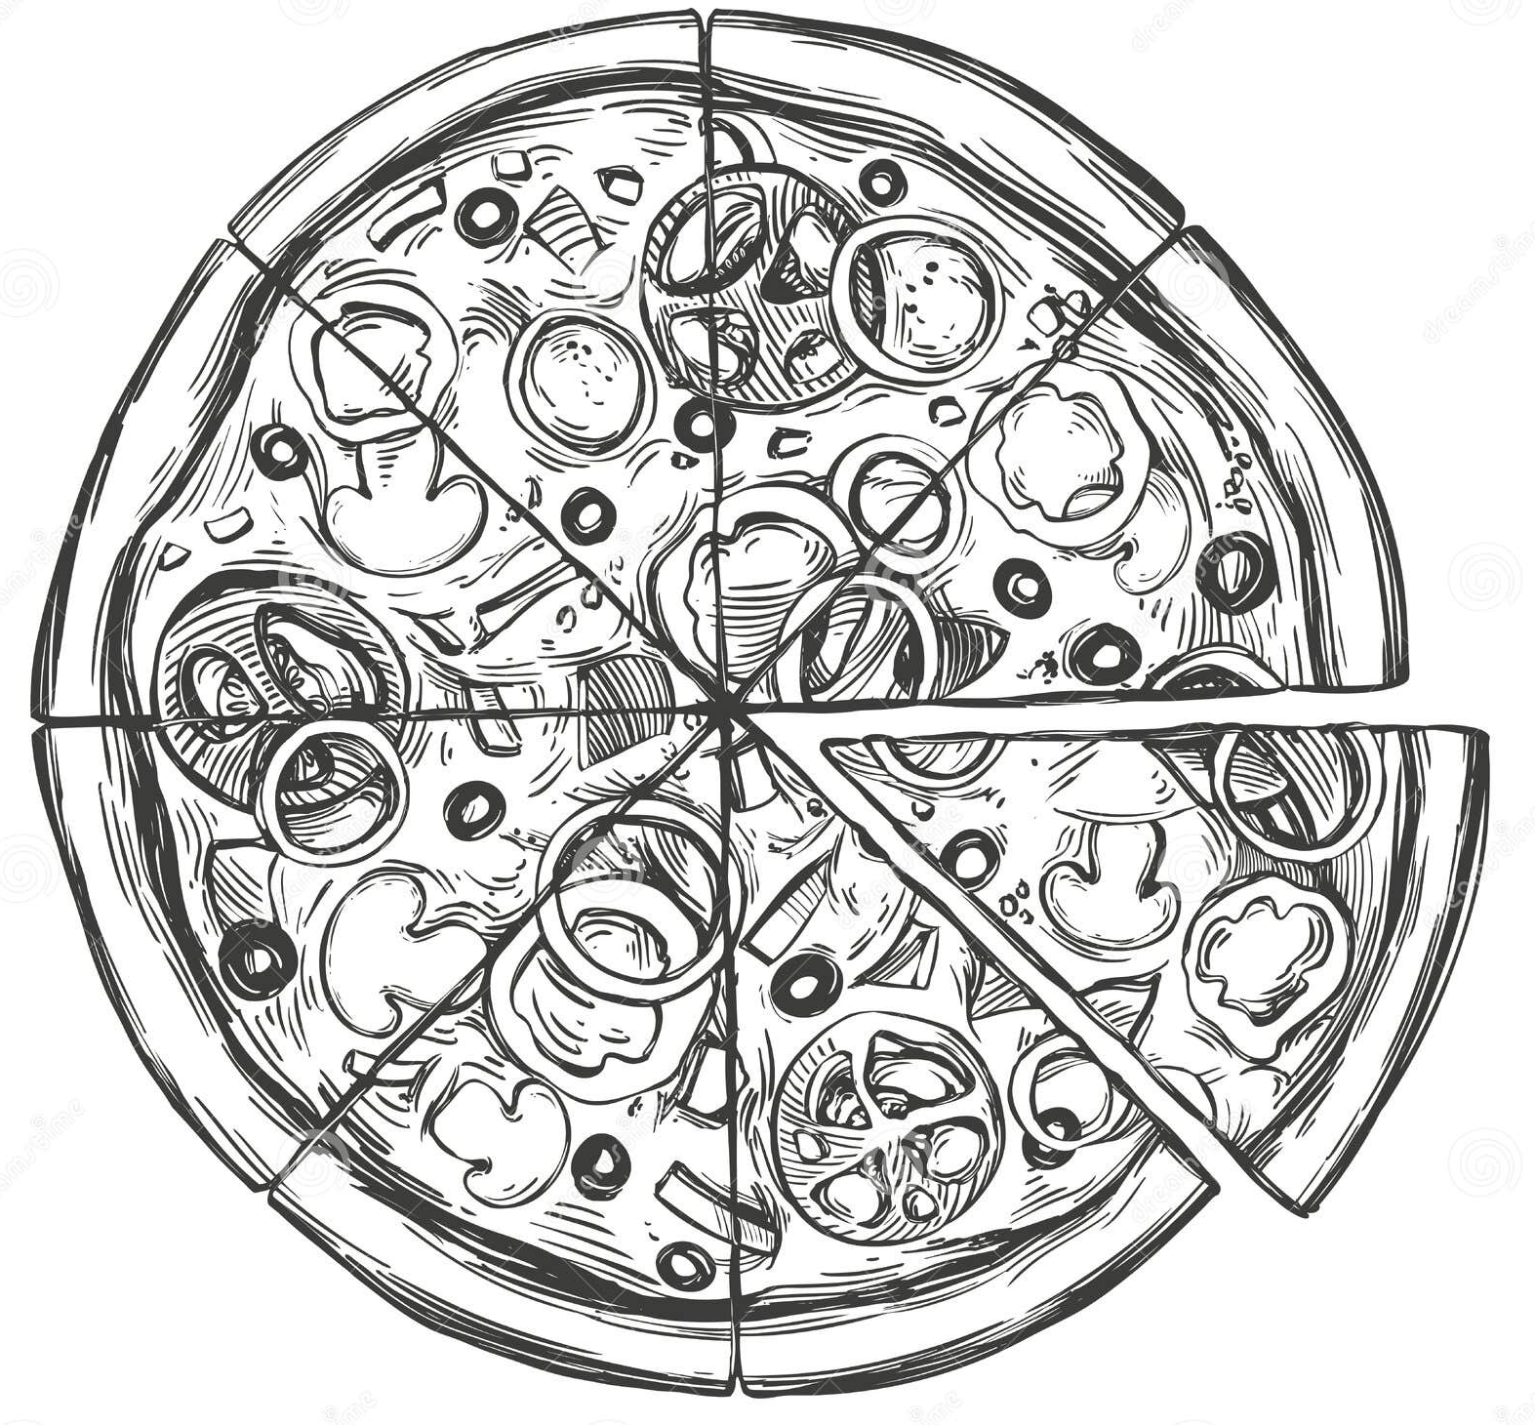
How does it work?
Choose your ingredients:
Vegetables
Mushrooms
Olives…
Cheese
Mozzarella
Cheddar…
Fish
Salmon
Anchovies…
Meat
Pepperoni
Bacon…

Slide 5

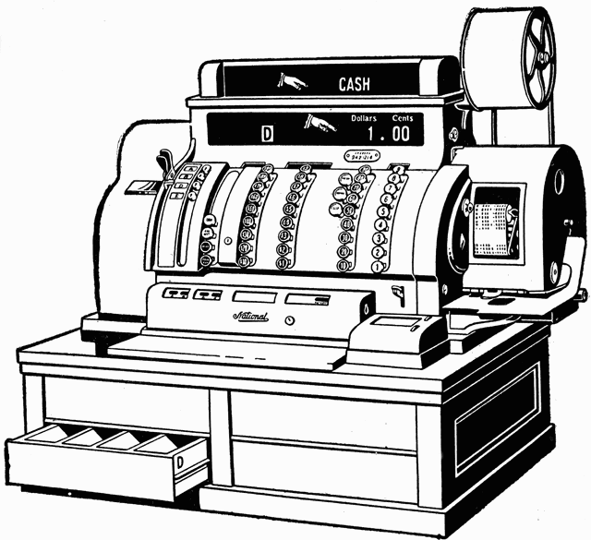

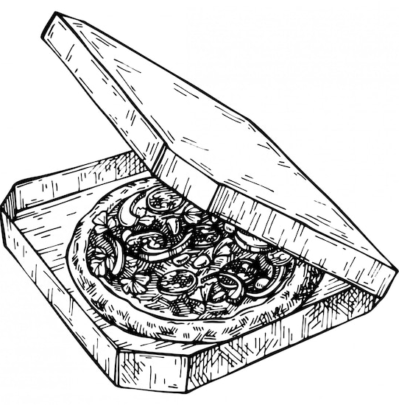
Output
Base size
+ Added ingredients
-----------------------------
= Total price
Enter the currency code you want to convert to (e.g. USD):
Output price in desired currency
Cooking time in minutes

Slide 6
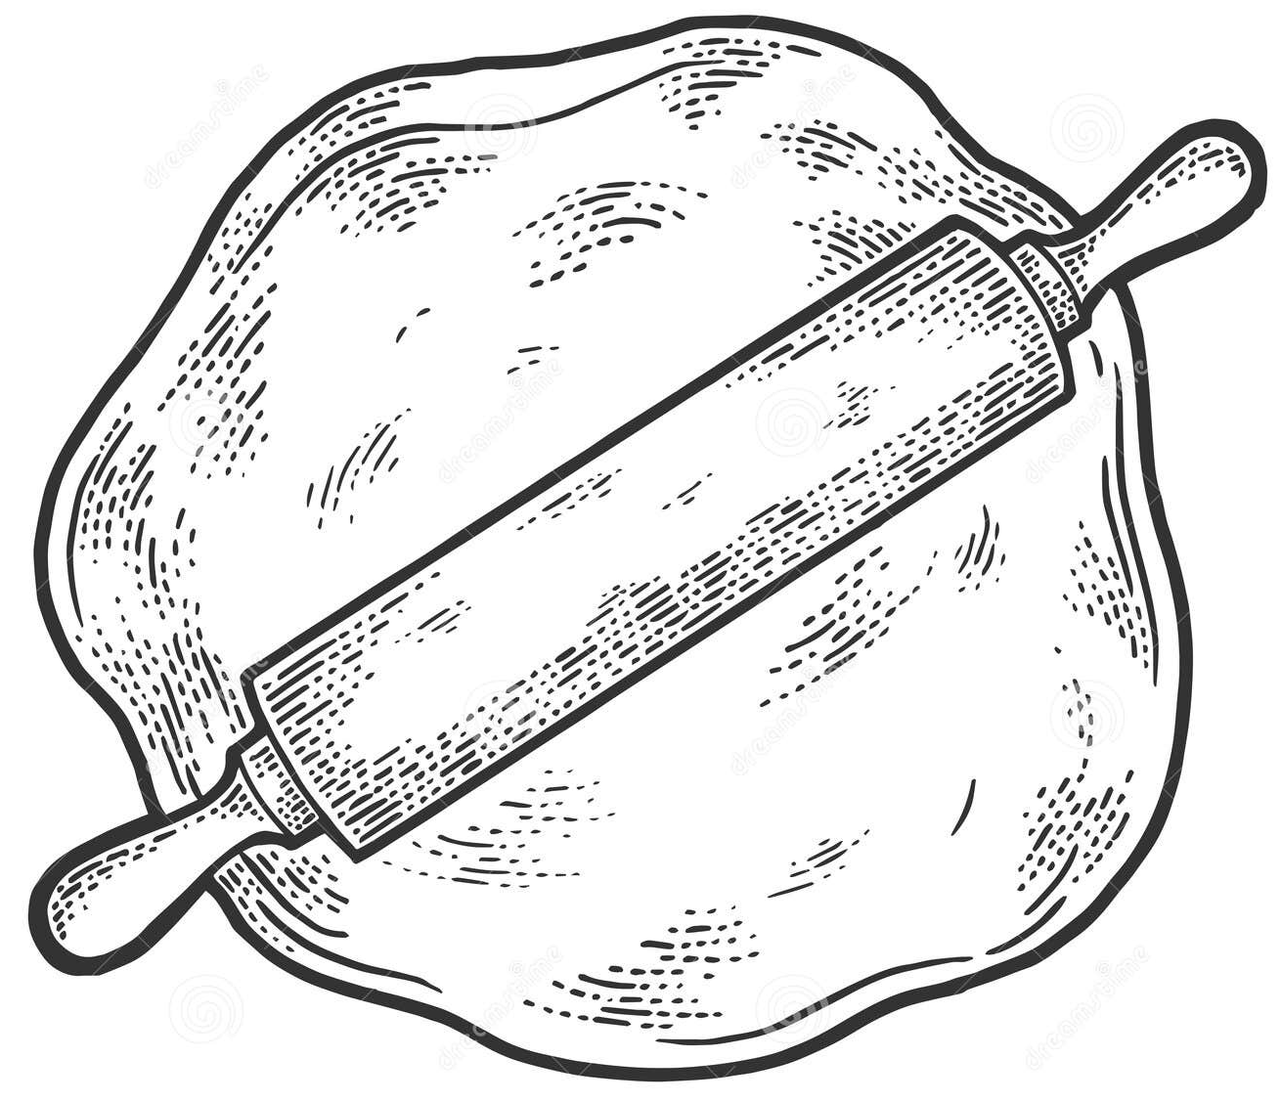

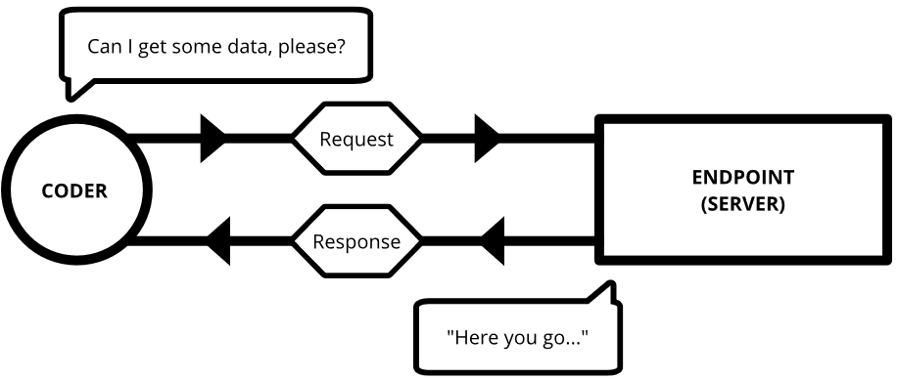
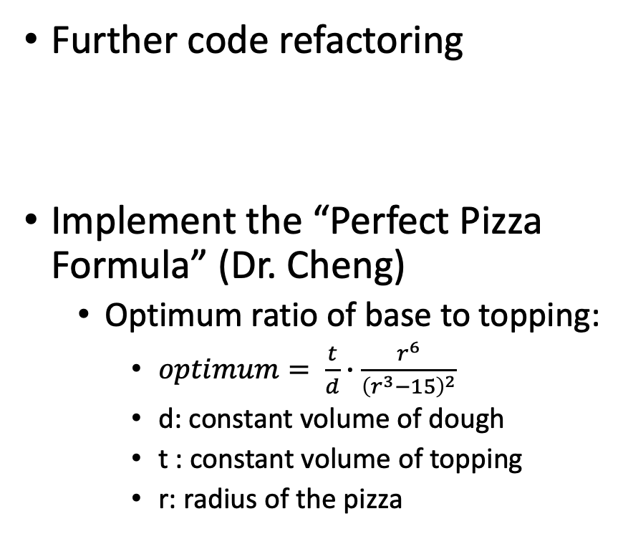
What can be improved?
Special dough
Gluten free
Stuffed crust
Thin crust
Flat bread…
Fetch API to obtain toppings
Further code refactoring
Implement the “Perfect Pizza Formula” (Dr. Cheng)
Optimum ratio of base to topping:
$optimum= \frac{t}{d}∙\frac{r^{6}}{{\left(r^{3}−15\right)}^{2}}$
d: constant volume of dough
t : constant volume of topping
r: radius of the pizza

Slide 7
What is been learnt and applied?
HashMap Operations:
Map<String, Size> sizes = new HashMap<>(); sizes.put("S", new Size(10, 15.0)); sizes.put("M", new Size(15, 20.0)); sizes.put("L", new Size(20, 25.0));
Inheritance (Subclass and Superclass):
public class Fish extends Topping { private static Integer timeToCook = 10; public Fish(String name, Double price) { super(name, price, timeToCook); } }
Abstract Classes:
abstract public class Topping { protected String name; protected Double price; protected Integer timeToCook; public Topping(String name, Double price, Integer timeToCook) { this.name = name; this.price = price; this.timeToCook = timeToCook; }
Object Classes
toString() method:
@Override public String toString() { return "Size{" + ", price=" + price + '}'; }

Slide 8
What is been learnt and applied?
Libraries
Maven
Json:
JsonNode ratesNode = rootNode.path("conversion_rates"); double fromRate = ratesNode.path(fromCurrency).asDouble(); double toRate = ratesNode.path(toCurrency).asDouble();
Exception Handling
Try-catch:
try { double endPriceCurrency = convert.convert(pizza.getPrice(), fromCurrency, toCurrency); System.out.println("Total price in " + toCurrency + ": " + String.format("%.2f", endPriceCurrency)); } catch (IOException | InterruptedException e) { System.out.println("Error getting exchange rates "); e.printStackTrace(); }
Collections
Map Interface
List Interface:
Array List:
ArrayList<Topping> meatToppings = new ArrayList<>(); Meat beef = new Meat("beef", 2.0); meatToppings.add(beef);
List of lists:
public static ArrayList<ArrayList<Topping>> ToppingLists() { ArrayList<ArrayList<Topping>> listOfLists = new ArrayList<>();
listOfLists.add(meatToppings); listOfLists.add(fishToppings);

Slide 9
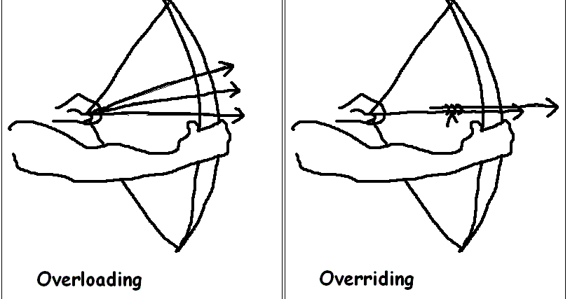
What is been learnt and applied?
Fetch data from API
public class CurrencyConversion { private static final String URL = "https://v6.exchangerate-api.com/v6/7298c00edad1769469b7957c/latest/EUR"; private final ObjectMapper objectMapper; private final HttpClient httpClient; public CurrencyConversion() { this.objectMapper = new ObjectMapper (); this.httpClient = HttpClient.newHttpClient(); }
And many others….

Slide 10
Thank you
Any Questions ?

