Slide 1
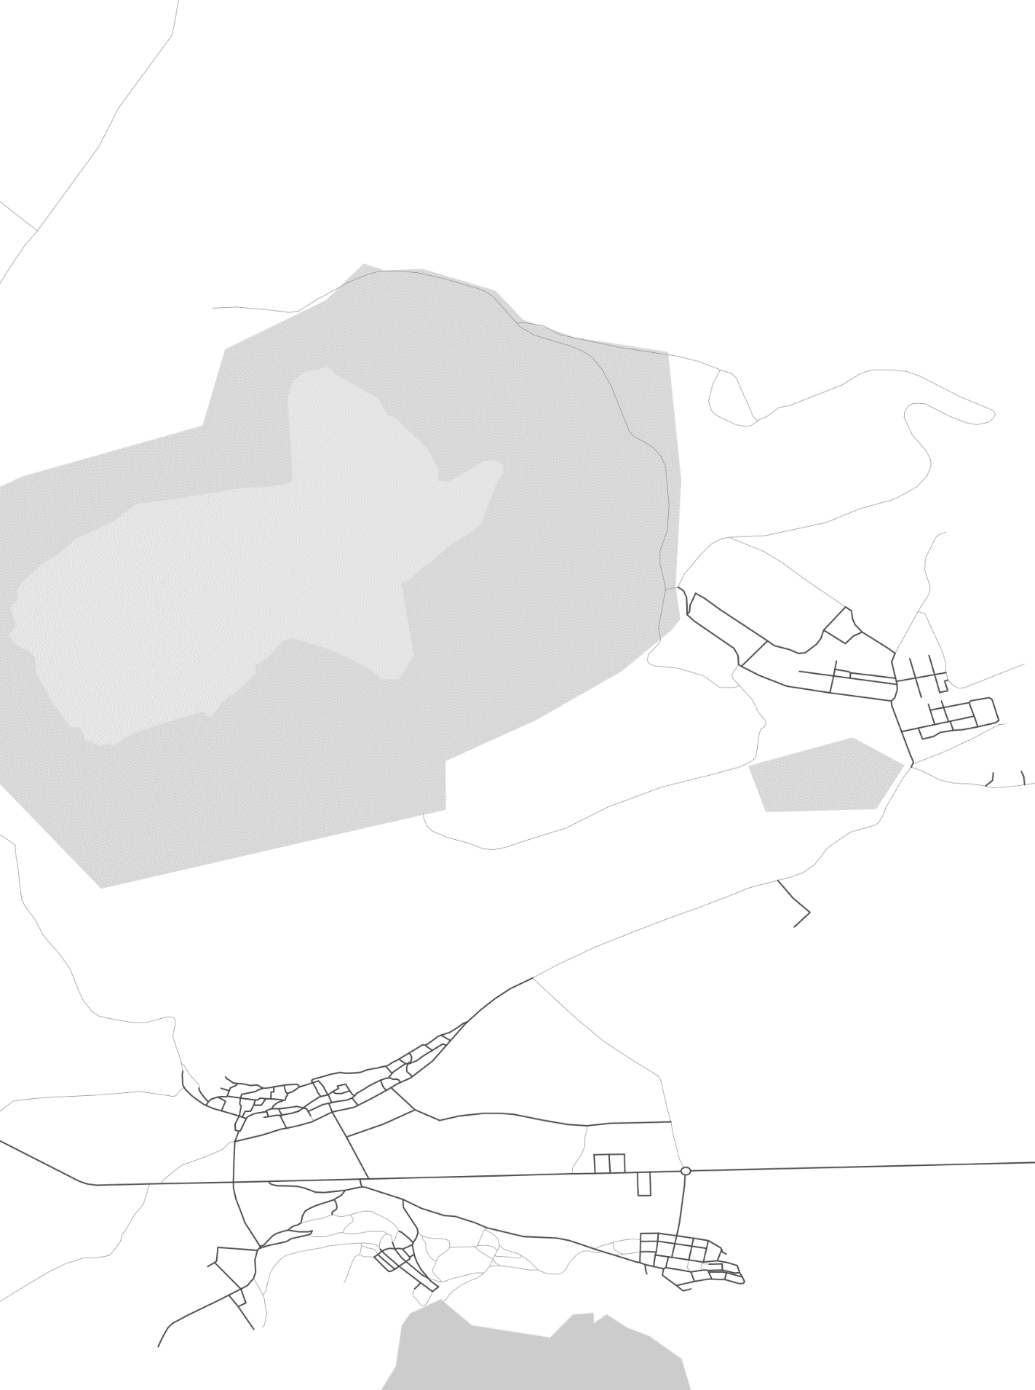
ALQUIFE
GRANADA, ESPAÑA
37°10'44.8"N / 3°06'53.0"W

